Slide 1
HISD JROTC CADET LEADERSHIP TRAINING
S3 TRAINING AND OPERATIONS OFFICER
29 to 31 July 2014

Slide 2
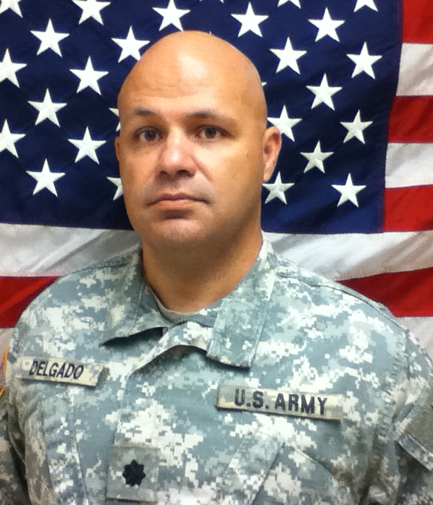
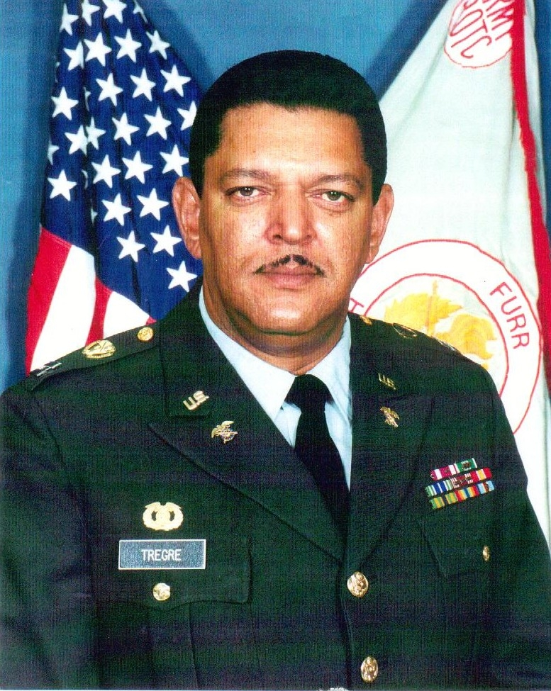
S3 WORKSHOP INSTRUCTORS & S3 CONNECTION
LTC JOSE DELGADO
SHARPSTOWN HS
(713) 773-6137
jdelgad3@houstonisd.org
MAJ JAMES JONES
AUSTIN HS
(713) 924-1644
jjones11@houstonisd.org
CPT KERWIN TREGRE
FURR HS
(713) 671-3633
ktregre@houstonisd.org
CADET BATTALION S3
ROSTER – PRINT NEATLY

Slide 3
Cadet Workshop July 29-31
GYM
PRACTICE GYM
A BUILDING
SWEET SNACKS
SNOW CONES
CHIPS/
SODAS
CAFETERIA
COLOR GUARD
IN COURT YARD
Walkway
JROTC Classrooms
John H. Reagan High School
Performance Hall
Track
FRONT
REGULATION DRILL
INSPECTION DRILL
EXHIBITION DRILL
Staff Classrooms S-1- Room A110 S-3 Room A112 S-4 Room A136 S-5 Room A131
CSM Room MB05
Director/Staff MB09
Drill Classrooms Inspection- Room A113
Regulation-Room A115
Exhibition- Room A117
(Drill Area As Needed Outside)
Extra Classrooms
For Presentations
A155
A171
A173
A175
Marksmanship-Gym
Leadership-Performance
Color guard- Cafeteria
Staff-Teaching Theatre

Slide 4
Agenda
Tuesday 29 July 2014
Time | Subject | Location | Instructor
0940-1030 | Introduction to S3 Duties and responsibilities; Inspection preparation; JROTC S3 Training files | A112 | LTC Delgado /Committee
1030-1040 | Break | Break Area | Cadre
1040-1130 | DJROTC schedule of Events (SOE); School Calendar; Suspense Calendar | A112 | CPT Tregre /Committee
1130-1210 | Lunch | Break Area | Cadre
1210-1400 | Training Schedules/Master Training Schedule/POI | TBD | CPT Tregre /Committee
1400-UTC | Cadets assemble & return to respective schools | TBD | Cadre

Slide 5
Agenda
Wednesday 30 July 2014
Time | Subject | Location | Instructor
0900-0930 | S3 Prepare the First Six Weeks of Training Schedule | A112 | CPT Tregre /Committee
0930-0940 | Break | Break Area | Cadre
0940-1030 | S3 Prepare the First Six Weeks of Training Schedule - Continued | A112 | CPT Tregre /Committee
1030-1040 | Break | Break Area | Cadre
1040-1130 | S3 Prepare the First Six Weeks of Training Schedule - Continued | A112 | CPT Tregre /Committee
1130-1210 | Lunch | Break Area | Cadre
1210-1400 | S3 Prepare the First Six Weeks of Training Schedule - Continued | A112 | CPT Tregre /Committee
1400-UTC | Cadets assemble & return to respective schools | TBD | Cadre

Slide 6
Agenda
Thursday 31 July 2014
Time | Subject | Location | Instructor
0900-1030 | Risk Management; Inspection Preparation OPORD/OPLAN/FRAGO | A112 | MAJ Jones / CPT Tregre
1030 -1040 | Break | Break Area | MAJ Jones /Committee
1040-1130 | Posting Training to JUMS & Cadet Challenge | A112 | Cadre
1130-1210 | Lunch | Break Area | Cadre
1210-1400 | Training Session Recap / Review | A112 | S-3 Training Committee
1400-UTC | Cadets assemble & return to respective schools | TBD | Cadre

Slide 7
HISD JROTC Cadet Leadership Training S3 Connection
 | Last name | First name | School | E-mail | Telephone # | Schedule | Remarks

Slide 8
Your turn
Who you are…..
Name, LET Level, cadet rank,
School and year
Your previous experiences within JROTC
What challenge(s) do you foresee in SY 14-15?

Slide 9
What you know…..
What is the Battalion S3

Slide 10
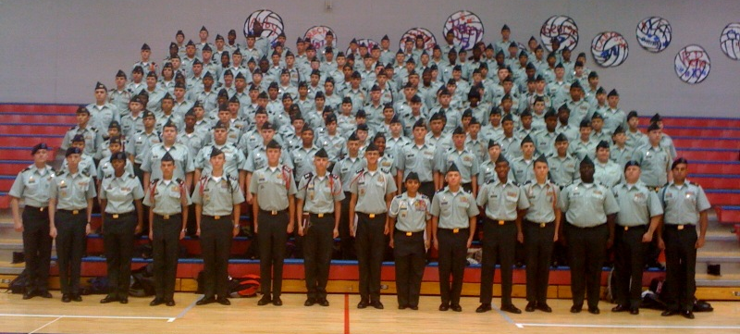
BATTALION S3
MOTTO:
“I AM MY UNIT’S S3, MY UNIT’S OPERATIONS AND TRAINING DEPEND ON ME.”

Slide 11
Don’t have to be this way……
JUMS
WTS
CALENDAR
PERMISSION SLIPS
MY GPA!!
DRILL
PRACTICE
But do not let us break up what works for you……

Slide 12
Your duties could include
Assists BC concerning matters of operations and training
Maintain training record folders
Prepares and publishes all training schedules and training reports IAW HISD DJROTC SOP.
Stores, maintains, and issues the training aids and reference materials
Exercises staff supervision of the merit/demerit system - Post results in the computer and on bulletin board
Plans for and coordinates all of the battalion's training activities to include field trips, parades, and other extracurricular activities
Monitors the conduct of drill, and conducts frequent training inspections of cadet classes
Update JUMS – fitness, teams and training
Responsible to ensure the classroom area is properly prepared prior to classes
Ensures that cadet instructors are properly prepared to give assigned classes
Responsible for the maintenance and posting of the unit bulletin board in coordination
Post training schedules on bulletin boards, school/JROTC Battalion webpage, etc
Performs other duties as assigned by the battalion commander and executive officer
Prepare parent consent and sponsor request for field trips
Request for Buses
Post weekly inspection results
Establish and maintain handover book
Maintain handover disk in AI's office

Slide 13
CADET S3 DUTIES AND RESPONSIBILITIES
TRAINING SCHEDULES
Prepares and publishes all training schedules (6 weeks in advance)
Prepares all training reports
Monitors all training and operations to ensure training objectives are met
PLANS AND OPERATIONS
Organizes and supervises all planning efforts – prepares documents supporting all unit’s activities (WARNORD, FRAGO, OPORD, tasking letters, MOI, unit report, permissions slips, etc.)
Completes risk management assessment and worksheet for ALL training
COORDINATION
Coordinates with school administrators, community, agencies for logistical support, event enablers (guest speakers, etc.)
CADET CHALLENGE
Update JUMS – Training and Cadet Challenge

Slide 14
CADET S3 INSPECTION PREPARATION
DISTRICT TRAINING MANAGEMENT CHECKLIST
CADET COMMAND TRAINING MANAGEMENT (S3)AND SECURITY (S2) CHECKLIST
STAFF BRIEFING (S3)

Slide 15
JROTC TRAINING FILES (S3) 3-1 to 3-12
3-1 Training Memorandum and POI
3-2 Weekly Training Schedules
3-3 (obsolete – no longer required)
3-4 (obsolete – no longer required)
3-5 Memorandum of Instruction (MOI)
3-6 (obsolete – no longer required)
3-7 (obsolete – no longer required)
3-8 Houston ISD DJROTC Formal Inspection
3-9 Formal Inspection
3-10 JROTC Cadet Leadership Challenge
3-11 Cadet Challenge
3-12 (obsolete – no longer required)

Slide 16
3-2 Weekly Training Schedules
Maintain original on hand
Prepare copies for S3 records, bulleting boards, and all classrooms
E-mail training schedules to DJROTC at least two weeks prior to the week of instruction
* DESTROY AFTER TWO YEARS*

Slide 17
3-5 MOI
MEMORANDUMS OF INSTRUCTION THAT PERTAIN TO ALL PLANNING, CONDUCTING AND SUPERVISING FIELD EVENTS.
* DESTROY WHEN NO LONGER NEEDED*

Slide 18
3-8 HISD DJROTC Formal Inspection
Letter of Instruction DJROTC Formal Inspection
Memorandum of Inspection Results DJROTC
Records of Corrective Actions Taken Since Last Inspection
Place in inactive file at the end of the school year
* DESTROY AFTER THREE YEARS *

Slide 19
3-9 Formal Inspection
Brigade Informal Inspection
Federal Inspection every three years
Place in inactive file at the end of the school year
* DESTROY AFTER THREE YEARS *

Slide 20
3-10 JROTC Cadet Leadership Challenge
MOI
JCLC Fee Roster
JCLC Equipment Pick-up and Return Memorandum
JCLC Camp SOP
* DESTROY AFTER ONE YEAR *

Slide 21
3-11 Cadet Challenge
MOI for Cadet Challenge
Record of cadet scores and participation results
Place in inactive file at the end of the school year
* DESTROY WHEN NO LONGER NEEDED OR AFTER THREE YEARS *

Slide 22
MYTH OR FACT

Slide 23
MYTH OR FACT ?
“YOU ONLY LIVE ONCE…..”

Slide 24
MYTH OR FACT ?
“YOU ONLY LIVE ONCE…..” is a myth
You live everyday of your life…..regardless of how long…..You only DIE once.

Slide 25
END OF PRESENTATION

Slide 26
Questions? Comments Break before the next presentation

