Slide 1

A+ Guide to Managing & Maintaining Your PC, 8th Edition
Chapter 21
Supporting Printers

Slide 2
Objectives
Learn about printer types and features
Learn how to install printers and share a printers and how to manage printer features, add-on devices, and the printer queue
Learn about routine maintenance tasks necessary to support printers
Learn how to troubleshoot printer problems

Slide 3
Printer Types and Features
Configure, repair, maintain printers
  Requires knowledge of printer types and features
Understanding how a printer works
  Helps in fixing printer problems

Slide 4
Printer Languages
Communication methods between OS and printer
  Printer uses PostScript commands to build the page
  Printer uses PCL commands to build the page
    PCL: Printer Control Language
  Windows GDI builds page, then sends it to the printer
    GDI: Graphics Device Interface
  Windows 7/Vista uses XML Paper Specification (XPS) to build the page, then sends it to the printer
    XPS (XML Paper Specification)
  Raw data printed with little-to-no formatting

Slide 5
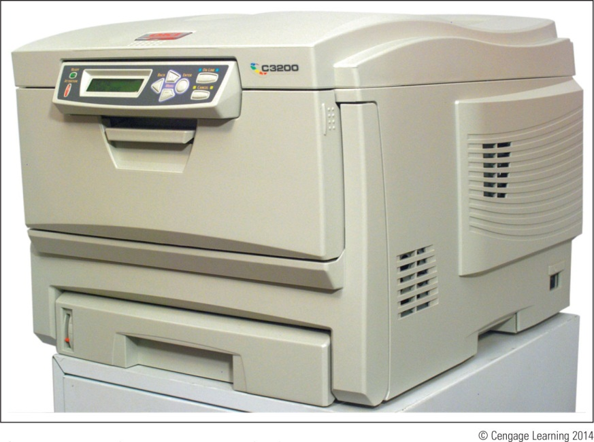
Types of Printers
Major categories:
  Laser, inkjet (ink dispersion), thermal printers, and impact printers
Figure 21-1 Okidata C3200n color laser printer

Slide 6
Laser Printers
Laser printer: electrophotographic printer
  Uses mechanical, electrical, and optical technologies
How laser printers work:
  Toner placed on electrically charged rotating drum
  Toner deposited on paper moving at drum speed

Slide 7
Laser Printers
Seven steps in laser printing:
  Processing image: bitmap of final page stored in memory
  Conditioning: drum surface charged to -600 V
  Writing: laser beam writes -100 V image to drum surface
  Developing: toner applied to -100 V areas of the drum
  Transferring: toner drawn off drum and onto paper
  Fusing: heat and pressure fuse toner to paper
  Cleaning: drum cleaned of residual toner and charge
Color laser printing
  Writing process repeated four times

Slide 8
Laser Printers
Parts used in the charging, exposing, developing, and cleaning steps undergo the most wear
Toner cartridge needs replacing most often
  Followed by image drum, fuser cartridge, and transfer assembly
Other printer parts that might need replacing:
  Pickup roller – pushes forward a sheet of paper
  Separation pad – keeps more than one sheet of paper from moving forward
Printer that is able to print on both sides of paper is called a duplex printer (double-sided printer)

Slide 9
Inkjet Printers
Overview of inkjet printer technology
  Uses a type of ink-dispersion printing
    Doesn’t provide high-quality resolution of laser printers
  Print head moves across paper
    One line of text created with each pass
  Ink applied to paper using matrix of small dots
    Plates with magnetic charge direct path to the page
  Different types of inkjets form droplets of ink in different ways
    Most popular is the bubble-jet

Slide 10
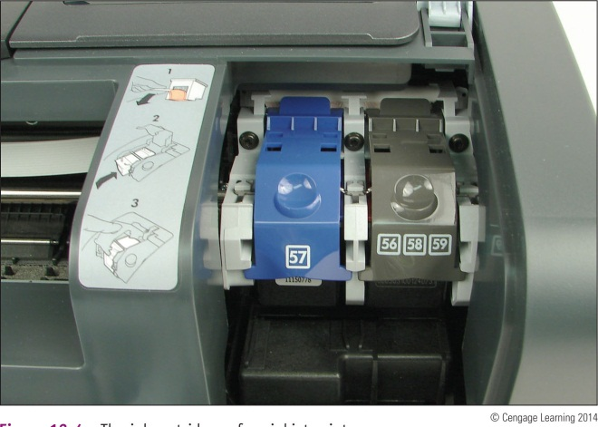
Inkjet Printers
Comparing inkjet to laser printers:
  Usually slower
  Images smudge on inexpensive paper
    Use only paper designed for inkjet printers
Inkjet printer buying advice:
  Printer using two or four separate cartridges
Figure 21-4 The ink cartridges of an inkjet printer

Slide 11
Impact Printers
Overview of impact printer technology
  Best known impact printer: dot matrix printer
  A print head moves across width of the paper
  Pins are used to print matrix of dots on the page
    Pins shoot against a cloth ribbon
    Ribbon impacts paper and deposits ink
Dot matrix printer technology advantages:
  Continuous tractor feed allows event and data logging
  Can use carbon paper: print multiple copies
  Extremely durable

Slide 12
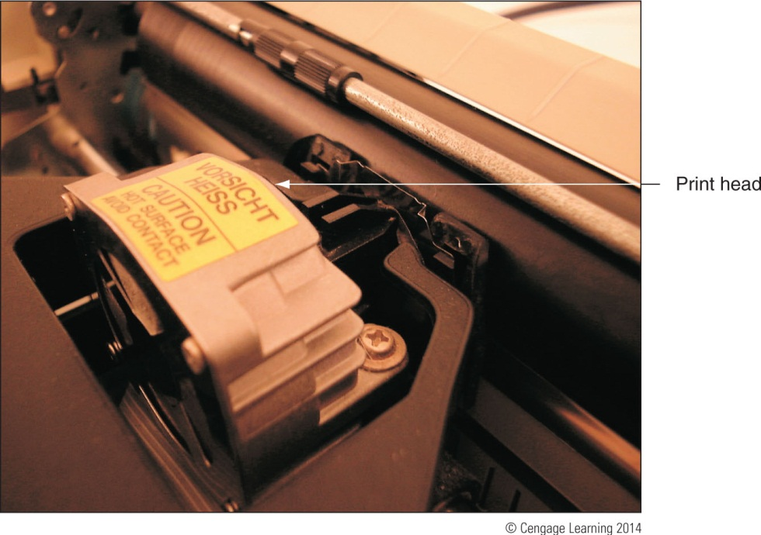
Impact Printers
Guidelines for maintaining print heads:
  Keep the printer in a cool, well-ventilated area
  Do not print over 50 to 75 pages without a cool down
Figure 21-6 Keep the print head of a dot matrix printer as cool as possible so that it will last longer

Slide 13
Thermal Printers
Use heat to create an image
Two types of thermal printers:
  Direct thermal printer
    Burns dots onto special coated paper (thermal paper)
    Often used as receipt printers
  Thermal transfer printer
    Uses a ribbon that contains wax-based ink
    Heating element melts ribbon onto thermal paper
    Used to print receipts, bar code labels, clothing labels, or container labels
    Reliable and easy to maintain

Slide 14
Using Windows to Install, Share, and Manage Printers
Printers can connect to a single computer or a network
  Local printer attached to a PC using a port or wireless connection
  Network printer has an Ethernet port to connect directly or uses Wi-Fi to connect to an access point
OS compatible print drivers required
  Use 32-bit drivers for a 32-bit OS and 64-bit drivers for a 64-bit OS
  Windows 7 has many drivers built in or drivers can be downloaded from manufacturer’s website

Slide 15
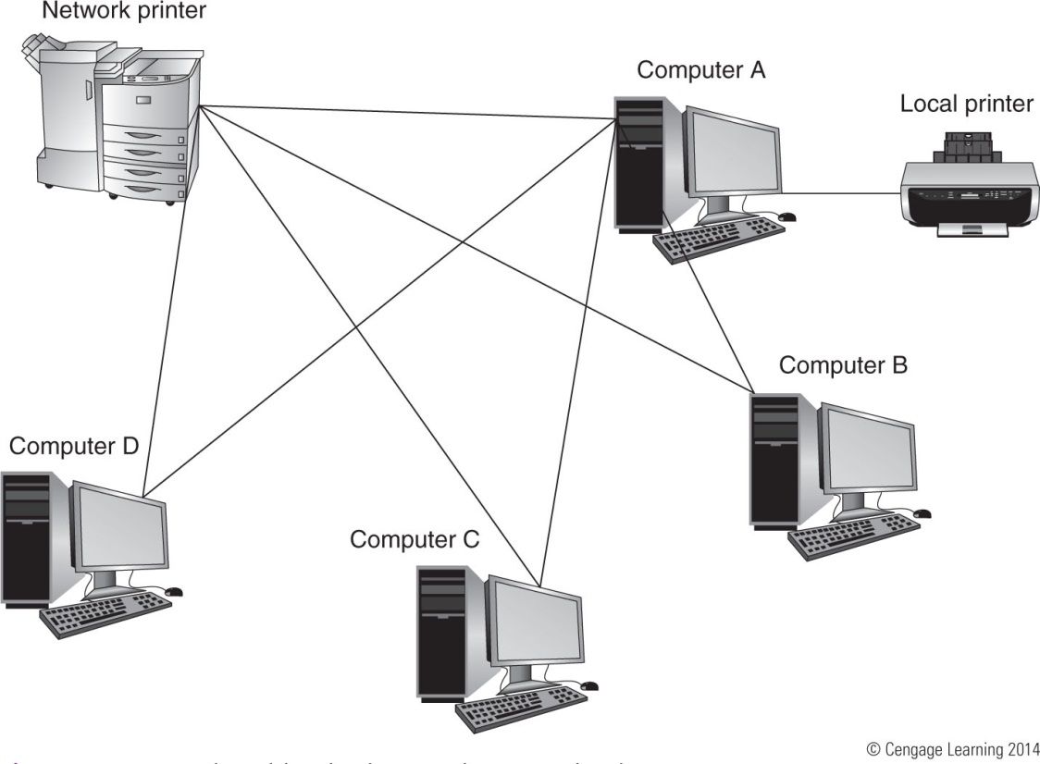
Figure 21-10 A shared local printer and a network printer

Slide 16
Installing A Local or Network Printer
Ways to install a local USB printer
  Plug in USB printer: Windows 7/Vista installs printer automatically
  Launch the installation program
Installing a non-USB local printer or network printer using Windows 7/Vista
  Verify printer on and available
  In Windows 7 Control Panel click Devices and Printers
    For Windows Vista, click Printers from Control Panel

Slide 17
Installing A Local or Network Printer
Installing a non-USB local printer or network printer using Windows 7/Vista (cont’d)
  Click Add a printer and select the type of printer
  Windows searches for available printers
    Select printer from the list and click Next
  Tell Windows where to find the printer drivers
  Follow the wizard to install the printer
  Send a test page to ensure proper setup
    A test page can be sent anytime through the Printer Properties dialog box

Slide 18
Install a Local Printer Using Windows XP
Installation begins differently depending on port
  FireWire, USB, PC Card, ExpressCard, wireless
    Software installation or printer connection order vary
    Review printer documentation
Generals steps
  Run setup program as an administrator
  Connect the printer to the port when instructed
  Close New Hardware Found Wizard
  Make selection for default printer
  Test the printer

Slide 19
How to Install a Local Printer Using Windows XP
Printer installation using a parallel port
  Serial and parallel ports: not hot-pluggable
Generals steps
  Plug printer into the port, turn on the printer
  If installing drivers from manufacturer’s program:
    Launch printer setup program, followed directions
  If using the Windows installation process:
    Open Printers and Faxes window, click Add a printer
    Follow Add Printer Wizard directions
    Print a test page

Slide 20
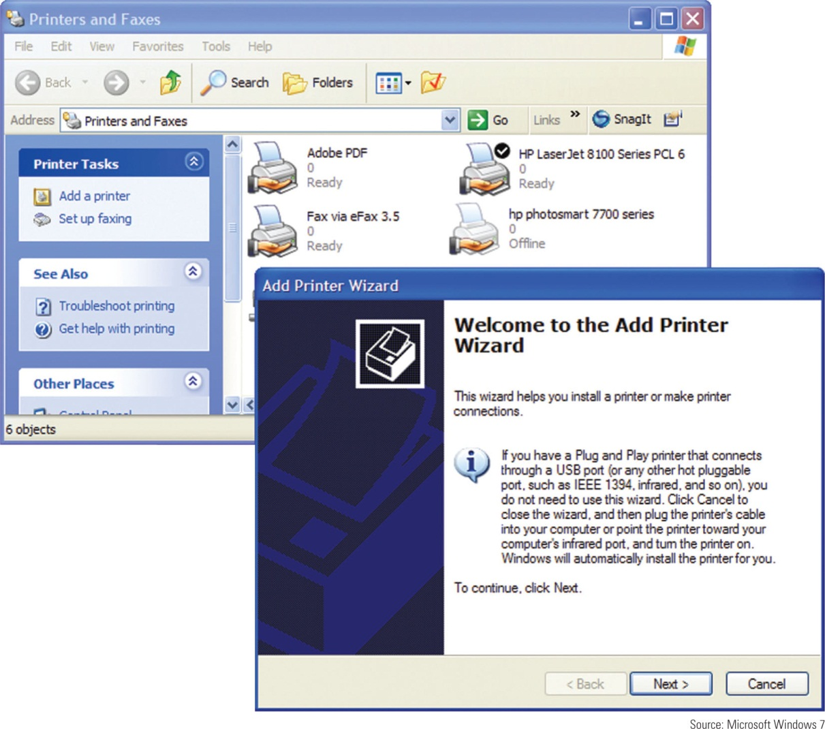
Figure 21-19 Use the Add Printer Wizard to install a printer

Slide 21
Steps To Install a Network Printer Using Windows XP
Follow manufacturer directions
General steps
  Open XP Printers and Faxes window
    Start the wizard to add a new printer
    Select option to install a local printer
    Do not ask Windows to automatically detect printer
  Choose Create a new port
    Select Standard TCP/IP Port, Click Next twice
  Identify the printer on the network
  Click Have Disk

Slide 22
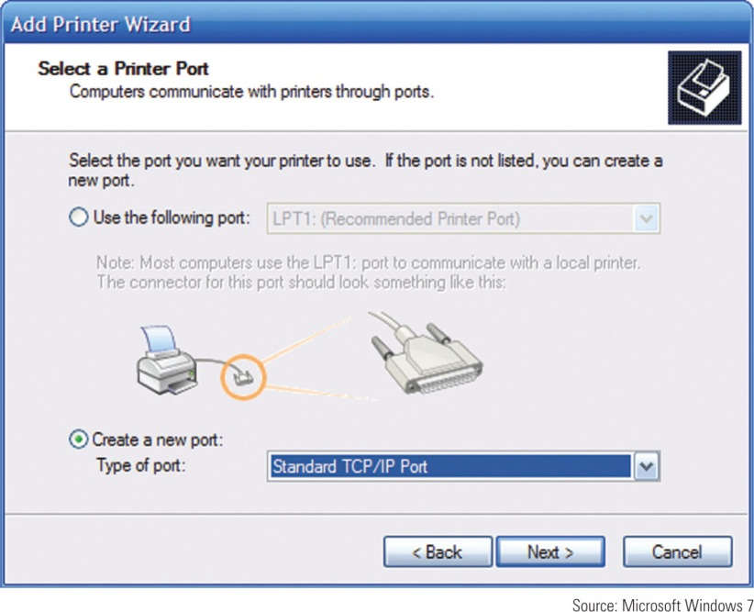
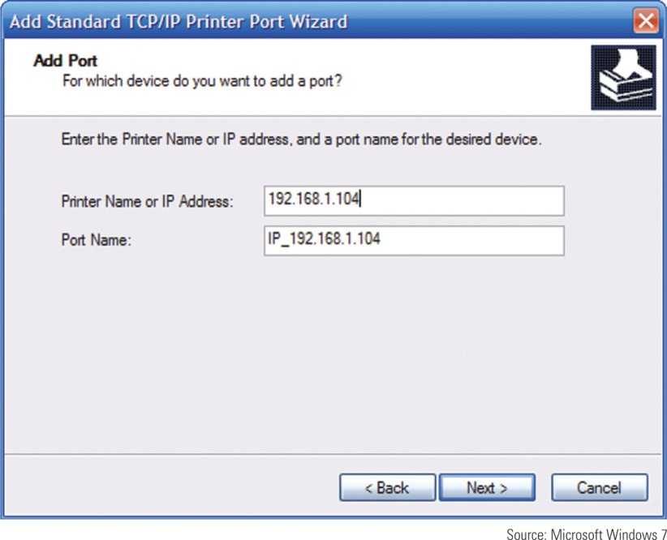
Figure 21-22 Configure a local printer to use a standard TCP/IP port.
Figure 21-23 Enter the printer name or IP address to identify the printer
on the network.

Slide 23
Sharing an Installed Printer
Windows 7: make sure Turn on file and printer sharing is selected
Vista: Printer sharing must be turned on
XP: File and Printer Sharing must be installed
General steps for Windows 7/Vista/XP
  Open Properties dialog box, select Sharing
  Select Share this printer, enter name for the printer
  Make drivers available in Additional Drivers window
    32-bit operating systems: select x86
    64-bit operating systems: select x64

Slide 24
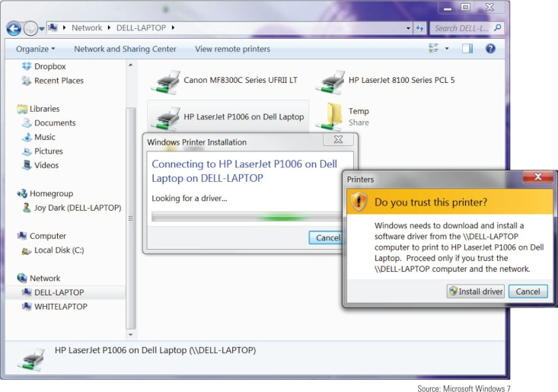
Installing a Shared Printer
Two ways to install a shared printer on a remote computer
  Use Windows 7 Devices and Printers window, Vista Printer window or XP Printers and Faxes window
  Use Windows Explorer, the Network, or My Network Places window
Figure 21-26 Install a shared printer using Windows Explorer

Slide 25
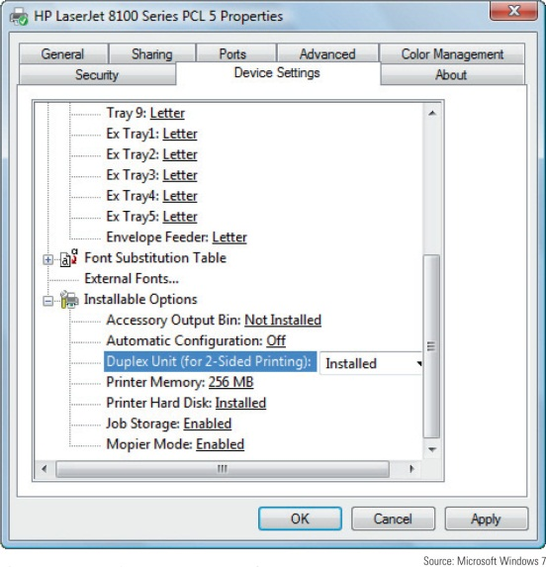
Managing Printer Features and Add-on Devices
Use the printer Properties box to:
  Manage printer features and hardware devices
  Click the Device Settings tab
    Manage duplex printing and paper sizes
  Useful option: print a test page
Figure 21-27 The Device Settings for an HP printer

Slide 26
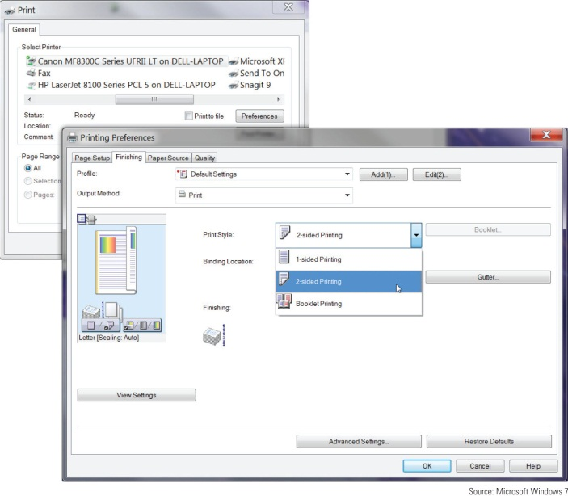
Managing Printer Features and Add-On Devices
After you have installed a new printer add-on:
  Equipment or feature is listed as an option in the Printing Preferences box
    Examples: input trays and feeders, staplers, sorters, stackers, binders, output trays to sort output by user
Figure 21-29 Printing on both sides
of the paper

Slide 27
Managing the Printer Queue
Spooling: process of queuing print requests from application
  Print spooler: print queue
To manage print queue: double-click the printer icon in Windows 7 Devices and Printers window
  If the printer reports a problem with printing, will be displayed as the status for the first job in the queue
  To cancel a print job, right-click the job and select Cancel from shortcut menu
    To cancel all print job, click Printer and select Cancel All Documents

Slide 28
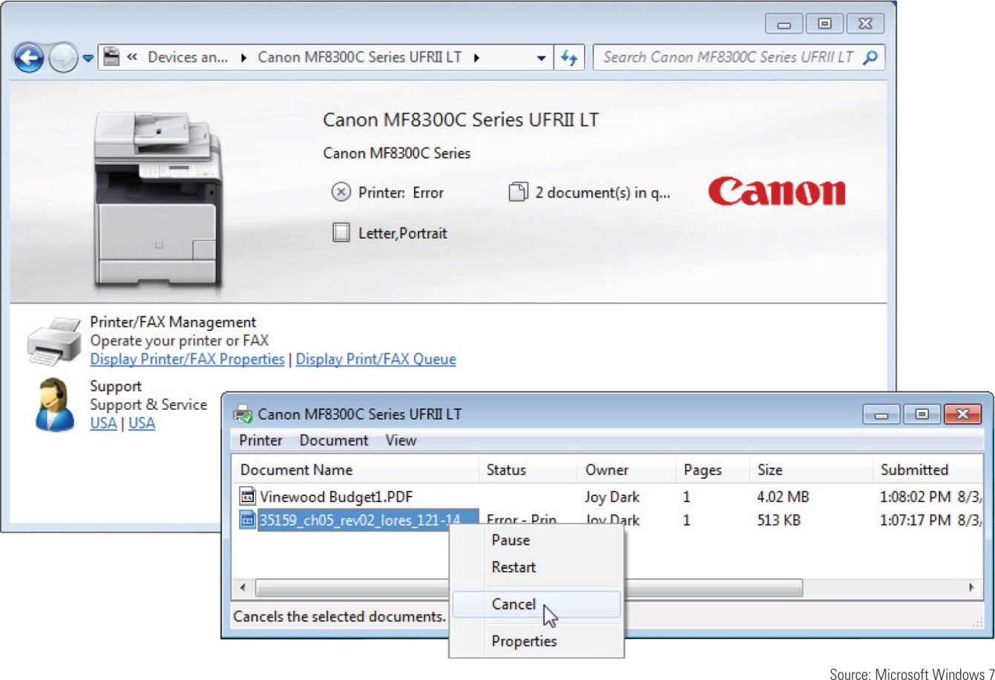
Figure 21-30 Manage the printer queue

Slide 29
Printer Maintenance and Upgrades
Extending printer working life
  Follow manufacturer’s directions for device use
  Perform necessary routine maintenance

Slide 30
Online Support for Printers
On printer manufacturer’s web site look for:
  Online documentation
  Knowledge base of common problems
    Explanation of what to do about them
  Updated device drivers
  Replacement parts
  Printer maintenance kits
  Additional software
  Firmware updates

Slide 31
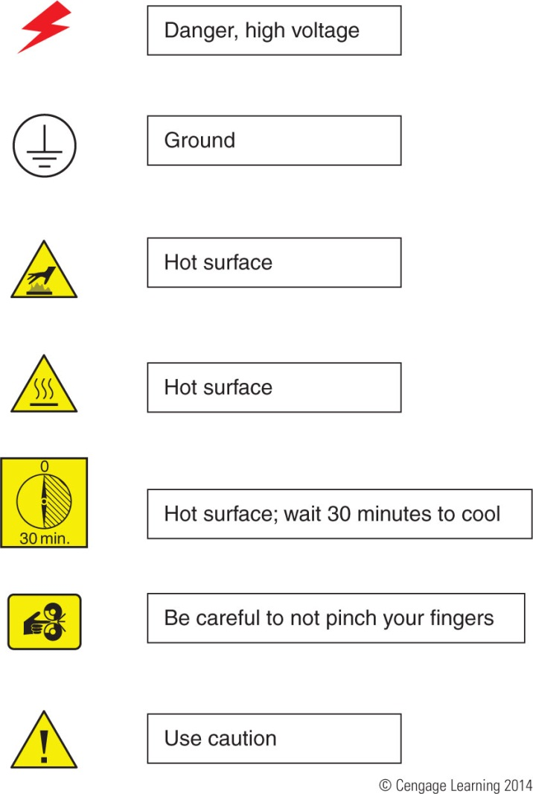
Figure 21-31 Symbols imprinted on a device that indicate danger

Slide 32
Online Support for Printers
Protection when working inside a printer
  Turn printer off, unplug it, wait about 30 minutes
  Never look at laser beam
  Use an antistatic ground bracelet
  Have help nearby
General directions to replace a cartridge:
  Turn on printer and open front cover
  Printer releases the cartridges so you can then open the latch on top of the cartridge to remove it
  Install new cartridge

Slide 33
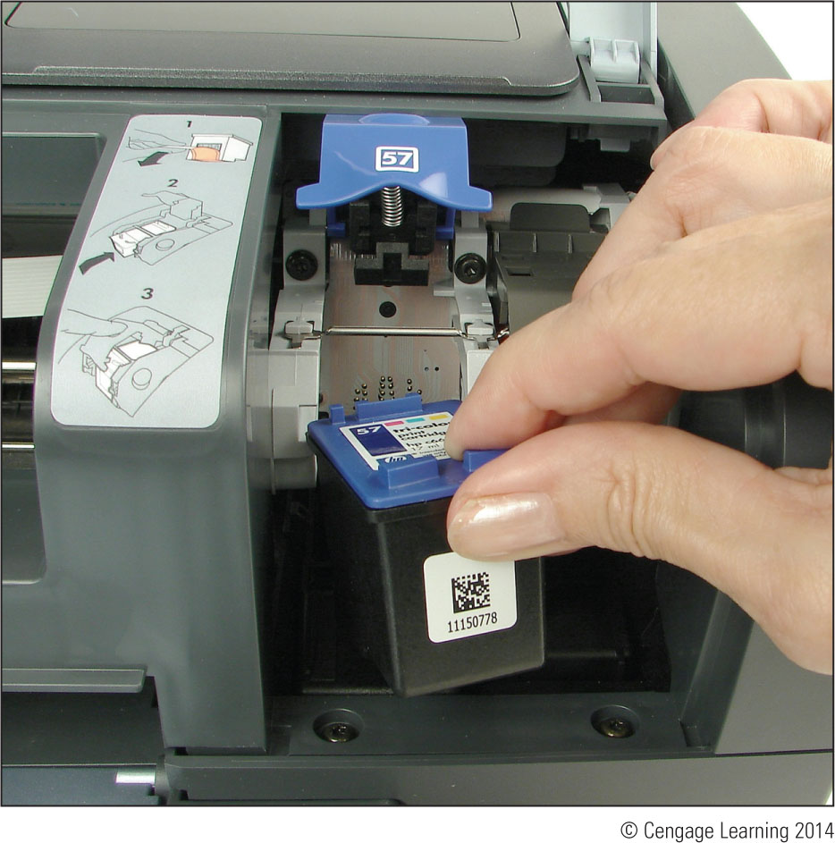
Figure 21-32 Installing an ink cartridge in an inkjet printer

Slide 34
Cleaning a Printer
As part of routine printer maintenance:
  Clean outside of the printer with a damp cloth
  Do not use ammonia-based cleaners
  Clean the inside of the printer with a dry cloth
  Do not blow out toner with compressed air
  Two safe tools:
    Toner-certified vacuum cleaner
    Extension magnet brush
  Software may be used to clean inkjet nozzles and calibrate/align cartridges
    Cartridge nozzles may have to be manually cleaned

Slide 35
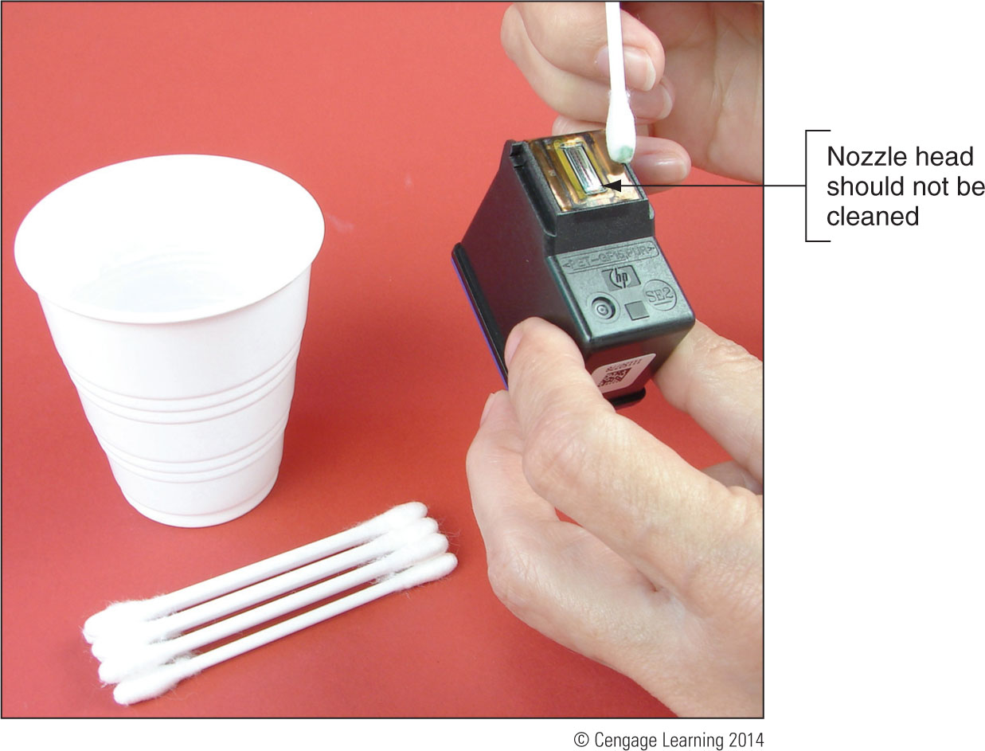
Figure 21-33 Clean the area around the nozzle plate with a damp cotton swab

Slide 36
Printer Maintenance Kits
Printer maintenance kit
  Specific printer components
  Step-by-step instructions for performing maintenance
  Special tools or equipment: utilities and printer buttons
Examples of replacing printer consumables (follow steps outlined on pages 613-617)
  Replacing a toner cartridge
  Replacing an image drum
  Replacing a fuser

Slide 37
Upgrade the Printer Memory or Hard Drive
Internal hard drives hold print jobs and fonts
Extra memory can speed up memory performance, reduce print errors, prevent Out of Memory errors
General installation:
  Use a screwdriver to remove printer cover plate
  Remove thumb screws on the back of the printer, pull out the formatter board
    Memory modules and hard installed on this board
    Hard drive embedded on proprietary board that fits in the bay
    Enable and configure using printer Properties window

Slide 38
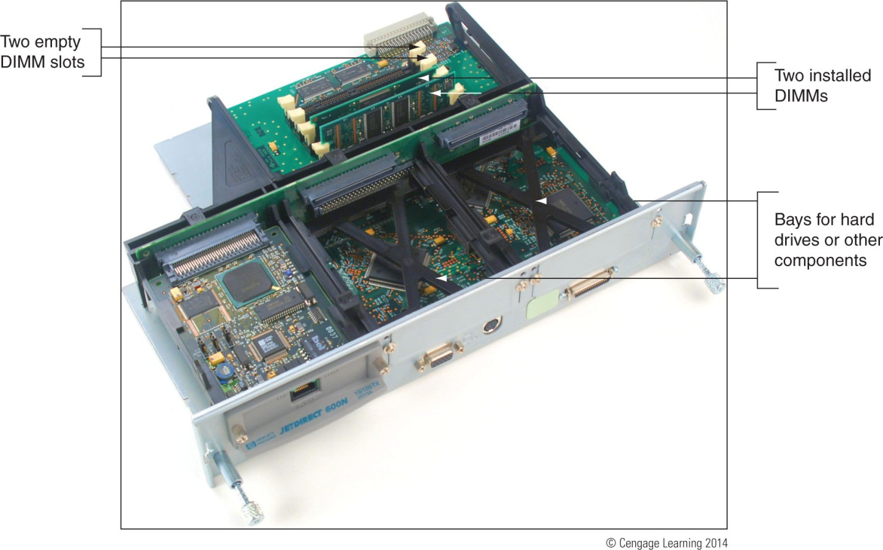
Figure 21-46 Memory is installed on the formatter board

Slide 39
Print Servers and The Print Management Tool
Print server: hardware or software that manages print jobs sent to one or more printers on a network
  Can be:
    A dedicated hardware device
    Software installed on a computer on the network
    Programs embedded in firmware on a printer
Embedded firmware print server
  Manage print jobs, view printer status, see job history, and check counters
  Utilities are access through a browser

Slide 40
Print Servers and The Print Management Tool
Windows Print Management
  Available in Windows 7/Vista professional and business editions
  Use it to monitor and manage printer queues for all printers on a network
In Print Management, each computer on the network that shares a printer is considered a print server

Slide 41
Troubleshooting Printers
Section topics:
  General printer troubleshooting
  Troubleshooting specific problems
General tasks performed during troubleshooting
  Interview the user
  Find out what works and does not work
  Make an initial determination of the problem
  When the problem is solved, check with the client
  Document problem symptoms and solutions

Slide 42
Printer Does Not Print
Use flowchart on next slide to isolate problem
Isolate problem to one of the following areas:
  The printer itself
  Connectivity between the PC and its local printer
  Connectivity between the PC and a network printer
  OS and printer drivers
  Application attempting to use the printer

Slide 43
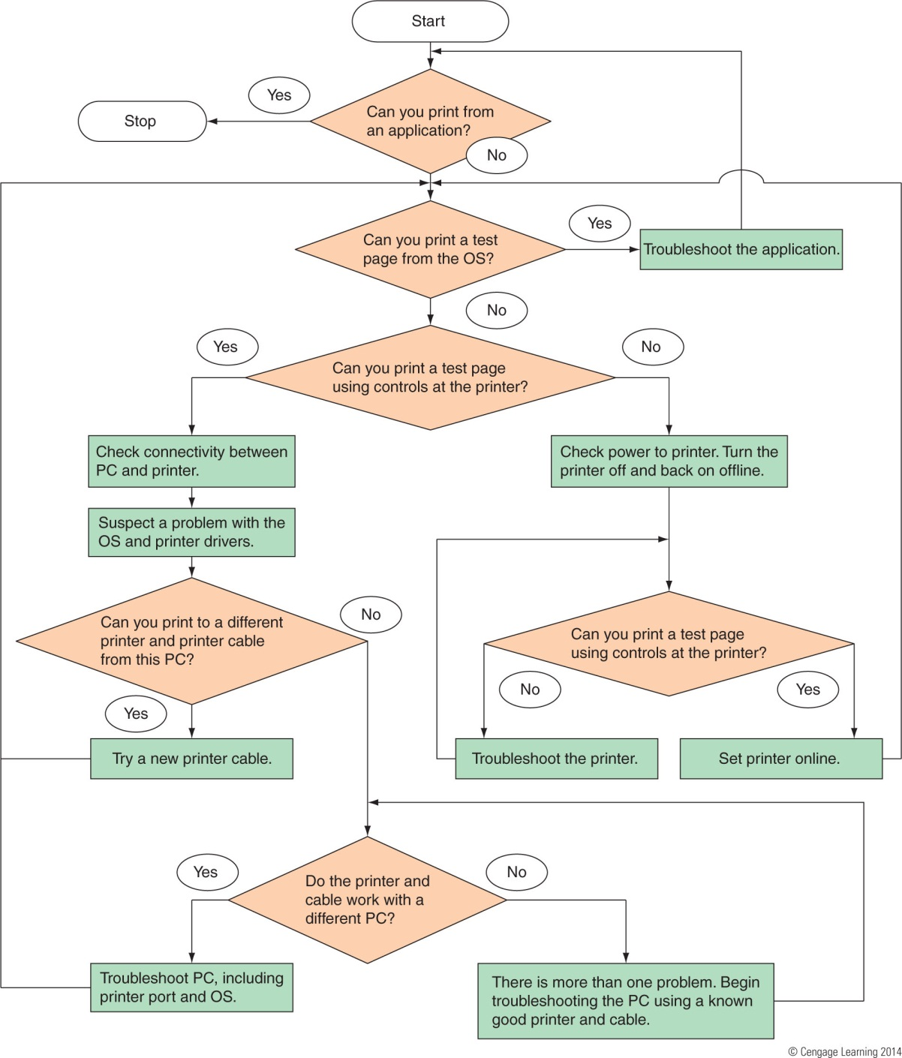
Figure 21-52 How to isolate a printer problem.

Slide 44
Printer Does Not Print
Problems with the printer itself
  Verify that the printer is on
    Print a self-test page
    Review test page for clues
  Test page not printing
    Troubleshoot the printer until it prints correctly: check paper issues, cover issues, cartridges installed, power source issues, reset the printer, check documentation
  Test page will not print at all
    Take printer to a certified repair shop

Slide 45
Printer Does Not Print
Problems with a local printer cable or port
  Verify cable firmly connected at both ends
    For a USB port, try a different port
  Try a different cable, use a shorter cable
  Use same printer and cable with different PC
  Use Device Manager to verify the port is enabled
  Use BIOS setup to check how the port is configured
  Use a port tester to test the port

Slide 46
Printer Does Not Print
Problems with connectivity for a network printer or shared printer
  If self-test page prints but Windows test page does not print then connectivity might be the issue
    Verify printer is online, power cycle printer, reboot PC
    Verify correct default printer selected
    Check IP address information
    Delete and reinstall printer
    Verify configuration, ping the printer, run diagnostics
    Research error codes, flash firmware

Slide 47
Printer Does Not Print
Problems with connectivity for a shared printer
  Print a test page from local computer
  Verify correct default printer selected and online
  At remote computer, verify access to the computer to which printer attached
  Delete printer and reinstall
  Print to another shared printer
  Verify hard drive space

Slide 48
Printer Does Not Print
Problems printing from Windows
  Delete all print jobs in the printer’s queue
  Verify correct printer selected and online
  Verify cable connections
  Stop and restart Windows Print Spooler service
  Delete printer and reinstall
  Check for updated driver
  Try to print to a file
  Verify that enough hard drive space is available
  Print from Safe Mode

Slide 49
Printer Does Not Print
Problems printing from applications
  Verify correct printer
  Printing a different file within same application
  Cancel print jobs in the queue and reboot computer
  Create data in a new file and try to print it
  Print from another application
    If you can print from other applications, consider reinstalling the problem application
  Close any applications that are not being used
  Add more memory to printer

Slide 50
Poor Print Quality
Can be caused by printer drivers, application, Windows, or the printer
Poor print quality for laser printers:
  Unplug printer and allow to cool for 30 minutes
  Rock or replace toner cartridge
  EconoMode (uses less toner) might be on; turn off
  Paper quality might not be high enough
  Printer might need cleaning
  Ensure printer does not require routine maintenance
  Laser drum might need replacing

Slide 51
Poor Print Quality
Poor print quality for laser printers (cont’d):
  Distorted images can be caused by foreign material
  If page has a gray background, image drum is worn out and needs replacing
    Ghosted images are usually caused by a problem with the image drum
Poor print quality for inkjet printers:
  Is the correct paper quality being used?
  Is the ink supply low? Remove and reinstall cartridge
  Follow printer’s documentation to clean each nozzle

Slide 52
Poor Print Quality
Poor print quality for inkjet printers (cont’d):
  Clean sponge near carriage rest
  If printing transparencies, change the fill pattern in your application
Poor print quality for impact printers:
  Ribbon might need replacing
  Adjust the print head spacing
  Check the print head for dirt

Slide 53
Poor Print Quality
Garbled characters on paper:
  Cancel all print jobs in the queue and try printing a different document from the same application
  Print using a different application
  Is USB cable securely connected at both ends?
  Power down printer by pressing a Reset button
  Update printer drivers
  Printer might needs servicing

Slide 54
Poor Print Quality
Low memory errors
  Possible indications of low memory
    Only part of page print
    Printer may have a flashing light
    Printer may display message on display panel such as:
      “20 Mem Overflow”, “Out of memory”, or “Low Memory”
  Install more memory or print only simple pages with few graphics
  Print a self-test page to verify how much memory is installed

Slide 55
Poor Print Quality
Wrong print colors:
  Some paper is designed to print on only one side
    Try flipping the paper over
  Adjust the quality of print
  For an inkjet printer, try cleaning the ink cartridges and calibrating the printer
  For a laser printer, try calibrating the printer

Slide 56
Summary
Languages that Windows can use with printing are PostScript, PCL, GDI, and XPS
Two most popular printers are laser and inkjet
Seven steps of laser printing include: processing, charging, exposing, developing, transferring, fusing, and cleaning
Inkjet printers print by shooting ionized ink at a sheet of paper
Dot matrix printers are a type of impact printer
Direct thermal printers use heat to burn dots into special paper

Slide 57
Summary
A printer is installed as a local printer connected directly to PC or a network printer
Under Windows7/Vista/XP, you can install a printer by launching a setup program on the CD that came with the printer
You can share an installed printer on a network
Network printers are usually identified by an IP address
An inkjet or laser printer can be calibrated to align color on the page

Slide 58
Summary
Check the page count of the printer to know when service is due
Memory and a hard drive can be added to improve performance
Use a print server to manage printers on a network
  The Print Management tool in Windows can be used
Poor print quality can be caused by printer drivers, the application, Windows, or the printer
A printer needs memory to render a print job
  If low on memory, add more memory

