Slide 1
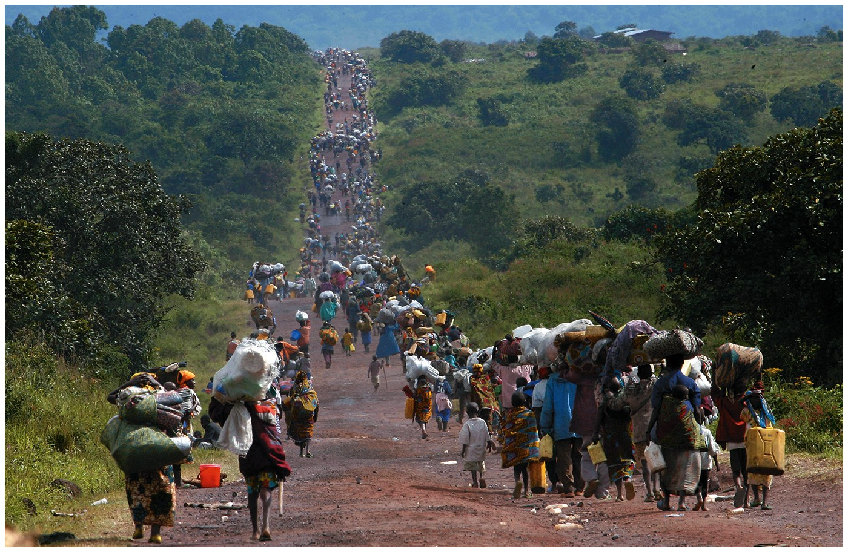
Human Migration
APHG – Spring 2013

Slide 2
Migration
A type of mobility
Migration is a permanent move to a new location
Migration = relocation diffusion
Emigration – number of people leaving a geographic area
Immigration – is the number of people entering a geographic area
Net migration is the difference between the number of people entering a geographic area (immigrants) and those leaving (emigrants)
International Migration: 145 million people lived outside their native countries in the mid – 1990’s, increasing by 2 – 4 million each year
http://hdr.undp.org/en/mediacentre/videos/mobility/

Slide 3
Why Do People Migrate?
Reasons for Migration
Economic Reasons
Push and pull factors
Economic: People move away from places with poor economic opportunities and toward places with better ones.
Cultural factors
Forced migration (e.g. slavery, refugees)
Political instability
20th century increased because of political instability resulting from cultural diversity.
Refugees are people who have been forced to migrate from their homes or country and cannot return for fear of persecution
Environmental factors

Slide 4
Why Do People Migrate?
Push and pull factors
Intervening obstacles
Historically, intervening obstacles = environmental
Transportation technology = limited environmental intervening obstacles

Slide 5
Why Do People Migrate?
Reasons for migrating
Political conditions – the lure of freedom
Ex. - The election of democratic governments in Eastern Europe during 1990’s, Western Europe’s political pull has disappeared the migration factor.
Other examples?
Environmental
Pulled toward physically attractive regions and pushed from hazardous ones.
Examples?

Slide 6
Refugee
A refugee is a person who… owing well founded fear of being persecuted for reasons of race, religion, nationality, membership in a particular social group or political opinion, is outside of the country of his nationality and is unable, or owing to such fear, is unwilling to avail himself to the protection of that country.
- United Nations Convention 1977

Slide 7
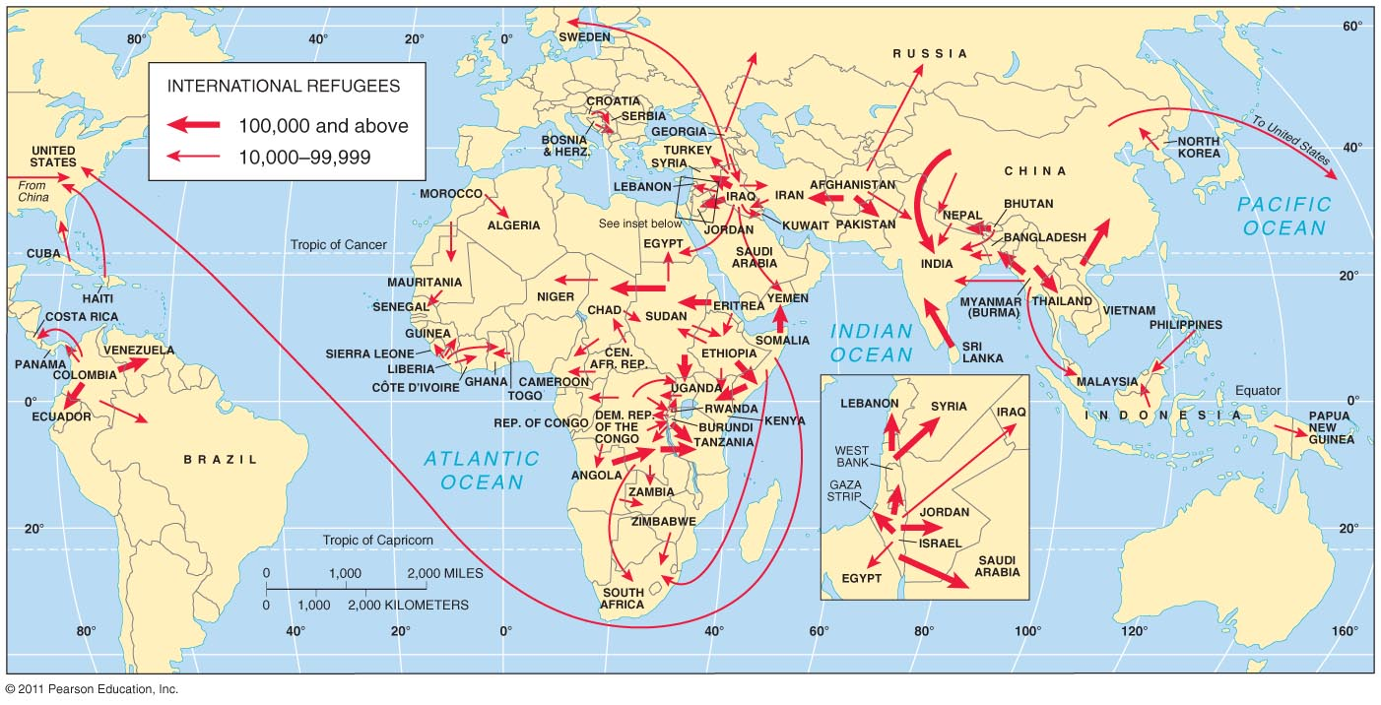
Refugees: Sources and destinations
Major source and destination areas of both international and internal refugees.

Slide 8
Why Do People Migrate?
Distance of migration
Internal migration
Interregional migration = movement from one region to another
Intraregional migration = movement within a region

Slide 9
Why Do People Migrate?
Distance of migration
International migration
Two types
Voluntary
Forced
Migration transition
International migration is most common in countries that are in Stage 2 of the demographic transition.

Slide 10
Characteristics of Migrants
Most long distance migrants are
Males - traditionally outnumber females
In the U.S. today, 55% of immigrants = female
Most long distance migrants are
adult individuals
families with children are less common
Family status
In the U.S. today, about 40% of immigrants = young adults, aged 25-39

Slide 11
Ravenstein’s Migration Laws
1. Net migration accounts to a fraction of the gross migration between two places
Every migration flow generates a return migration, so the actual migration is the volume of the original flow minus that of the return flow
2. The majority of migrants move a short distance.
Migrants who move longer distances tend to choose big-city destinations.
Urban residents are less migratory than inhabitants of rural areas.
Families are less likely to make international moves than young adults.

Slide 12
Gravity Model
The number of migrants declines as the distance they must travel increases.
The gravity model predicts migration on the basis of the size of population in the respective places and the distance between them.
It states that migration is directly related to the populations and inversely related to the distance between them.
Distance Decay – The diminishing in importance and eventual disappearance of a phenomenon with increasing distance from its origin.

Slide 13
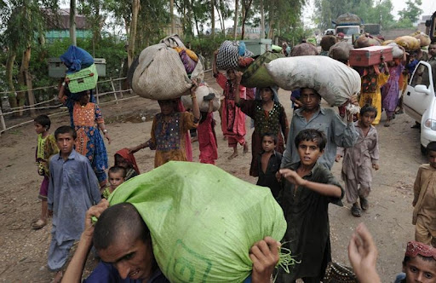
Where Are Migrants Distributed?
Global migration patterns
Regions with Net Out - Migration: Asia, Africa, and Latin America
Regions with Net In - Migration: North America, Europe, and Oceania
The U.S. has the largest foreign-born population

Slide 14
Global Migration Patterns
The major flows of migration are from less developed to more developed countries.

Slide 15
Net Migration by Country
Net migration per 1,000 population. The U.S. has the largest
number of immigrants, but other developed countries also
have relatively large numbers.

Slide 16
Where Are Migrants Distributed?
U.S. Migration Patterns
Three main eras of migration
Colonial migration from England and Africa
Nineteenth-century immigration from Europe
Recent immigration from LDCs

Slide 17
Where Are Migrants Distributed?
U.S. Migration Patterns
Colonial Immigration from England and Africa
Immigration to the American colonies and the newly independent United States came from two sources: Europe and Africa. Most of the Africans were forced to migrate to the United States as slaves, whereas most Europeans were voluntary migrants – although harsh economic conditions and persecution in Europe blurred the distinction between forced and voluntary migration for many Europeans.

Slide 18
Migration to U.S., by region of origin
Most migrants to the U.S. were from Europe until the 1960s. Since
then, Latin America and Asia have become the main sources of
immigrants.

Slide 19
Where are Migrants Distributed?
Impact of immigration on the United States
Legacy of European migration
Europe’s demographic transition
Stage 2 growth pushed Europeans out
65 million Europeans emigrate
Diffusion of European culture

Slide 20
Regional Origins of Immigrants to the United States, Selected Years
Source: Immigration and Naturalization Service, 1998 Statistical Yearbook

Slide 21
U.S. Migration Patterns
Recent Immigration from Less Developed Countries
Immigration to the United States dropped in the 1930’s and 1940’s, during the Great Depression and World War II. Immigration increased steadily during the 50’s – 80’s and 1990’s to historically high levels.
Asia was the leading source of immigrants between the late 1970’s and the late 1980’s until overtaken by Latin America.
About 2 million Latin Americans migrated to the United States 1820 – 1960, about 11 million between 1960 – 2000. The unusually large number of immigrants from Latin America resulted from the 1986 Immigration Reform and Control Act, which issued visas to several hundred thousand who had entered the United States in previous years without legal documents.

Slide 22
Migration from Asia to the U.S.
Migration in 2001. The largest numbers of migrants from Asia
come from India, China, the Philippines, and Vietnam.

Slide 23
Migration from Latin America to the U.S.
Mexico has been the largest source of migrants to the U.S., but migrants have
also come from numerous other Latin American nations.

Slide 24
Where Are Migrants Distributed?
Impact of immigration on the United States
Unauthorized immigration
2008 = estimated 11.9 million unauthorized/undocumented immigrants
About 5.4 percent of the U.S. civilian labor force
Around 59 percent are undocumented immigrants from Mexico
http://www.nytimes.com/interactive/2011/07/06/world/americas/immigration.html?pagewanted=print

Slide 25
Undocumented Immigration
1 million & above
10,000- 99,999
100,000 – 999,999
Below 10,000
http://www.nytimes.com/interactive/2011/07/06/world/americas/immigration.html?pagewanted=print

Slide 26
Undocumented Immigration: Mexico to Arizona
The complex route of one group of undocumented migrants from
a small village north of Mexico City to Phoenix, Arizona.

Slide 27
Destinations of Immigrants within the United States
Impact of immigration on the United States
Destinations
California = one-fifth of all immigrants and one-fourth of undocumented immigrants
New York = one-sixth of all immigrants
Immigrants are not distributed uniformly through the United States. Chain Migration is the migration of people to a specific location because relatives or members of the same nationality previously migrated there.

Slide 28
U.S. States as Immigrant Destinations
California is the destination of about 25% of all U.S. immigrants; another 25%
go to New York and New Jersey. Other important destinations include Florida
Texas, and Illinois.

Slide 29
What Are The Obstacles To Migration?
What are some physical intervening obstacles?
Mountains
Water
Other Examples?
Distance to destination – Actual vs. Friction (ex. Germany, Israel)
Immigration policies of host countries
U.S. quota laws - global quota of 620,000, with no more than 7% from one country (The Quota Act – 1921; The National Origins Act 1924)
Temporary migration for work - guest workers (Europe, Middle East)
Time-contract workers – Asia
Economic migrants or refugees? – Cuba, Haiti, Vietnam
Cultural problems faced while living in host countries
U.S. attitudes to immigrants
Attitudes to guest workers

Slide 30
Guest Workers in Europe
Guest workers emigrate mainly from Eastern Europe and North Africa to
work in the wealthier countries of Western Europe.

Slide 31
Emigration from China
Various ethnic Chinese peoples have distinct patterns of
migration to other Asian countries.

Slide 32
Migration of Vietnamese Boat People
Many Vietnamese fled by sea as refugees after the war with the
U.S. ended in 1975. Later boat people were often considered
economic migrants.

Slide 33
Brain Drain
Countries give preference to skilled workers, U.S. immigration policy contributes to a brain drain, which is a large – scale emigration by talented people. Nearly one-fourth of all legal immigrants to the United States have attended graduate school, compared to less than one-tenth of native – born Americans.

Slide 34
Why Do People Migrate Within a Country?
Migration between regions of a country
U.S. settlement patterns
Colonial settlement
Early settlement in the interior (early 1800s)
California
Gold Rush in the 1840s
Great Plains settlement
Recent growth of the South

Slide 35
Center of Population in the U.S.
The center of U.S. population has consistently moved westward, with
the population migration west. It has also begun to move southward
with migration to the southern sunbelt.

Slide 36
American Settlement
Early Settlement in the Interior –
By 1830 the center of population moved west of West Virginia. After 1830 the population center moved west more rapidly, to just west of Cincinnati, Ohio, in 1880. The population center shifted west rapidly because most western pioneers during the mid-nineteenth century passed through the interior of the country on their way to California.
Settlement of the Great Plains –
The United States population center continued to migrate westward at a much slower pace after 1880.. In part because large migration to the East Coast… offset some of the migration to the U.S. West. The westward movement of the U.S. population center also slowed after 1880 because people began to fill in the area between the 98th meridian and California.

Slide 37
U.S. Interregional Migration
Loup Valley, Nebraska 1886

Slide 38
American Settlement
Between 1950 and 1980 the population center moved west faster. In 1980 the population center jumped west of the Mississippi River.
Recent Growth of the South –
During the 1990’s, for the first time more Americans migrated out of the West than to the West. The population center has moved southward since 1980. Americans are immigrating to the South primarily for jobs. People also are migrating to the South for environmental reasons.

Slide 39
Interregional Migration in the U.S.
500
250
Northeast
800
400
750
Midwest
West
300
600
1,600
1,000
1,600
1,000
South
1,500
1995
Average annual migrations between regions in the U.S. in 1995 and in 2007

Slide 40
Interregional Migration in the U.S.
93
56
Northeast
118
56
125
Midwest
77
West
299
199
244
228
176
300
South
2007
Figures shown in thousands

Slide 41
Why Do People Migrate within a Country?
Two main types of internal migration are interregional and intraregional.
Interregional migration is between rural and urban areas
Intraregional migration is from older cities to suburbs
Center of Population – population center is the average location of everyone in the country “center of population gravity.”

Slide 42
Migration between Regions and Other Countries
Russia – Soviet policy encouraged factory construction near raw materials rather than near existing population concentrations. The collapse of the Soviet Union ended policies that encouraged interregional migration.
Brazil – Most Brazilians live in large cities on the Atlantic coast. To increase the attractiveness to the interior, the government moved its capital in 1960 from Rio to Brasilia. Offered incentives for people to move into the interior.
Indonesia – Since 1969 the government has paid for the migration of more than 5 million people, primarily from the island of Java, to less populated islands.

Slide 43
Migration between Regions in Other Countries
Europe – Throughout Western Europe … the regions with net migration are also the ones with the highest per capita income.
India – Indians require a permit to migrate to the State of Assam. The restrictions, which date from the British rule, are designed to protect the ethnic identity of Assamese. There is restricted migration in India.

Slide 44
Migration in Europe

Slide 45
The Polish plumber “emblematic reaction to anti-immigrant sentiment”
In 2005, French nationalists complained in the press that Polish plumbers were taking French jobs. (In fact, there was a significant shortage of plumbers in France) The “Polish Plumber” quickly became shorthand across Europe for issues related to immigration and jobs. Poland responded by featuring on its tourism posters a “hunky” male model posing as a plumber and saying seductively, “I’m staying in Poland; won’t you come over?”

Slide 46
Migration Trends
Migration from Rural to Urban Areas
Urbanization began with the industrial development. Migration from rural to urban areas has grown in recent years in the less developed countries of Africa, Asia, and Latin America. (primary reason = economic migration)
Migration from Urban to Suburban Areas
In more developed countries , most intraregional migration is from central cities out to suburbs (primary reason = suburban lifestyle)
Migration from Metropolitan to Nonmetropolitan Areas
More developed countries of North America and Western Europe are witnessed a new trend. More people immigrated into rural areas than emigrated out of them. Net migration from urban to rural areas is called counterurbanization.

Slide 47
Intraregional Migration in the U.S.
2007
Average annual migration among urban, suburban, and
rural areas in the U.S. During the 1990s, the largest flow
was from central cities to suburbs.

Slide 48
Net in-migration and Net out-migration
Canada
Atlantic Ocean
Pacific Ocean
Russia
2.0 and above
1.0-1.99
0.50-.099
0.01-0.49
Mexico
Canada
Gulf of Mexico
0.00
Rocky Mtns region net in-migration (rural counties)
Great Plains region net out-migration (rural counties)
0.01-0.49
0.50-0.99
1.0-1.99
2.0 and above
U.S net migration by county, 2007.

Slide 49
Up Next: Exam on Chapters 1 – 3.
Then,
Folk and Popular Culture
Read Chapter 4

