Slide 1
Write these questions down in your notes.
What settlement patterns you see?
How are the settlement patterns different from 1790 to the mid-19th century?...from the mid-19th century to the early 20th century?...from the early 20th century to the present?.

Slide 2
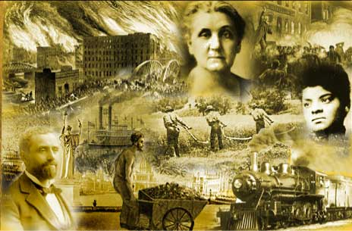
U.S. History Unit #1: The Gilded Age
Part 2 &3: Political Problems, Urbanization, Group Roles

Slide 3
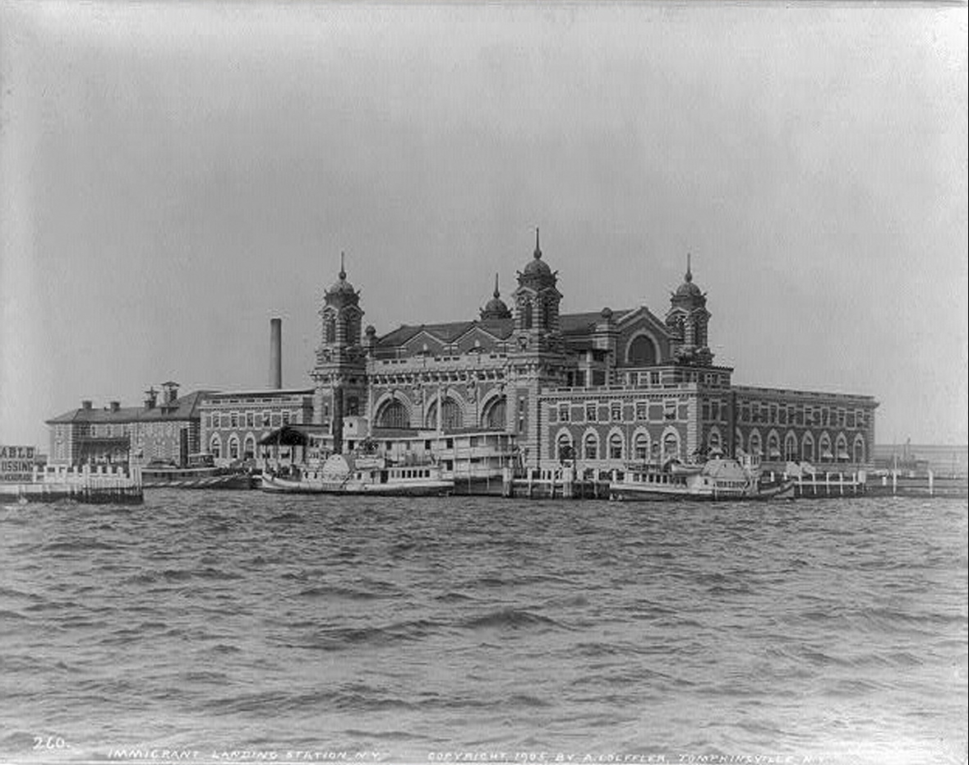
Immigration Prior to 1890
Immigrants prior to 1890 - worked as industrial laborers, were skilled and mostly Anglo-Saxon (White).
Many settled the West. Those from northern Europe (Great Britain, Germany, Scandinavia) settled in eastern cities. Why head West right away?

Slide 4
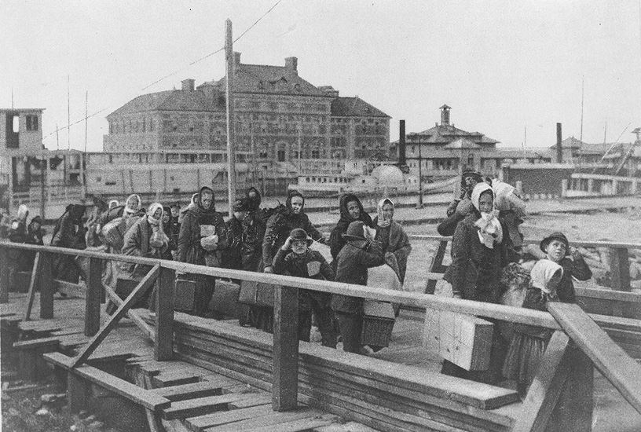
Immigration After 1890
New immigrants - after 1890 there was an influx of immigrants from Eastern Europe who came with different languages and cultures. (Italy, Poland, Russia, Greece, The Balkans)
They suffered discrimination by both Americans and immigrants from Northern Europe. There was also a lot of Anti-Catholic feelings because America at the time was majority Protestant.

Slide 5
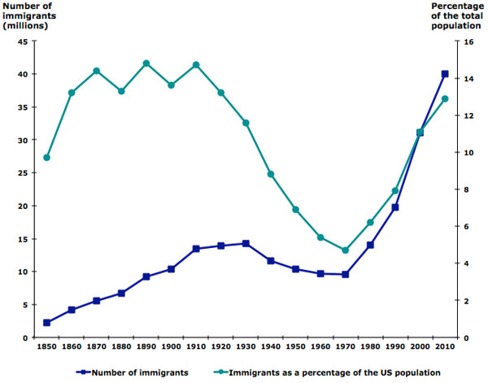

Slide 6
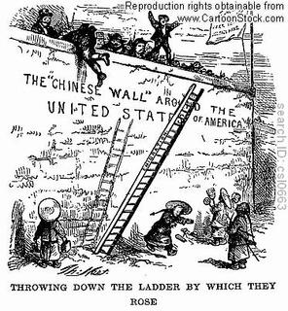
Negative Attitudes Towards Immigration
Social Darwinism is the belief that one race/ethnicity is superior to another (especially in terms of intelligence).
Used to support racist and discriminatory policies and behaviors.
Chinese Exclusionary Act was passed in 1882 and denied citizenship to people born in China and stopped Chinese immigration to the U.S.
This was done to provide more jobs to Non-Chinese Americans. How is this similar to today?

Slide 7
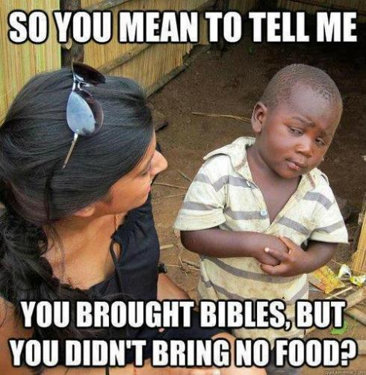
Positive Attitudes Toward Immigration
Optimism: Despite challenges, immigrants continued to pour into America in the hope of a new life and prosperity for their families (The American Dream).
Social Gospel: This was a movement that called upon to live up to their Christian principles and helped immigrants, especially poor ones, to succeed.
Philanthropy: Wealthy Robber Barons who controlled vast fortunes gave large amounts of money to charity. How do they benefit from this?

Slide 8
Population Growth And Shifts
Expanded population of eastern cities due to large immigrant populations that searched for work in cities and factories (late 19th and early 20th centuries).
Growth of the Pacific Coast due to immigration from Asia.
Changing population of the Southwest (Texas to California) due to the influx of immigrants from Mexico and Central America.
Expansion of the farm population of the Southwest over time as agriculture developed and depended on immigrant and migrant labor.

Slide 9
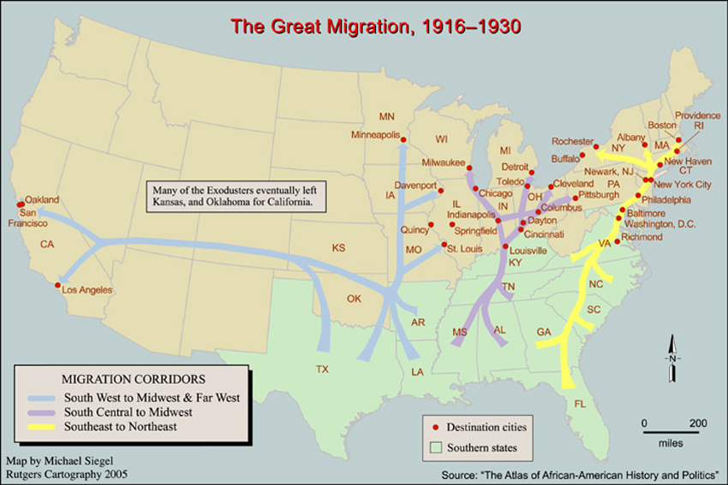

Slide 10
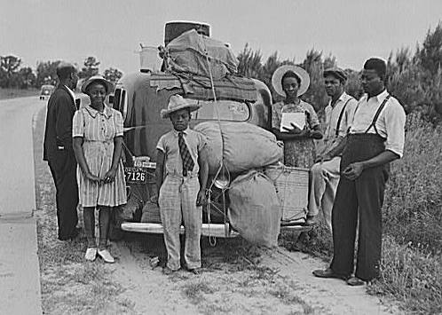
Treatment of Minorities
Minorities of all kinds faced discrimination during the Gilded Age, even beyond just immigrant groups.
African Americans lived in a segregated south and had few voting rights, resulting in many migrating to northern cities.
Native American populations almost completely vanished.
Hispanics in Texas and the Southwest faced discrimination similar to what African Americans faced in the South.

Slide 11
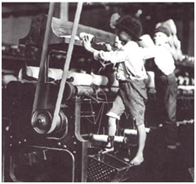
Child Labor
No laws existed that protected children and many worked long hours in dangerous conditions.
As a result, laws were passed banning child labor and making a certain amount of school mandatory.

Slide 12
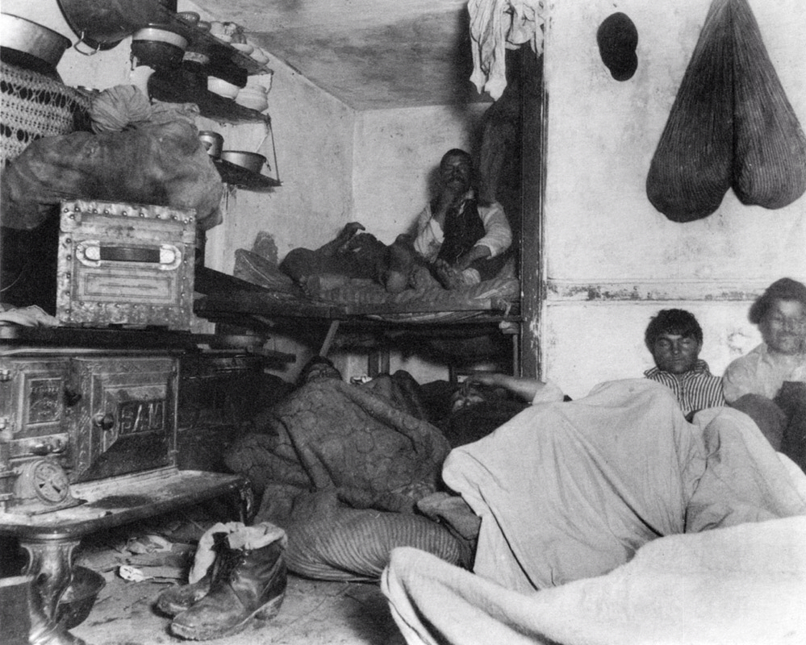
Growth of Cities
Problems of overcrowding, inadequate infrastructure, crime, pollution, disease, education, and efficient local government were created.
It took time but each problem was slowly addressed as public awareness was raised through the media.

Slide 13
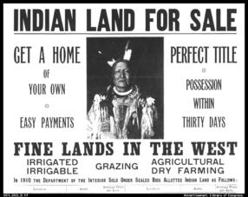
Dawes Act and Indian Policies
Dawes Act: This act broke up Indian Reservation land into individual plots and any extra land was taken over by the government.
The government often gave this land to railroads to encourage them to continue to expand into new territory.
The Dawes Act did not apply to all tribes however in total close 2/3 of Native American land was lost.

Slide 14
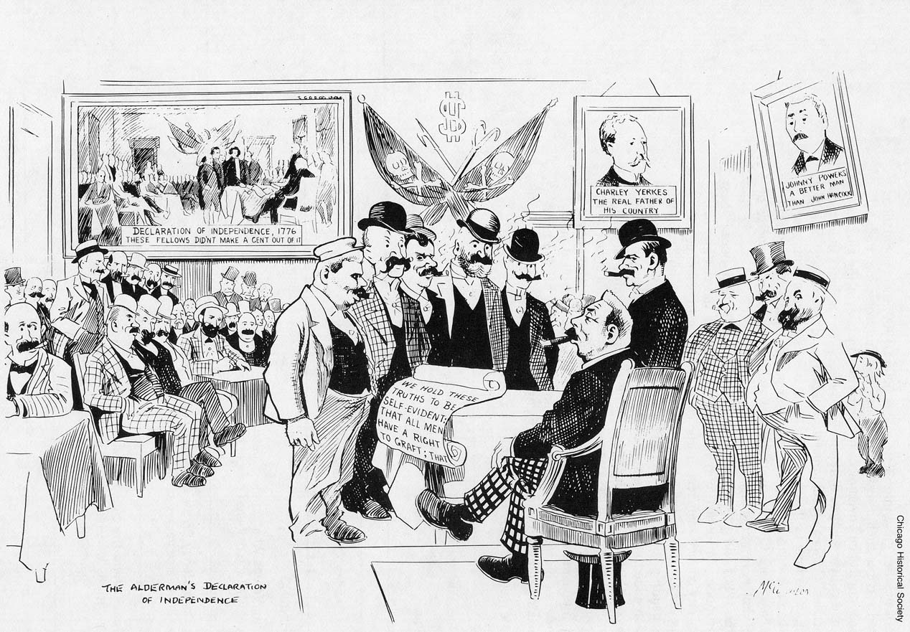
Growth of Political Machines
Encouraged by the spoils system, it led to political corruption and control of elections in some areas by political organizations, Boss Tweed for instance in New York City.
The Spoils System is when somebody is elected to office and then uses his or her position and power to award jobs to friends regardless if they are qualified or not.

Slide 15
Boss Tweed & Tammany Hall
William “Boss” Tweed was in charge and organized the Democratic Political Party in New York from his headquarters at Tammany Hall
He was notorious for corruption, rigging elections, giving jobs to those who did what he said, and really was no different than organized crime today

Slide 16
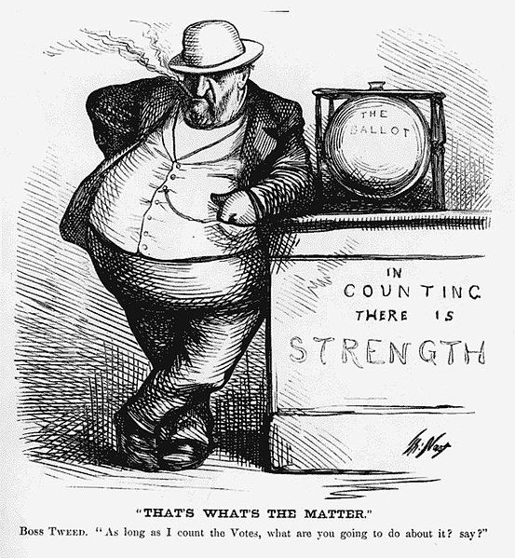
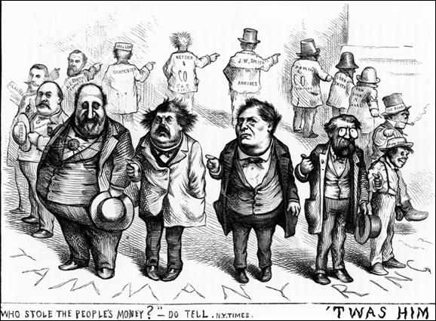

Slide 17
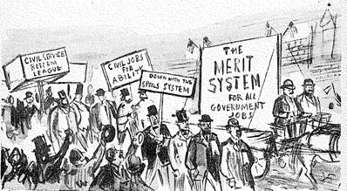
Civil Service Reform
Corruption caused by the spoils system and political machines led to the creation of “civil service” positions in government at the local, state, and national levels based on merit and meeting job qualifications.
Now you had to earn a government job and it wasn’t just given to you.

Slide 18
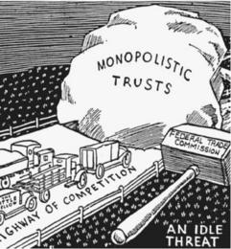
New Legislation
The Interstate Commerce Act of 1887 created the Interstate Commerce Commission to help regulate railroads (and later trucking) to ensure fair rates and prices.
The Sherman Antitrust Act of 1890 was the first government attempt to limit monopolies.
This new legislation represented a shift from previous thinking that businesses should not have to abide by any government regulation. For some people including a new political group called the Populists, this wasn’t enough.

