Slide 2
Our goal is for every HISD student to be …
Notes:
In today’s complex world, preparing our students for success goes beyond test scores, GPAs, and diplomas.
Our students are prepared to compete with their peers globally. That’s why we’ve created the HISD Global Graduate.
This profile was developed with the help of industry and higher education leaders who know what they want NOW and are thinking AHEAD to anticipate what our students will face in the future.
With their help, we’ve identified six characteristics or qualities we want ALL our graduates to possess.
The HISD global graduate is:
A leader
Adaptable and productive
A College ready learner
A critical thinker
A skilled communicator
A responsible decision maker
These skills will prepare them to be part of a global society, ready to enter a global workforce… ready for the world!

Slide 3







A Leader
Works collaboratively and leads by example. Embraces new ideas and technologies and motivates others to be open to change.

Slide 4

Adaptable & Productive
Industrious member of a global society. Demonstrates flexibility and cross-cultural skills when fulfilling personal, professional, and community experiences.

Slide 5

A College-Ready Learner
Proficient in the core disciplines as evidenced by successful performance on state and national assessments. Works hard and persists to achieve academic and career goals.

Slide 6

A Critical Thinker
Identifies and dissects issues, seeks multiple opinions, and critically evaluates various solutions. Understands when additional information is needed and effectively uses technology to research.

Slide 7

A Skilled Communicator
Reads, writes, speaks, and listens effectively — adapts to diverse audiences and settings.

Slide 8

A Responsible Decision Maker
Sets goals, develops action plans, and works hard. When faced with challenges and obstacles is able to persist to achieve goals.

Slide 9
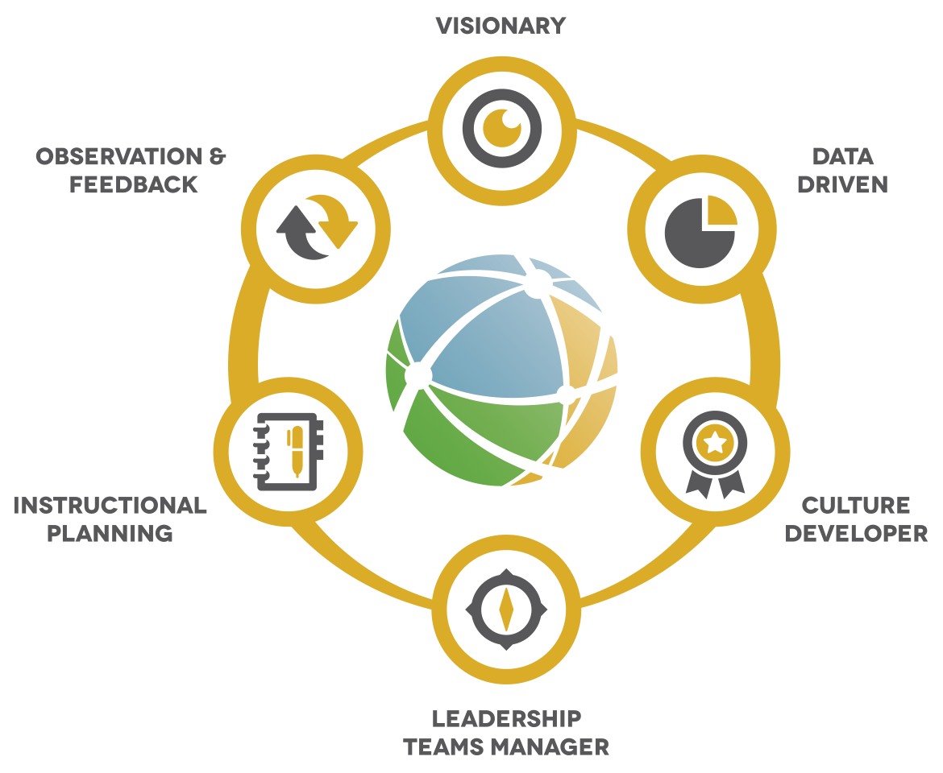
Our goal is for every HISD Leader to be …

Slide 10







A Visionary
Establishes a collective vision of excellence and builds a shared commitment among stakeholders in achieving that vision. Develops a school culture that promotes habit building and inspires behaviors that directly align with the established vision of excellence.

Slide 11

Data Driven
Gathers and organizes data from multiple stakeholders. Ensures data is robust, relevant, and systematically utilized to improve practices and impact scholar outcomes.

Slide 12

A Culture Developer
Creates a strong culture where learning thrives and habits for success are developed.

Slide 13

A Leadership Teams Manager
Leverages colleagues inside and outside of school to build expertise, share best practices, and foster collaboration across the district. Develops structures to manage and support the school leadership team in delivering on the mission.

Slide 14

Instructional Planning
Assures instructional plans afford every scholar rigorous and well-structured lessons that promote intellectual growth, curiosity, collaboration, problem-solving, and creativity.

Slide 15

Observation & Feedback
Prioritizes professional development, learning communities, and a consistent feedback cycle to empower staff and improve their craft. Exemplifies a growth mindset and builds capacity among leadership team/colleagues through distributed leadership.

Slide 16
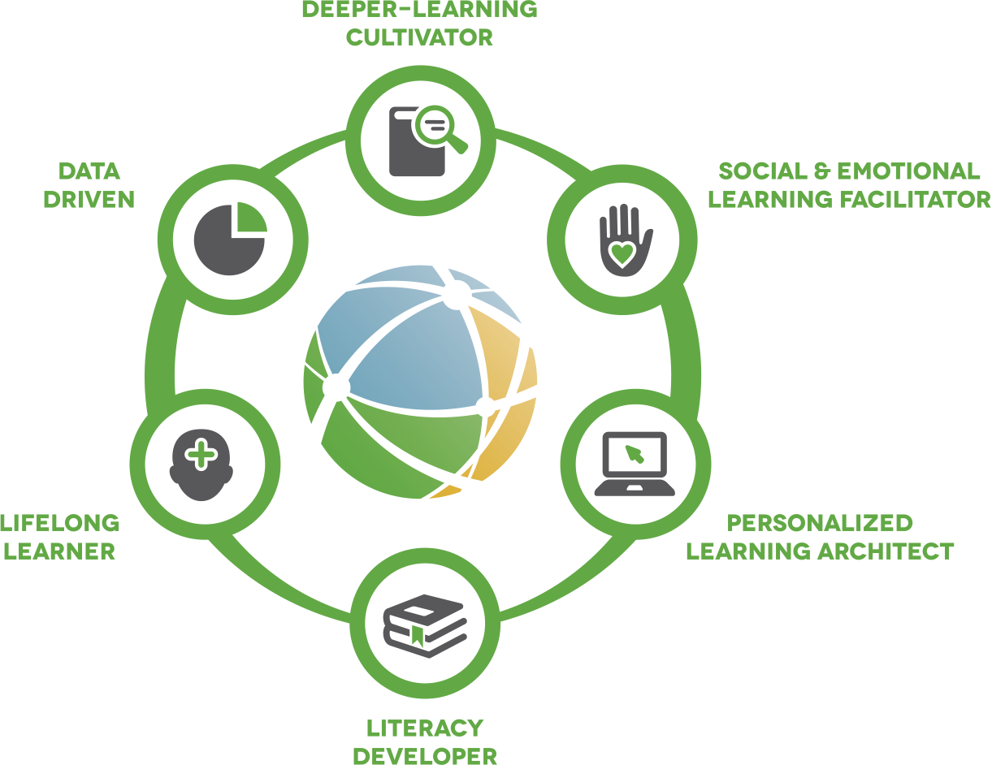
Our goal is for every HISD Teacher to be …

Slide 17







A Deeper-Learning Cultivator
Designs learning experiences that develop academic mindsets and foster critical thinking, innovation, and collaboration. Ensures mastery of core academic content through application of knowledge and skills in novel and meaningful contexts.

Slide 18

A Social & Emotional Learning Facilitator
Creates a learner-centered community with safe and flexible environments to meet the needs of all learners. Develops attitudes and skills of learners to establish and maintain relationships, be empathetic, and make responsible decisions.

Slide 19

A Personalized Learning Architect
Curates, creates, and collaborates with learners to provide path choices and resources to achieve individual goals. Utilizes strengths and interests of individuals to build knowledge and skills.

Slide 20

A Literacy Developer
Designs and facilitates learning experiences that develop necessary skills for fluent reading, writing, speaking, and communicating. Develops proficiency in use of technology to create, analyze, and synthesize multimedia to skillfully communicate and collaborate with global audiences for a variety of purposes.

Slide 21

A Lifelong Learner
Seeks feedback and growth opportunities to develop, lead, and collaborate with all stakeholders. Persists in the continual development of the technical, content, and pedagogical knowledge necessary
for teaching diverse learners.

Slide 22

Data Driven
Designs and uses multiple forms of data to monitor and adjust learning experiences. Ensures students utilize precise and timely feedback to inform goal-setting and be adaptive and productive learners.

