Slide 1
FORM-A-BLOK A Severe Fluid-Loss Lost Circulation Material
Milena Martinez & Lenaia Robinson
IPAA project at MI-SWACO - 26th June, 2014

Slide 2
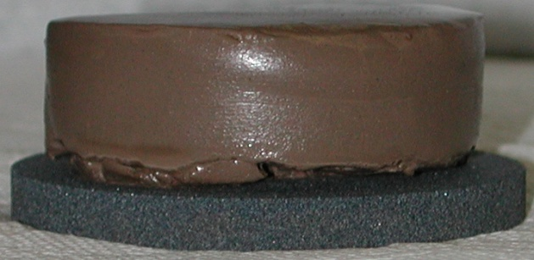
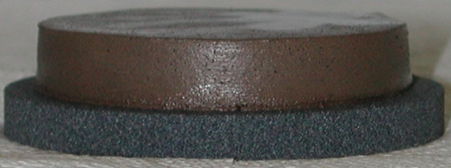
FLUID LOSS
One of the most challenging problems faced by Operators while drilling for Oil and Gas is Lost Circulation
Fluid Loss
Loss of the fluid phase of a drilling fluid as it filters through porous rock
Leaves a filter-cake behind proportional to fluid / filtrate loss
Measured in lab – API, HPHT and DYNAMIC fluid-loss tests
16.5ppg
Lignosulfonate mud
Dynamic Filtration filter-cakes
60min fluid loss
15D, 50µ filter media
Base mud
72ml, 25/32”
Base mud + 3% Black Fury
38ml, 12/32”

Slide 3
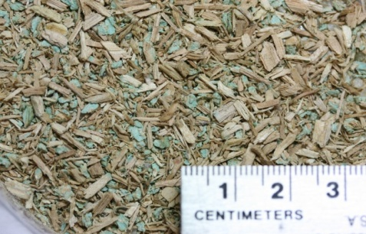
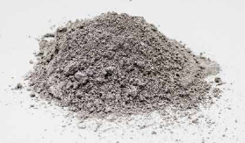
LOST CIRCULATION
Lost Circulation – refers to loss of whole mud to the formation
SEEPAGE Loss < 10 bbl/hr. PARTIAL Loss 10-20 bbl/hr.
Tiger Bullets - A superior bridging agent highly effective when drilling high-permeability / high- porosity zones with high differential pressures
HEAVY Loss 20-40 bbl/hr. SEVERE Loss >40 bbl/hr.
Form-A-Squeeze - A high-fluid loss particulate LCM that address severe fluid loss in all types of fractures, vugular formations, matrix and underground blowout events
Form-A-Blok - A high-fluid loss fibrous LCM designed for Wellbore Strengthening applications
Tiger Bullets
Form-A-Squeeze
Form-A-Blok

Slide 4
FORM-A-BLOK
Description
A high-fluid loss fibrous LCM designed for Wellbore Strengthening applications and a wide variety of lost circulation scenarios, including, but not limited to fractures and matrix permeability
Characteristics
Easily mixed in freshwater, seawater or base oil/syn.
Combined with barite for weighted slurries
Placed in and/or across loss zone → liquid phase squeezes from slurry
Leaves a semi-permeable plug that seals the formation
Not dependent on time, temp., activator/retarder or pH
Stop loss occurring in WBMs, NAFs
Can be used for seepage loss, @ 10ppb
Can be used as plug to run in front of cement squeeze
Can be used as plug to improve casing shoe integrity
Applications
Mixed according to mud weight typically @ 40ppb

Slide 5
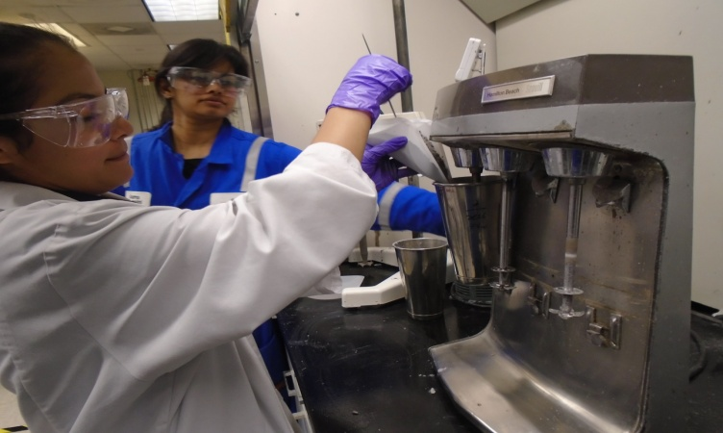
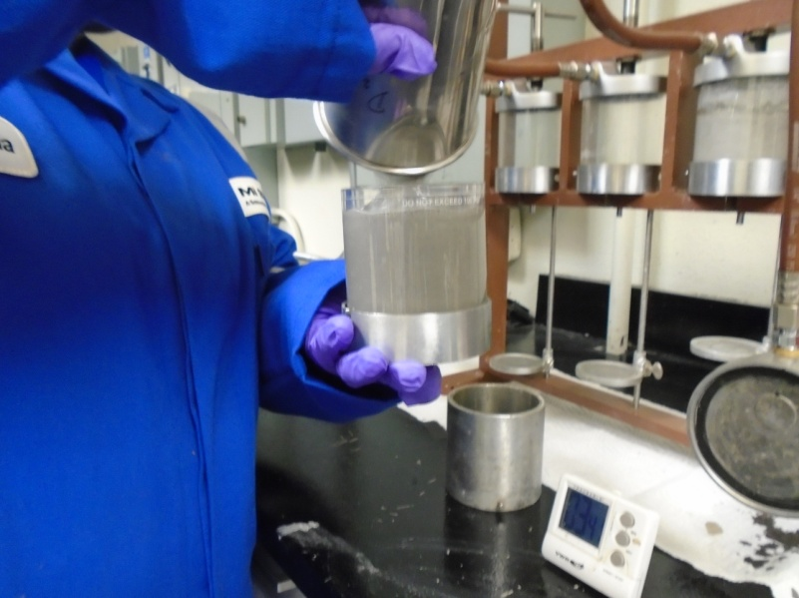
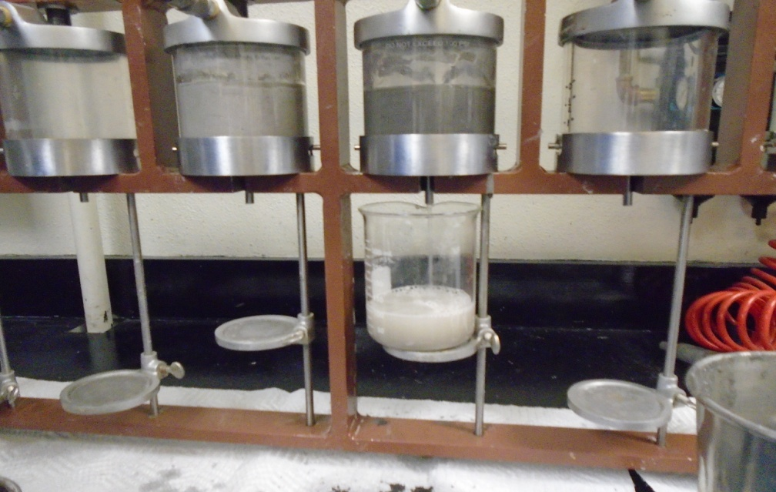
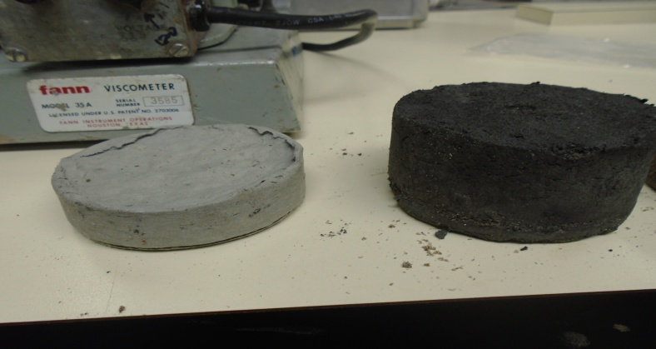
WORKING IN THE LAB

Slide 6
PLUGS WHEN MIXED IN WATER
 | Water, g | FAB, g | Barite, g | Filtrate, g | Plug wt, g | Time to De-fluidize, s
Un-weighted | 330 | 40 | 0 | 277 | 89 | 30
12ppg | 287 | 40 | 176 | 222 | 275 | 37
16ppg | 235 | 30 | 396 | 150 | 497 | 53
API filtration plugs @ 100psi on a 60 mesh, 250µ screen

Slide 7
IMPORTANCE OF SHEAR STRENGTH

Slide 8
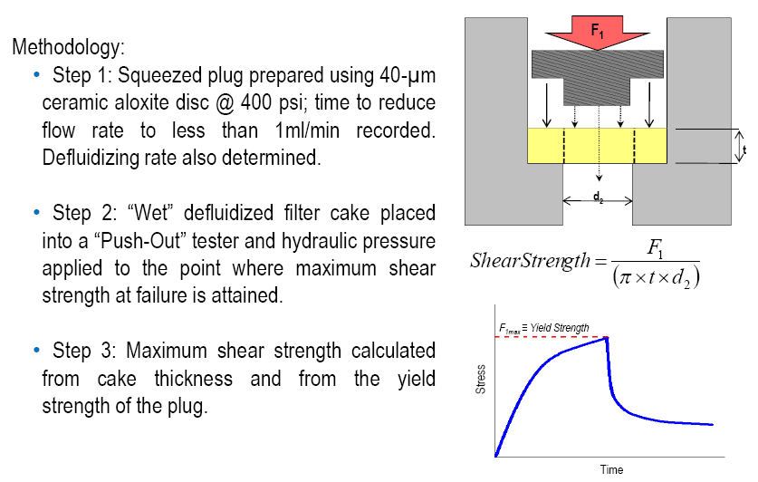
SHEAR STRENGTH MEASUREMENT

Slide 9
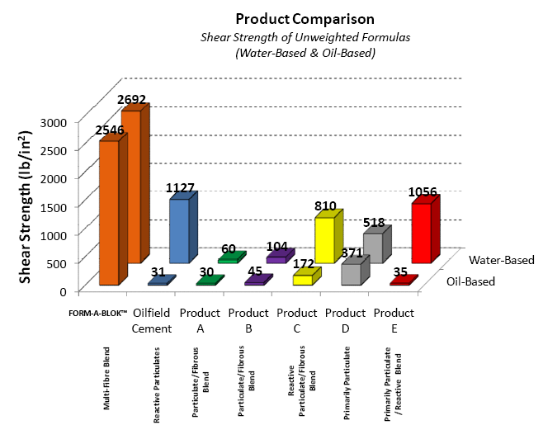
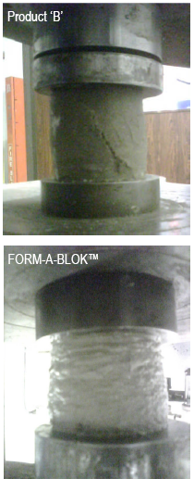
LOAD FRAME & SHEAR STRENGTH MEASUREMENT

Slide 10
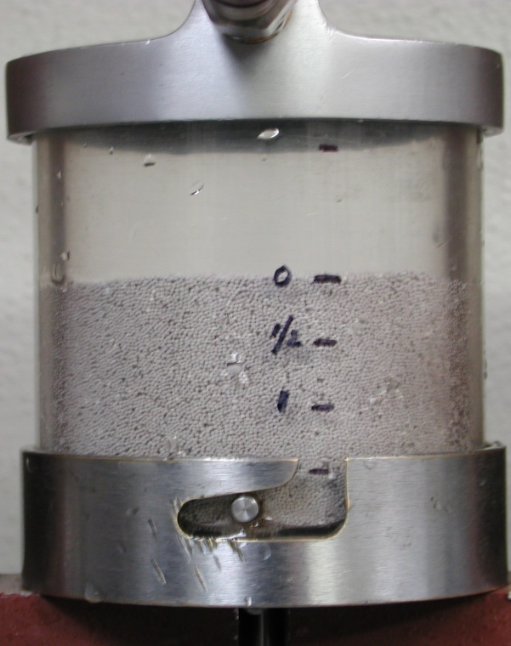
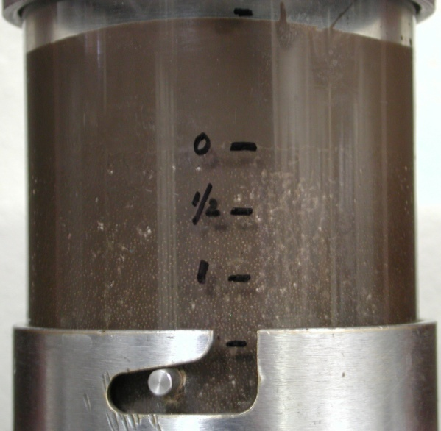
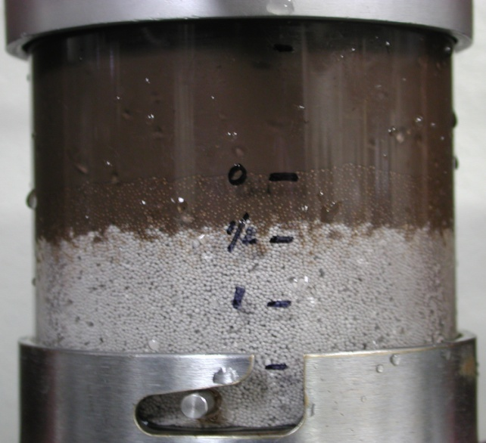
BACKGROUND LCM
Mud Invasion through 20-40 frac sand in API fluid loss cell
Wet compacted 20-40 frac sand
2 inches deep
Total Fluid Invasion of Base mud through frac sand @ 100psi
~0.4 inches Fluid Invasion of
Base mud with 8ppb Form-A-Blok after 5 min @ 100psi

Slide 11
APPLICATIONS IN NAM, 2014
Date | Operator | Location
January | Stone Energy | GOM
 | Stone Energy | GOM
 | Energy Partners Limited | GOM
February | Apache Corporation | Mid-Continent
March | BHP | Permian Basin
 | Walter Oil & Gas | GOM
April | Continental Natural Resources | Mid-Continent
 | OXY | South Texas
 | Walter Oil & Gas | GOM
May | Continental Natural Resources | Oklahoma
June | Shoreline Energy | Louisiana
 | Continental Natural Resources | Oklahoma

Slide 12
FIELD EXAMPLES
Region | MD (ft) | Event | LCM work? | MW in ppg | FAB work? | Final MW ppg
Alaska | 7881 | T.L. | No | 9.5 | Yes | 10.3
Alaska | 11005 | 200bph | No | 9.8 | Yes | 10.3
Mexico | 14125 | 200bph | No | 14.2 | Yes | 12.7
Egypt | 18737 | T.L. | No | 12.5 | Yes | 12.5
Mexico | 14436 | T.L. |  | 11.5 | Yes | 13.3
Mexico | 12963 | 38bph |  | 16.7 | Yes | 16.9
Mexico | 15525 | 38bph |  | 16.7 | Minor Loss | 17.5
Mexico | 19373 | 63bph |  | 8.2 | Yes | 10.4
Mexico | 20784 | T.L. |  | 12.5 | Yes | 15.8
Mexico | 17674 | 38bph |  | 9.6 | Minor Loss | 10.0
Mexico | 12139 | 13bph |  | 16.0 | Minor Loss | 17.2

Slide 13
NEW EXCITING DEVELOPMENTS
Acid-Soluble Form-A-Blok was recently developed for losses in Production zone
95% acid soluble in 15% HCl @ 212°F
Shear Strength of ~ 2400 psi compared to ~ 2700psi for regular FAB in water
Project is currently underway to enhance Cement’s bonding strength
Currently, competitor’s LCM product Diaseal-M is added to Cement
To replace with the addition of Form-A-Blok to Cement
Initial testing shows – no Contamination effect
Up to 120ppb Cement, class G added to 40 ppb FORM-A-BLOK slurry
→ No change in de-fluidizing rate.
Next: To measure Shear Strengths of plugs…in dry and wet conditions

Slide 14
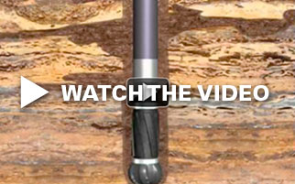

Slide 15
SPECIAL ACKNOWLEDMENT
Schlumberger
MI-SWACO
Lashaunda Johnson
Kumar Ramtahal
Josh Sheldon
Asma Huissini
Ingrid Velasco
Brian Rogers
Aaron Blue
Mishel Grubac
Khai Ngyen
Tim Wilkin
Tim Hubbard
Hernan Hernandez

Slide 16
THANK YOU
QUESTIONS?

