Slide 1
Aggie Alvez, Chief Communications Officer
Management Oversight

Slide 2
OFFICE OF COMMUNICATIONS
The Office of Communications coordinates internal and external districtwide communications and strategic partnerships to increase transparency, support, and confidence in HISD.

Slide 3
OFFICE OF COMMUNICATIONS MAY 2011 ORGANIZATION
Chief Communications Officer
General Manager Communications
Media Relations
Administrative Services
HISD TV
Strategic Partnerships
120 Employees
67.25 GF1
50.75 PS1
2 SR1
• 46 Prof Staff (Pay grade 25 and above)
• 74 Admin (Pay grade 24 and below)
3 Prof Staff
11.25 Prof Staff (GF1)
11.75 Prof Staff (PS1)
2 Prof Staff (SR1)
19 Admin (GF1)
39 Admin (PS1)
8 Prof Staff
4 Admin
8 Prof Staff
11 Admin

Slide 4
OFFICE OF COMMUNICATIONS MAJOR FUNCTIONS
Administrative Services
Graphics, copy, print, and mail services (PS1)
Facility management operations (PS1)
Records management and document imaging
Web/translation/creative services
Strategic Partnerships
School support through districtwide corporate and nonprofit partnerships
Partnership training for schools
Connect-ED training and support
Special events
Main switchboard, HMWESC reception, group visits
HISD TV
Video production
TV/web coverage of Board meetings and key events
Operation and programming of HISD cable channel
A/V and technical support to schools and offices
Media Relations
School support for media issues, Connect-ED messages
Local, state, national media relations
Crisis communications
Press events

Slide 5
OFFICE OF COMMUNICATIONS BUDGET
Current Annual Budget—$10.15 M
Payroll—$6.04 M
Operational Cost—$4.11 M
Current Budget
$1,791,165
$244,243
$2,072,391
$6,042,374
Funding Sources
Funding Sources
Priority Services 1—$5.50 M
General Fund—$4.52 M
Special Revenue—$.13 M
$136,818
$4,517,178
$5,496,177

Slide 6
OFFICE OF COMMUNICATIONS COST REDUCTION/ REVENUE GENERATING EFFORTS
Reorganized office to combine similar job functions and create efficiencies. Net reduction of 6.5 GF1 positions for savings of $323,300
Zero-based budgeting for all departments
2011–2012 proposed GF1 budget reduced by approximately 10 percent
2011–2012 proposed PS1 budget reduced by approximately 28 percent
PS1 saved the district $757,853 in printing and mailing costs in 2009–2010
Last year, generated over $4 million in total revenue, with $1.3 million from external clients

Slide 7
OUR WORK SPANS ALL STRATEGIC DIRECTION CORE INITIATIVES
1
Effective Teacher in Every Classroom
2
Effective Principal in Every School
3
Rigorous Instructional Standards and Supports
Data-driven Accountability
4
5
Culture of Trust through Action

Slide 8
OFFICE OF COMMUNICATIONS KEY ACCOMPLISHMENTS
Strategic Direction
Main Element
Developed video archive of monthly Board meetings on the web; consolidated links for video, agenda, and minutes in easy-to-use format
Created Principal Resource page on employee portal to aggregate information, videos, key messages, and sample letters to support communications with staff and parents
Produced weekly communications update to principals highlighting new web content, video resources, press releases, etc.
Launched partnership newsletter, Making the Connection
Establish structures and protocols for disseminating information to and from stakeholders
Established editorial group that meets weekly to prioritize requests from schools/departments and to ensure that all platforms are used to disseminate information
Standardized processes for publicizing Board of Education workshops/ meetings and actions taken using video/print/web/email/Twitter

Slide 9
OFFICE OF COMMUNICATIONS KEY ACCOMPLISHMENTS

Slide 10
OFFICE OF COMMUNICATIONS KEY ACCOMPLISHMENTS
Strategic Direction
Main Element
Produced live, call-in TV shows on Strategic Direction, budget, EVAAS
Produced series of WOW videos on great schools and programs
Established partnerships with African American and Latino news media outlets (KCOH, Univision radio/ TV, African American News & Issues)
Held Community Conversations meetings on budget and Magnet review
Launched HISD Facebook page and YouTube channel
(Continued)
Use a variety of methods to communicate with internal and external stakeholders
Redesigned main pages of HISD website
Revamped HISD TV news update and created Spanish version
Launched Spanish Twitter feed
Created district marketing brochure and video

Slide 11
OFFICE OF COMMUNICATIONS KEY ACCOMPLISHMENTS
Strategic Direction
Main Element
Launched Mythbusters on HISD website
Hosted Vietnamese radio and TV programs on local Asian media outlets
Launched Community Connections program on HISD TV and web that highlights outstanding partnerships
Use a variety of methods to communicate with internal and external stakeholders
(Continued)
Conducted first superintendent’s press conference with student journalists
Launched K12 Radio

Slide 12
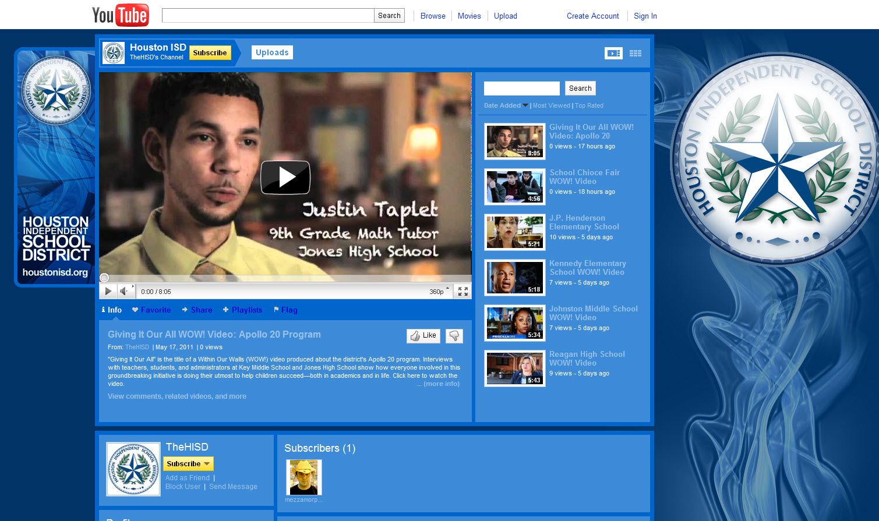
OFFICE OF COMMUNICATIONS KEY ACCOMPLISHMENTS
Facebook
YouTube

Slide 13
OFFICE OF COMMUNICATIONS KEY ACCOMPLISHMENTS
Strategic Direction
Main Element
Conducted communications/media training for PTA leadership
Enrolled 80 schools in first cohort to implement new web hosting and content management system
Provided training for schools on developing business partnerships
Developed partnership training webinar for principals
Provided ongoing support and coaching to central office staff on messaging district initiatives
Provided guidance and assistance to principals on marketing and developed print, video, and web materials for schools
Build capacity to ensure implementation of timely, effective, two-way communication
Coordinated communications/media training for Cabinet and SIOs
Conducted trainings for assistant principal cohort on effective communications
In collaboration with Leadership Development department, established partnership with the Rice University Business School to provide marketing seminar for principals.

Slide 14
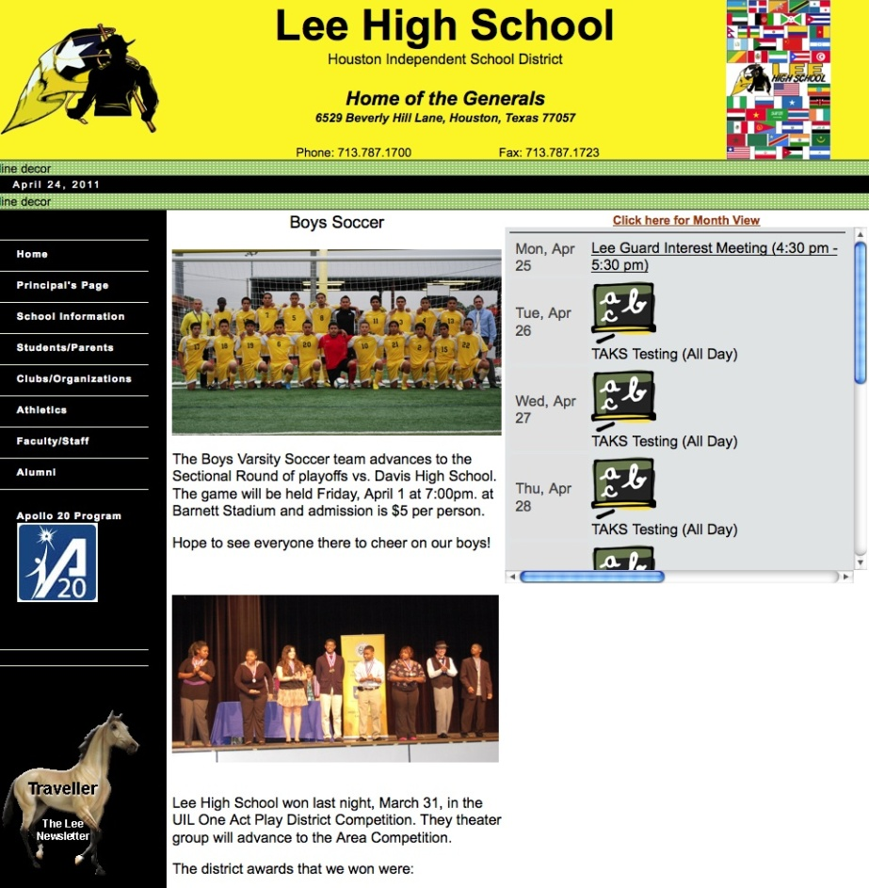
OFFICE OF COMMUNICATIONS KEY ACCOMPLISHMENTS

Slide 15
OFFICE OF COMMUNICATIONS KEY ACCOMPLISHMENTS
Strategic Direction
Main Element
Included postage-paid feedback card for first time in Welcome to HISD publication—nearly 1,000 returned
Gathered feedback through surveys and focus groups in development of new website
Met regularly with advisory committees and strategic partners, including civic, business, and faith-based organizations and local chambers
Developed standardized feedback form for community meetings
Define and implement methods to evaluate effectiveness of communications
Revised biannual community survey to align with Strategic Direction; added online pilot version for first time this year
Established media tracking protocol to monitor coverage

Slide 16
OFFICE OF COMMUNICATIONS KEY PERFORMANCE INDICATORS
Facilitated 19 Community Conversations (7 budget/legislative; 12 Magnet review) attended by more than 2,800 parents, staff, students, and community members
Fulfilled 1,558 requests for translations (26 percent from schools) from April 2010 through March 2011
Provided 354 hours of interpretation services
Through PS1 (July 1, 2010– April 30, 2011):
Served 238 schools, 100 departments, and 102 external clients
Produced 66,422,331 copies and processed 2,739,871 pieces of mail
Completed 5,138 print jobs; 40 percent of the jobs were to assist schools in their communications and marketing efforts

Slide 17
OFFICE OF COMMUNICATIONS KEY PERFORMANCE INDICATORS
From April 2010 through March 2011, the HISD public website experienced 79.1 million page views and 3.0 million unique visitors, an increase of 300,000 unique visitors compared with the previous year (11 percent increase)
Increased the number of Twitter followers by 74 percent, from 949 in January 2011 to 1,649 in May 2011
Increased the number of eNews community subscribers by 50 percent, from 16,556 in April 2010 to 24,876 in March 2011
Produced 449 videos from July 2010 through April 2011
369 informational (includes 61 in Spanish and 4 in Vietnamese)
58 instructional
22 professional development
Planned and coordinated 100 special events in 2010

Slide 18
OFFICE OF COMMUNICATIONS KEY PERFORMANCE INDICATORS
Responded to record number of calls—149,751—to main switchboard in 2010
Served 139,383 guests at the HMWESC front desk in 2010
Increased number of schools participating in Principal for a Day to 282, a jump of 66 percent compared with the previous year
Tripled the average number of press releases issued per month (257 releases issued this school year)
Established media tracking protocol:
2,645 stories reported in media (2010–2011 school year to date)
64.5 percent positive; 29 percent neutral; 6.5 percent negative
Responded to average of 44 requests per month from principals, SIOs, and CSOs for support with media issues and Connect-ED scripts

Slide 19
OFFICE OF COMMUNICATIONS CRITICAL CHALLENGES
Upgrading/replacing web content management system
Equipment upgrades
Replacing key pieces of equipment at McCarty printing facility
Bringing TV facility up to standard
Impact on PS1 revenue of reduction in HISD school/office printing budgets and reduction in City of Houston printing
Marketing support for individual schools

Slide 20
OFFICE OF COMMUNICATIONS ON THE HORIZON
Develop suite of tools and resources to support principals in marketing their schools
Collaborate with Leadership Development department to build capacity of administrators in communications and marketing
Create a comprehensive toolkit for internal communications, including processes, protocols, brand guidelines, and ready-to-use templates
Develop a practical, easy-to-use “neighbor-to-neighbor” engagement toolkit for school community members
Hold first annual HISD Back-to-School Fest on August 6
Continue to work with IT department on addressing the need to upgrade/replace the web content management system
Audit all HISD TV programming to ensure greater alignment with Strategic Direction

Slide 21
OFFICE OF COMMUNICATIONS
Department Summaries

Slide 22
ADMINISTRATIVE SERVICESMAY 2011 ORGANIZATION
Senior Manager, Administrative Services
Translation Services Manager
Manager, Creative Services
Portal Services Manager
Records Manager
Plant Production Manager
Sales and Service Manager
Translator
Graphic Design Manager
Senior Writer
Senior Graphic Designer
Web Content Administrator
Writer
Web Designer (2)
Imaging Team Leader
Plant Production Team Leader (5)
Outside Sales Representative
Digital Prepress Technician
Translator SR1
Translator SR1
25 Prof Staff (Pay grade 25 and above)
11.25 GF1
11.75 PS1
2 SR1
58 Admin (Pay grade 24 and below)
19 GF1
39 PS1
Internal Service Funds (PS1)
Special Revenue Funds (SR1)

Slide 23
ADMINISTRATIVE SERVICES BUDGET
Current Budget
Current Annual Budget—$7.15 M
Payroll—$3.70 M
Operational Cost—$3.45 M
$196,800
$15,000
$1,666,873
$3,700,665
$1,587,621
Funding Sources
Funding Sources
Priority Services 1—$5.50 M
General Fund—$1.50 M
Special Revenue—$.13 M
Capital Outlay—$.02 M
$136,818
$15,000
$1,503,964
$5,496,177

Slide 24
ADMINISTRATIVE SERVICES PRIORITY SERVICES (PS1) MAJOR FUNCTIONS
McCarty Printing Plant
Provides printing and bindery services to HISD schools, departments, and external clients
District Post Office
Receives, sorts, and processes all HISD departmental mail from schools and offices
Meters all out-going HISD mail
Print Services Center
Provides copy and small bindery services in HMWESC
Manages fleet copiers in HMWESC
Design Department
Provides design services for schools and departments to support marketing and communications efforts
Copy and Mailing Facility Management
Manages day-to-day operations of copy centers and/or mailing services for Lone Star College, Spring ISD, and City of Houston
Acts as primary contractor to external customers for onsite copy and mailing services

Slide 25
ADMINISTRATIVE SERVICES PRIORITY SERVICES (PS1) KEY ACCOMPLISHMENTS
Produced key documents and resources for schools and departments
Practice tests, school handbooks, school forms, marketing collateral, fine arts performance programs, all graduation programs
Back-to-school publications, including Welcome to HISD booklet and Code of Student Conduct
District financial audit books
Array of resources for Strategic Direction, budget, School Choice Fair, Apollo 20, Magnet review, etc.
State of the Schools event materials—Annual Report, stationery, invitations, banners, program, collateral
Installed 4-color digital press in July 2010 that has produced more than 234 jobs in 7 months; old press produced 240 jobs for the entire previous year. New press has produced more than $222,546 in printing revenue.

Slide 26
ADMINISTRATIVE SERVICES PRIORITY SERVICES (PS1) KEY ACCOMPLISHMENTS
PS1 saved the district $757,853 in printing and mailing costs in 2009–2010
$432,000 in printing costs
$325,853 in mailing costs
Last year, generated over $4 million in total revenue, with $1.3 million from external clients
Generated enough revenue last year to have positive fund balance

Slide 27
ADMINISTRATIVE SERVICES PRIORITY SERVICES (PS1) KEY PERFORMANCE INDICATORS
238 schools served
100 departments served
5,138 print jobs for schools and departments (40 percent of the jobs were from schools)
102 external clients
2,102 external print jobs
62,842,211 B&W copies produced
3,580,120 color copies produced
2,739,871 pieces of mail processed

Slide 28
ADMINISTRATIVE SERVICES PRIORITY SERVICES (PS1) AWARDS
2010 Printing Industries of the Gulf Coast Printing Excellence Awards
SPARK 2009 Calendar —Best In-plant
Black History Heritage Month —Award of Excellence
A Family Affair —Award of Excellence
Get a Jump on Success —Award of Excellence
Student and Parent Handbook—Award of Excellence
2011 Graphics Printing Excellence Awards
City of Houston Calendar —Best In-plant
Asian and Asian-Pacific American Heritage Month —Best of Category
Milby HS Brochure —Award of Excellence
SPARK 2010 Calendar —Award of Excellence

Slide 29
ADMINISTRATIVE SERVICES PRIORITY SERVICES (PS1) AWARDS
2011 Graphics Printing Excellence Awards, cont.
Williams MS Brochure —Award of Excellence
Furr HS Brochure —Award of Excellence
2010 State of the Schools Annual Report —Award of Excellence
HCDE Popular Annual Financial Report— Award of Excellence
Glassell School of Arts Vanitas Booklet —Award of Excellence
SPARK Art 2011 Calendar —Award of Excellence
Citizens for Animal Protection 2011 Calendar —Award of Excellence

Slide 30
ADMINISTRATIVE SERVICES RECORDS MANAGEMENT MAJOR FUNCTIONS
Ensures full compliance with state laws by properly archiving and destroying records according to their retention period
Converts hard-copy documents to digital images for multiuser access and to microfilm for long-term preservation
Provides for the storage and control of inactive district vital records; houses more than 40,000 boxes of records. Assists schools and departments with proper file storage
Provides secure and confidential records destruction for schools and departments for paper, CD/DVD, cassettes, and video media

Slide 31
ADMINISTRATIVE SERVICES RECORDS MANAGEMENT KEY ACCOMPLISHMENTS
Converted SAP-posted Accounts Payable documents to online images, improving response time for vendor and customer questions and providing documentation for audit inquiries
Designed and implemented electronic work-in-progress tracking program
Improves employee job scheduling
Reduces costs
Reports timely production volume/cost data
Reduced Special Education department’s cost to mail Complaint Response Books to TEA by scanning them to CDs. TEA now uses CD format as the standard for all Texas school district responses.

Slide 32
ADMINISTRATIVE SERVICES RECORDS MANAGEMENT KEY PERFORMANCE INDICATORS
Records retrievals
1,664 for 2009–2010
1,430 for July 2010 to March 2011
Records destruction (boxes)
3,939 for 2009–2010
3,576 for July 2010 to March 2011
Storage transfers
3,820 for 2009–2010
1,841 for July 2010 to March 2011
Record Center service requests
1,322 for 2009–2010
1,394 for July 2010 to March 2011
Total images scanned
1,207,824 for 2009–2010
918,470 for July 2010 to March 2011

Slide 33
ADMINISTRATIVE SERVICES WEB/TRANSLATION/ MAJOR FUNCTIONS CREATIVE SERVICES
Manages the HISD public website, department sites, and employee portal
Provides training and user support for 180 employees who manage or enter content on 80 HISD department portal websites
Implements new web hosting and content management system for schools, including training and ongoing support
Writes, formats, and coordinates electronic distribution of weekly eNews and other email communications to employees and the community
Maintains district Twitter account
Writes major district publications, including Annual Report, as well as speeches, letters, weekly communications update for principals, video scripts, web stories, and talking points
Photographs school and district events

Slide 34
ADMINISTRATIVE SERVICES WEB/TRANSLATION/ MAJOR FUNCTIONS CREATIVE SERVICES
Provides translations of letters, fliers, newsletters, brochures, Connect-ED messages, video scripts, and other materials for schools and departments in Spanish and Vietnamese
Facilitates translations in other languages as needed
Provides interpretation services at Board meetings, community meetings, parent–teacher conferences, ARD meetings, and employee hearings
Provides translated content for the public Spanish and Vietnamese websites

Slide 35
ADMINISTRATIVE SERVICES WEB/TRANSLATION/ KEY ACCOMPLISHMENTS CREATIVE SERVICES
Redesigned main pages of HISD website (English, Spanish, and Vietnamese)
Developed online video archive for monthly Board meetings; consolidated links for video, agenda, and minutes in easy-to-use format
Enrolled 80 schools in the first cohort to implement new web hosting and content management system; all expected to be live by beginning of 2011–2012 school year
Created new pages on district issues/initiatives—budget crisis, government relations, Annual Report, Apollo program, Strategic Direction
Created Principal Resource page on employee portal that provides direct access to information, including key messages, links to videos, and sample letters, to support communications with parents and staff
Included more videos with related web content
Launched use of QR code in printed materials (Strategic Direction brochure, Annual Report)

Slide 36
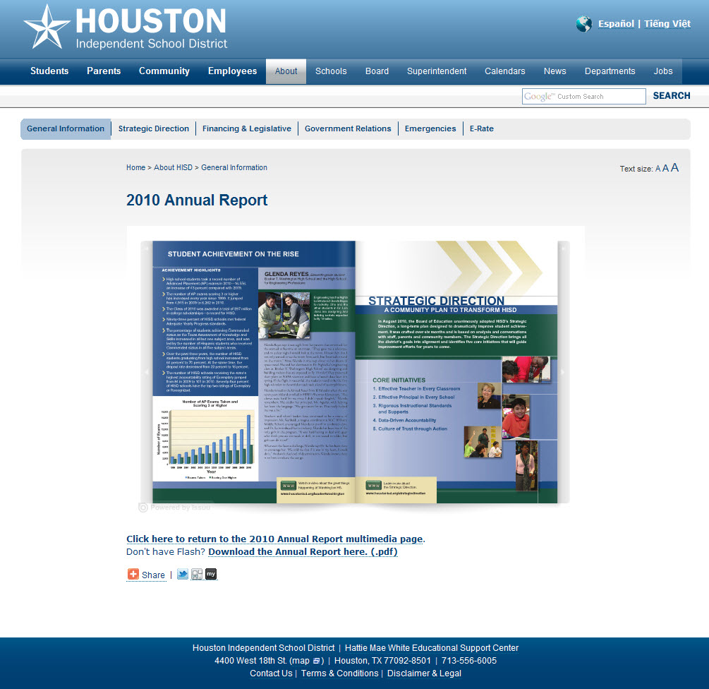
ADMINISTRATIVE SERVICES WEB/TRANSLATION/ KEY ACCOMPLISHMENTS CREATIVE SERVICES

Slide 37
ADMINISTRATIVE SERVICES WEB/TRANSLATION/ KEY ACCOMPLISHMENTS CREATIVE SERVICES

Slide 38
ADMINISTRATIVE SERVICES WEB/TRANSLATION/ KEY PERFORMANCE INDICATORS CREATIVE SERVICES
From April 2010 through March 2011, the HISD public website experienced 79.1 million page views and 3.0 million unique visitors, an increase of 300,000 unique visitors compared with the previous year (11 percent increase)
Number of Twitter followers has grown from 949 in January 2011 to 1,649 in May 2011, an increase of 74 percent
Number of eNews community subscribers increased from 16,556 in April 2010 to 24,876 in March 2011, an increase of 50 percent
Provided 354 hours of interpretation services from April 2010 through March 2011
Fulfilled 1,558 requests for translations(26 percent from schools) from April 2010 through March 2011

Slide 39
HISD TV MAJOR FUNCTIONS
Produces informational, instructional, and professional development programs that are disseminated to staff, parents, students, and the community though the HISD TV channel, the web, email, and DVDs, as well as Univision and Channel 8
Provides TV/web coverage of board meetings and key community engagement events
Provides audio/visual and technical support for schools and the central office, including press conferences and events
Fulfills requests from schools and offices for loan of A/V equipment

Slide 40
HISD TV MAY 2011 ORGANIZATION
8 Prof Staff (Pay grade 25 and above)
4 Admin (Pay grade 24 and below)
Executive Producer
Senior Producer/Director
Producer/ Director (3)
Senior Manager HISD TV
Multimedia Manager
Senior Network Systems Engineer

Slide 41
HISD TV BUDGET
Current Annual Budget—$.81 M
Payroll—$.71 M
Operational Cost—$.10 M
Current Budget
$55,000
$2,000
$41,900
Funding Source
General Fund—$.81 M
$709,380

Slide 42
HISD TV KEY ACCOMPLISHMENTS
Began implementing plan to upgrade TV facility by replacing obsolete equipment and migrating to digital and HD environment. Current facility lacks file-based workflow, electronic archiving, graphic capabilities, modern studio cameras, and state-of-the-art master control
Launched HISD TV News as weekly 5-minute program that airs on the HISD cable channel, is streamed on the web, and is incorporated in the employee and community eNews
Launched Spanish version of HISD TV News
Revamped program schedule for the HISD TV channel; dated programs have been phased out and replaced with more local programming
Produced live, call-in TV shows on Strategic Direction, budget crisis, and EVAAS
Produced videos following Board meetings highlighting actions taken
Videotaped key messages for Effective Teachers initiative

Slide 43
HISD TV KEY ACCOMPLISHMENTS
Produced series of WOW (Within Our Walls) videos highlighting outstanding schools and programs. Used by principals with staff to highlight best practices
Launched “Behind the Scenes” videos that show how the work of central office departments supports schools and the district
Began weekly, live production of Math-A-LeticsTV program featuring questions from students via email and telephone. Program is aired live on the HISD TV channel and website
Awards
2011 Bronze Telly Award
2010 Texas School Public Relations Association Awards
7 Gold, 2 Silver, Best of Show
2010 Texas Lonestar Emmy nomination

Slide 44
HISD TV KEY PERFORMANCE INDICATORS
449 videos produced (July 2010–April 2011)
369 informational (includes 61 in Spanish and 4 in Vietnamese)
58 instructional
22 professional development
21 live Math-A-Letics shows produced (Sept. 2010–April 2011)
212 math question (K–5) answered from students in 53 HISD schools
104 equipment loan requests (Dec. 2010–April 2011)
228 A/V support service calls in HMWESC (Dec. 2010–April 2011)
30 A/V support visits to schools (Dec. 2010–April 2011)

Slide 45
MEDIA RELATIONS MAJOR FUNCTIONS
Pitches stories to local, state, and national news media to highlight HISD progress and achievements
Provides information to news media in response to inquiries
Provides assistance, guidance, and training to principals and central office staff that supports their communications efforts with internal and external audiences
Produces video segments for Univision and Channel 8
Coordinates crisis communications
Maintains district’s Spanish Twitter and Media Relations Twitter accounts

Slide 46
MEDIA RELATIONS ORGANIZATION AND BUDGET
Current Annual Budget—$.25 M
Payroll—$.24 M
Operational Cost—$.01 M
Senior Media Relations Manager
Senior Media Relations Specialist (2)
$8,821
$237,898
Funding Source
General Fund—$.25 M

Slide 47
MEDIA RELATIONS KEY ACCOMPLISHMENTS
Established media tracking protocol to gauge percentage of positive, negative, and neutral stories
Executed partnership and strengthened relationships with African American and Spanish media outlets
KCOH radio show (live call-in)
Weekly article in African American News andIssues
Univision KLAT radio show (live call-in)
Weekly video story for Univision TV
Conducted superintendent’s press conference with student journalists; first conference held April 2011 with students representing 19 high schools
Launched Mythbusters feature to clarify misinformation
Launched Spanish Twitter feed
Partnered with Fox 26 to air “Ask the Superintendent” segment

Slide 48
MEDIA RELATIONS KEY PERFORMANCE INDICATORS
Nearly tripled the average number of press releases per month
2009–2010 school year: 128 (average 11 per month)
2010–2011 to date: 257 (average 32 per month)
Increased number of press events—conferences, roundtables, editorial board meetings
2009–2010 school year: 18
2010–2011 to date: 19
Responded to average of 50 media requests per week
Established media tracking protocol
2,645 stories reported in media (2010–2011 school year to date)
64.5 percent positive
29 percent neutral
6.5 percent negative
Responded to average of 44 requests per month from principals, SIOs, and CSOs, for support with media issues, Connect-ED scripts, and other communications needs

Slide 49
STRATEGIC PARTNERSHIPS MAJOR FUNCTIONS
Community Engagement
Identifies, develops, and engages community, corporate, nonprofit, higher education, and other partnerships to support schools, students, and their families. First point of contact for external partnerships. Vets 20–25 partnerships per month
Provides training to schools on how to identify, develop, and sustain business partnerships
Coordinates district’s faith-based partnerships
Manages Asian Advisory Committee; Hispanic Advisory Committee and African American Advisory Committee to hold inaugural meetings in June 2011
Coordinates Community Conversations meetings
Coordinates Asian Career Day and Asian Lunar New Year celebration; hosts Vietnamese radio talk shows and produces Vietnamese television programs

Slide 50
STRATEGIC PARTNERSHIPS MAJOR FUNCTIONS
Information Center
Provides Connect-ED trainings, maintenance, and support for schools; sends districtwide Connect-ED messages
Provides main switchboard services
Staffs HMWESC main desk and directs visitors
Coordinates tours and programs for group visits
Acts as liaison for K-12 Radio Houston partnership
Special events
Plans and executes districtwide special events to engage community and campuses; average attendance ranges from 50 to 2,000 guests
Manages district’s annual Combined Charities Campaign

Slide 51
STRATEGIC PARTNERSHIPS MAY 2011 ORGANIZATION
Strategic Partnerships General Manager
Information Center
Manager
Community Relations Liaison
Community
Engagement
Senior Manager
Special Events
Planner
Community Liaison (3)
8 Prof Staff
11 Admin

Slide 52
STRATEGIC PARTNERSHIPS BUDGET
Current Annual Budget—$1.2 M
Payroll—$1.04 M
Operational Cost—$.16 M
Current Budget
$62,593
$27,943
$71,124
Funding Source
General Fund—$1.2 M
$1,042,561

Slide 53
STRATEGIC PARTNERSHIPS KEY ACCOMPLISHMENTS
Launched Community Conversations meetings
Developed webinar for school principals on recruiting and retaining business and community partners
Provided training to schools on developing business partnerships
Launched partnership newsletter, Making the Connection
Organized six Student Roundtable meetings with Board of Education president
Developed and facilitated partnership with NCAA Final Four
Added online pilot version to biannual community survey for first time this year
Established partnership with City of Houston to provide Back-to-School Fest
Launched Community Connections program on HISD TV and web that highlights outstanding partnerships

Slide 54
STRATEGIC PARTNERSHIPS KEY ACCOMPLISHMENTS
Awards
Texas Association of Partners in Education
Capital One Bank Principal for a Day—Partnership Program Award, Innovation
Partnership Appreciation Breakfast —Special Event
TJX Companies/Youth Business Institute—Business Partnership Award, Career Education
Houston Livestock Rodeo—Community Partnership Award, Art
Jim Wilson—Individual Partnership Award, Wisdom
Alliance for Multicultural Community Services—Partnership Program Award, Mentor
Soccer for Success—Community Partnership Award, Health

Slide 55
STRATEGIC PARTNERSHIPS EXAMPLES OF DISTRICTWIDE PARTNERSHIPS AND THEIR IMPACT
Partner | Description | # Schools | Approximate# Students Impacted
Elves & More | Incentive program that provides bicycles to students for academic improvement, regular attendance, and good behavior | 18 | 7,000
Luby’s | Character education and attendance incentive programs | 42 | 33,000
KBR | Science teacher training and awards program | 17 | 22,000
NCAA | Academic and athletic programs for middle school students associated with Final Four | 53 | 6,000
Chevron | New Century Energy online game that teaches STEM-based content to students in grades 8–10 | 20 | 2,300
Shell | Eco Marathon competition that challenges high school students to create fuel-efficient vehicles | 10 | 300
Prepared 4 Life | Lemonade Day entrepreneurship event | 69 | 15,000
Capital One Bank | Principal for a Day program that points to the critical need for partnerships between local businesses and district schools | 282 | 190,000
NASA | Exploration Academy earth and space science course for 8th graders | 7 | 490

Slide 56
STRATEGIC PARTNERSHIPS KEY PERFORMANCE INDICATORS
Facilitated 19 Community Conversations (7 budget/legislative; 12 Magnet review) attended by more than 2,800 parents, staff, students, and community members
Increased number of schools participating in Principal for a Day to 282, a jump of 66 percent compared with the previous year
Increased number of students participating in Houston Real Men Read program in 2011 to 7,342, a 45 percent increase compared with 2009. Number of schools participating increased 34 percent to 47, and number of mentors increased 46 percent, to 308
HMWESC front desk representatives served 139,383 guests in 2010. Each representative serves an average of 27 guests/hour
Responded to record number of calls—149,751—to main switchboard in 2010. Each representative answers approximately 20 calls/hour

Slide 57
STRATEGIC PARTNERSHIPS KEY PERFORMANCE INDICATORS
Hosted and arranged programs for 17 visiting groups in 2010, with some programs lasting up to two weeks and participants visiting multiple schools per day
Planned and coordinated 100 special events in 2010
Coordinated State of the Schools event, which raised $164,976 benefiting the HISD Foundation, an increase of $64,976 compared with last year
Raised $494,795 in 2011 Combined Charities Campaign; 334 HISD schools and departments participated

Slide 58
OFFICE OF COMMUNICATIONS KEY GOVERNING POLICIES
GBBA School Communications Program: News Media Relations
CPAB Office Communications: Mail and Delivery
CPC Office Management: Records Management
GK Community Relations
AE Educational Philosophy

