Slide 4
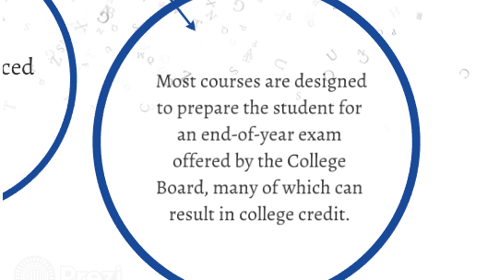

Slide 6
For more information on
Advanced Placement
Please contact Mrs. D. Morales
At despinal@houstonisd.or

