Slide 1
Organization & Study Skills For Middle Schoolers
The Parent Power Workshop
La Dora Matthews
School Counselor
lmatthe8@houstonisd.org

Slide 2
WORKSHOP AGENDA
Part 1: Organization
Part 2: Study Skills
Part 3: Knowing Assignments & Grades
Part 4: Motivation
Part 5: Parent Resources
Part 6: Questions or Comments
But first…

Slide 3

Why Improve Your Child’s Organization & Study Skills?
Better Grades!
Less Stress!
More Free Time!
Positive Self-Esteem!

Slide 4
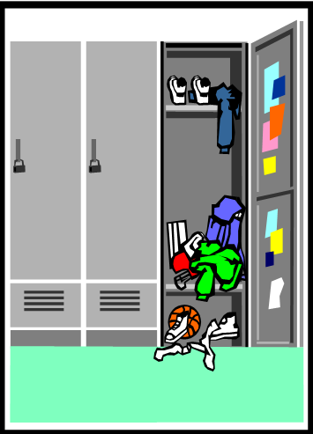

PART 1: ORGANIZATION

Slide 5
The Book Bag
Some students carry their bags from class to class. However, some carry everything with them everywhere, all the time! This may not be efficient for them.
*No loose papers! Loose papers should always be in the binder or folder, or kept at home.

Slide 6
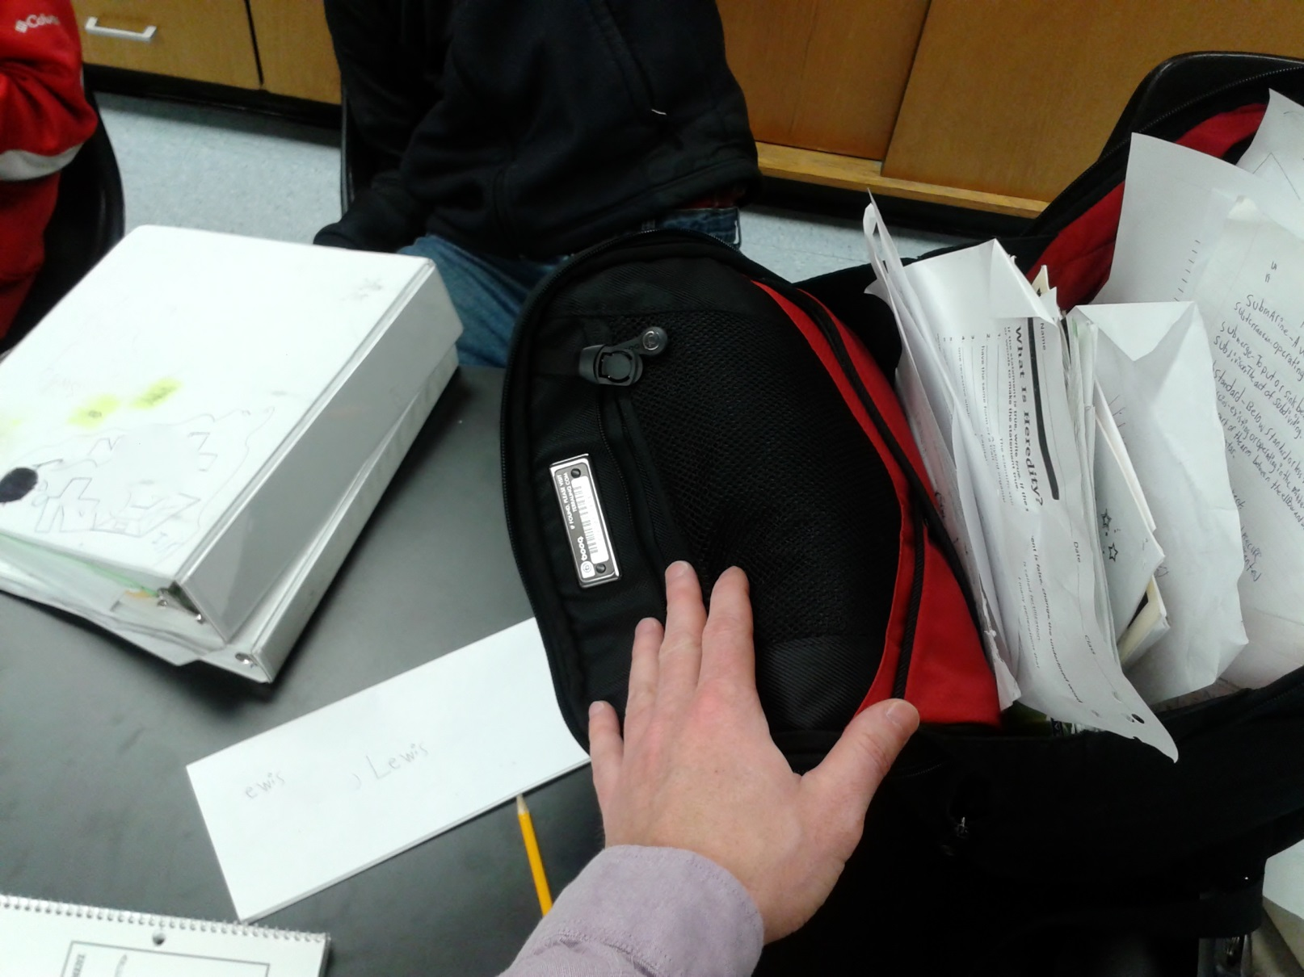
Yikes!

Slide 7
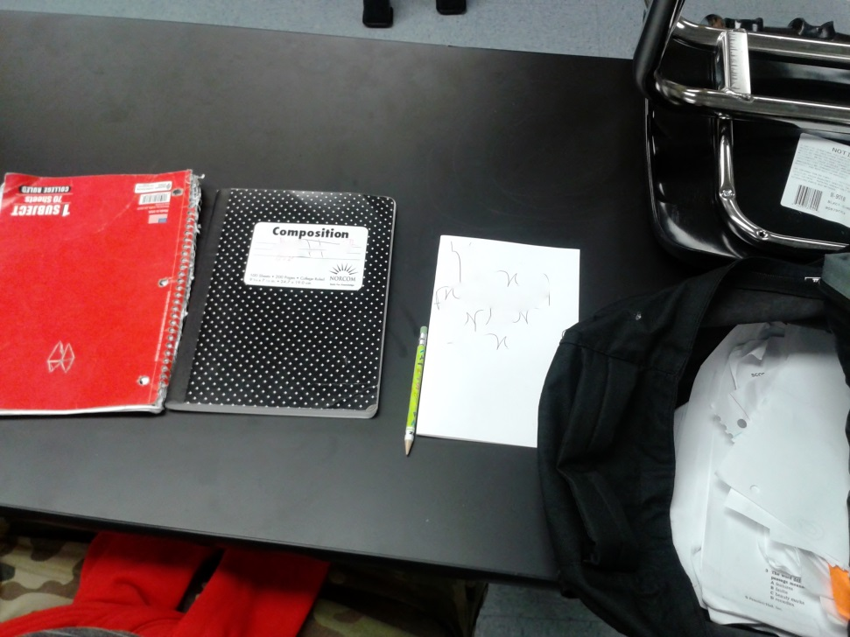
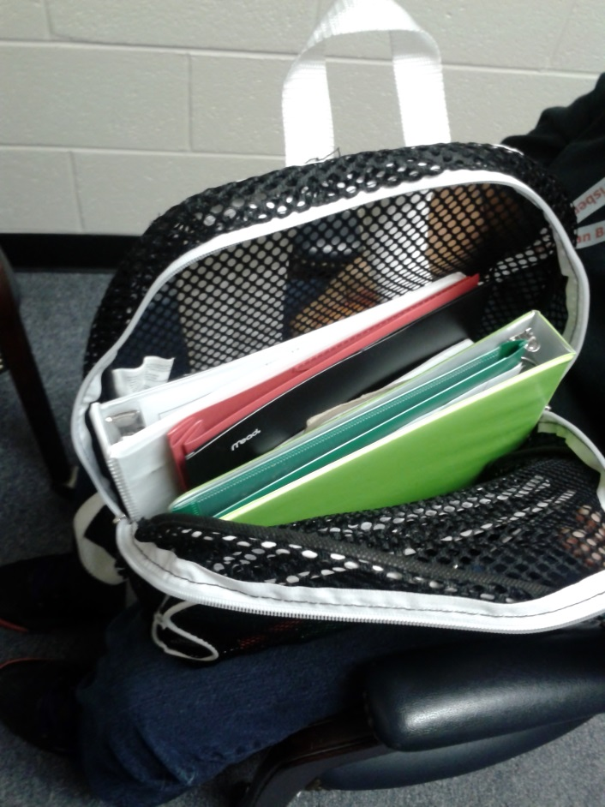
BEFORE & AFTER
YIKES!
AHHH!

Slide 8
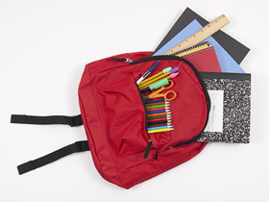
Organized Backpack

Slide 9
The Students Locker
Some students may only use for storage.
Buy or make a shelving system.
Draw a “locker map” and keep it inside the locker door. In case things get messy, refer back to the map to re-organize.
Use magnets to hang up notes/reminders or photos.
*No loose papers!!!!!!!!!

Slide 10
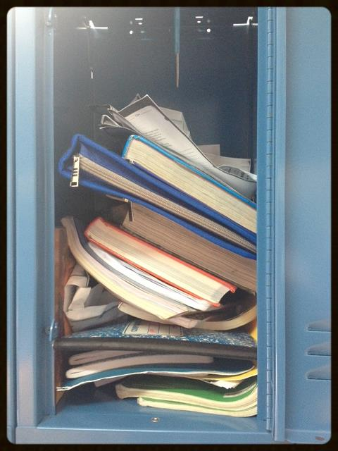
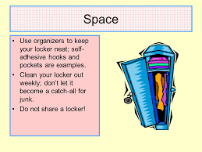
Disorganized Locker

Slide 11
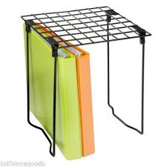
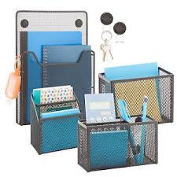
Locker Organization Accessories

Slide 12
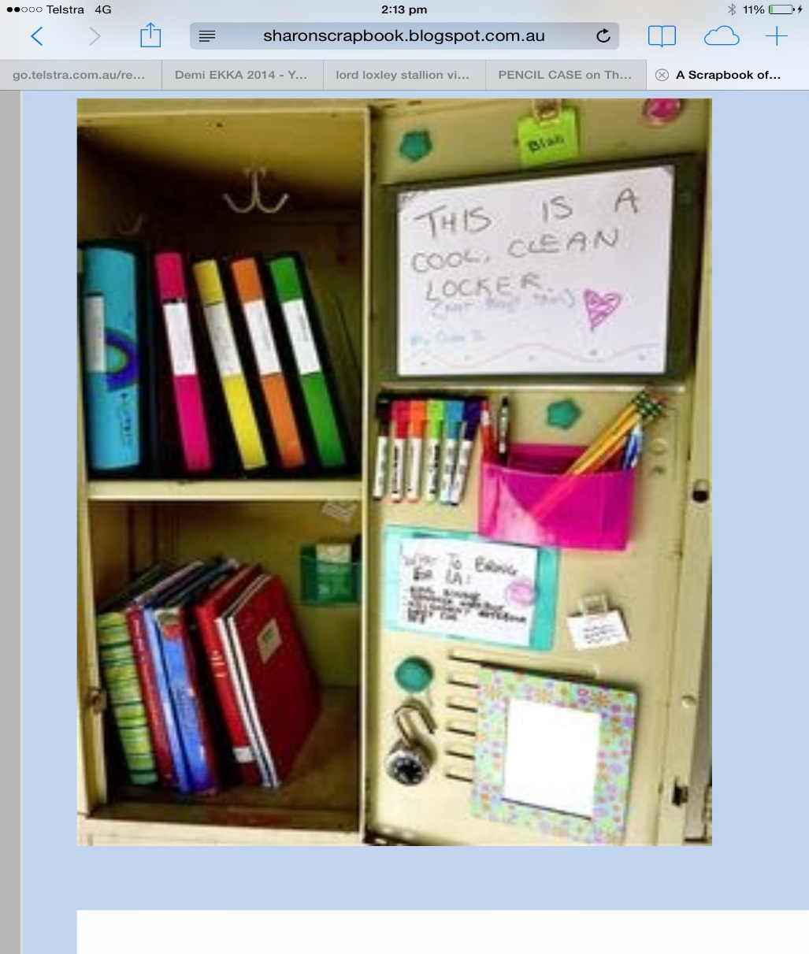
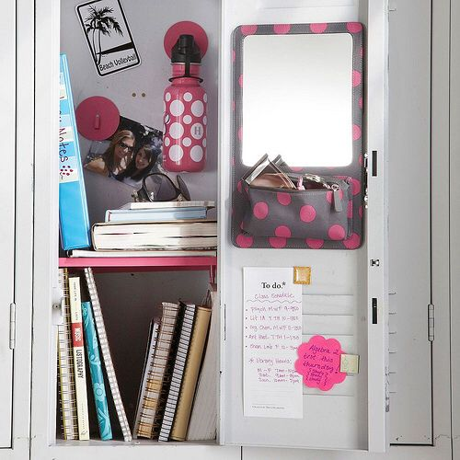
Organized Locker Examples

Slide 13
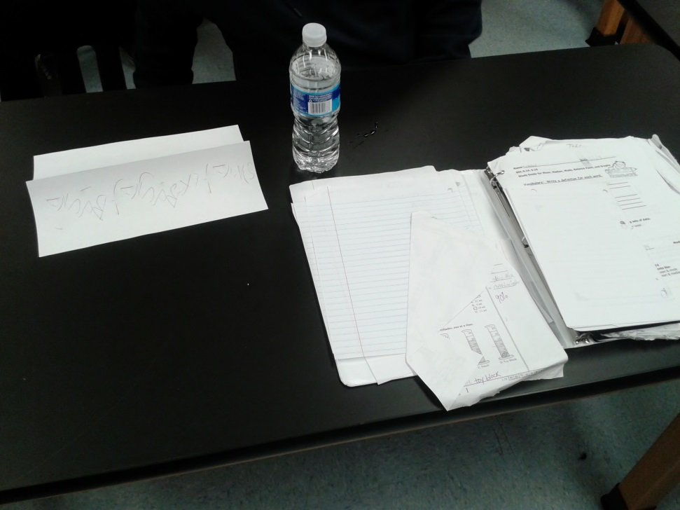
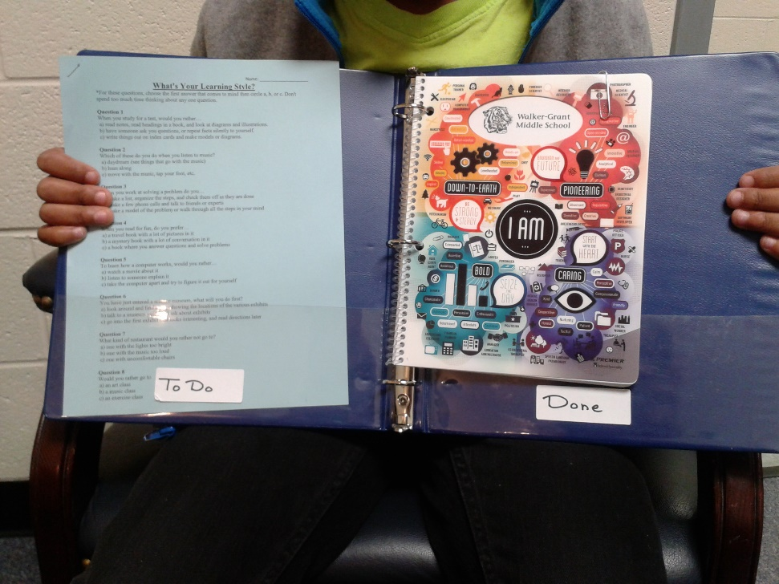
The Homework Binder
Yikes!
Aaah!

Slide 14
The Agenda
Teaches Time Management!
Helps with setting goals.
Tracks immediate deadlines and long-term ones.
Can use for personal events and info.
Calculate time needed to complete work.
Block out study time in your schedule.

Slide 15
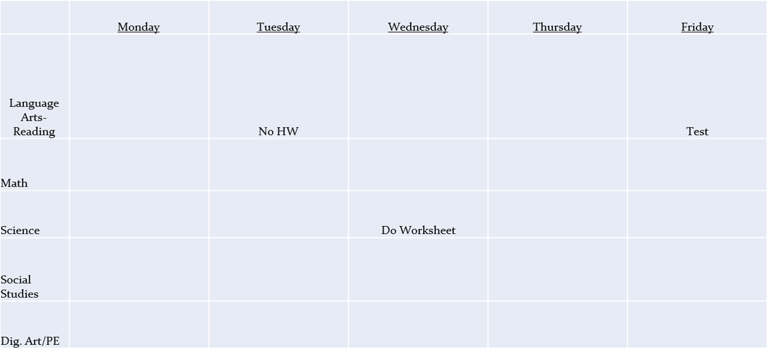
A Typical Middle-Schooler Agenda

Slide 16
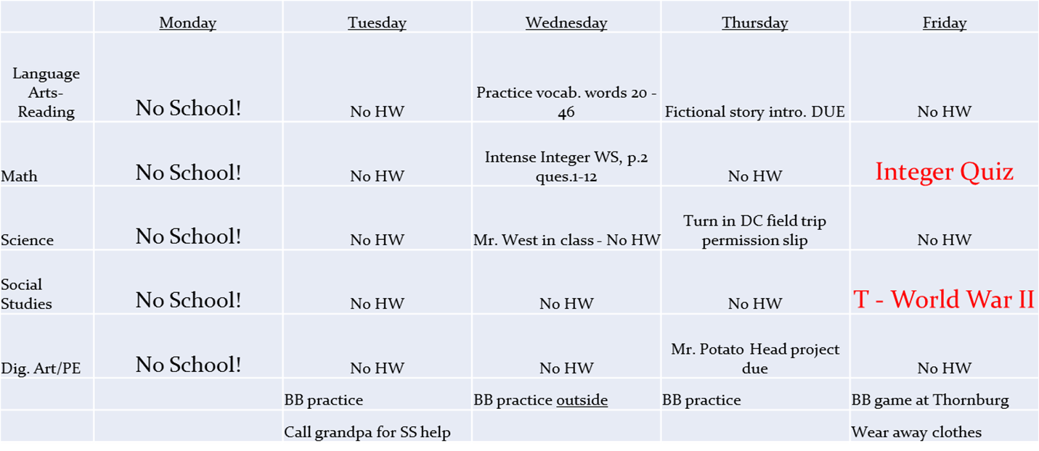
A New and Improved Agenda!

Slide 17
The Organized Home Study Space
Paper Management for older school papers
  Accordion folders, hanging folders, pocket cases, bins or binders
Container for writing utensils & other tools
Flash cards w/ rubber bands, ziploc bags or card boxes
Desk, table or other hard surface
Good lighting
Mellow music (works for some, but not all)
Away from distractions:
No TV. No cellphone. No computer.

Slide 18
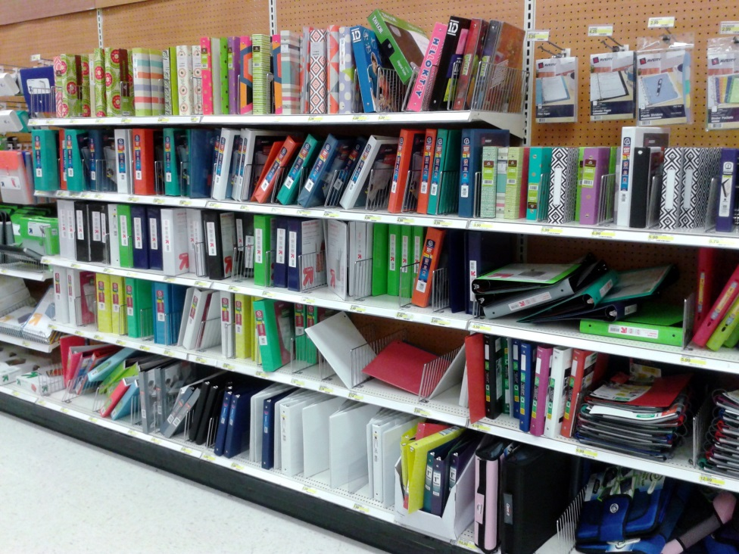
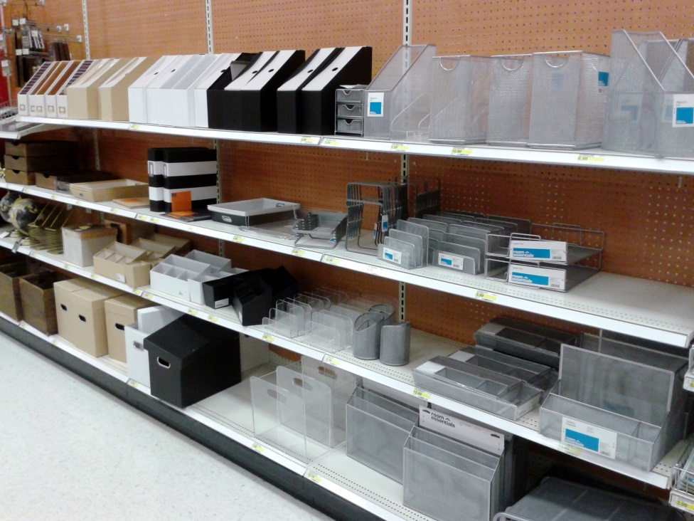
Examples…

Slide 19
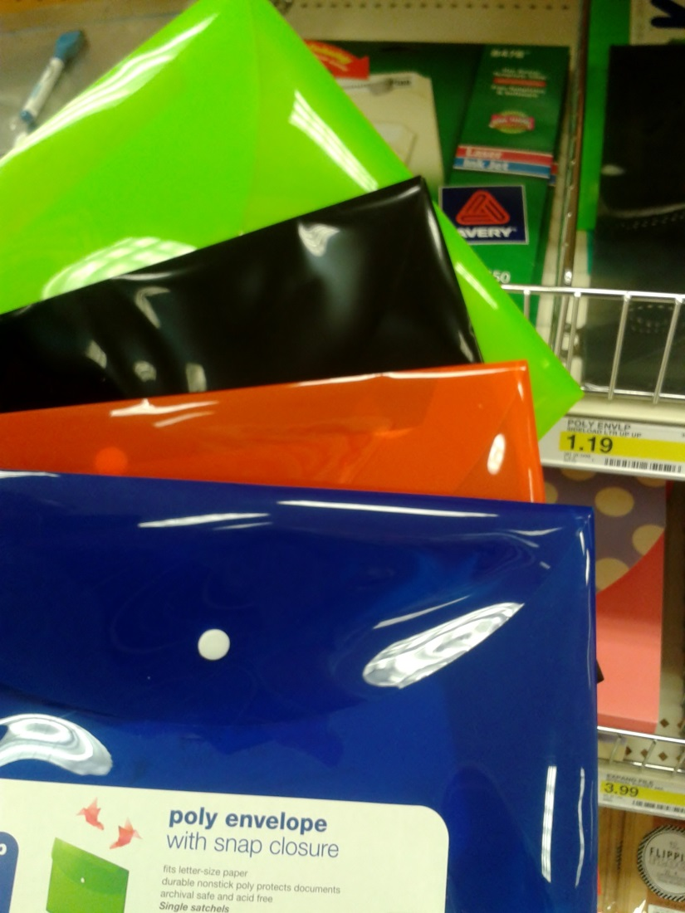
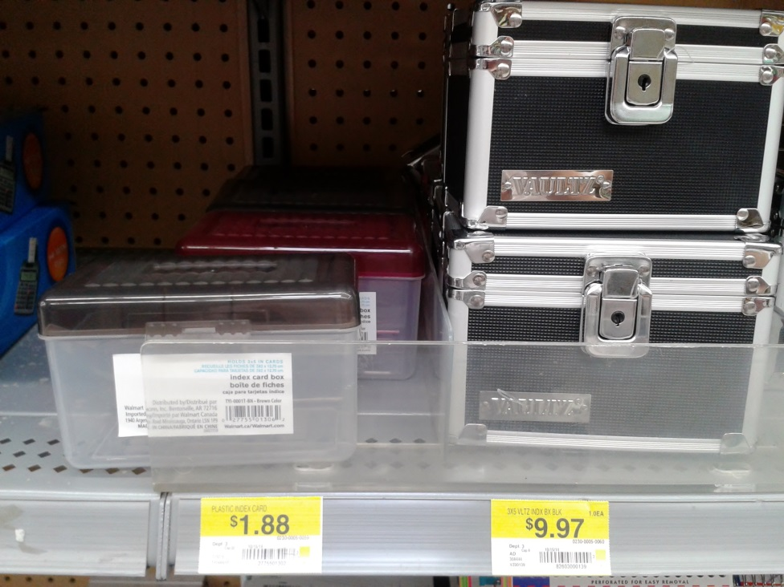
More Examples…

Slide 20
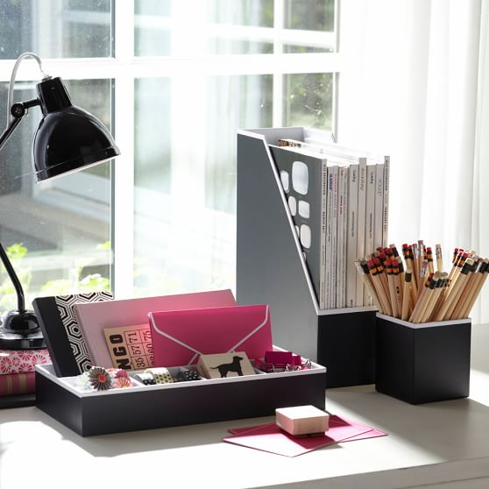

Slide 21
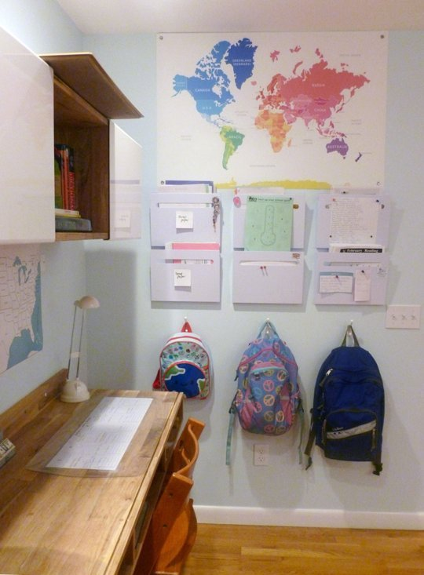

Slide 22
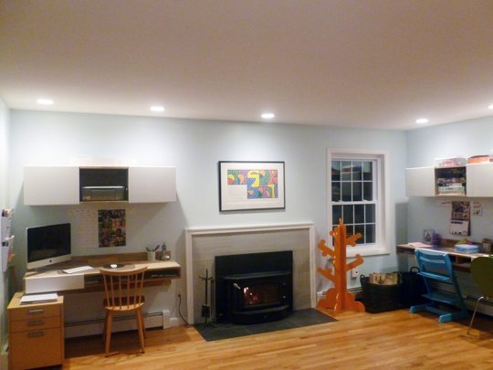

Slide 23
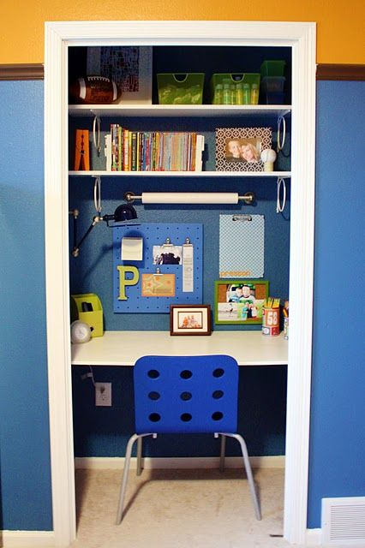
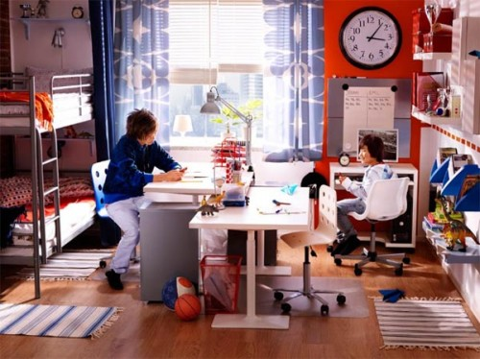

Slide 24
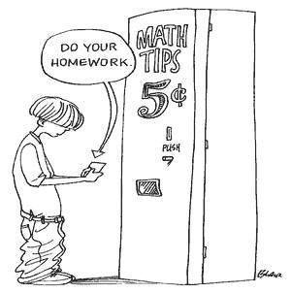


HOMEWORK
It’s homework time!
vs.
Do your homework first!

Slide 25
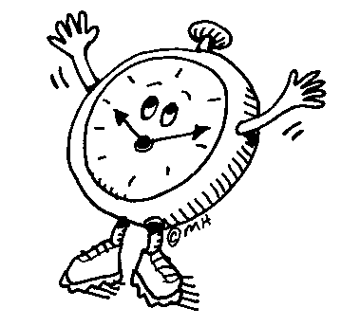
Set Aside Time Daily
It is best to do homework at the same time every day.
Do it as soon as you get home or after an hour of relaxation.
Studies show that doing homework before dinnertime will yield the best results.
Waiting until 7 P.M. is not an effective strategy.

Slide 26
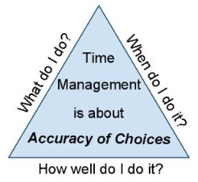
TIME MANAGEMENT
Effective time management:
Is an essential life skill
Can decrease stress and increase confidence
Is proven to be more useful for test-taking than cramming at the last minute

Slide 27


PART 2: STUDY SKILLS

Slide 28
Studying Should Be a Nightly Routine
Setting aside five to ten minutes a night to review vocabulary words or key chapter points will allow your student to digest and retain information better than trying to absorb an avalanche of knowledge all at the last minute.
Try to make study time a period of quiet time each night when the T.V. is turned off and everyone takes out a book or a newspaper to read for fifteen minutes or so.
By demonstrating to your child that quiet time for concentration is part of a daily routine, you will help to develop better study skills and concentration that will be needed for college and high school.

Slide 29
LEARNING STYLES
Different styles of learning require different styles of studying.
Visual Learners – Learn best by seeing
Auditory Learners – Learn best hearing
Kinesthetic Learners – Learn best by doing
Have your child take a Learning Style Quiz to find out what type of learner he/she is. These can be found online and vary in length. Next, have him/her study in ways which cater to that style.

Slide 30
Common Methods of Studying…
Read & Re-read - Most common, not always most effective. VISUAL
Read & Re-read out loud – VISUAL & AUDITORY
Teach someone else – VISUAL & AUDITORY & KINESTHETIC
Study Buddies - VISUAL, AUDITORY & KINESTHETIC
-Use flash cards, play charades or play Pictionary
-May not be most efficient if not focused

Slide 31
FLASHCARDS!
Hit all 3 Learning Styles!
Great for vocab., definitions, math equations/examples
Used solo or with study buddies
Many different games can be played
Can make your own or use some websites.
Most kids don’t use them!
  WHY: “I don’t have any.”
  “I have to make them before I can study.”
  “They’re messy.”

Slide 32
Part 3: Knowing Assignments & Grades
1. Use the teacher /school websites to find out what your child is learning.
2. Use your child’s agenda to see what assignments are given.
3. Use Parent Portal to see the results of those assignments. (Passwords obtained at main office).
*Great Idea: Give your child his/her Parent Portal password so he/she can track personal progress.

Slide 33
Part 4: Motivation
The Speech
Goal Setting
Incentives & Consequences
Role Model
Hold Accountable
Praise

Slide 34
The Speech
1:1 talk without interruptions
Be positive
Acknowledge it won’t be easy, but you are there to help – NOT to do it for them!
Goal-Setting
Must be important personally
Must be within his/her power to make it happen
Must be something reasonably achievable
Must be clearly defined w/ specific plan of action

Slide 35
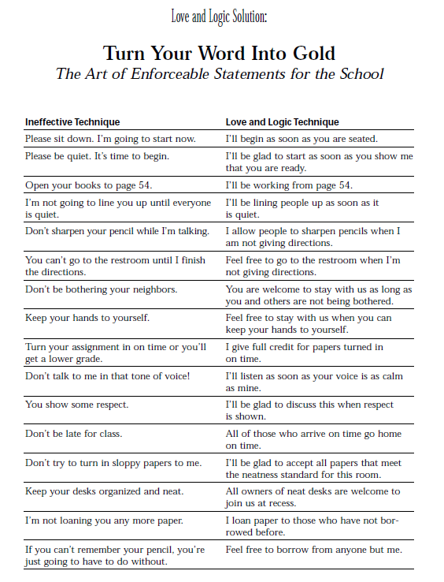
Incentives & Consequences
Bribery doesn’t usually work.
Use Parent Portal and/or contact teachers for reinforcement.
Middle Schoolers are super-social! Loss of time or increased time being with or communicating with friends is usually pretty impactful.

Slide 36
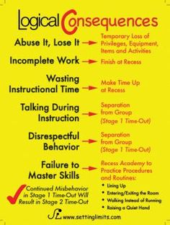
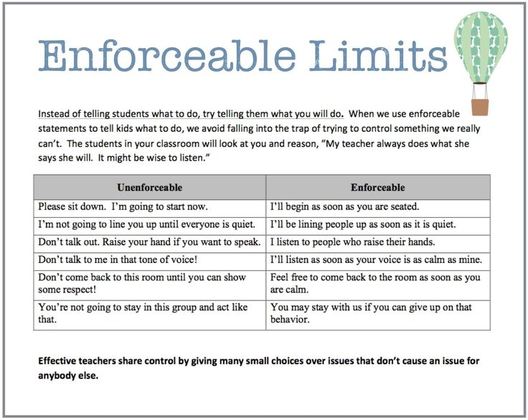

Slide 37

Parents Must Role Model
Pay the bills
Clean & Organize!
Read regularly
Do your own homework
Do some chores
Fill in your own agenda or calendar
When you’re both done, talk about what you’ve accomplished.

Slide 38
Hold Accountable
Consistency = your goal!
It may get worse before it gets better.
Ask family/friends for support.
Remember, you are teaching perseverance, too!

Slide 39
Praise the Effort
Remember, changing habits takes time and dedication on your child’s part and yours; it’s not an event, it’s a process.
Check in regularly, but try not to nag.
Seek and point out the small successes.
Praise the effort!

Slide 40

Rome wasn’t built in a day
These are long term tips to improve organization, homework completion, and study skills.
Begin by following the steps on a daily basis. After a few weeks you may start to pull back the reigns.

Slide 41
Part 5: Parent Resources
Utilize your child’s teachers
Call in family support
Use internet/library (Use reputable sources)
Refer to handout

