Slide 1
My country

Slide 2
Get a blank paper sheet

Slide 3
This country is known:
as the “Cradle of Civilization”
Sumerians (4,000 years B.C.)
Assyrians
Babylonians
Mesopotamians
Persians
Macedonians
Romans
Ottoman Empire
British Empire

Slide 4
In this country :
scientist have found evidence of:
earliest writing system
urban centers
Literature
Metallurgy
Science
Medicine
business

Slide 5
This country :
in its modern form it has experienced great turmoil for the last 50 years
fought bitter 8 year war against neighbor country
after that war, it invaded a neighbor country
was invaded twelve years later

Slide 6
Country Study Presentation Iraq
Prepared by LTC (Retired) José R. Delgado
Sharpstown High School
JROTC Senior Army Instructor
Notes:
On 22 January 2008, a new design for the flag was confirmed by Law 9 of 2008. In this current version, the three stars were removed, while the Takbir was retained in its 2004 form. The parliament intended that the new design last for one year, after which a final decision on the flag would be made. However, the flag law was reviewed in parliament on 30 April 2009.

Slide 7
Agenda
Geographical Location:
Location in the world
Time Zone
Size
Government
Type of government
Year established
Population
Life Expectancy
Population of entire country
Capital
Name
Population of the capital
Cultural:
Primary Religion
National Sport
Food
Questions
Summary

Slide 8
Geographical Location & Time Zone
Location:
Southwest corner of the Persian (Arabian) Gulf,
Bordering Turkey to the north, Syria to the North West, Jordan to the West, Saudi Arabia and Kuwait to the South and Iran to the East.
Standard time zone:
Universal Coordinated Time (UTC) +3 hours
- or 6 hours less than Houston CST

Slide 9
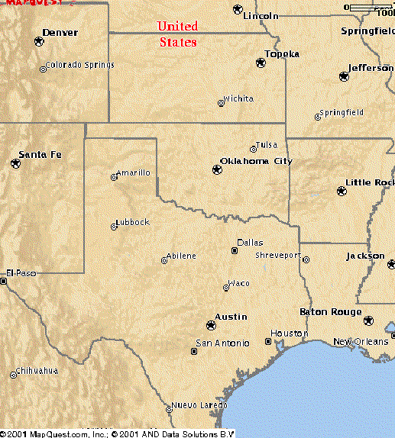
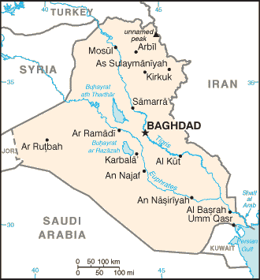
Iraq size comparison
437,072 km²
(168,754 sq mi)
Roughly smaller than Texas
58th Largest country in the world

Slide 10
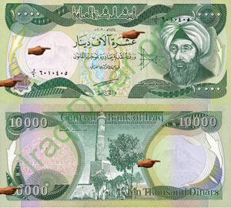
Population
Population: 31,234,000 (July 2009 est.) Arabs form 75%–80% of the population.
Minorities include a 15%–20% of Kurds
Turkoman, Assyrian, or other make up 5% of the population.
Life expectancy at birth: total population: 77.09 years (78.30)
male: 69.41 years (75.70)
female: 72.35 years (80.80)
2011 est.
Currency: Iraqi Dinar (IQD)
1,164 IQD = $1.00
* Represents population comparison with USA

Slide 11
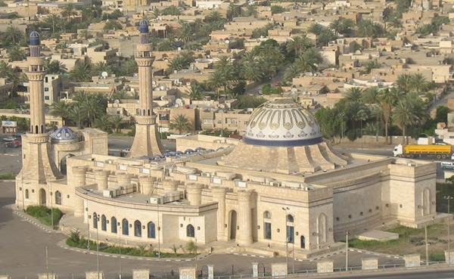
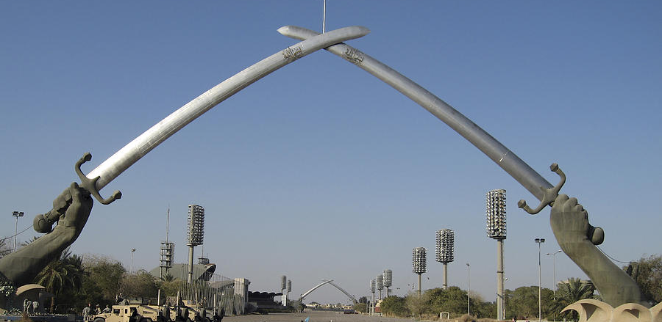
Capital – Baghdad
Name:
Baghdad
283.4 sq miles (734 km²)
½ size of Houston
Population:
City – 7,216,000
(Houston Metro 5,900,000)
Al Nida Mosque
Victory Arches

Slide 12
Type of Government
Federal parliamentary representative democratic republic. It is a multi-party system whereby the executive power is exercised by the Prime Minister of the Council of Ministers as the head of government, as well as the President of Iraq, and legislative power is vested in the Council of Representatives and the Federation Council.
The Prime Minister of Iraq
Haider Al-Abadi

Slide 13
Establishment
First Settlement – 4th Millennium B.C.
First known as Iraq – 11 November 1920
Independence from the United Kingdom - 19 June 1932

Slide 14
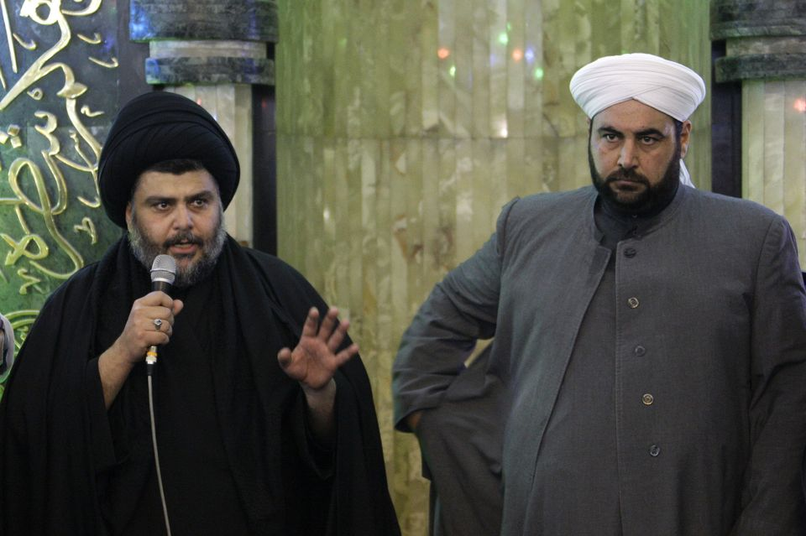
Cultural Characteristics Religion
Religions
95% Muslims
35% Sunni
65% Shiite
3% others
Christians
Shiite cleric Muqtada al-Sadr, left, address worshippers as a Sunni cleric Anas al-Issawi observes on

Slide 15
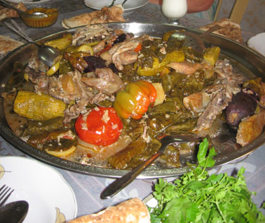
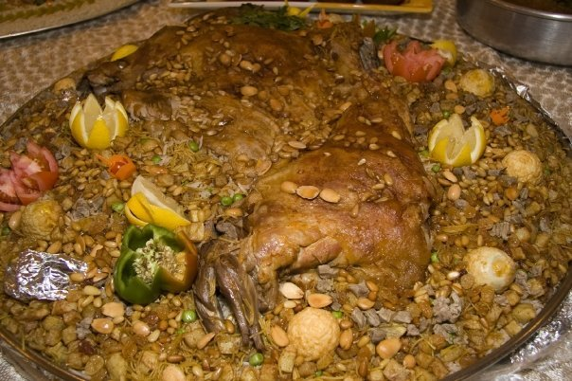
Cultural Characteristics Food
Qousi
Dolma

Slide 16
Cultural Characteristics Sports
Soccer
Lions of Mesopotamia

Slide 17
Summary
Country linked to vast historical events
Turmoil past
Great expectations for recovery

Slide 18
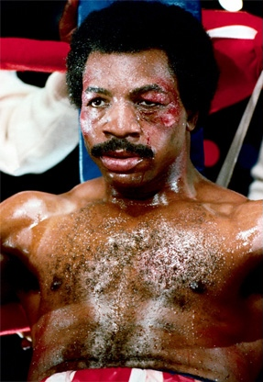
Quiz
Iraq or Not
Thumbs up
Thumbs Down

Slide 19
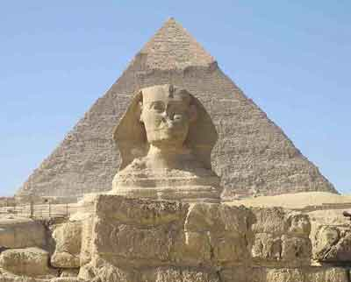
Iraq?

Slide 20
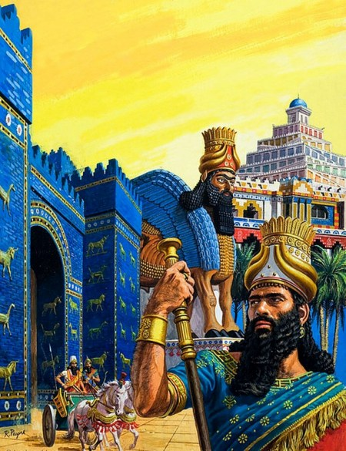
Iraq?

Slide 21
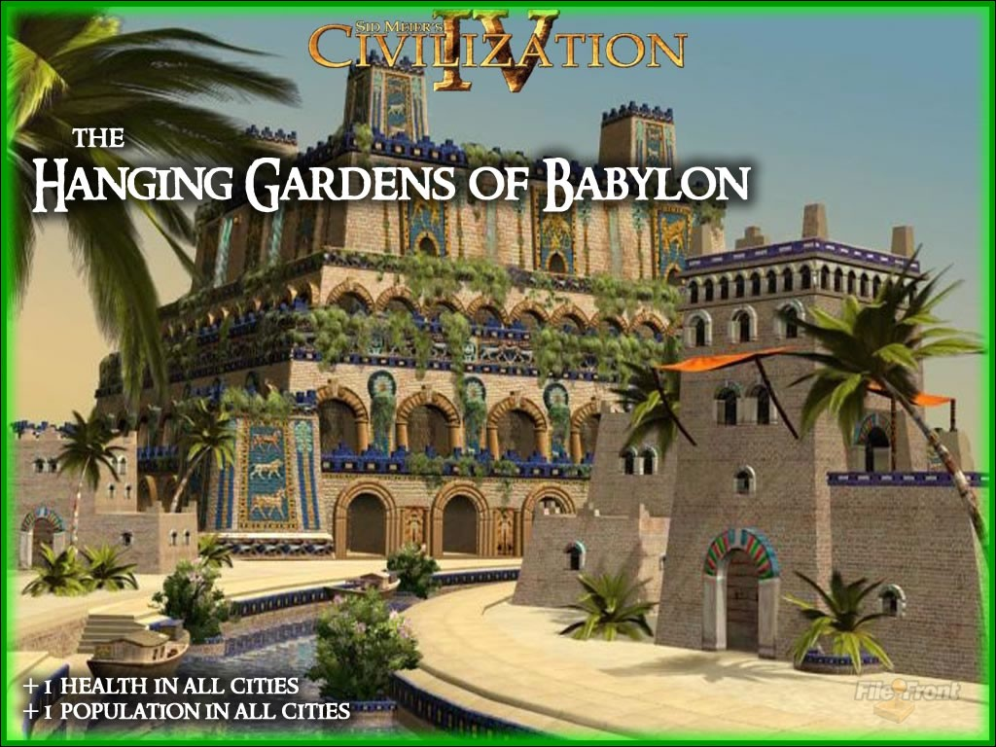
Iraq?
Notes:
Mesopotamia
Assyrians
Babylonians

Slide 22
Questions?

