Slide 1




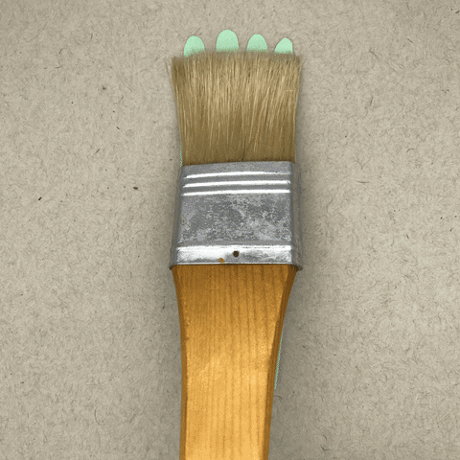
Welcome to Art

Slide 2
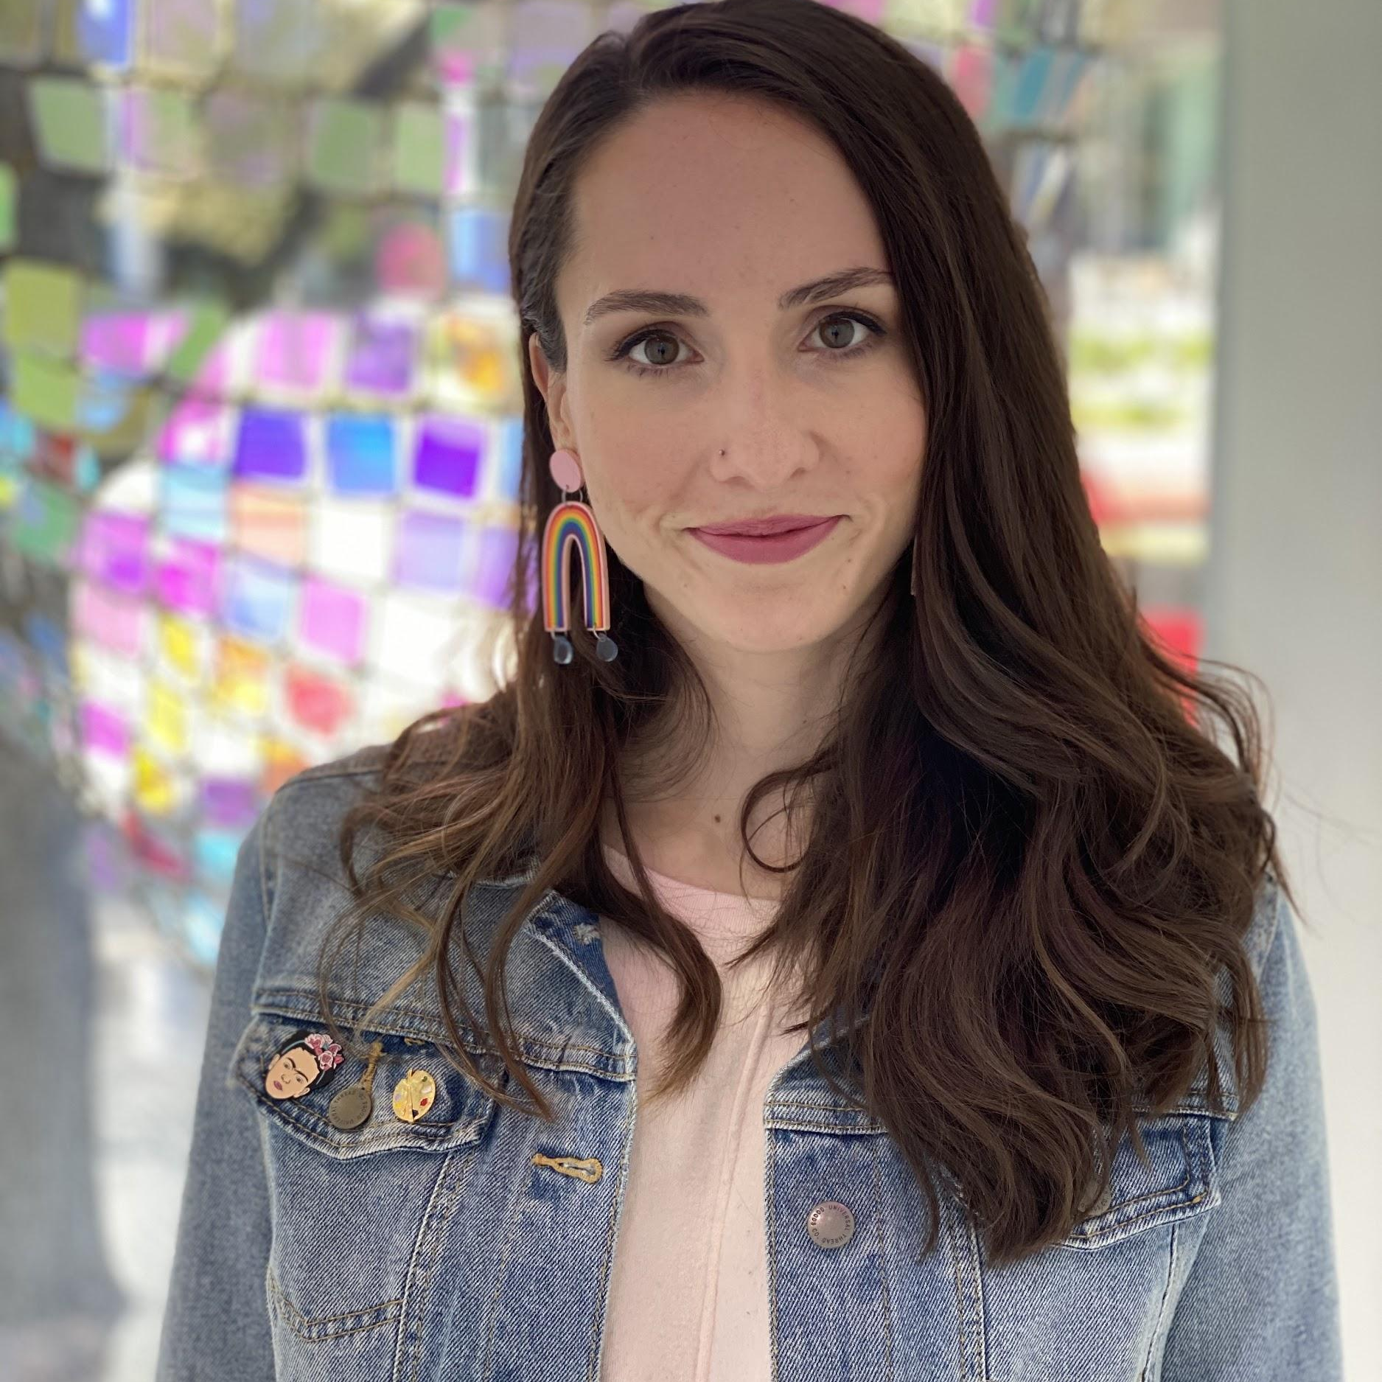




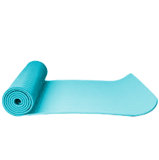


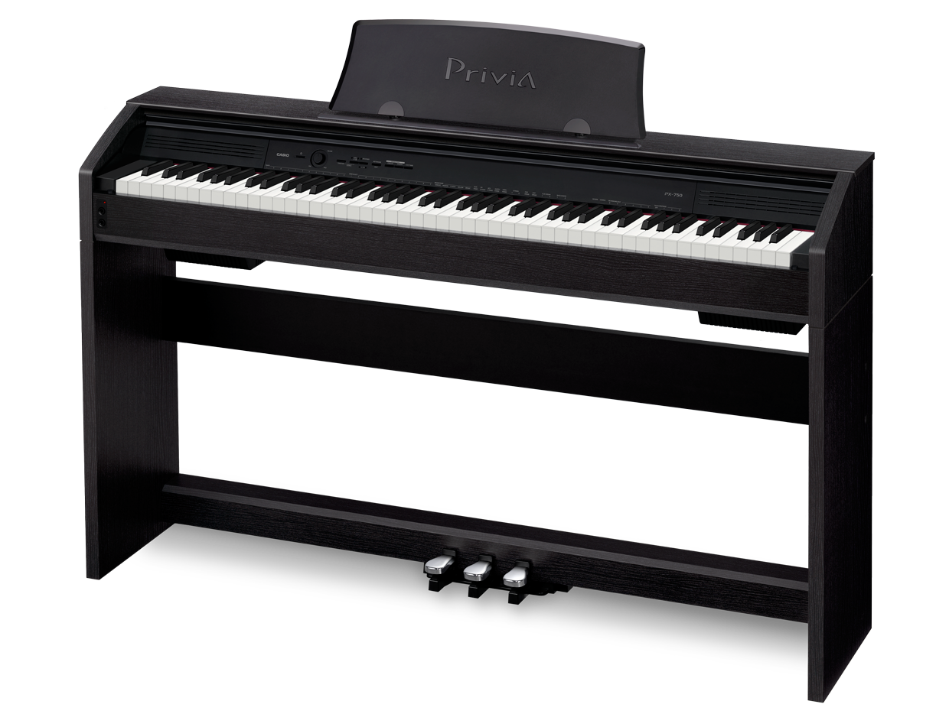

Your Art Teacher
My email is Jordan.Eggers@houstonisd.org
Things I Like:
This is my 8th year teaching art and my 3rd year at Rogers.

Slide 3
ART RULES!
Student Expectations
Arrive on time and be prepared.
Begin working on the Sketch of the Week when the bell rings.
Do your best on all assignments.
Respect (your teacher, peers, and classroom).
Be responsible with art supplies.
Clean up at the end of every class.
Consequences
Verbal Warning
Student/Teacher Conference
Behavior Reflection Form
Loss of privilege/seat change
Contact Parent
Parent Conference
Office Referral
The art room expectation level is high and I will expect focus, productivity, and quality work from each student.

Slide 4
REWARDS
If the whole class is able to meet the expectations for the day your class gets a star.
10 stars=Friday Fun Free Create Day
During Fun Free Create Day:
Free choice of supplies I set out
Class Playlist
2 spins on the Wheel of Whimsy
Based on Google’s 20 Time Project which allows employees to take 1 day a week to work on side projects or learn new skills

Slide 5
Weekly
Sketchbook Assignment
The whole page must be filled and colored (or shaded depending on the assignment)
You will be graded on:
Effort
Craftsmanship
Creativity
Class Participation

Slide 6
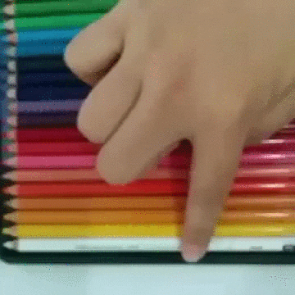
Art Supplies
Supplies:
These will be listed on your syllabus
Current Need: Empty Cereal boxes/thin cardboard for pinatas
1 mixed media sketchbook 9x12 with at least 60 pgs
2 Pencils (Wooden Ticonderoga #2)
2 White polymer erasers
1 Personal Pencil Sharpener
2 Sharpies (1 ultra fine and 1 fine tip)
Optional: Big shirt to protect your clothes, 1 Roll of Paper Towels
YOU are responsible for caring for and keeping up with individual supplies. Please have supplies no later than September 1st.

Slide 7
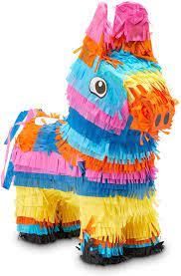
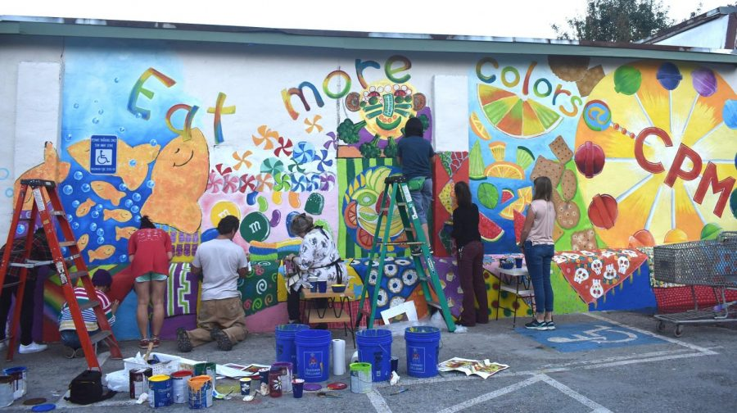
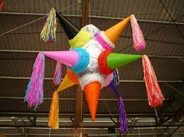
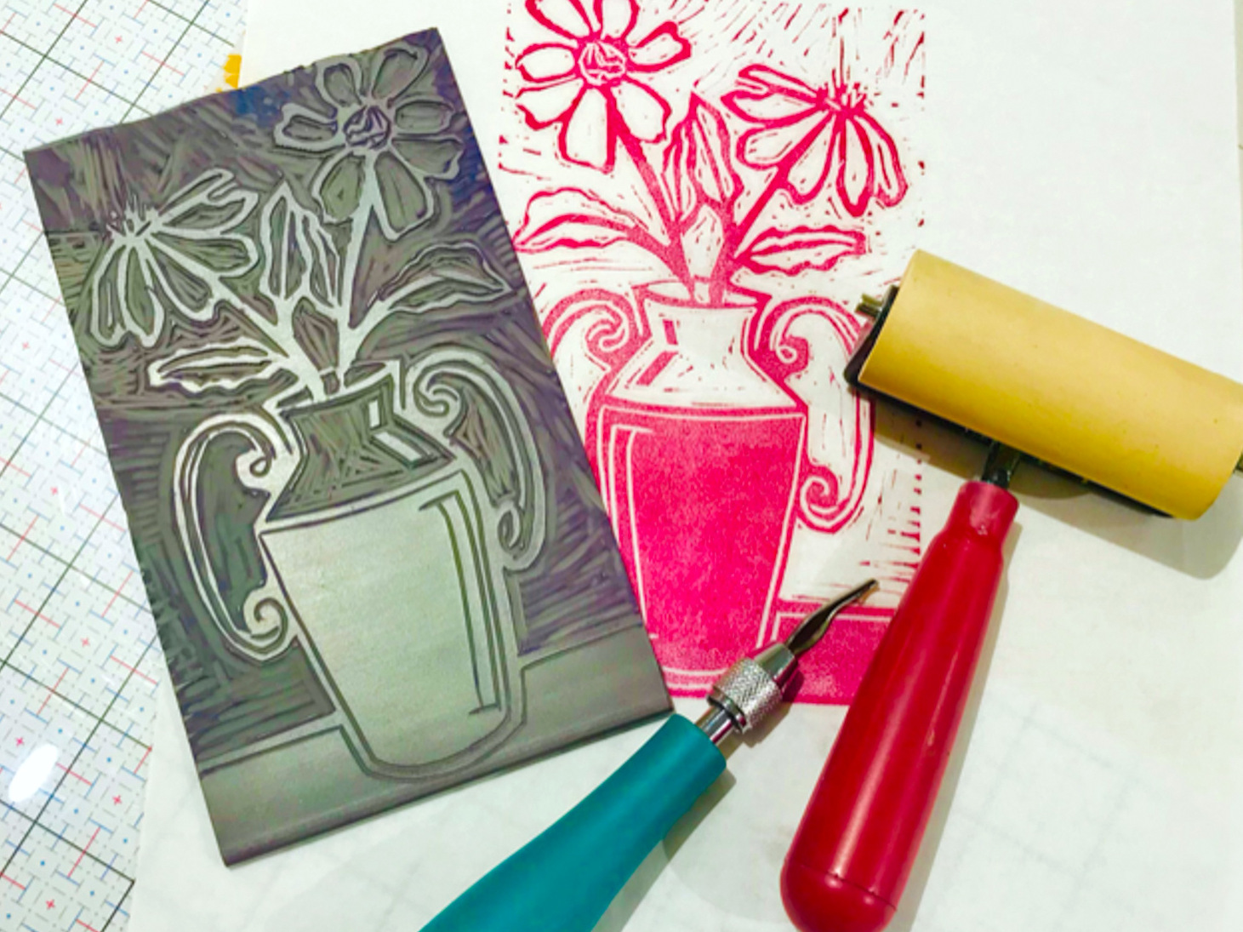
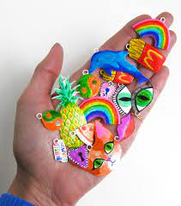
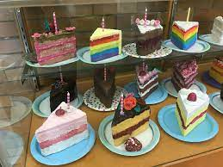
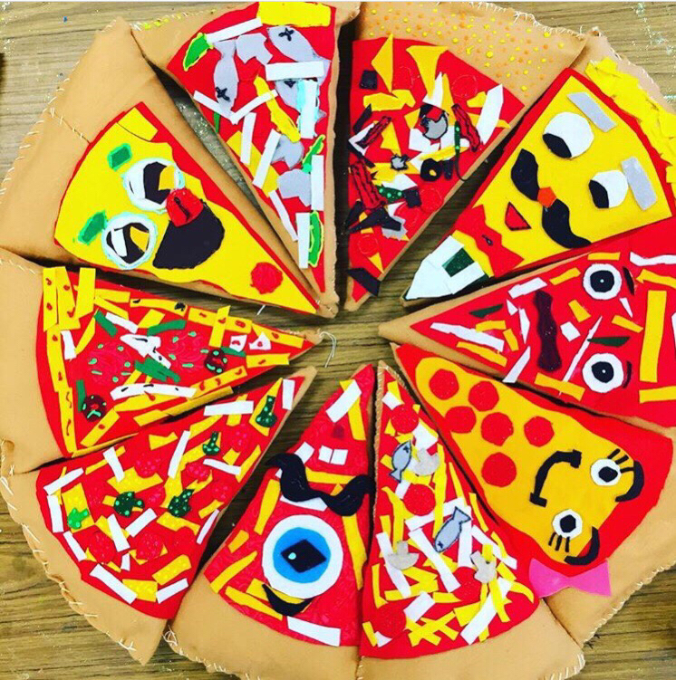
Fun Projects
We will cover 4 basic strands:
Art Journey: Historical and Cultural Art
Art Looking: Observation and Perception
Art Making: Creative Expression
Art Talk: Critical Evaluation and Response

Slide 8

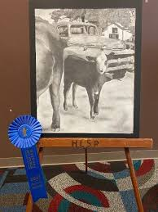

Art 1 (8th Grade Advanced)
Rodeo Art
HSPVA
workshops on 10/15 & 10/22

Slide 9
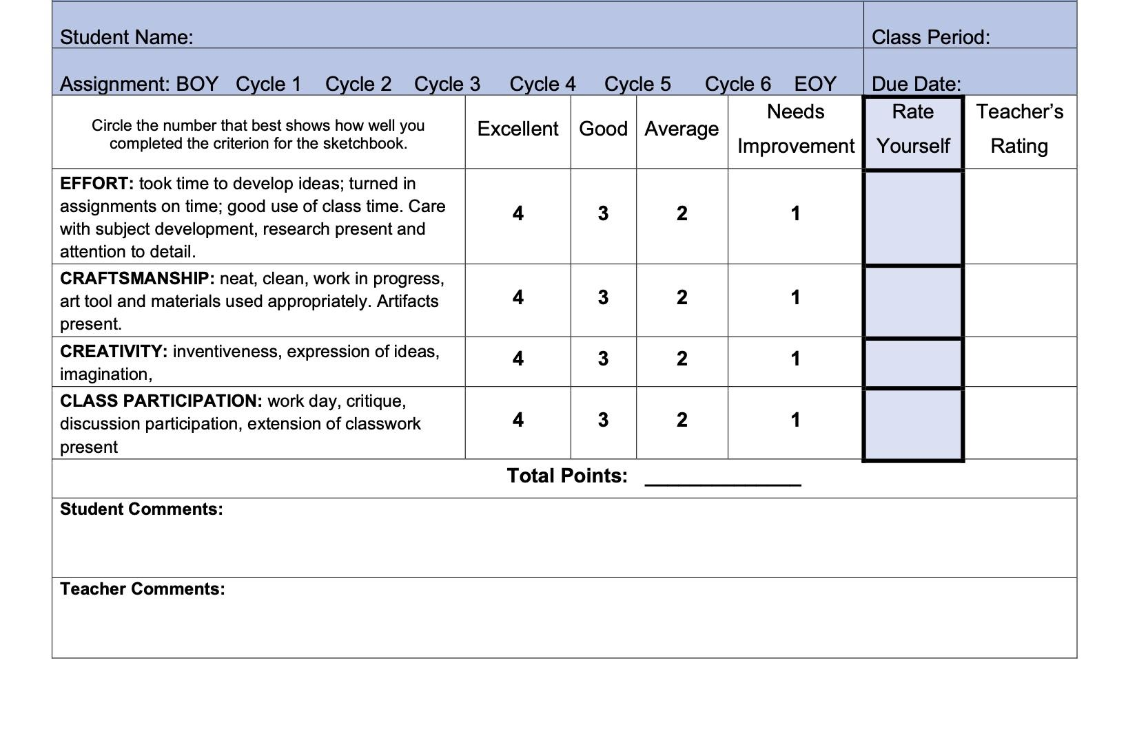
Grades
30% Major Grades
Artwork, Critique, Portfolio Assessments, Tests
70% Minor Grades
Sketchbook assignments/homework, Daily Assignments, Worksheets, Quizzes, Participation, Clean up
Late Work: After the due date, you have 2 weeks to turn in a late assignment. Late assignments will receive 10% off the earned grade.
Art Class is NOT an easy A. You earn every grade through hard work and dedication.
Students complete a rubric with each artwork

Slide 10
Daily Schedule
Beginning of Class:
Work on weekly Sketchbook Assignment (10-20 min)
Instructions/ Demo (10-20 min)
Middle of Class:
Studio time to work on artwork (40 min quiet work time)
End of Class:
Clean up time (5 min)
If you have extra time you should work on the weekly Sketchbook Assignment
Exit Ticket (5 min)
Fridays: Art History Fridays and Sketchbook Assignment Check

Slide 11
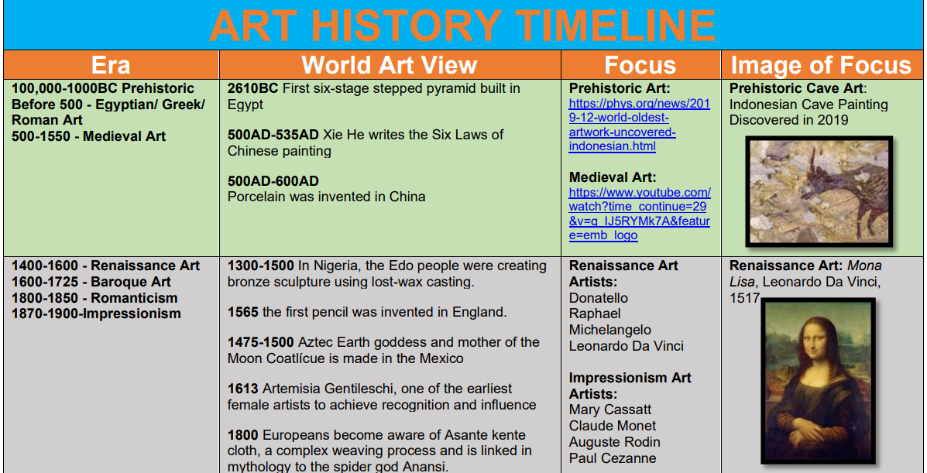
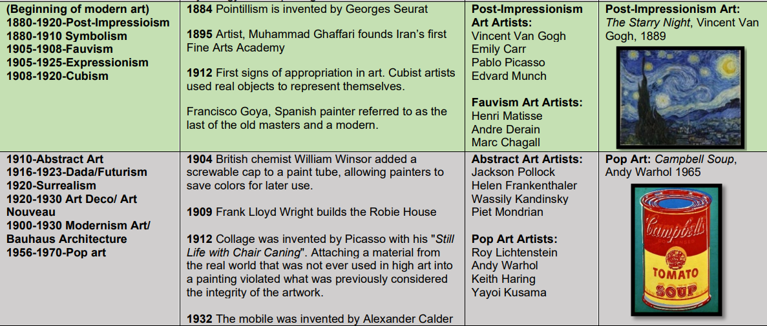
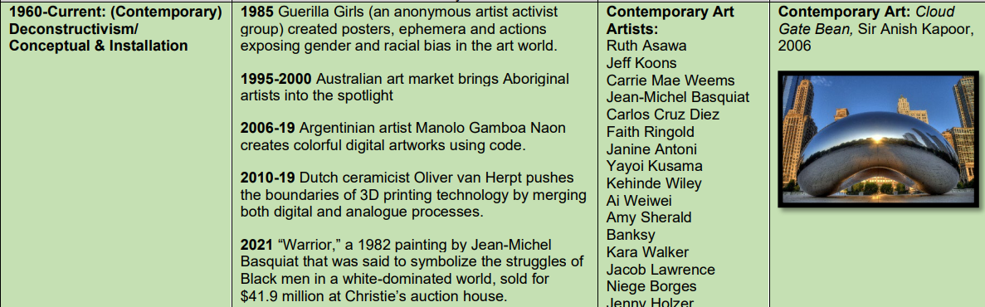
Art History Fridays

Slide 12


