Slide 1



6th Grade Math – HISDADV VG
Mrs. Victoria Simmons
Open House
September 21, 2022
WELCOME

Slide 2
Introduction
Victoria Simmons
Math Teacher
20+ years of teaching experience
5th year teaching at TH Rogers this school year

Slide 3
Plans and what is happening in the classroom
I am excited and glad to have your child in my class.
We are using the following in the classroom:
Curriculum: Based on HISD Scope and Sequence
Textbook: Carnegie Learning Accelerated Grade 6
Software: MATHia
We are doing different activities based on Carnegie Learning lessons as cutting, drawing, tracing, and folding figures to model the math concepts we are learning in class. We are solving real-world problems as well.
Students are encouraged to work collaboratively.

Slide 4
Learning in your classrooms, students’ daily schedules, grades, assignments, quizzes, etc.
Students will be working using the Carnegie Learning Lessons following the structure:
Engage, Develop and Demonstrate
Students complete practice items by working in groups, in pairs, or individually.
We utilize additional digital resources such as Study Island, BrainPop, Flocabulary, and Khan Academy. Also, worksheets are available for completion by students from different math books.
Grades are computed based on the following:
Learning (70%) – exit tickets, quizzes, classwork, homework
and Assessments (30%) – mid-topic and topic assessments, projects

Slide 5
Graded assessments and standardized tests.
Students' assessments are from the Carnegie Learning resources.
After each topic which consists of a few lessons, students will take the enhanced mid or end-topic assessments.
Students are also required to take the District assessments such as Renaissance 360 BOY, MOY and EOY.
In May 2023, the STAAR test will be given in Math and Reading for 6th Grade.

Slide 6
Behavior management strategies and class rules and routines that you are following
Class rules were established by the students during the 1st week of school based on the following class expectations:
1. Be Respectful
2. Be Prepared
3. Be On Task
Class Procedures are posted in the classroom to remind them of what to do every class meeting.

Slide 7
How I communicate with parents/guardians?
I email parents if my students are missing assignments, or if I have a concern about their behavior in class.
Parents can also check the Power School for their child’s grade.

Slide 8
Explain how you will reach out to parents and how you will handle their questions.
If you have any questions or concerns, email me at victoria.simmons@houstonisd.org.
I will try my best to reply in 48 hours to an email I receive.

Slide 9
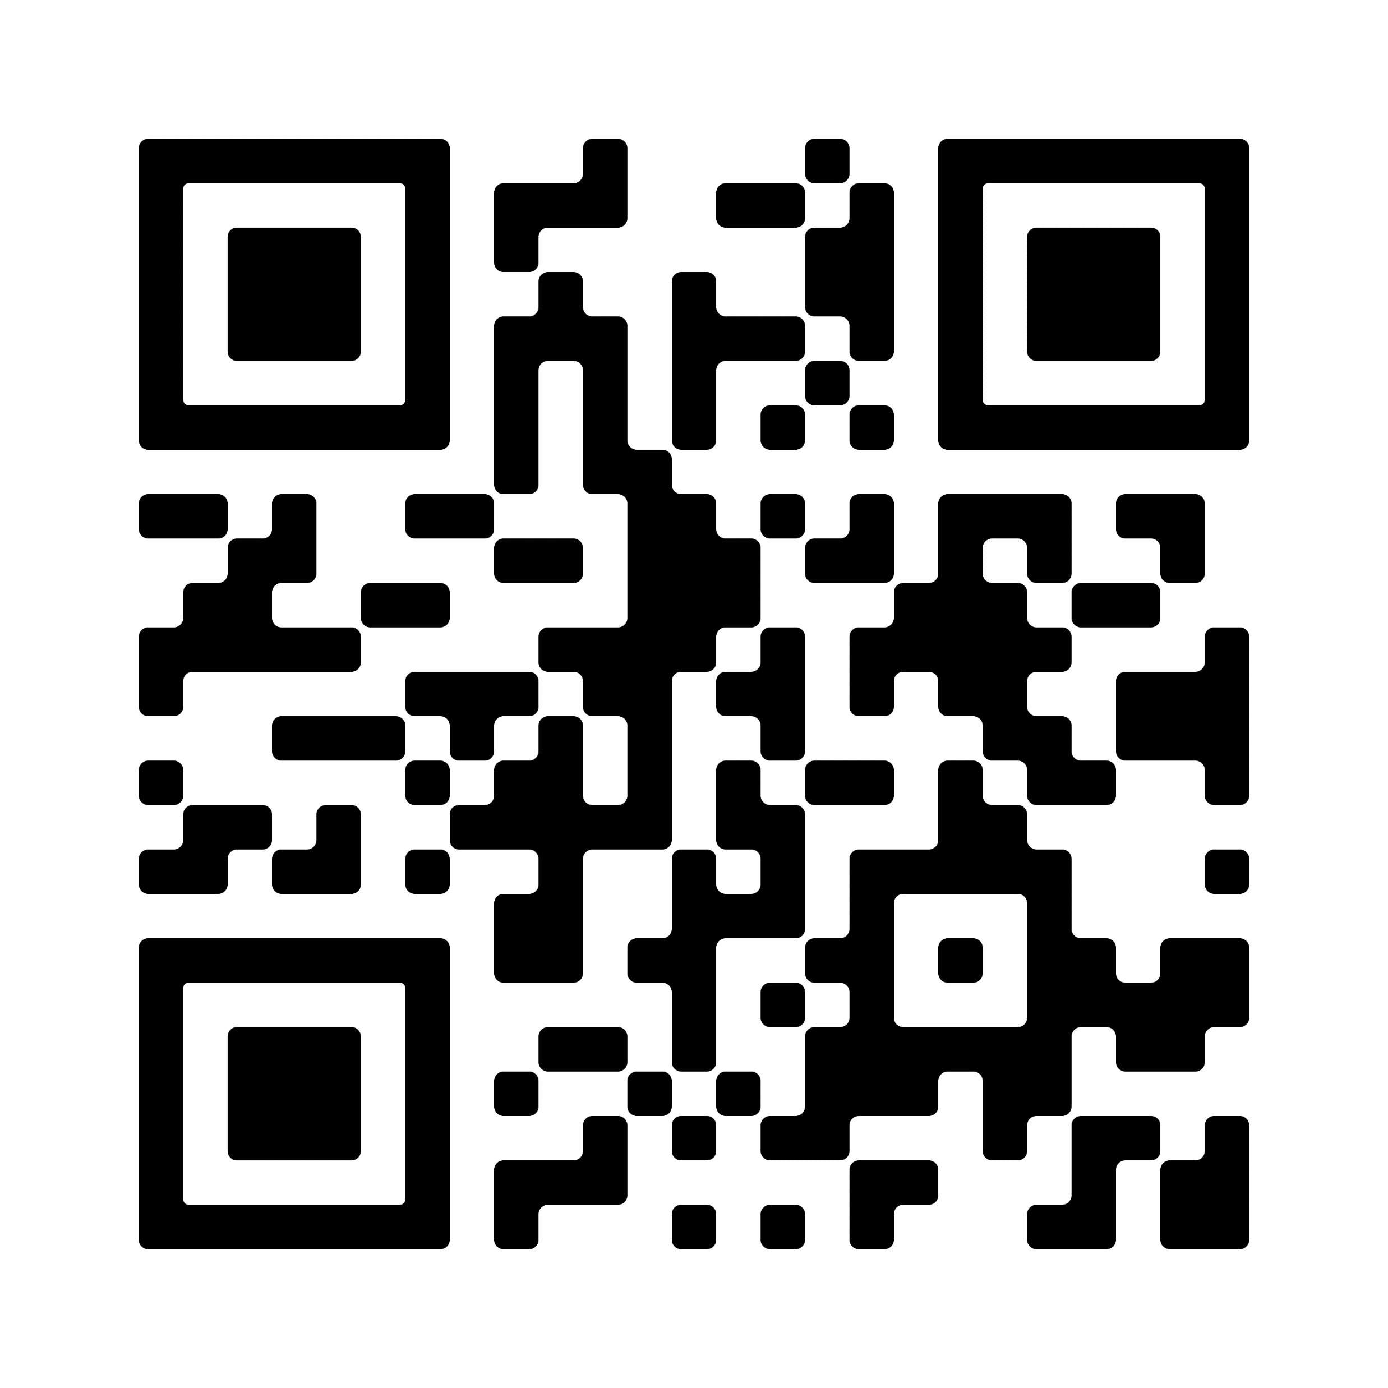
TH Rogers Math Club qualifying test will be on dates below:
Elementary Division(Grade 3 to 5) on Thursday,
Oct 6th,2022 ; Time 3:30 PM to 4:30 PM in school
Middle School Division(Grade 6 to 8) on Friday,
Oct 7th,2022 ; Time 3:30 PM to 4:30 PM in school
Parents are requested to fill the google form here or using the QR code below.

Slide 10
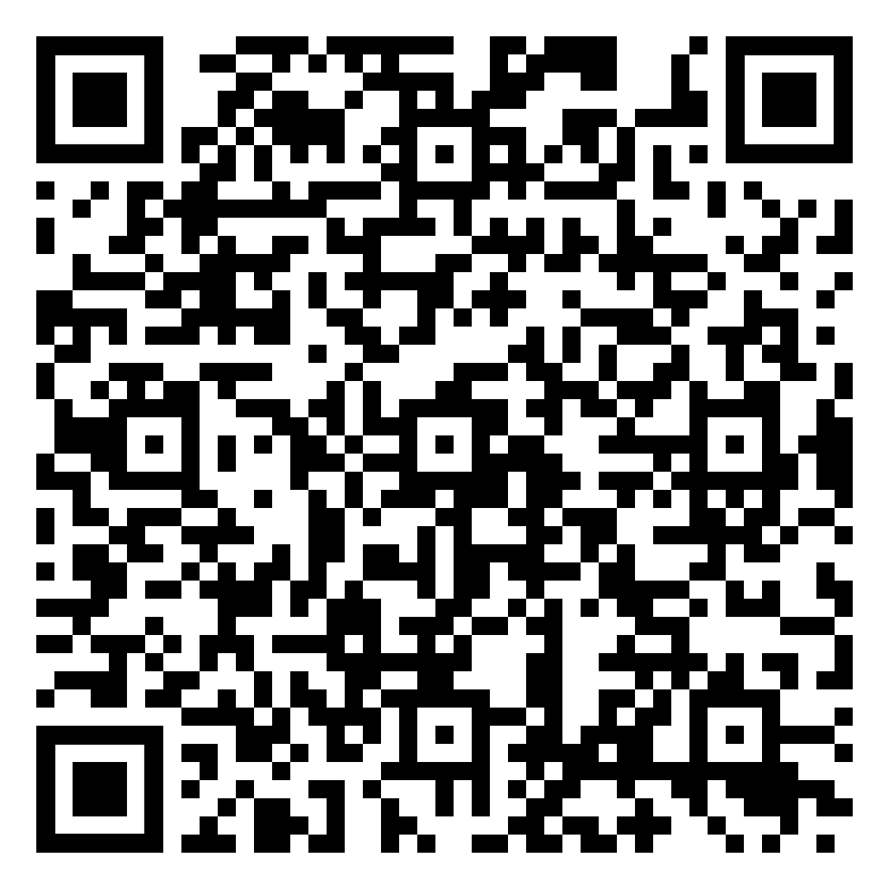
If you would like to share your comment/s or question/s
you can use the form (scan - QR code)

Slide 11
