Slide 1
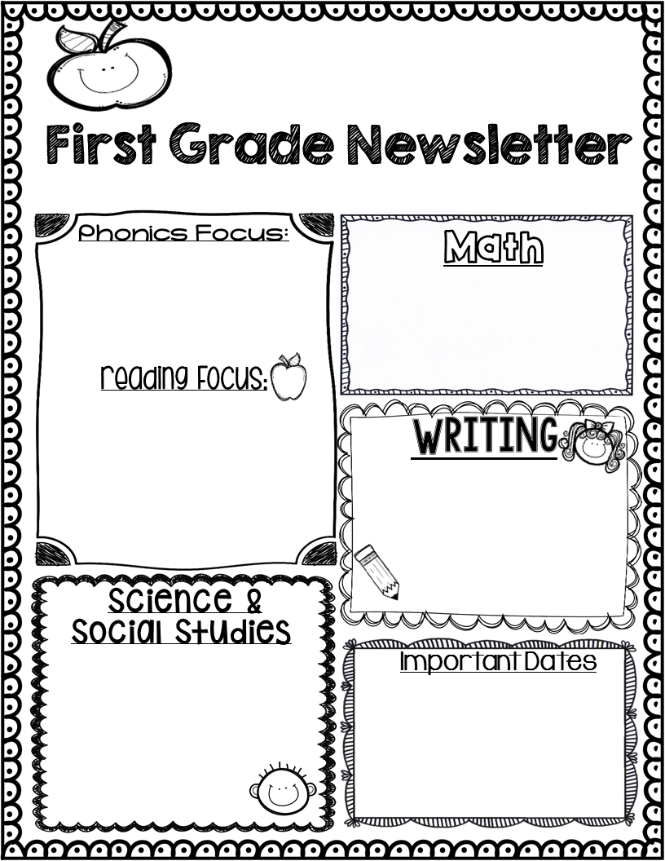
Golfcrest E.S.
Boletin de primer grado
Septiembre/September 2023
-Practice vowel sounds and letter sounds.
-Repasar las vocales y silabas con las letras m p, s.
Count from 1 to 20
Recognize 1+ and 1-
( example 9+1=10) ( 9-1=8)
Contar del 1 al 20
Reconocer 1+ y 1-
( ejemplo 9+1=10) ( 9-1=8)
Practice reading according to the level at least 15 minutes a day.
Practicar lectura según el nivel al menos 15 minutos al día.
Fables and stories
Fabulas y cuentos
-Writing Upper and lower case letters.
-Escribe letras mayúsculas y minúsculas.
Science/ciencia:
Living and non-living beings.Needs of living beings. Seres vivos y no vivos.
Necesidades de los seres vivos.
S.S.
Rules and behaviour in the school.
Reglas y comportamiento
en la escuela.
-September 4th: Labor Day, NO CLASS.
-September 7: Grandparents day + PTO pictures:5. Grandparents are allowed to eat in the cafeteria
-September 8: 1st day packets due
-September 14: Parents meeting and PTO meeting at 8:30am
-September 21: Open house from 400pm to 5:30pm
-September 25: no school

