Slide 1
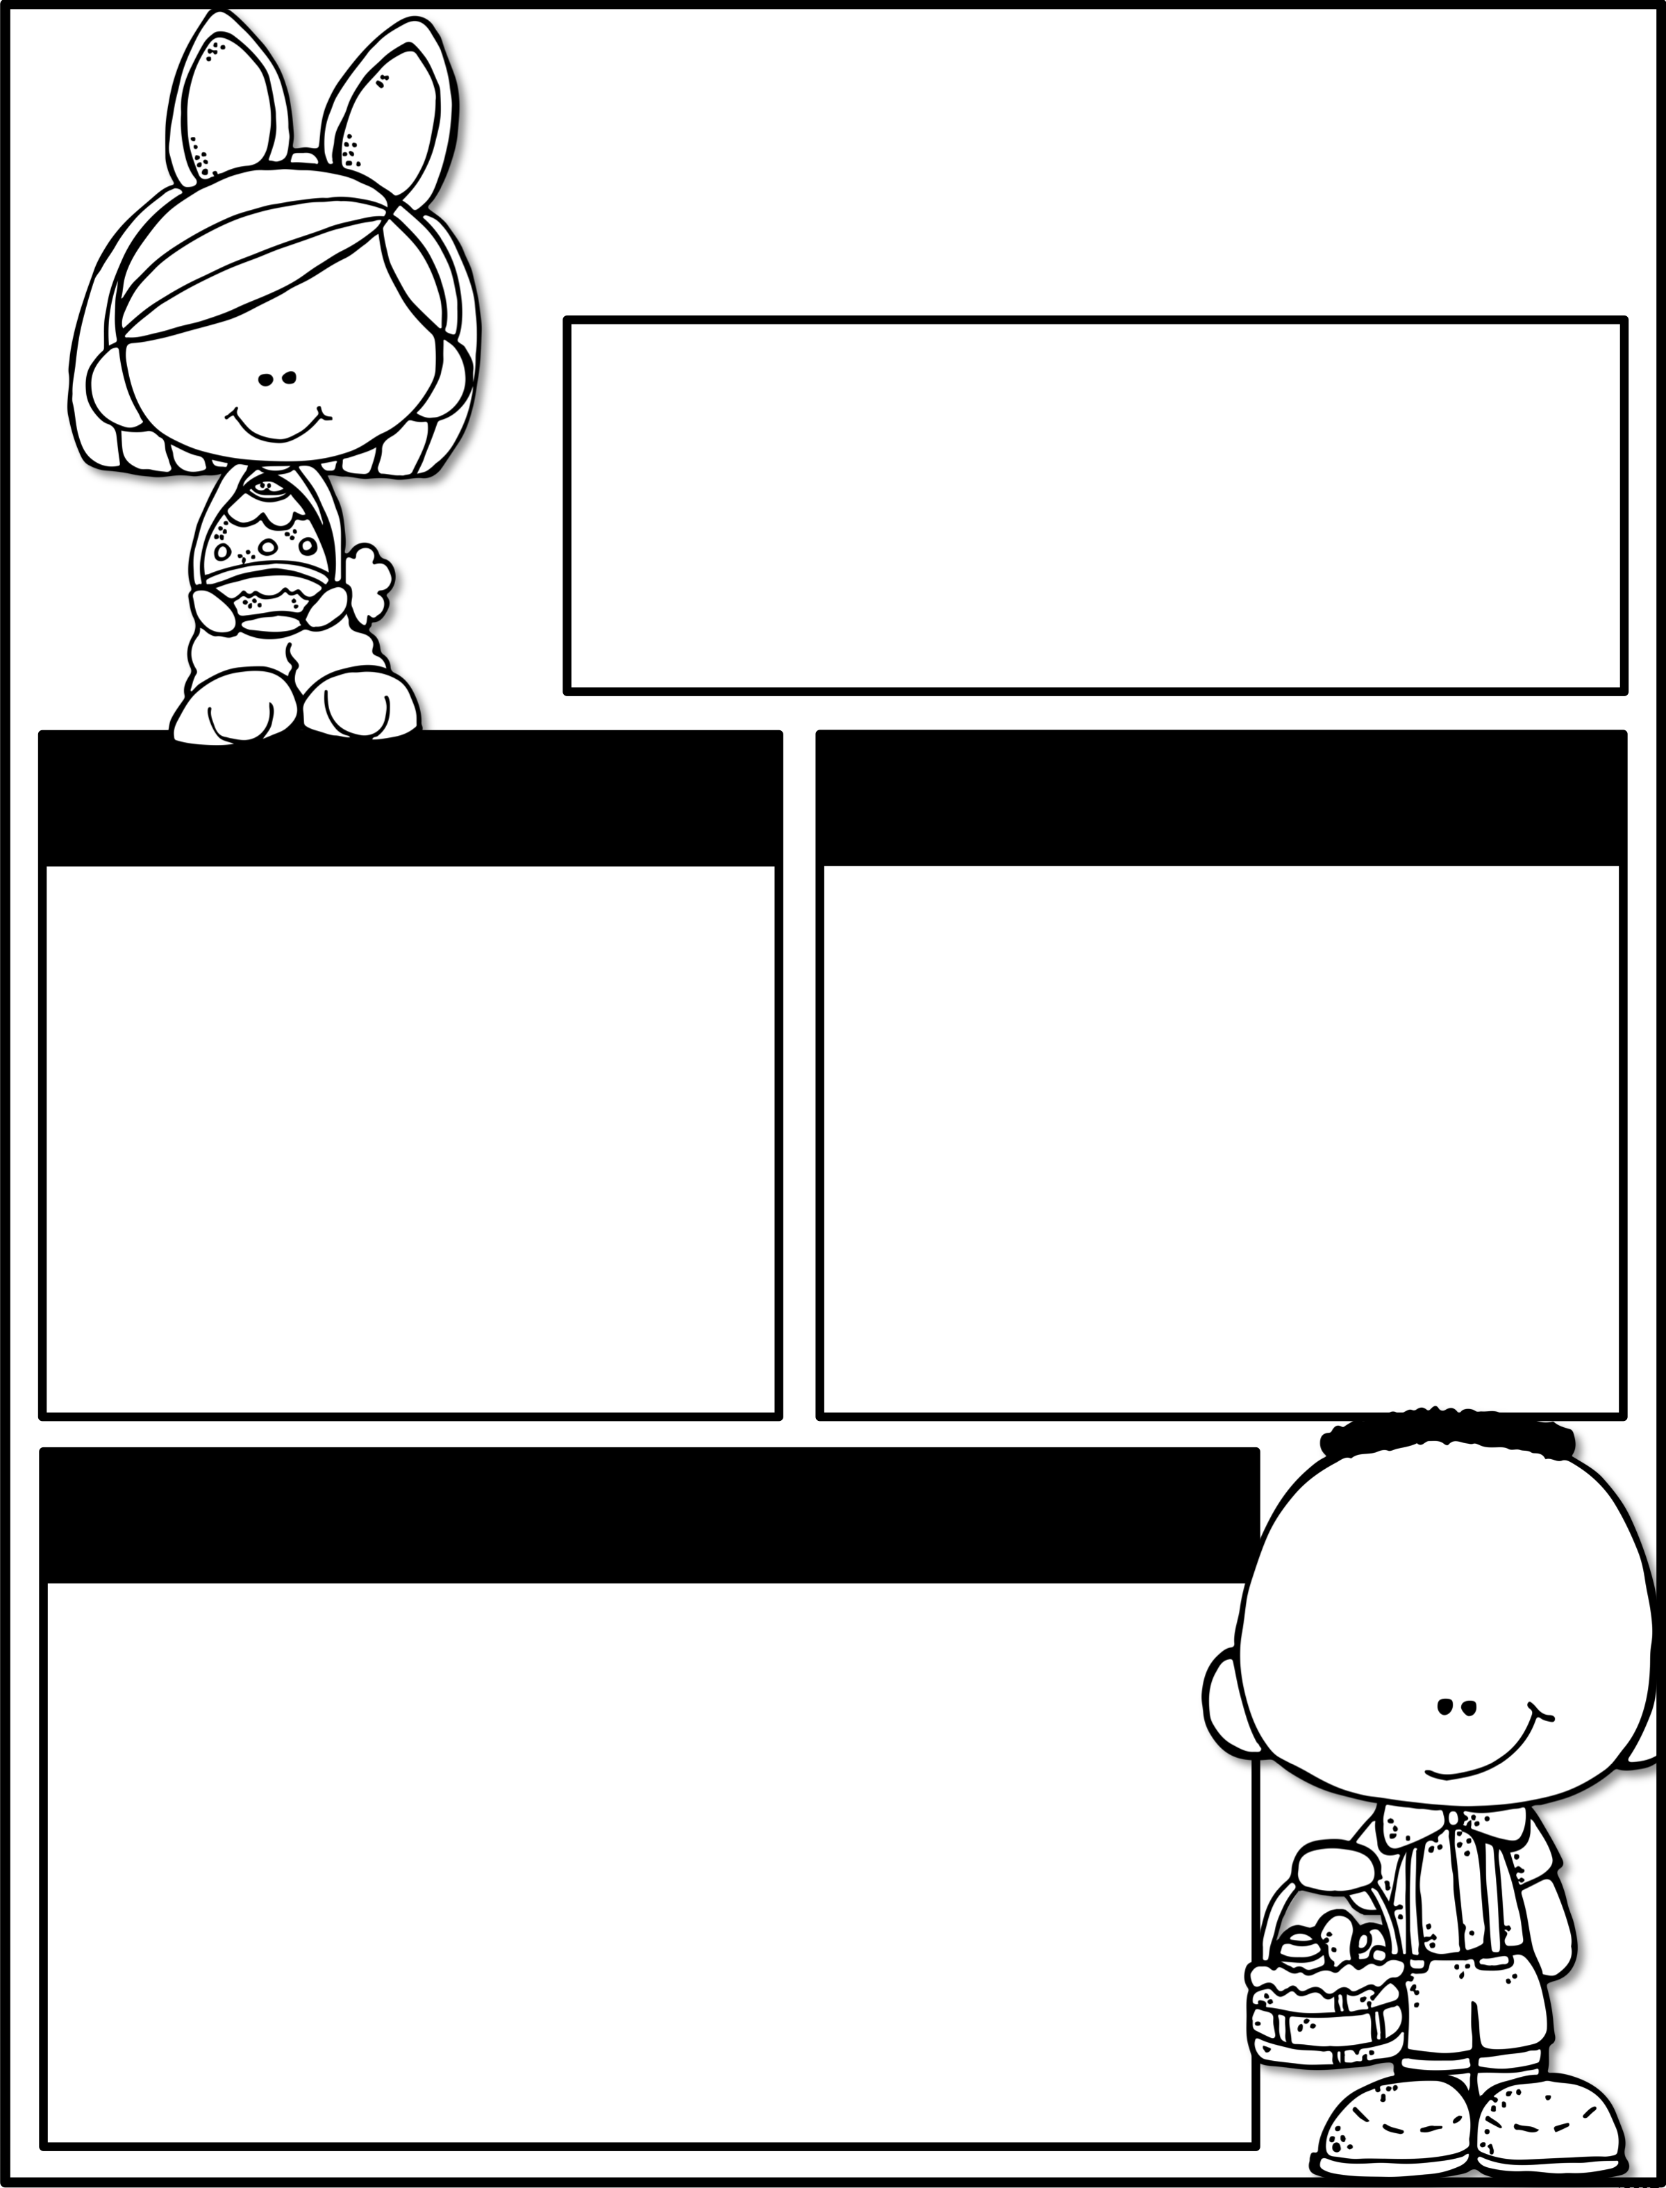
april
abril
Please remember to practice reading and math daily.
Recuerden de practicar matemática y la lectura todos los días.
Mr. Morales/Mr. Etxaniz
Math
Social & Science
Classify and sort two- and three-dimensional solids, including cones, cylinders, spheres, triangular and rectangular prisms, and cubes, based on attributes using formal geometric language.
Social Studies Unit 10: Celebrations in a Community
Estudios Sociales Unidad 10: Celebraciones en la comunidad
Science: Identify and describe the flow of energy in a food chain and predict how changes in a food chain affect the ecosystem.
Reading & Language Art
Reading/Language Arts:
Unit 12:
Students will explore and deeply comprehend the genres within this unit by making predictions, making personal connections, and visualizing the key details to make inferences about the elements of poetry.
Lectura / Artes del lenguaje:
Unidad 10:
Los estudiantes exploraran y profundizaran la comprensión haciendo predicciones, conexiones personales y visualizando detalles acerca de los elementos de la poesía.

