Slide 1
Bond Oversight Committee Meeting
Third Quarter 2014
October 28, 2014

Slide 2
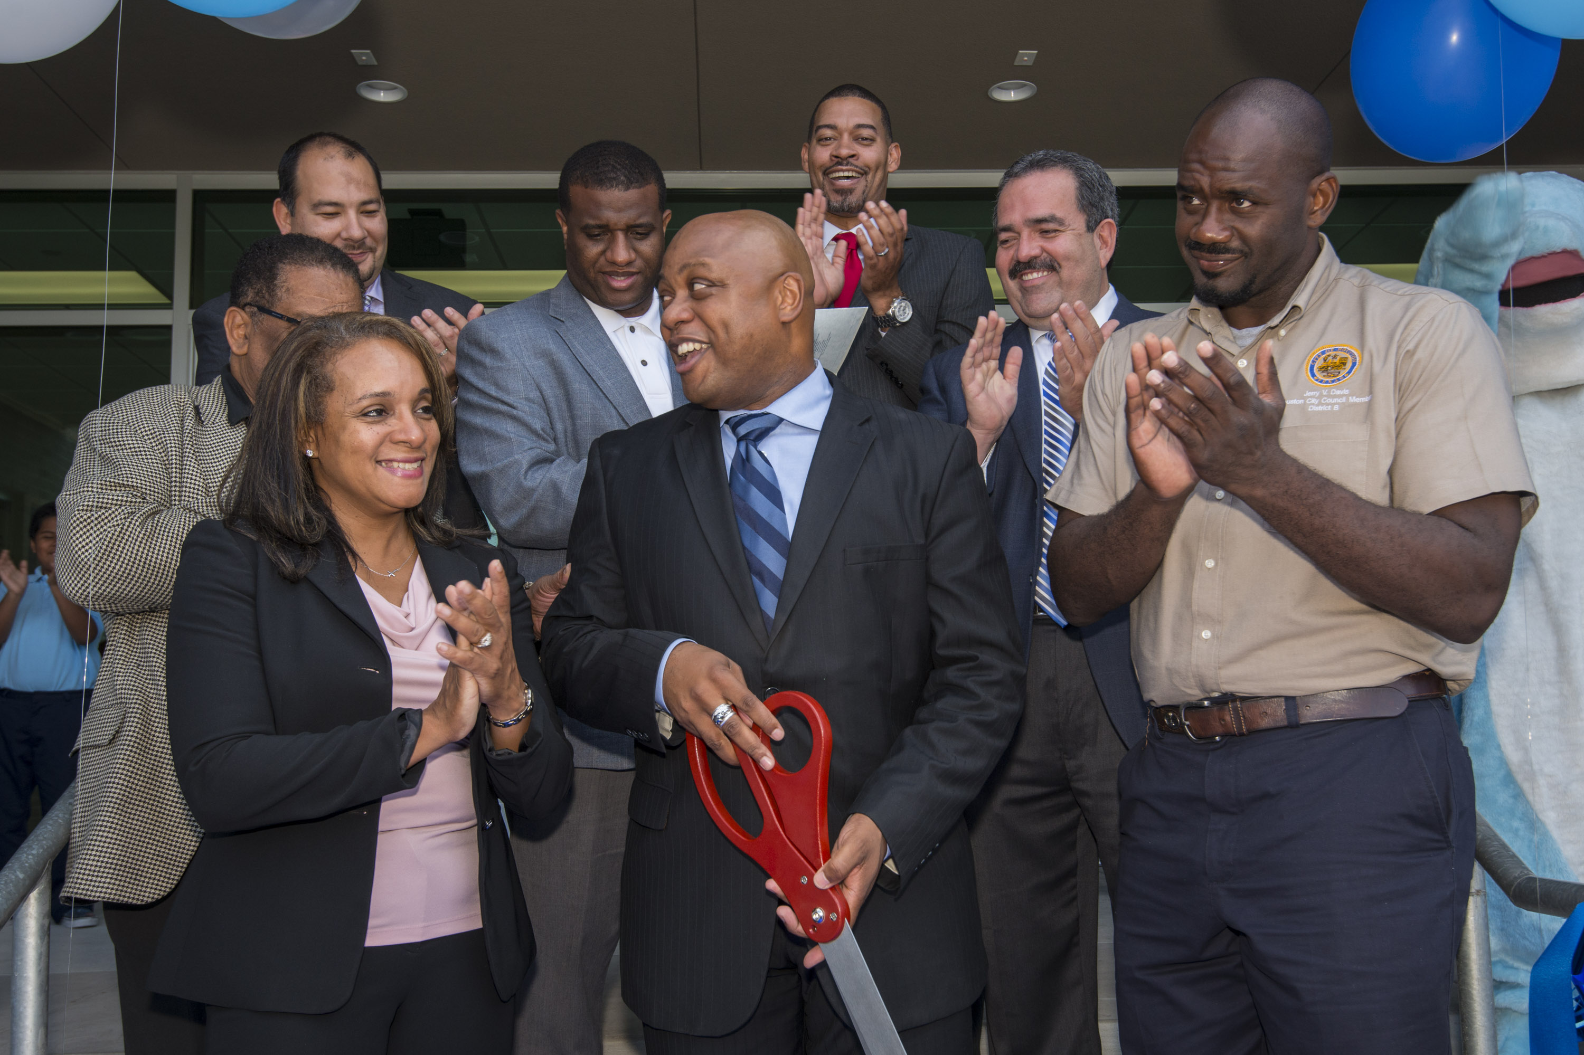
2007 Bond Update
Dedication ceremony held at Dogan ES
Significant progress at Southmayd ES, Wainwright ES, Hogg MS and Pugh ES
All work in the 2007 program will be completed by the end of 2014

Slide 3
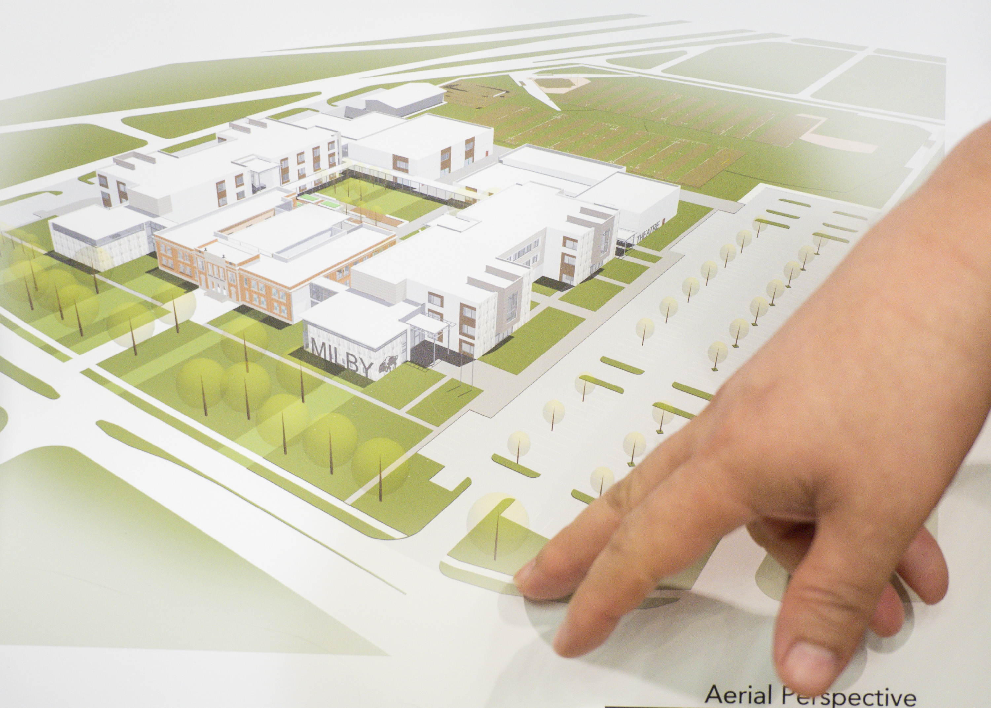
2012 Bond Planning & Design
90% of Group 1 school projects have entered the Construction Documents phase
Remaining schools in Group 1 completing Design & Development phase, moving into Documents phase, and on track to begin construction by year end
Group 2 projects working through Design phase
Group 3 and 4 began Planning phase

Slide 4
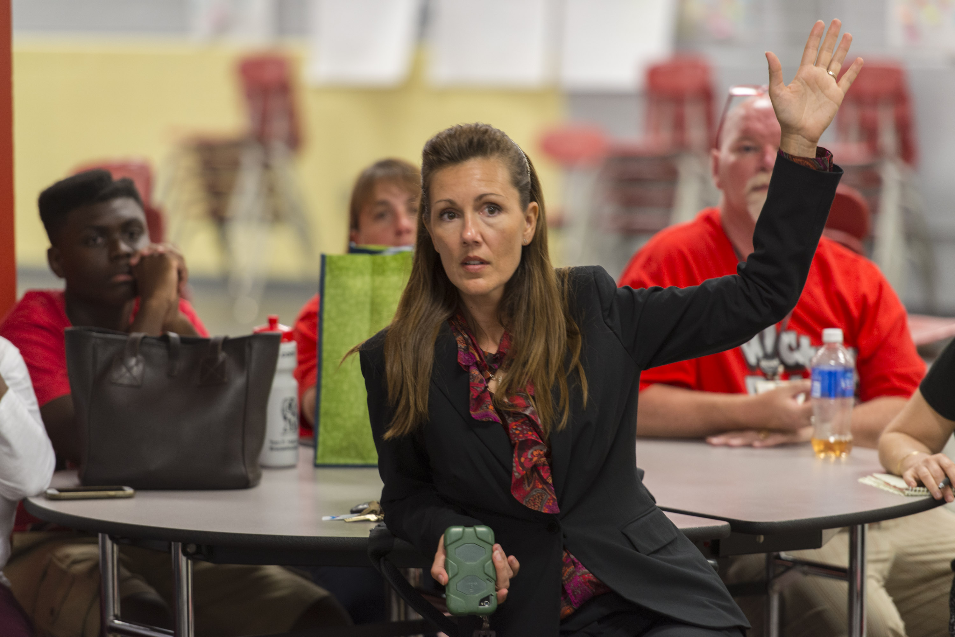
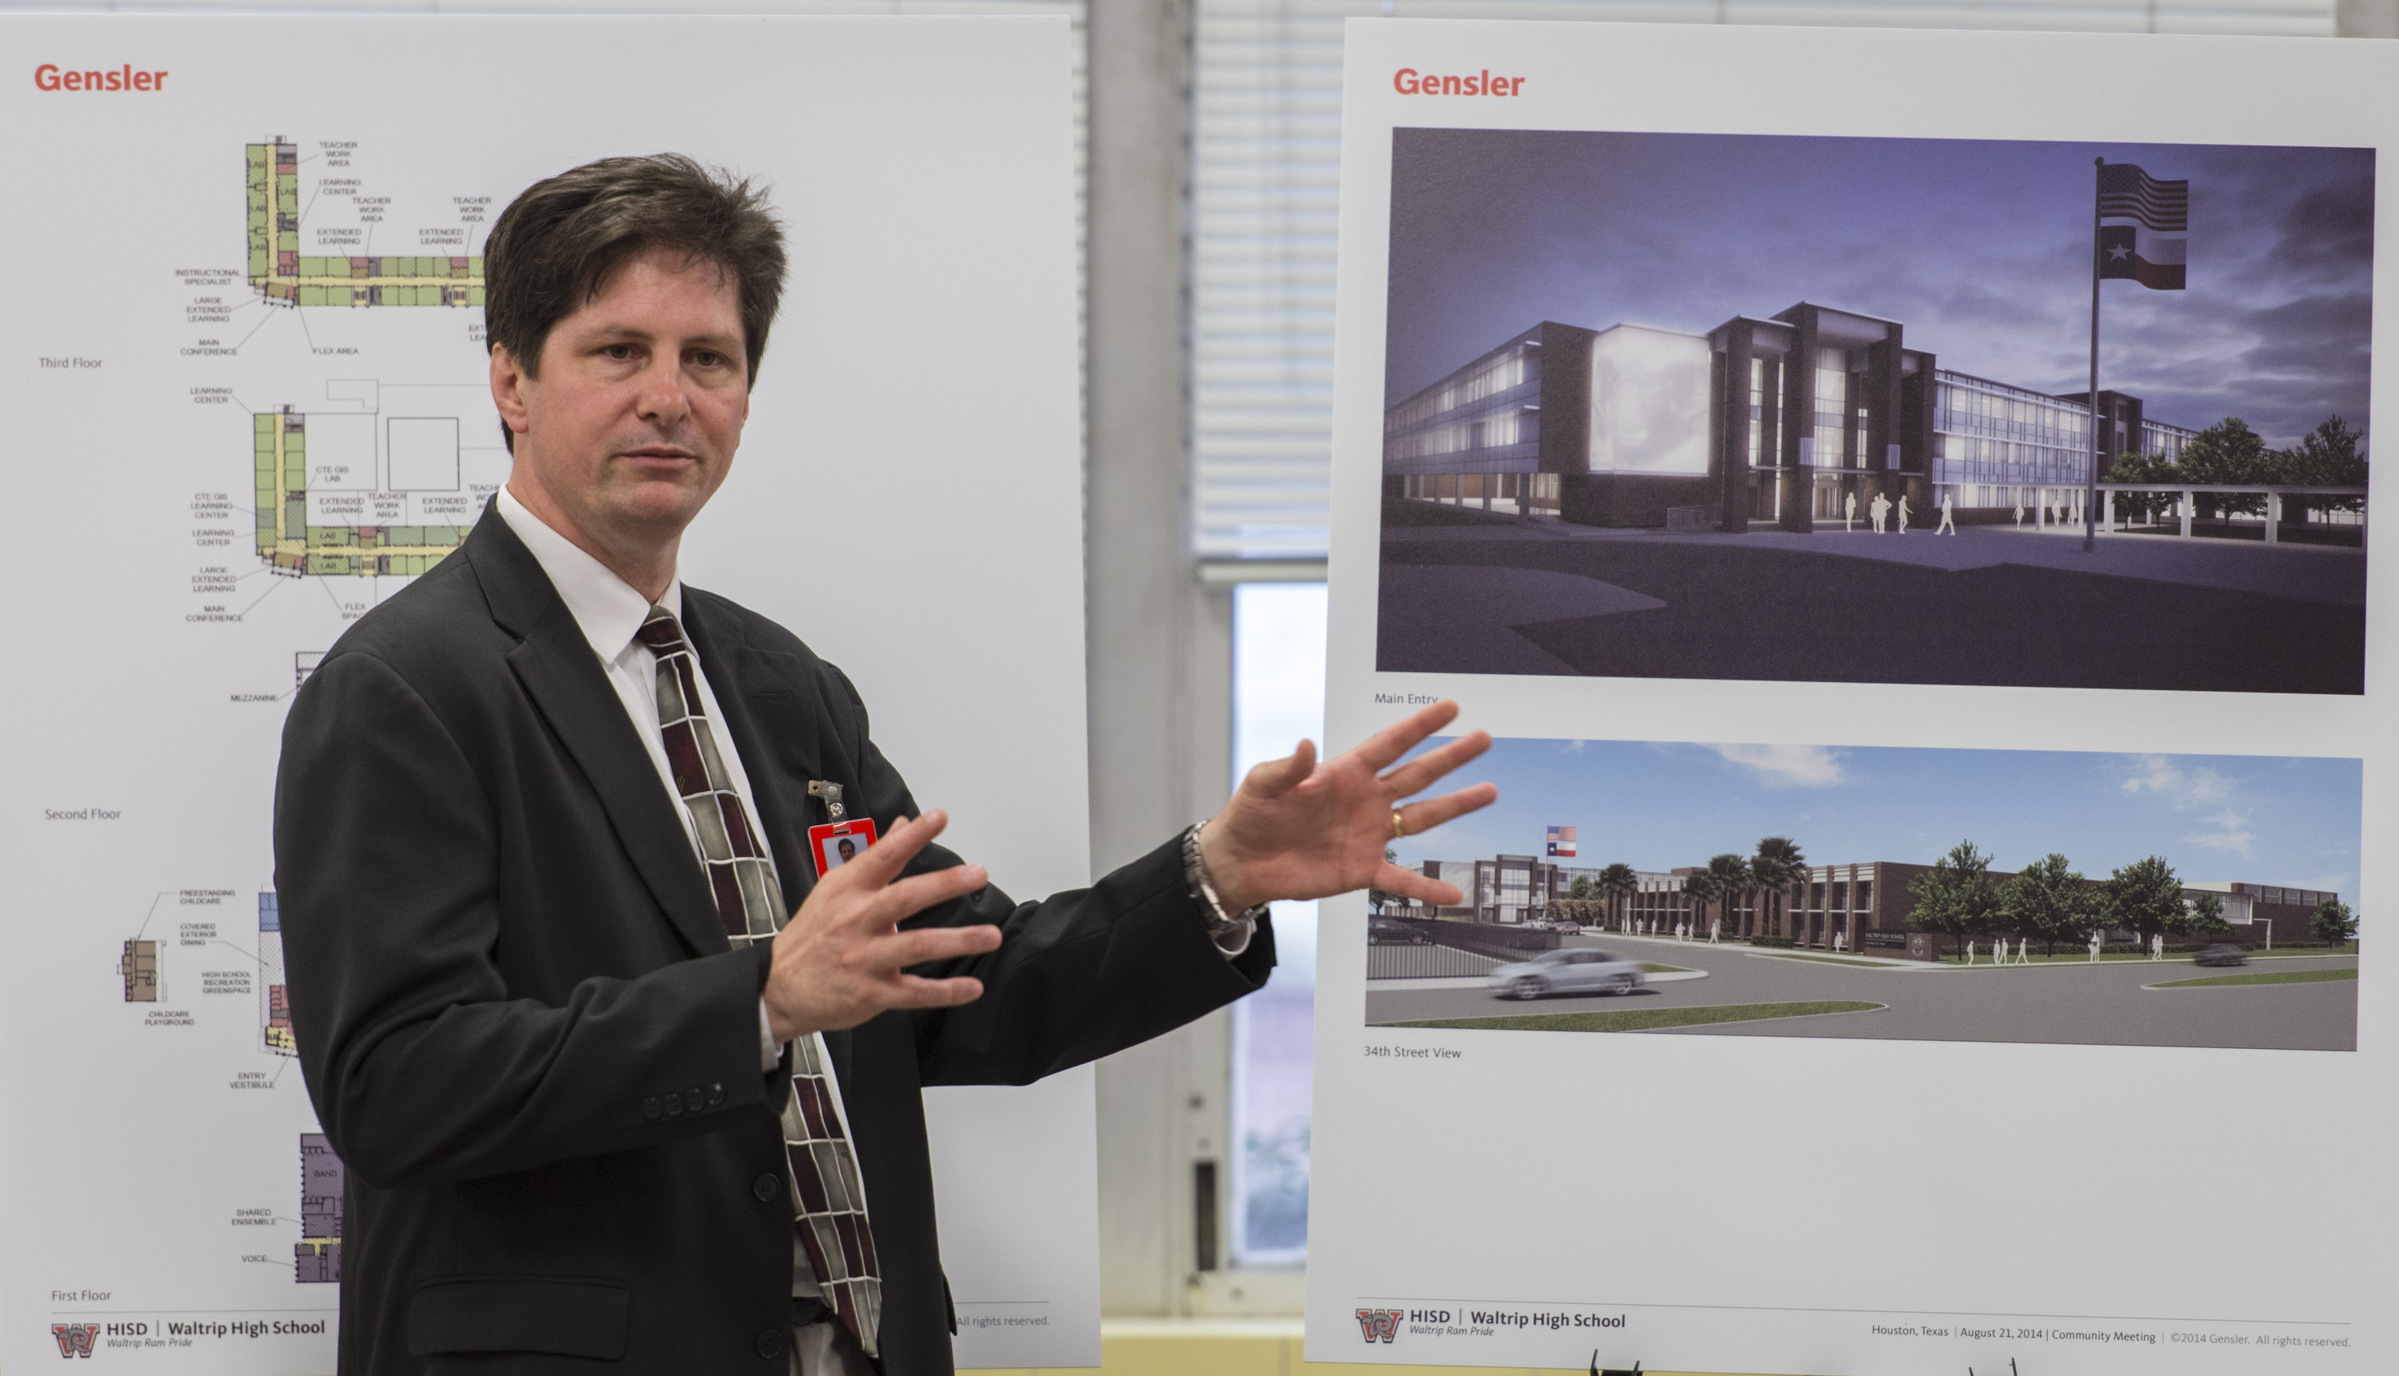
2012 Bond Planning & Design
IT/Design summit held with local experts
Community meetings held for 10 schools
PATs at all Group 3 and 4 schools are now meeting
Architect selection process for Group 3 and 4 schools ahead of schedule

Slide 5
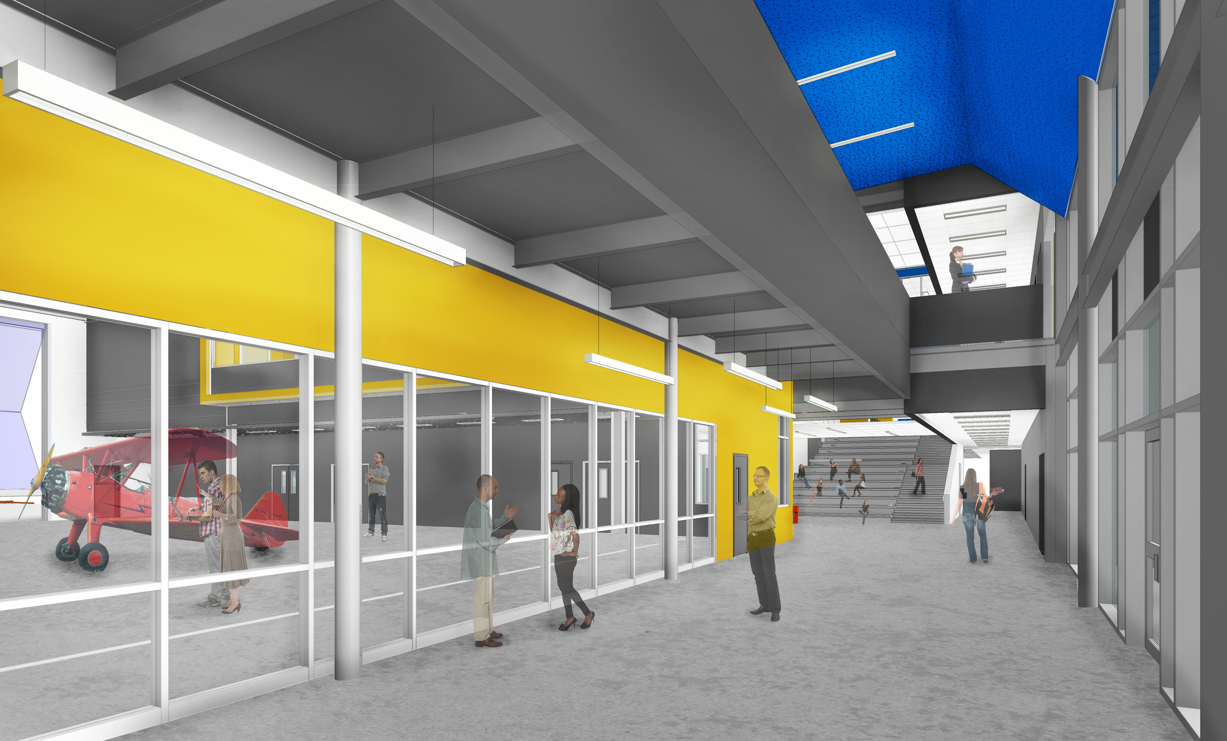
2012 Project Highlights
Sterling Aviation HS
Will feature a hangar for aviation program, visible at the entrance and the 2nd floor
Washington HS
As an engineering-focused school, PAT members requested engineering labs be located at the front of school along main corridor so they are highly visible to students and visitors

Slide 6
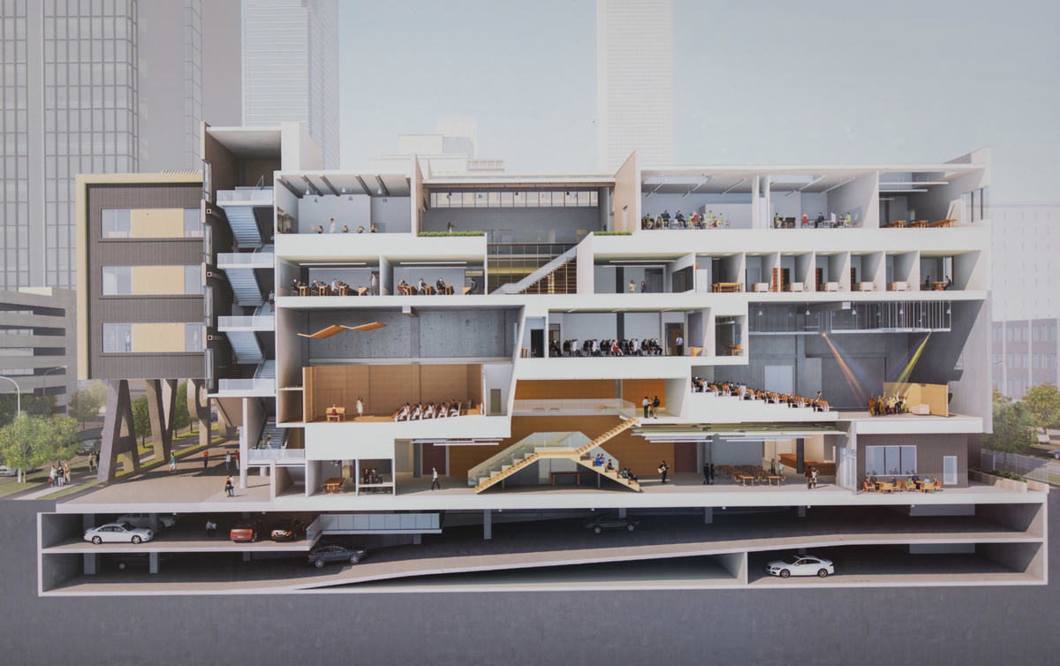
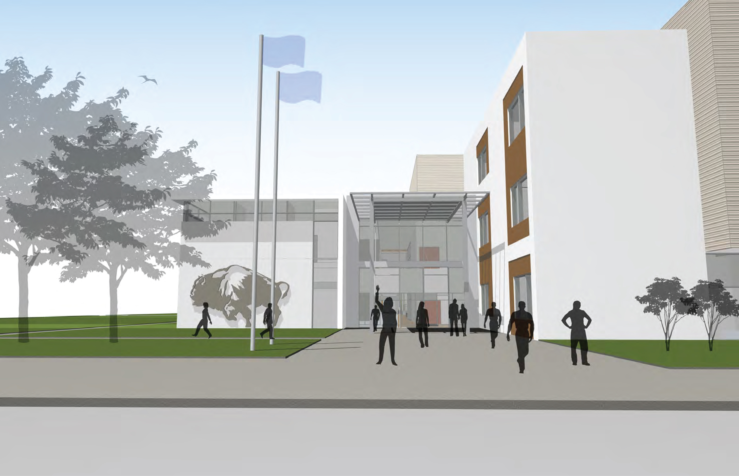
2012 Project Highlights
HSPVA
Interactive and collaborative spaces
Milby High School
Designed with CTE spaces in mind
Collegiate atmosphere a primary design component
Parker Elementary School
Music learning centers and performance space included

Slide 7
2012 Construction Update
Project | Ongoing | Start Date | On hold
Worthing HS | ✓
Waltrip HS | ✓
Delmar Fieldhouse | ✓
Milby HS | ✓
Grady MS | ✓
DeBakey HS | ✓
Washington HS | ✓
Furr HS |  | October
Mandarin Chinese |  | October
South Early |  | November

Slide 8
2012 Construction Update
Project | Ongoing | Start Date | On hold
Lee HS |  | November
Sterling HS |  | November
North Early |  | November
Condit ES |  | November
HSPVA |  | November
Sharpstown HS |  | November
Butler/Barnett |  | November
Mark White ES |  | December
High School for Law |  | December
Mickey Leland |  |  | ✓

Slide 9
Districtwide Upgrades
Middle School Restrooms
Phase 1 restroom renovations are underway
Phase 2 restroom renovations are scheduled to start in 2nd quarter of 2015
Safety and Security
High-priority work is underway

Slide 10
Doing Business
Office of Business Assistance held and participated in multiple programs to promote HISD business opportunities
M/WBE commitments for contracts awarded to date:
Professional Services represent 51%
CMARs represent 20% to 40%
Office of Business Assistance received the 2014 Supplier Diversity Champion Award, presented by D-Mars Publications

Slide 11
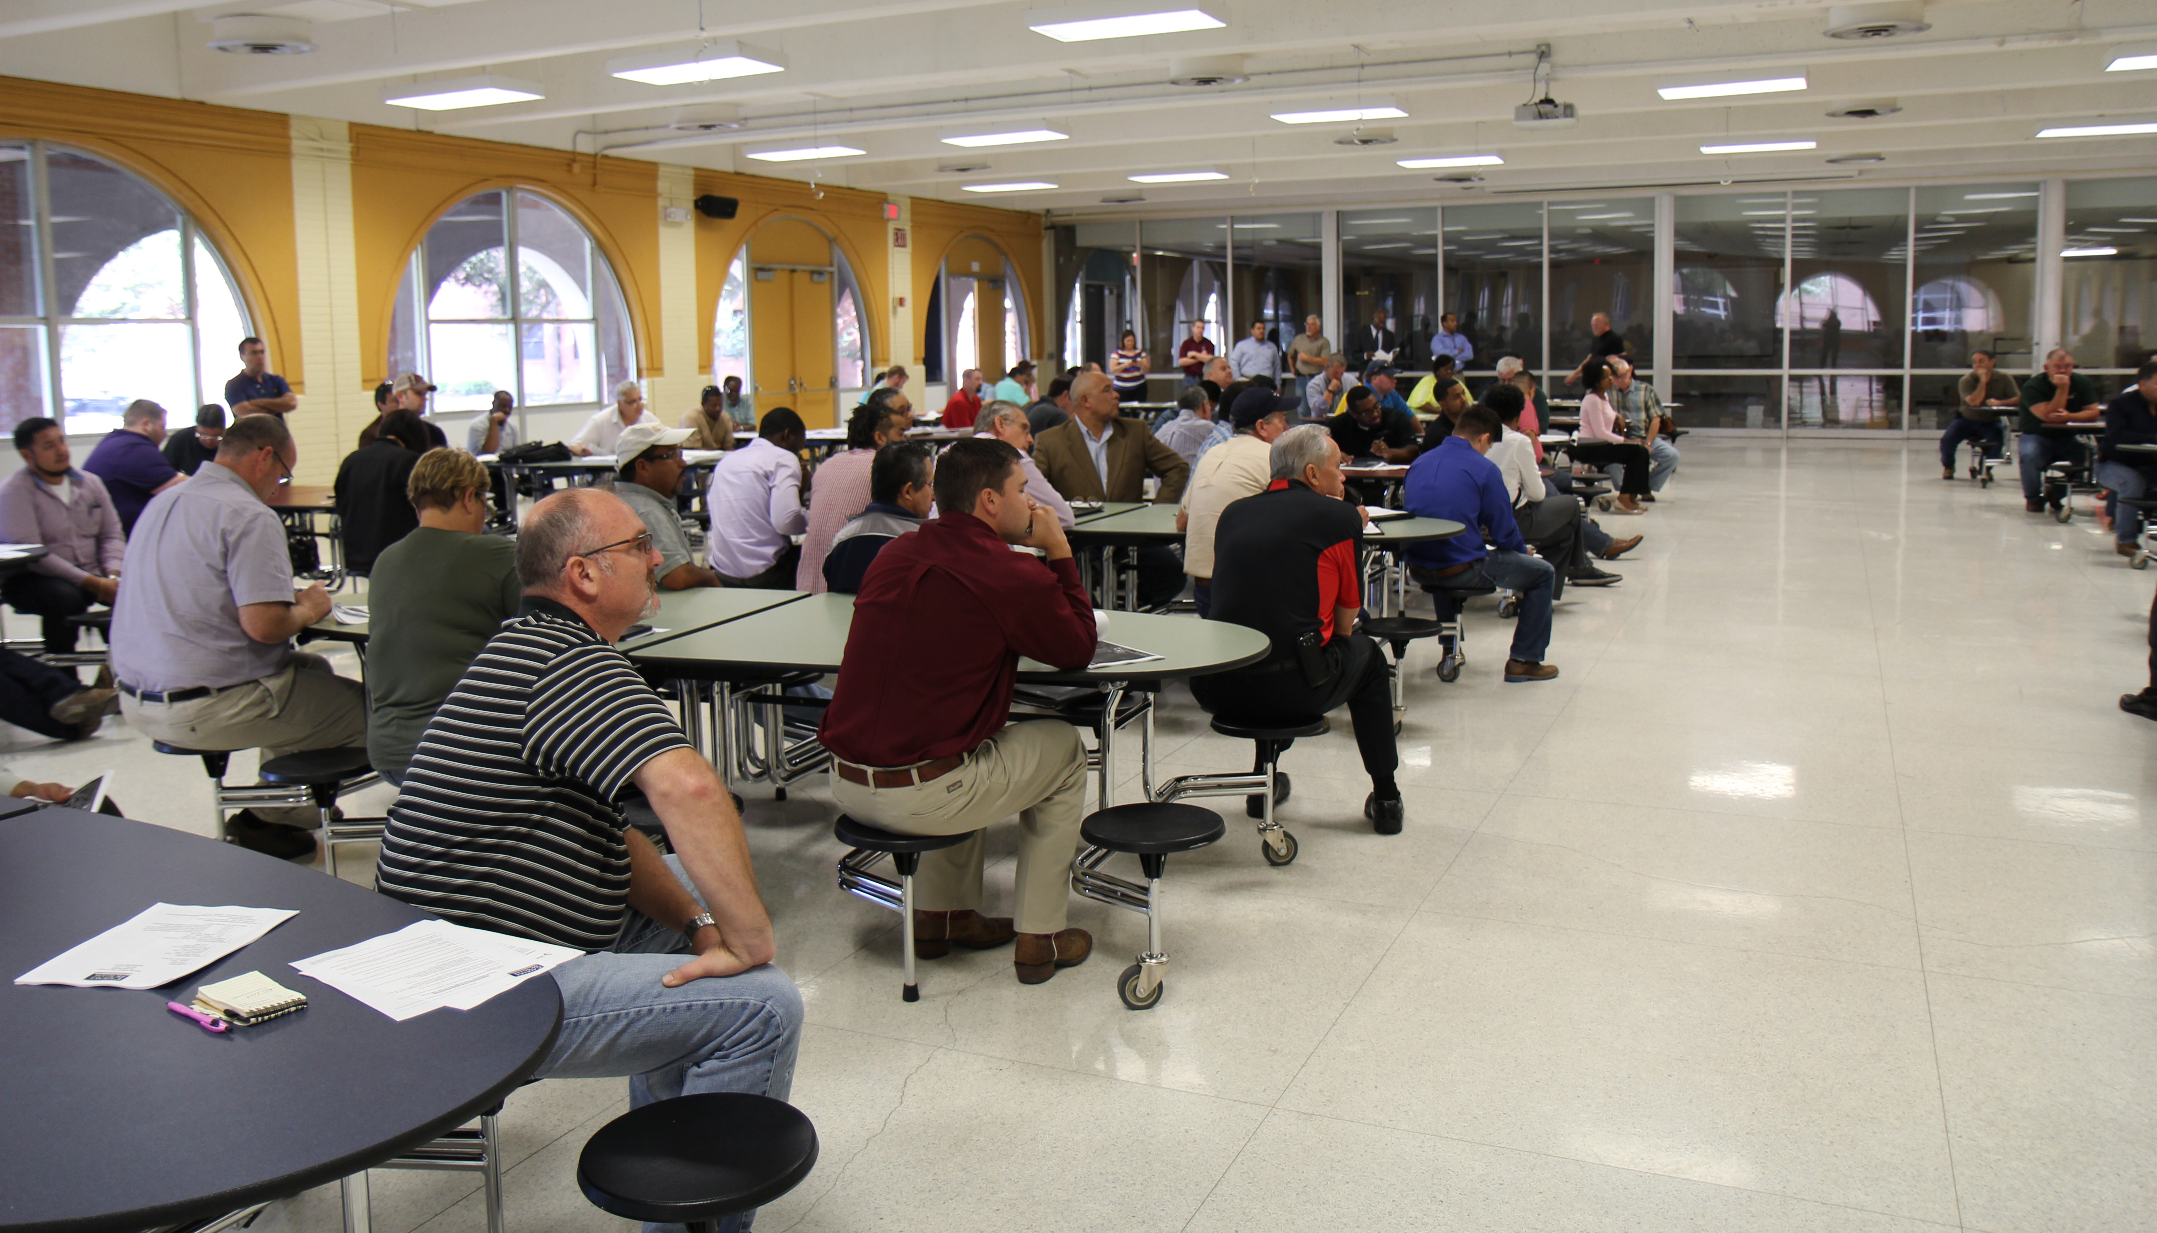
M/WBE Networking Events
M/WBE Outreach with Cadence McShane Construction Company at Sterling Aviation High School
Workshop Wednesdays
July – “Let’s Talk Finance”
August – “How to Present Your products/Services & Increase Your Chances to Win Contracts”
September – “How to Present a Successful Business Plan”

Slide 12
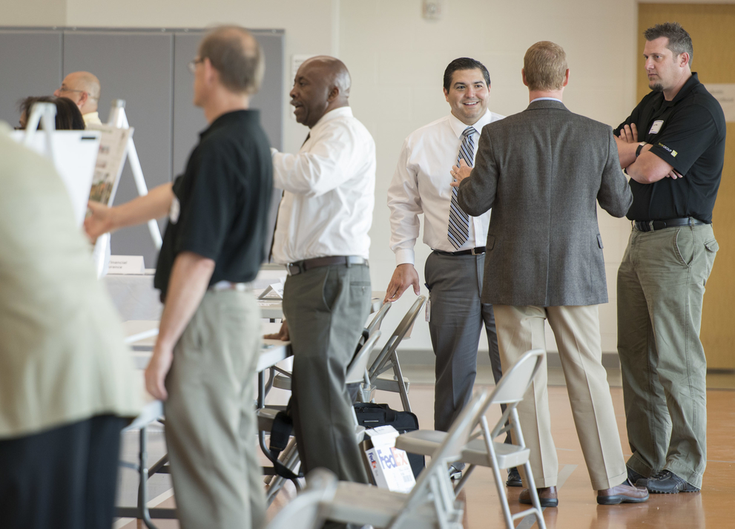
M/WBE Outreach Events
Greater Houston Business Procurement Forum
Greater Houston Business Procurement Forum – Houston Community College
Contractors Construction College
Kingdom Builders Center
Greater Heights Chamber of Commerce
“Gateway to Local Government” – Sheraton Brookhollow

Slide 13
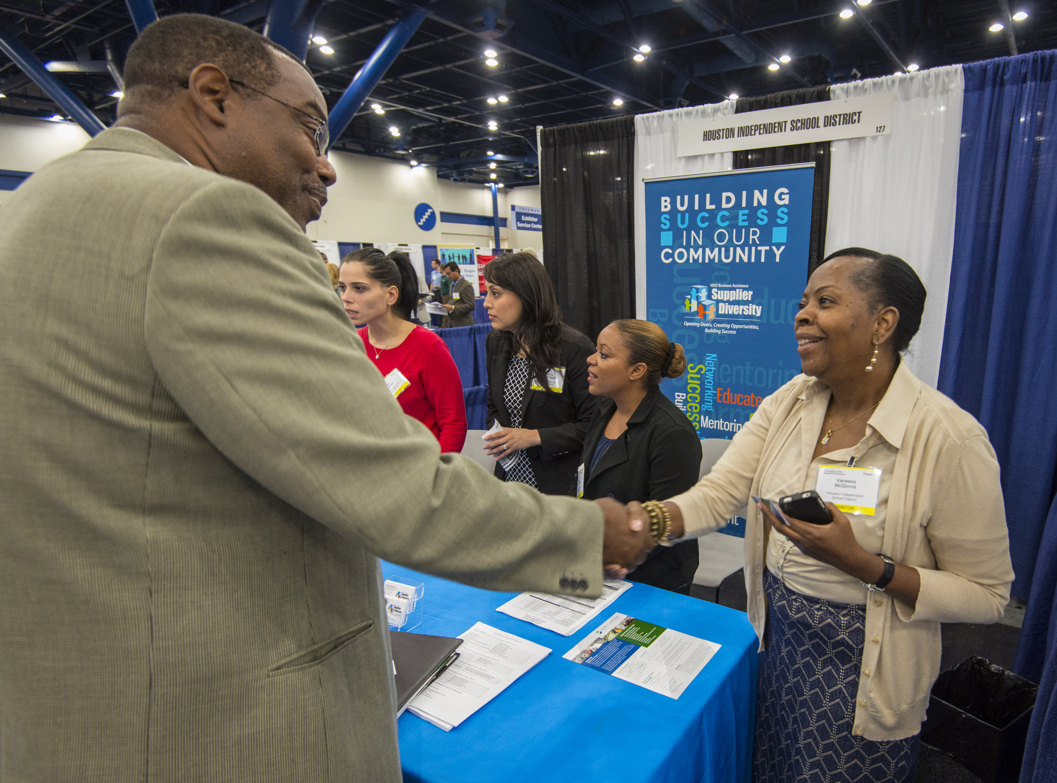
M/WBE Outreach Events
University of Houston Small Business Development Center
Doing Business with HISD
Capital One Bank
Getting Down to Business
Houston Minority Supplier Development Council
HMSDC Expo 2012 – Energizing the Economy

Slide 14
2007 Bond M/WBE Participation
Exceeded minimum M/WBE goal levels of 20% for 2007 bond program
M/WBE participation has reached nearly 35% in 2007 bond program
*As of September 30, 2014

Slide 15
2012 Bond M/WBE Commitment
Certified Minority/Women Owned Businesses Breakdown

Slide 16
2007 Bond Financial Report
Total funding of $1,176,130,676
Actual committed of $1,077,563,401(including encumbrances of $46,173,487 and actual expenditures of $1,031,389,914)
Uncommitted funding balance of $98,567,275 or 8% of total funding

Slide 17
2012 Bond Financial Report
The total for the 2012 Bond Program is $1.89 billion, and the issuance of the bonds has been planned in four sales
Commitments of $184,153,380 (including encumbrances of $111,072,852 and actual expenditures of $73,080,528) leaving $1,705,846,620 of available funding

Slide 18
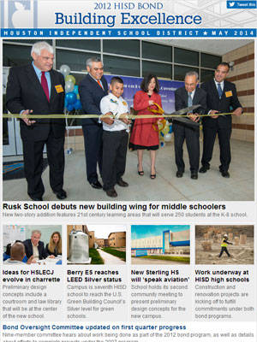
Communications
HISD is committed to providing timely and accurate information on the 2007 and 2012 bond programs.
Produced 6 videos that show PATs and community participation in design process and school site tours
Creating and distributing fliers and meeting invitations to key stakeholders for 10 school community meetings
Posted 22 blog posts and photo galleries on school community meetings, green school efforts, and community outreach events
Highlighted bond activities in about 45 tweets and Facebook posts

Slide 19
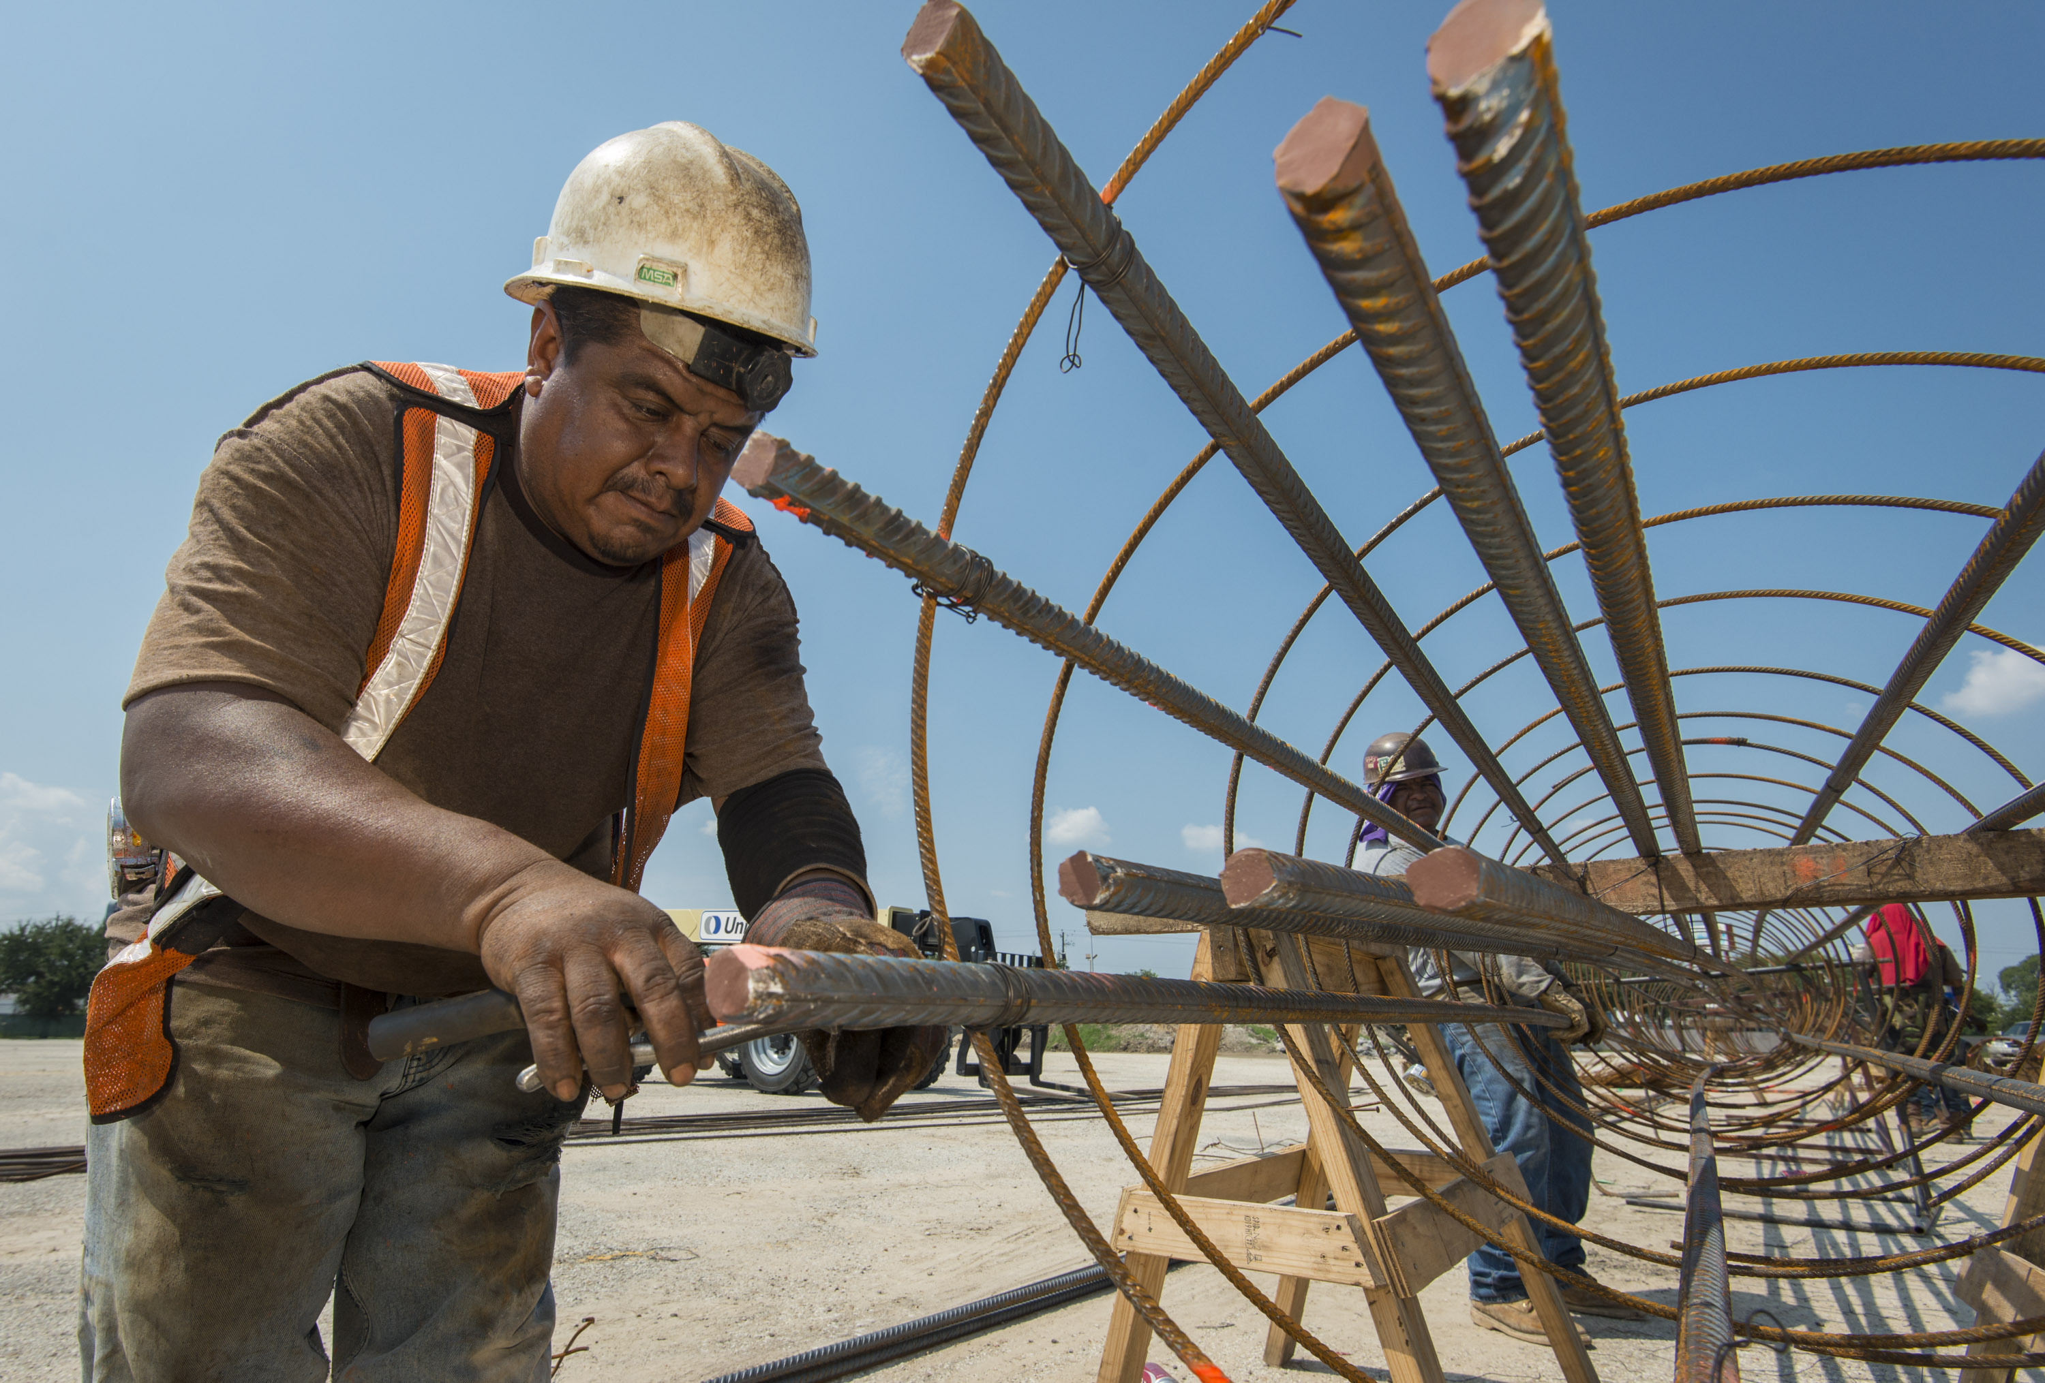
Looking Ahead
By the end of 2014, construction will begin on all Group 1 projects, as well as renovations at Butler and Barnett athletics facilities and middle school restrooms
Group 2 schools will begin transition from Schematic Design to Design Development during the first quarter of 2015

Slide 20
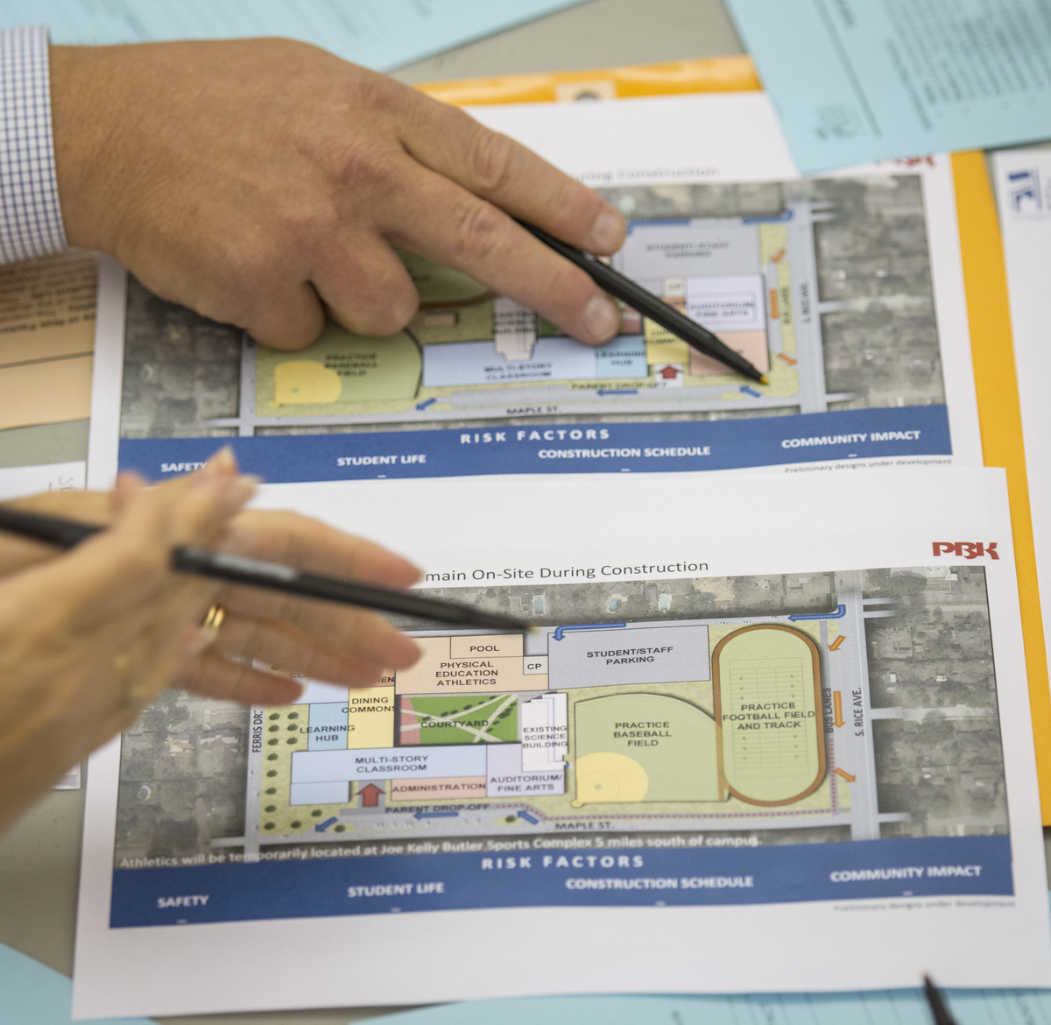
Looking Ahead
Community meetings are scheduled in the 4th quarter for HSPVA, Condit ES, Lee HS, DeBakey HS, and Sterling HS
Groups 3 and 4 architects will be fully engaged in PAT meetings
Group 1 projects will undergo a final scope-to-budget review that may necessitate some changes or modifications

Slide 21
Thank you

