Slide 1
Bond Construction Update
October 28, 2014

Slide 2
Where we were then: 2011-12
Houston commercial construction costs hold steady, report says
CBO: ‘Fiscal Cliff’ Could Trigger Recession
Construction jobs down in Houston
‘Modest recovery toward end of the year’ in store for 2011
Slow climb predicted for new home construction, experts say
Sources: Houston Business Journal, New York Times, Houston Chronicle

Slide 3
Houston area bond dollars
In 2012, Houston area voters approved $5.4 billion in bond projects:
HISD: $1.89 billion
Rest of Houston area: $3.5 billion

Slide 4
Fluctuating construction costs
Average Construction Cost for Texas Schools
(Per Square Foot, from 2007-2013)
In planning for its 2012 bond, HISD budgeted for $160/SF
$172
$164
$149
$153
$146
Sources: Texas Comptroller of Public Accounts, RS Means, data reported by school districts

Slide 5
Planning for inflation
A increase of 5% per year in inflation was anticipated ahead of HISD’s 2012 bond election
Inflation has actually come in at about 8% per year
*Based on cost estimates

Slide 6
Where we are now: 2014
Houston’s construction market: Short on labor, high on costs
Multifamily construction projects spread over Houston region
Contractors becoming more selective as prices soar
Houston-area construction industry faces price hike in materials, labor shortage
Over $1B of Houston construction projects could be up for grabs
Sources: Houston Business Journal, Houston Chronicle

Slide 7
Area bond dollars on horizon
$2.4 billion in projects on November 2014 ballots
$511
million proposed for municipal and
higher education
projects
$1.9 billion
in school construction

Slide 8
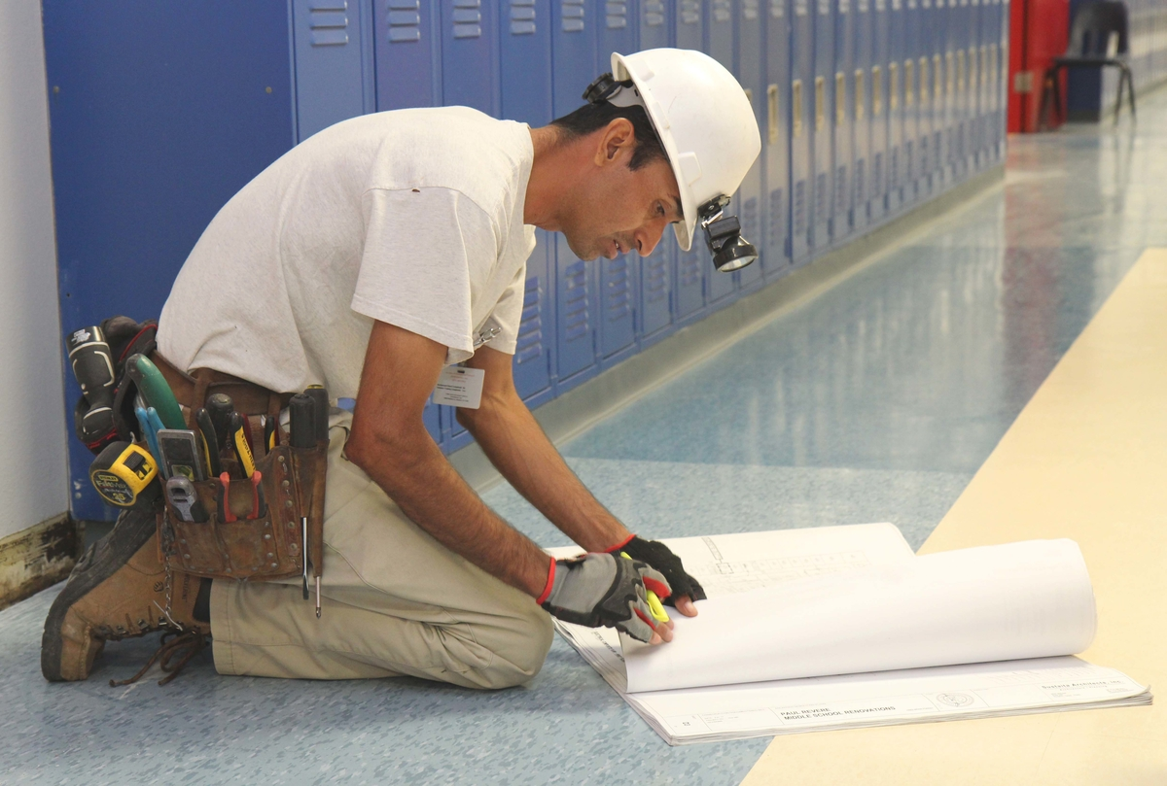
Tighter Houston labor market
43% DROP IN UNEMPLOYMENT
IN HOUSTON REGION FROM 2011 TO 2014
8.0
6.5
6.0
4.6
Source: Bureau of Labor Statistics

Slide 9
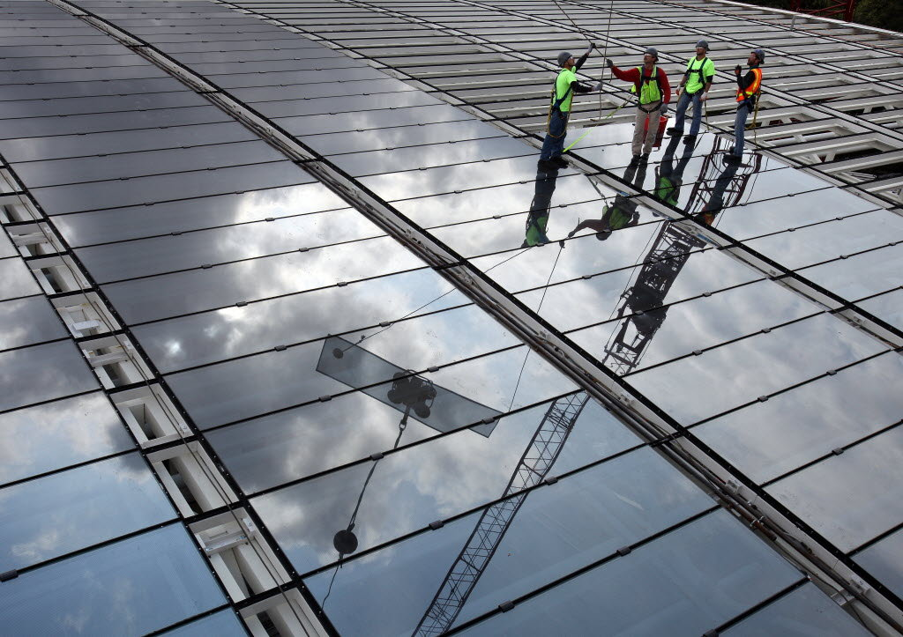
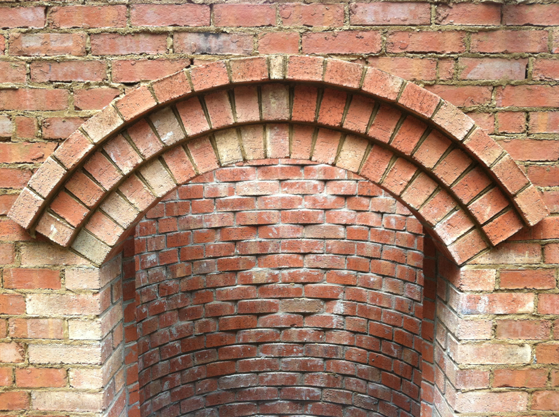
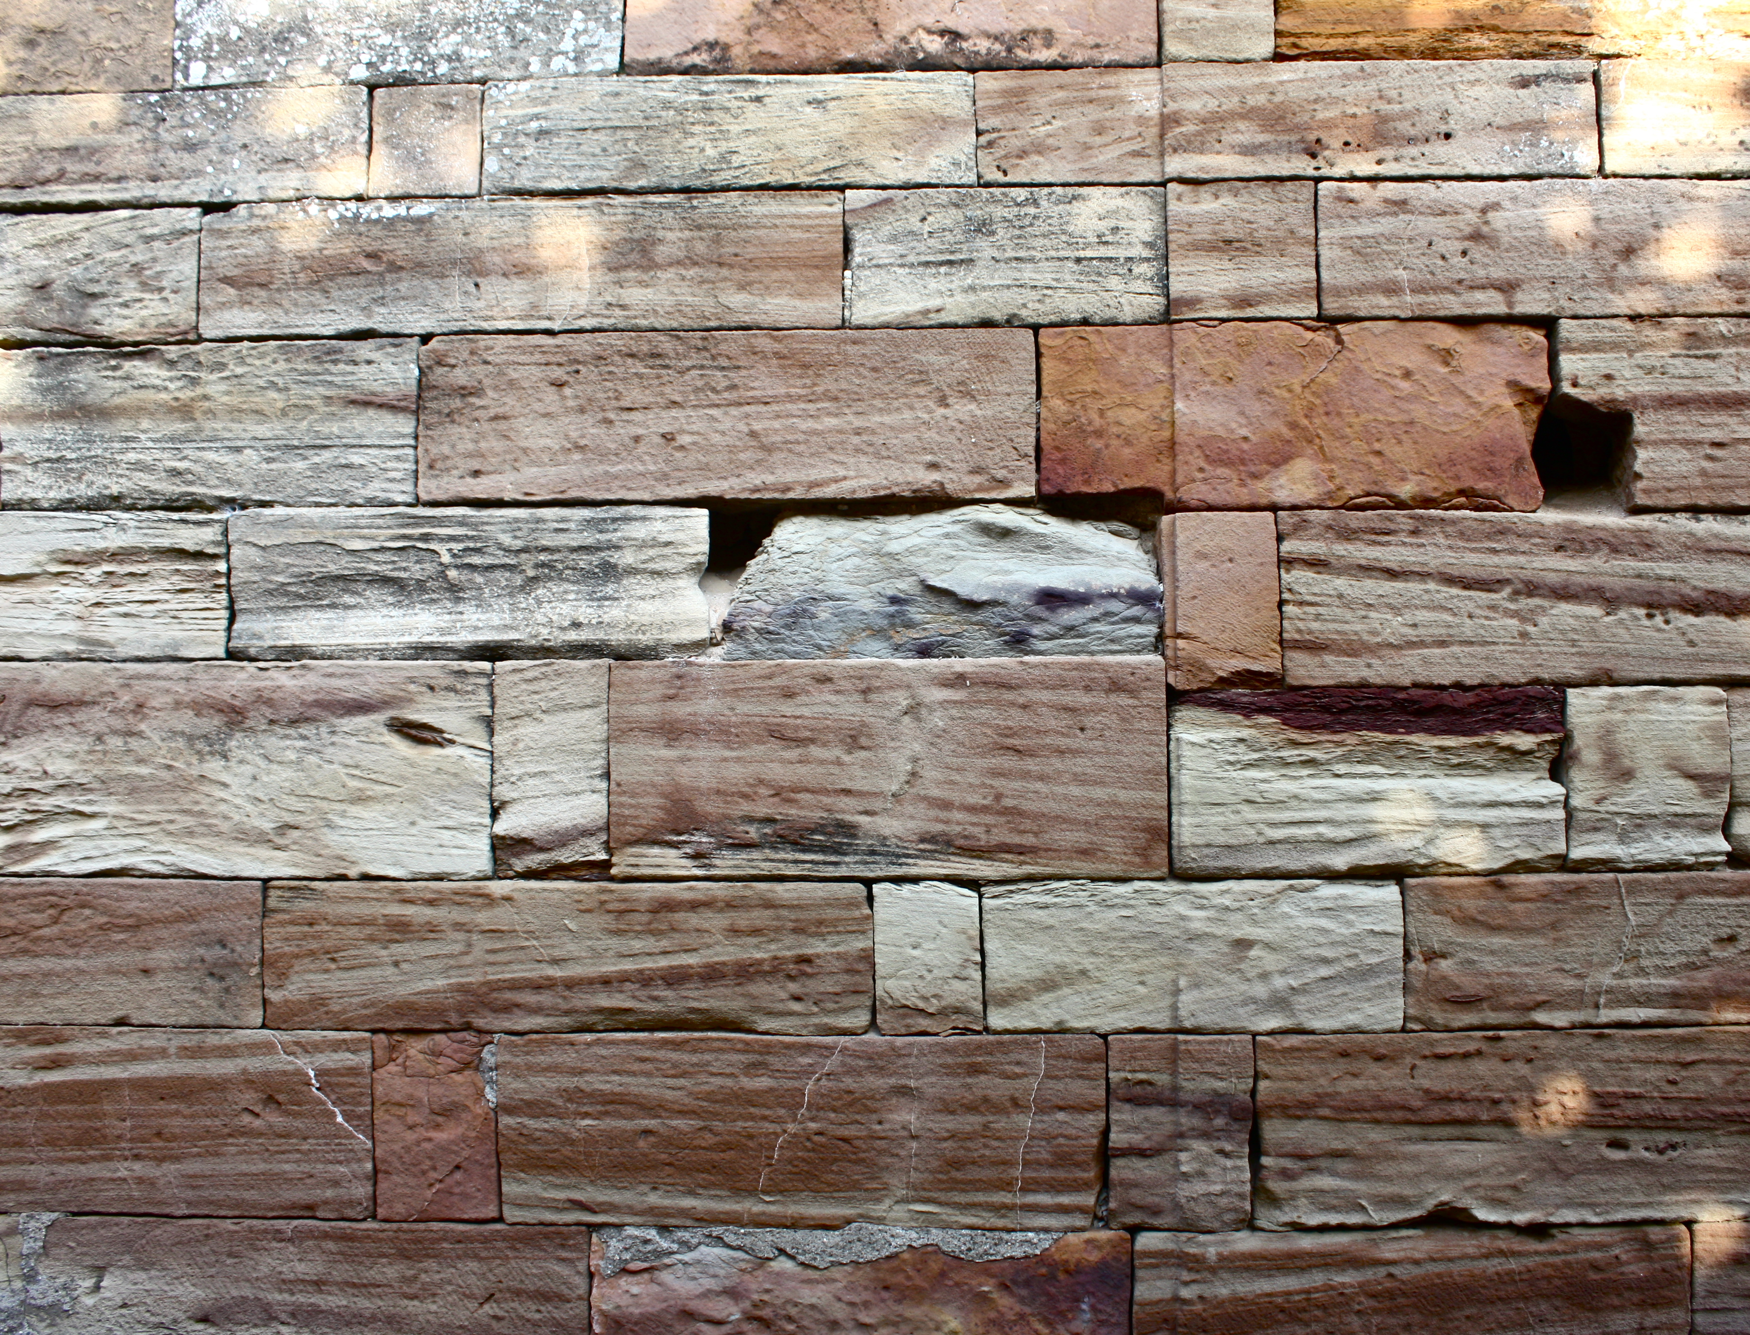
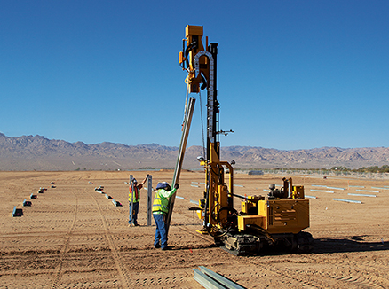
Rising demand for workers
Projected increases through 2022
49%
42%
40%
Rebar workers
Glaziers
Brick masons
37%
36%
Stone masons
Pile-driver operators
Source: Jones Lang LaSalle

Slide 10
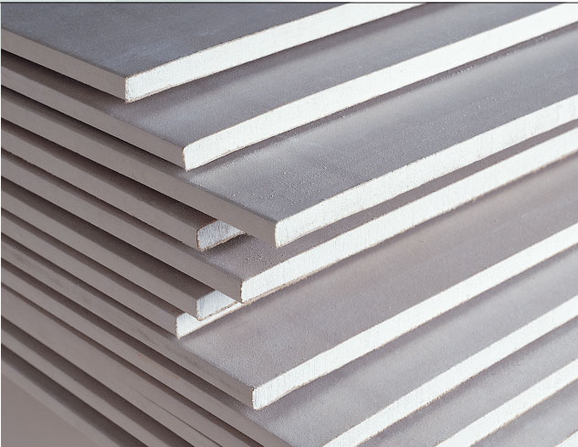
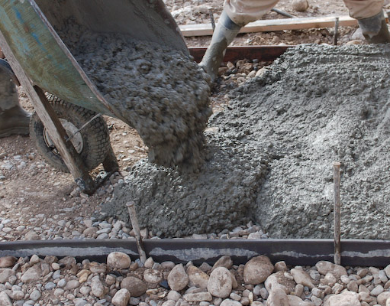
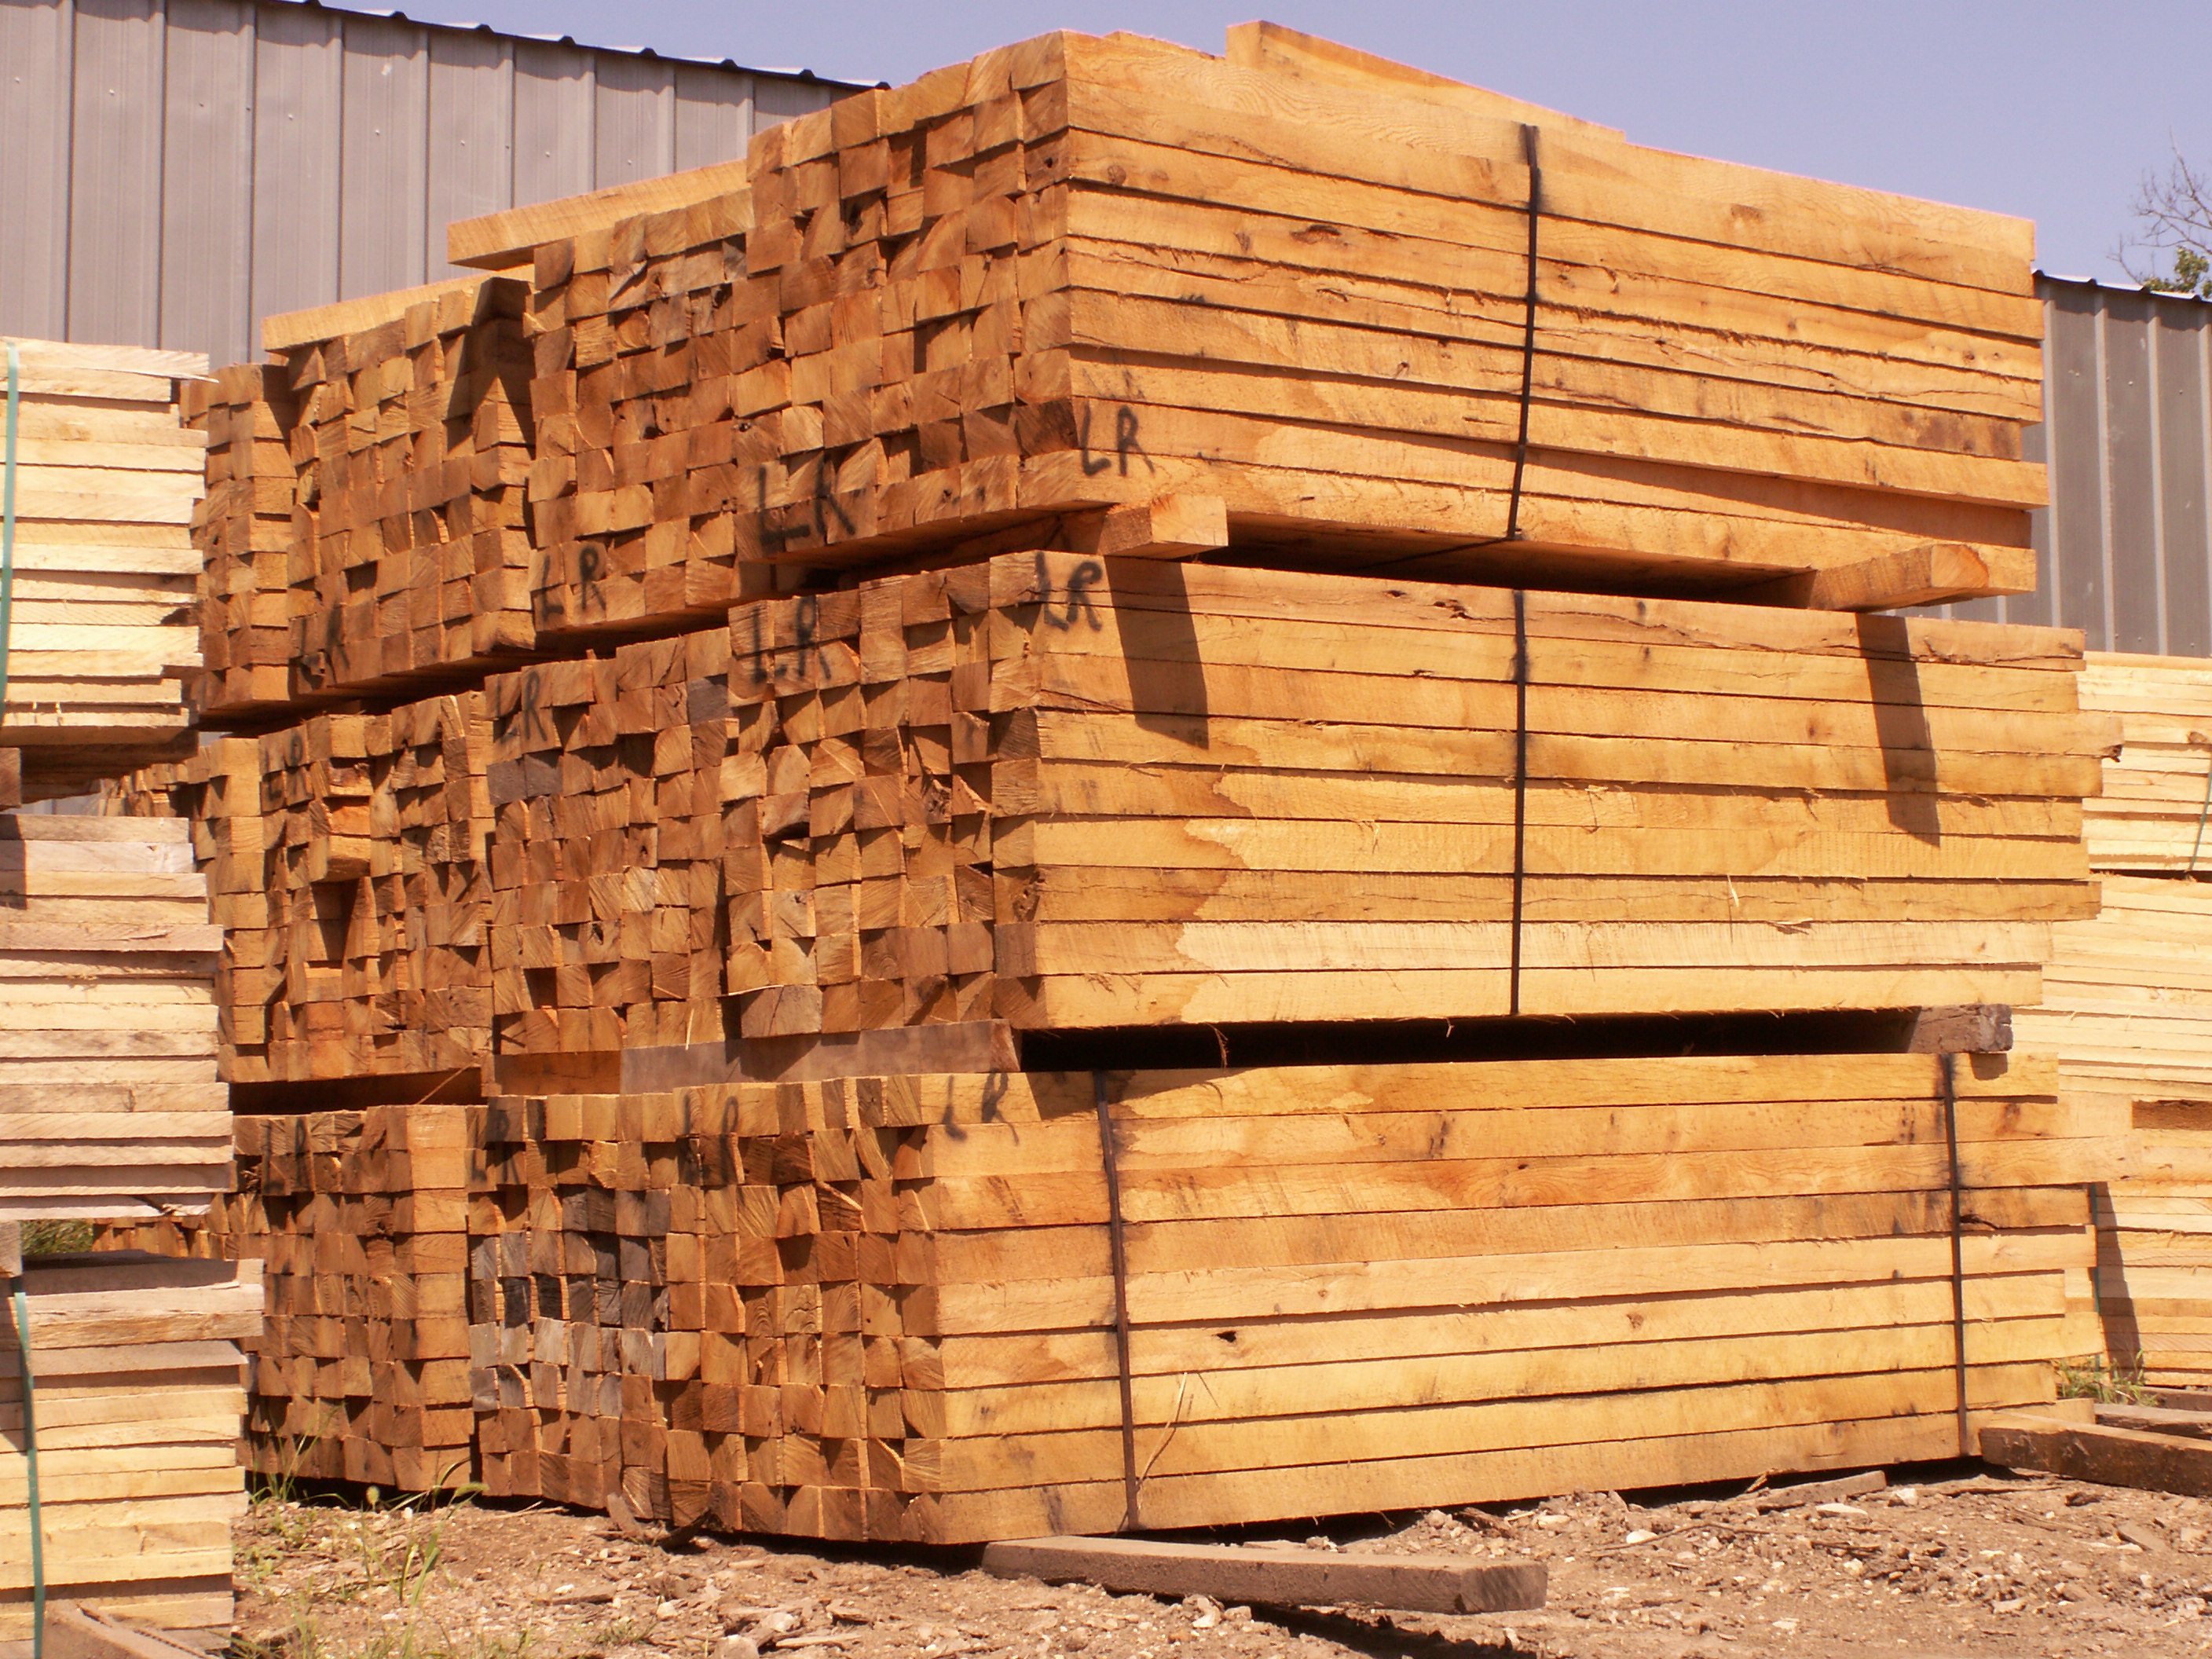
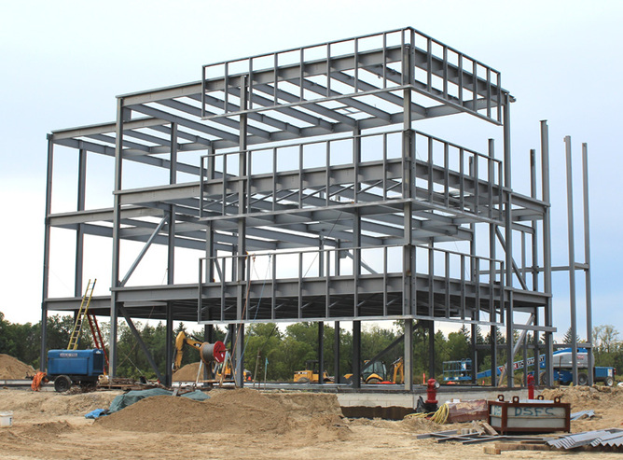
Rising demand for materials
Projected increases for 2014
49%
42%
40%
Rebar
Gypsum
Cement
37%
36%
Lumber
Structural steel
Source: Jones Lang LaSalle

Slide 11
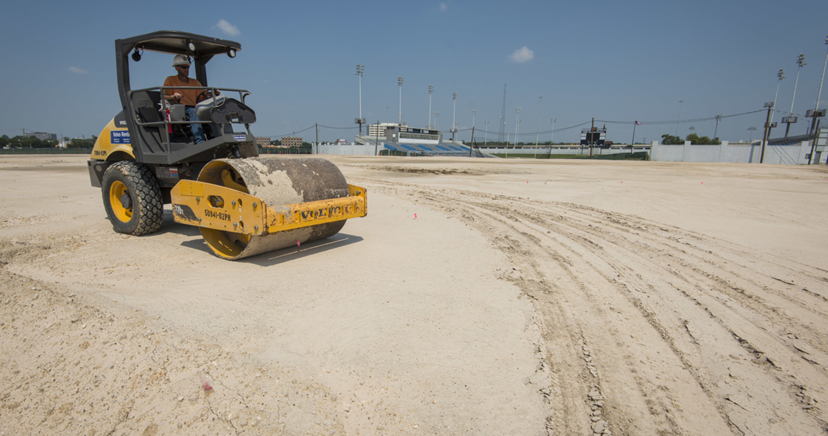
By the numbers
Total
construction spending
Up 6%
to 10%
per year
Materials costs
Up 1%
to 3%
per year
Labor
costs
Up 3%
to 5%
per year
Source: AGC

Slide 12
Anticipated impact
Flooded construction market
Reduced labor talent
Higher construction costs
Source: Skanska Market Trends and Alerts, October 2014

Slide 13
How are other districts coping?
Increasing the number of students allowed per class
To lower the cost per student
Source: Skanska Market Trends and Alerts (Oct. 2014)

Slide 14
HISD’s design/budget process
Planning
Schematic Design
Permit & Bid
Design Development
Construction Documents
Construction

Slide 15
Scope-to-budget checkpoints
1
Planning
Develop cost model
Scope-to-budget alignment as needed
2
Schematic Design
Verify cost estimate with CMAR, architect and program manager
Scope-to-budget alignment as needed
3
Design Development
Critical cost estimate within 5% of approved budget
Scope-to-budget alignment as needed
4
Construction Documents
Detailed estimate with some trade bids
CMAR estimate is critical
Scope-to-budget alignment as needed
5
Permit & Bid
Budget, scope and schedule confirmed (no cost increase)
Scope-to-budget alignment as needed

Slide 16
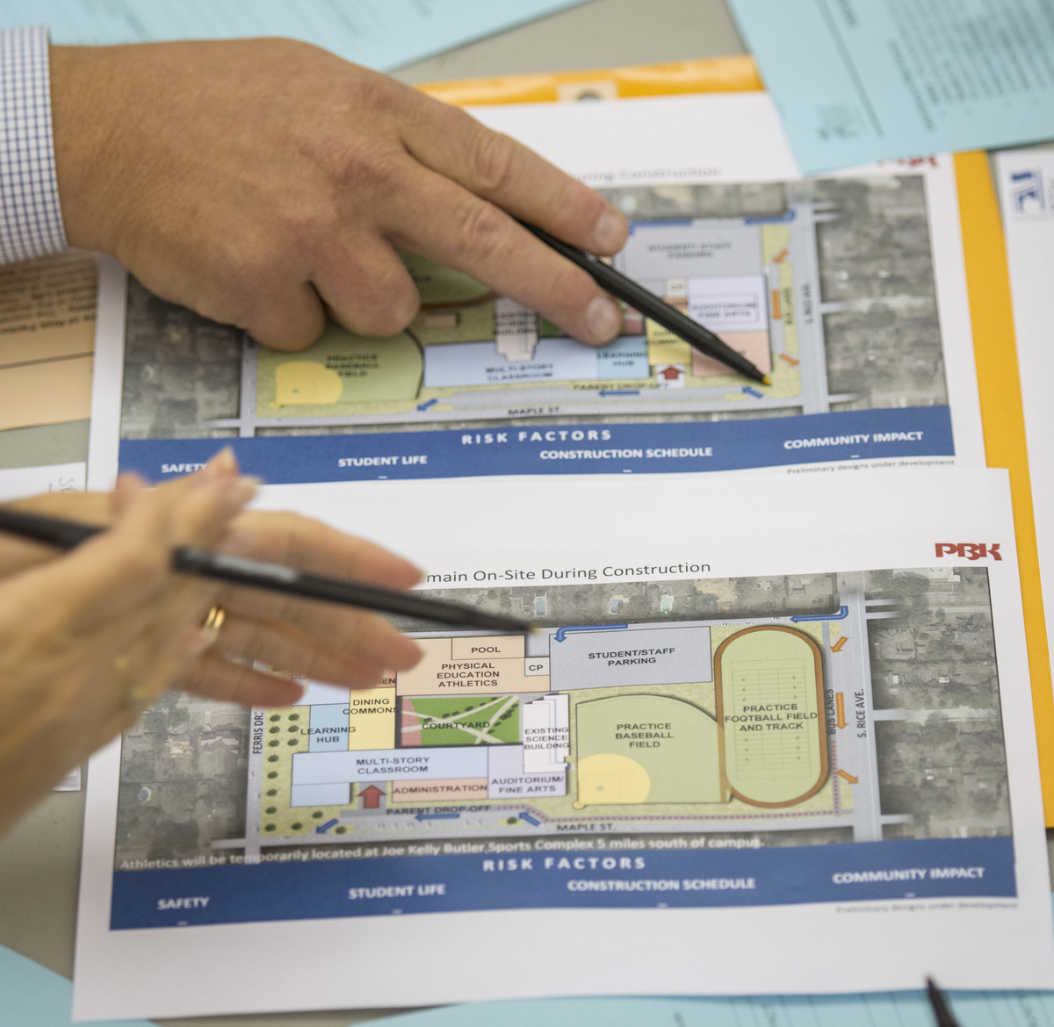
Other strategies
Accelerating work and revising schedules for Group 2 projects
Early starts for planning and design for schools in Groups 3 & 4
Group 3 campuses are 6 to 9 months ahead
Group 4 campuses are 15 to 18 months ahead

Slide 17
Questions?

