Slide 1
Bond Oversight Committee Meeting First Quarter 2014
April 29, 2014

Slide 2
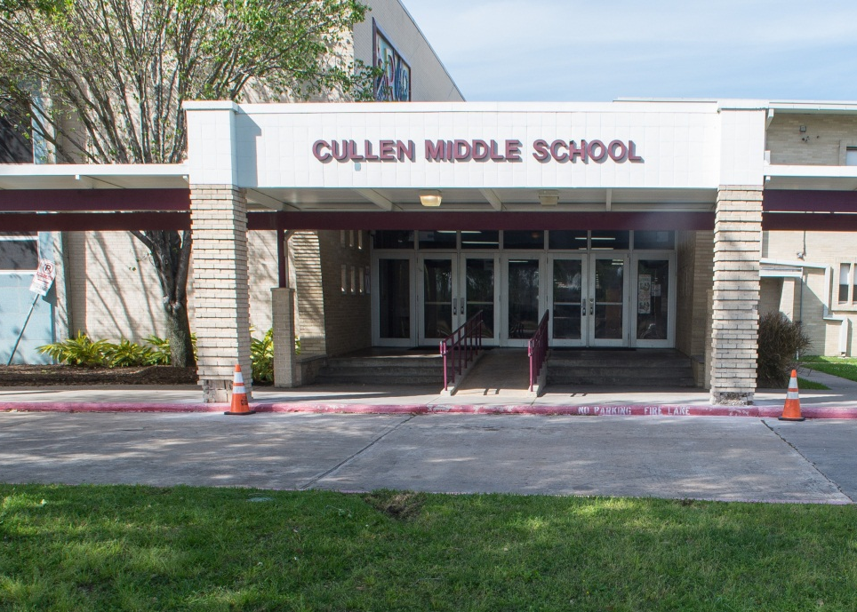
2007 Bond Update
Completion of major renovations at Cullen MS and Southmayd ES will occur over the next several months, including roof work at both sites
The expansion of Kate Smith ES is moving forward, which is an additional scope of work made possible through program realignments
All work in the 2007 program will be in the closeout phase by the end of 2014

Slide 3
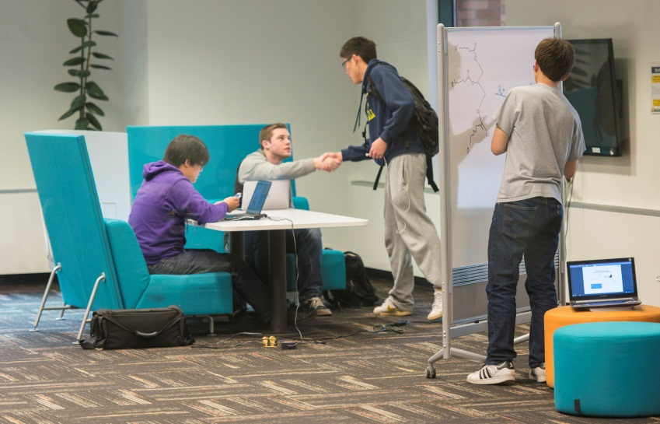
2012 Bond Planning
Planning is almost complete for all schools in Group 2 of the 2012 bond program.
Group 2 projects include some of the district’s largest high schools – Bellaire, Lamar, Davis, and Yates
Design charrettes are being scheduled
Each school’s first community meeting will be held by the end of the 2nd quarter of 2014
PATs have toured schools in the metro area and across the country to gain a greater knowledge of 21st century features for new HISD schools

Slide 4
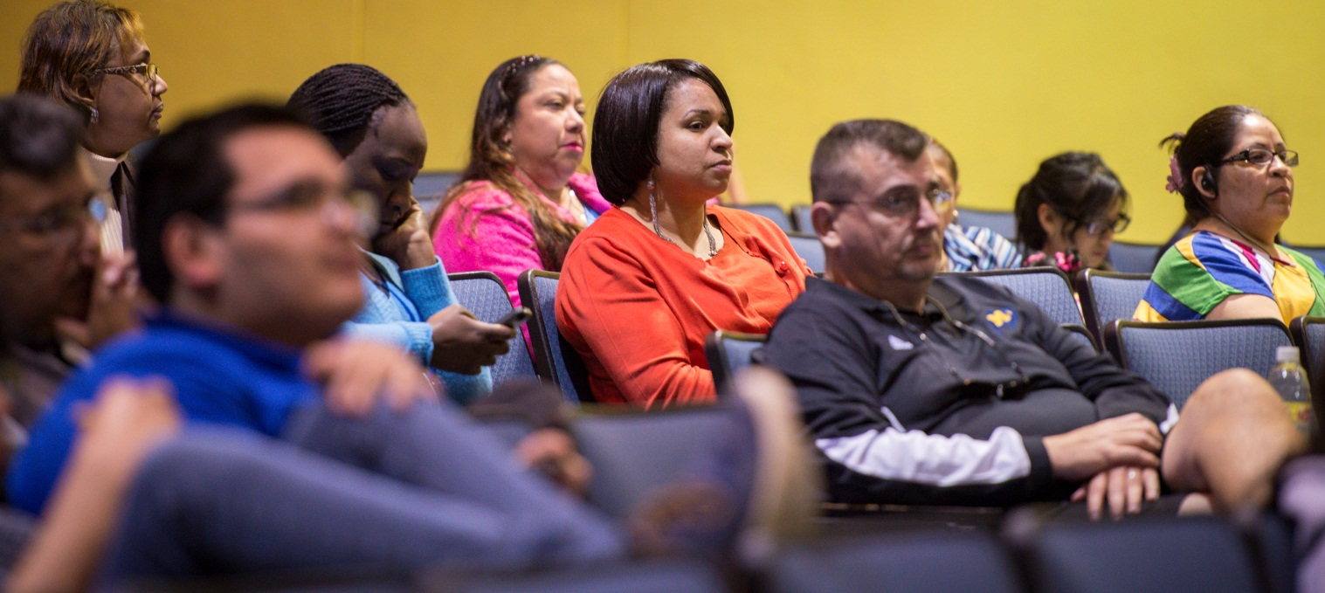
2012 Bond Design
Second round of community meetings held for Group 1 campuses
Community meetings held for 16 schools during first quarter
Group 1 projects are moving out of Schematic Design and into the Design Development stage
Construction scheduled to begin by end of 2014

Slide 5
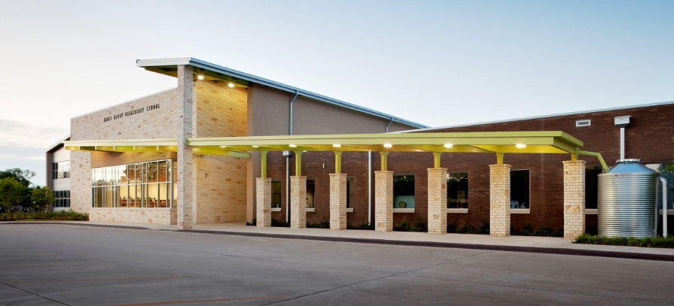
Sustainability
HISD is committed to building sustainable schools with eco-friendly design features that serve as learning tools.
Berry Elementary School, a new environmental studies magnet school funded by the 2007 bond program, received a Silver LEED (Leadership in Energy and Environmental Design) certification for its environmental enhancements designed to save energy at the facility.
In Group 1, 3 schools are going for gold certification, 11 are going for silver, and the rest are seeking certification.

Slide 6
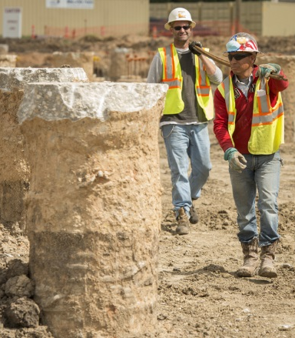
2012 Bond Construction
Waltrip
Swimming pool renovation complete
Next phase of construction to begin 2nd quarter of 2014
Worthing
Construction on new wing underway
North Houston Early College HS
Sewer and main water lines complete
Site work to start 2nd quarter of 2014
South Early College HS
Installation of meter vault and sanitary sewer to start 2nd quarter of 2014

Slide 7
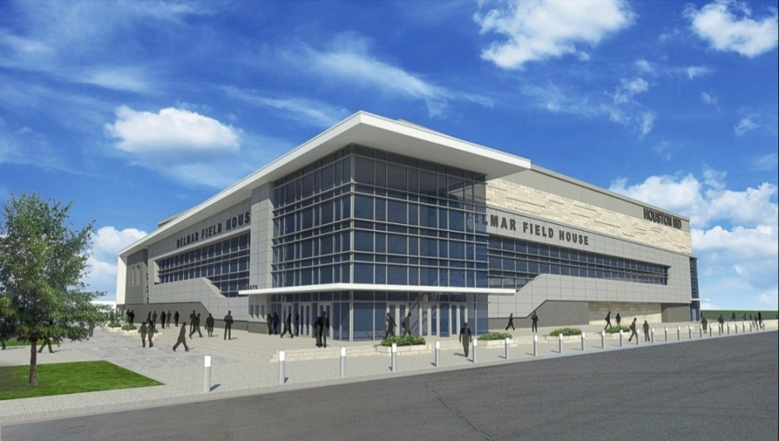
Districtwide Upgrades
Delmar Fieldhouse
Demolition complete
Site work in progress
Construction to begin 2nd quarter of 2014
Middle School Restrooms
Assessments complete
Design has begun on the Phase 1 projects
Construction will start in the 2nd quarter of 2014
Safety and Security
Priority 1 work (security cameras) is underway
Safety and security assessment of all district facilities complete
CFS working with Threat Assessment Team to review and prioritize districtwide safety improvements

Slide 8
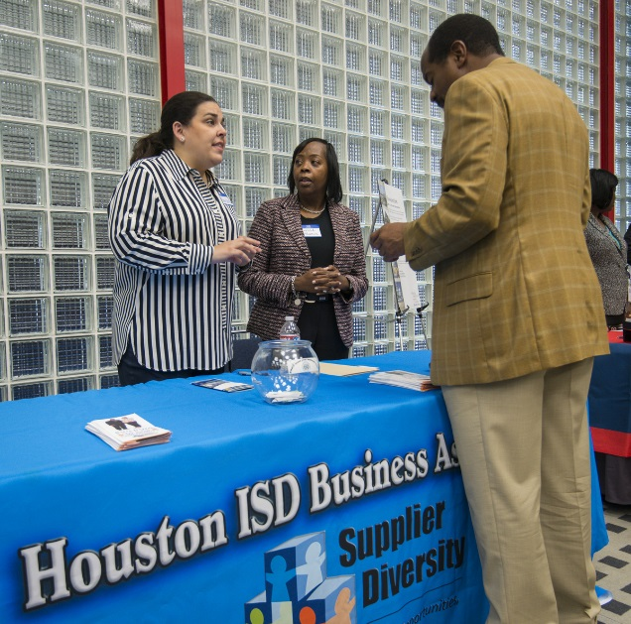
M/WBE Outreach Events
Workshop Wednesday
January: “Meet the Contractors” 2012 Bond Event for CMARs, M/WBEs
February: Introduction of Procurement team: Reviewing current structure
March: New M/WBE Participation Process Workshop for prospective vendors
Acres Homes Chambers
Networking Luncheon
Greater Houston Business Procurement Forum
Houston Community College Auditorium
Procurement Summit & Business Expo
Government Procurement Connections
2014 Planning Committee

Slide 9
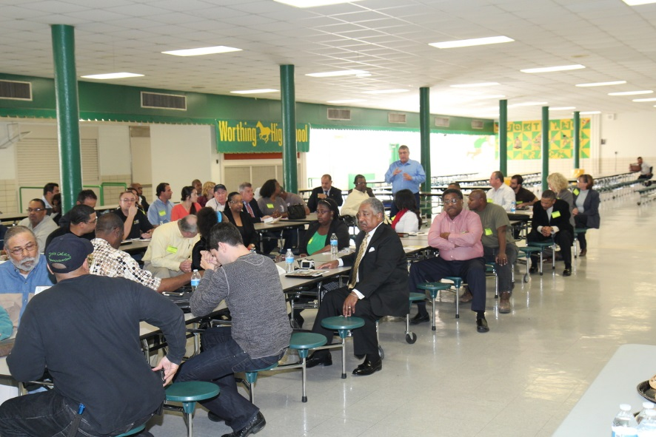
M/WBE Outreach Events (continued)
Houston Minority Supplier Development Council
Strategic Teaming Alliance Committee (STAC) Meeting
HCC-Spring Branch
How to Do Business with HISD
Interagency Mentor Protégé Program
Track 2 Graduation Event
Kingdom Builder’s Center
Contractors College: “Calling All Construction Partners”
Metro Transit of Harris County
Contractor Workshop
Government Procurement Connections Planning Committee Meeting

Slide 10
2007 Bond M/WBE Participation
Exceeded minimum M/WBE goal levels of 20% for 2007 bond program
M/WBE participation has reached nearly 35% in 2007 bond program

Slide 11
2012 Bond
M/WBE Commitment
Certified Minority/Women Owned Businesses Breakdown

Slide 12
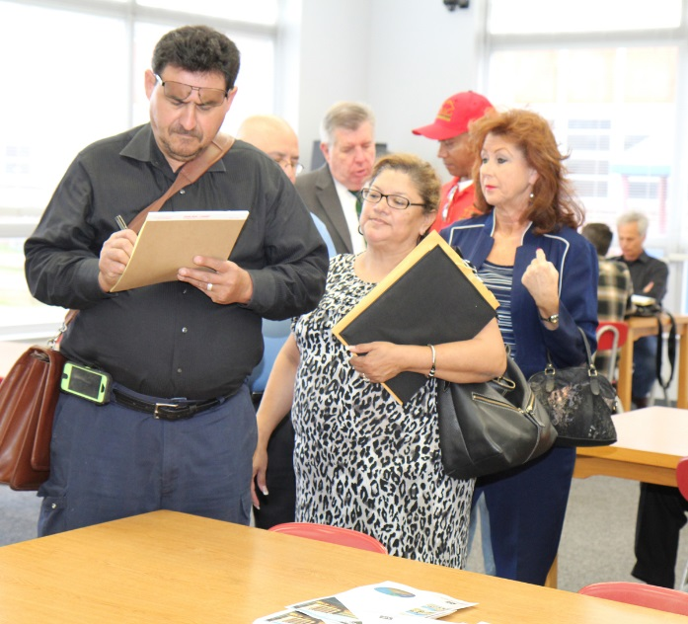
Doing Business
HISD is committed to Supplier Diversity.
Monthly outreach events are being held for minority and women-owned businesses
M/WBE commitments for contracts awarded to date:
Professional Services represent 51%
CMARs represent 20% to 40%
Meet & Greets were held at:
Worthing High School for awarded CMAR (Balfour Beatty)
Delmar Fieldhouse for awarded CMAR (DivisionOne Construction)
Waltrip High School for awarded CMAR (Satterfield & Pontikes)
Nominated for Distinguished Supplier Diversity Award the by the Houston Minority Business Development Agency Business Center

Slide 13
2007 Bond Financial Report
Total funding of $1,176,130,676
Actual committed of $1,044,546,922 (including encumbrances of $50,594,360 and actual expenditures of $993,952,562)
Uncommitted funding balance of $131,583,754 or 11% of total funding
As of March 31, 2014

Slide 14
2012 Bond Financial Report
The total for the 2012 Bond Program is $1.89 billion, and the issuance of the bonds has been planned in four sales
Commitments of $115,615,425 (including encumbrances of $75,443,541 and actual expenditures of $40,171,884) leaving $1,774,384,575 of available funding
As of March 31, 2014

Slide 15
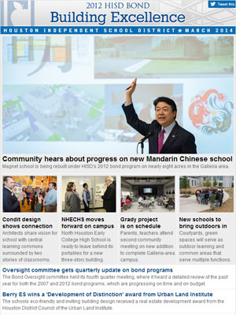
Communications
HISD is committed to providing timely and accurate information on the 2007 and 2012 bond programs.
Creating and distributing fliers and meeting invitations to key stakeholders for 16 school community meetings
33 blog posts and photo galleries on school community meetings, green school efforts, and community outreach events
More than 30 tweets and Facebook posts highlighting bond activities
Produced 5 videos that show PATs and community participation in design process and school site tours

Slide 16
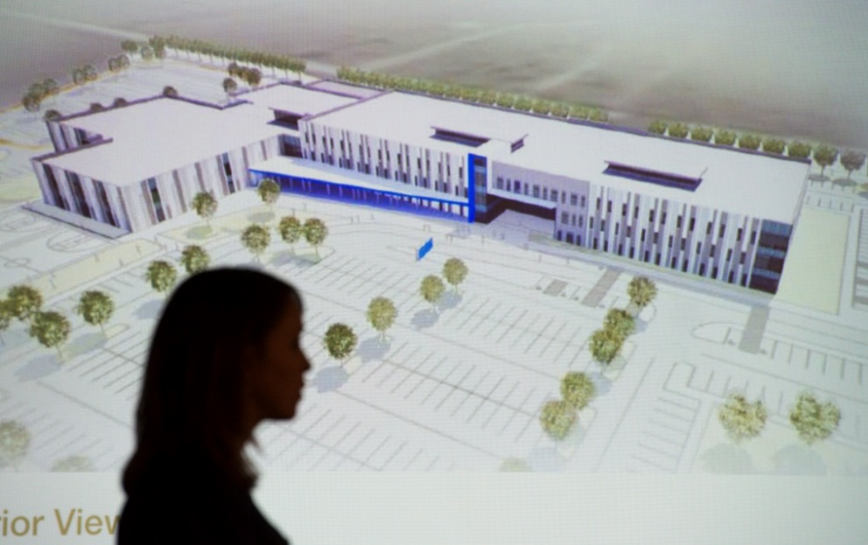
Looking Ahead: 2014
By the end of 2014, construction will begin on all remaining schools in Group 1
Between the 2nd and 3rd quarter, all Group 1 schools will have their third community meeting
In the 2nd quarter, Group 2 schools will have their first community meeting and design charrette

Slide 17
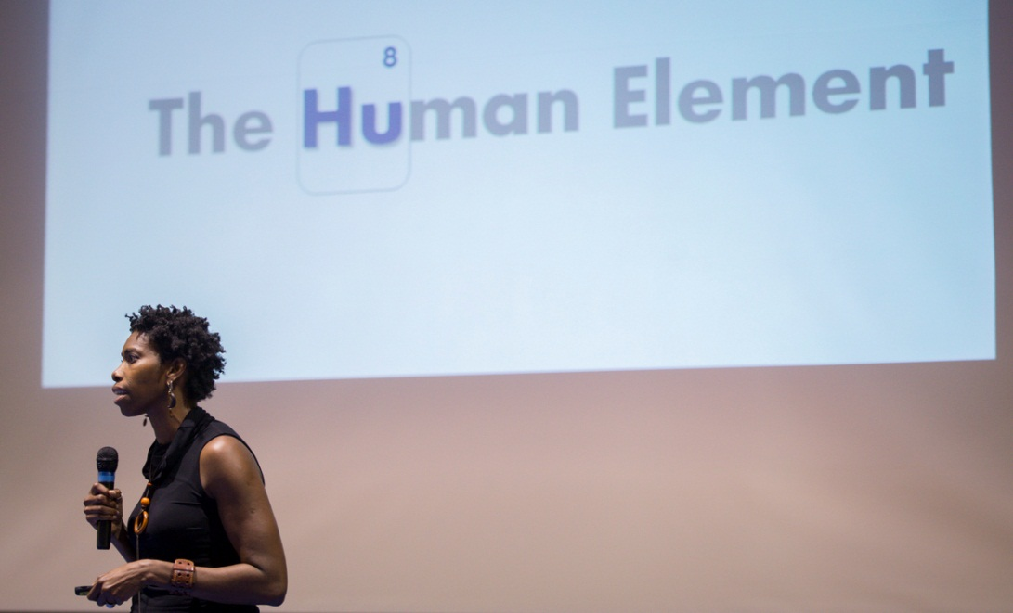
Looking Ahead: 2014 (continued)
In the 2nd quarter, Group 1 projects will transition from SD to DD and will go through a budget/program alignment process
In the 2nd quarter, a design RFQ will be advertised for Group 3
Supplier diversity networking events will be held at bond campuses to encourage community participation

