Slide 1
Bond Oversight Committee Meeting Fourth Quarter
February 7, 2014

Slide 2
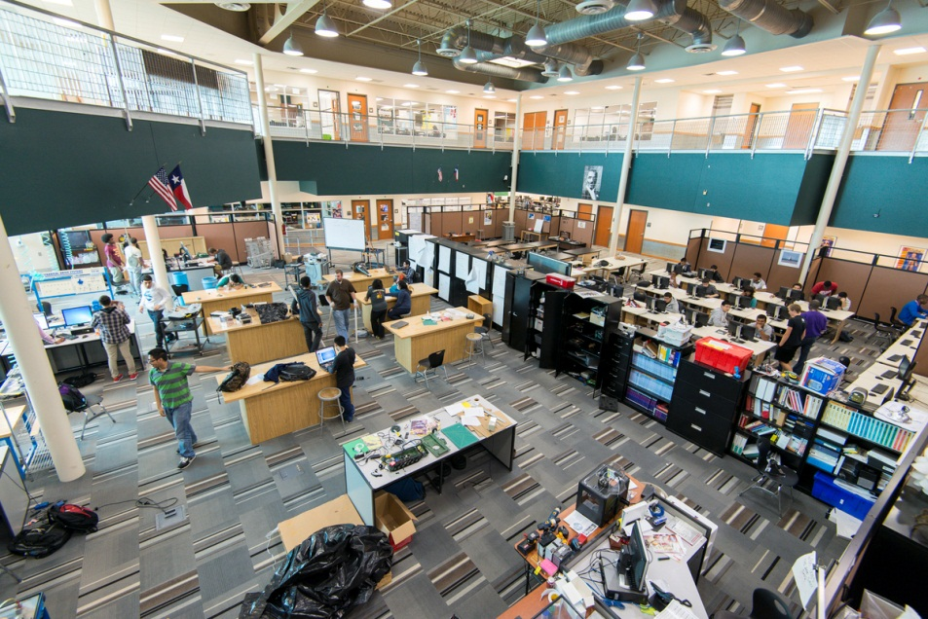
21st Century Learning Spaces
HISD is building modern facilities to support students in becoming college and career ready in the 21st century.
Flexible learning spaces
Ergonomic furniture
Visual connections
Linked learning
Natural light
Sustainable design
Technology to support a variety of teaching and learning styles
More info at houstonisd.org/21stCentury

Slide 3
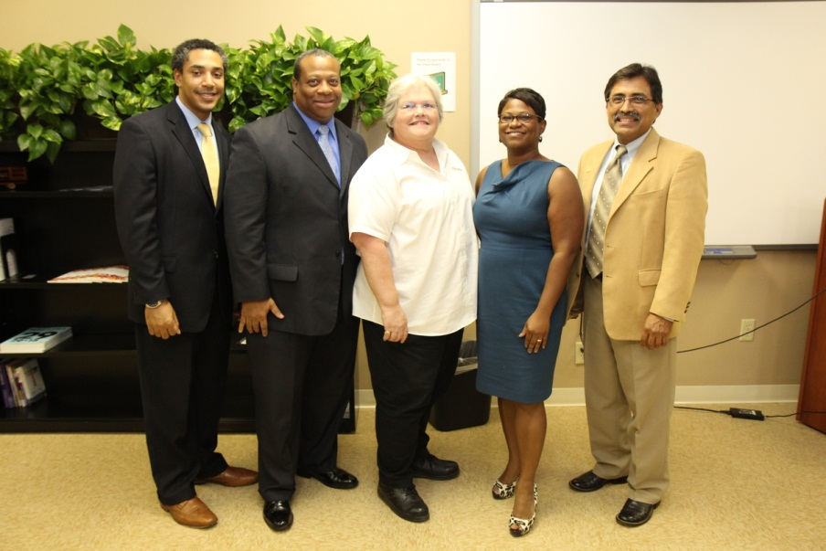
M/WBE Outreach Events
Workshop Wednesday
November: NAMC “Utilizing Joint Ventures/Strategic Partnerships on HISD Projects”
December: Virtual Assistant
Business Matchmaking Event
Houston Minority Supplier Development Council
2014 Strategic Economic Opportunity Forum
Contractor’s College Workshop
Interagency Mentor Protégé Program

Slide 4
2007 Bond M/WBE Participation
Exceeded minimum M/WBE goal levels of 20% for 2007 bond program
M/WBE participation has reached nearly 35% in 2007 bond program

Slide 5
2012 Bond
M/WBE Commitment
Certified Minority/Women Owned Businesses Breakdown

Slide 6
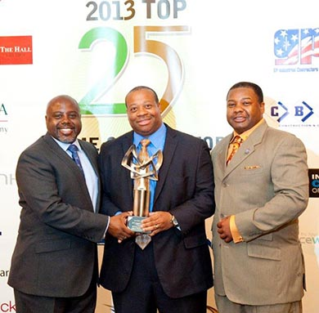
Doing Business
HISD is committed to supplier diversity.
Monthly outreach events are being held for minority and women-owned businesses
Contracts awarded to date represent a 51 percent commitment rate by M/WBE firms
Local job fairs will be held at each bond campus to encourage neighborhood participation

Slide 7
2007 Bond Financial Report
Total funding of $1,176,130,676
Actual committed of $1,024,281,933 (including encumbrances of $58,516,133 and actual expenditures of $965,765,800)
Uncommitted funding balance of $151,848,743 or 13% of total funding
As of December 13, 2013

Slide 8
2012 Bond Financial Report
The total for the 2012 Bond Program is $1.89 billion and the issuance of the bonds has been planned in four sales
Commitments of $72,092,672 (including encumbrances of $64,750,890 and actual expenditures of $7,341,782) leaving $1,817,907,328 of available funding
As of December 13, 2013

Slide 9
Year in Review

Slide 10
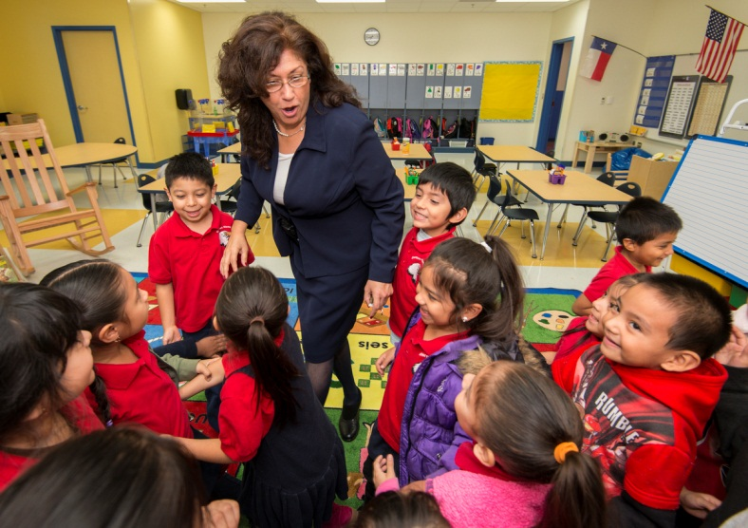
Year in Review: 2007 Program
HISD is delivering on promises made as part of the 2007 bond program:
136 projects completed
12 projects in close-out phase
48 projects currently active in design, procurement and construction
3 new schools opened in 2013: Atherton, Dogan and Sherman
1 school completed a major addition: Katherine Smith ES

Slide 11
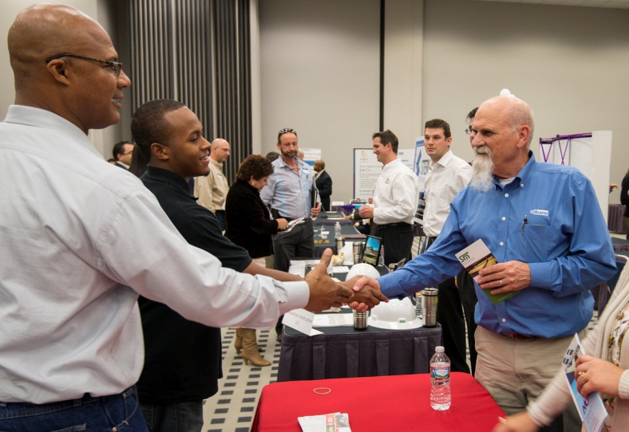
Year in Review: 2007 Program
HISD is delivering on promises made as part of the 2007 bond program:
M/WBE participation rate: 34 percent
Number of M/WBE companies participating in the 2007 program: 307
All remaining projects are fully funded to meet commitments made in the 2007 bond program

Slide 12
Looking Ahead: 2007 Program
Major milestones ahead:
More than 180 projects will be complete by end of 2014
LEED (Leadership in Energy and Environmental Design) certification process underway for eligible projects
Improved campus safety and security

Slide 13
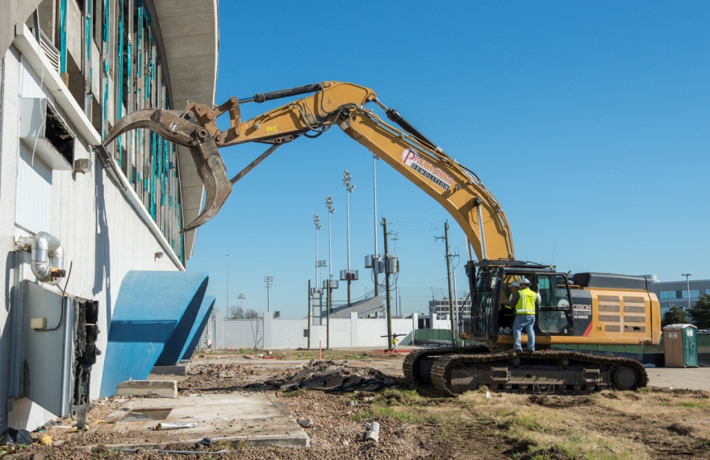
Year in Review: 2012 Program
Planning, design and construction are underway for 21st century campuses across the district:
Project Advisory Teams were formed at 25 schools to begin planning and design
More than 150 PAT meetings were held across the district
Design contracts were awarded for the 25 schools in Groups 1 & 2
All projects are on time and on budget

Slide 14
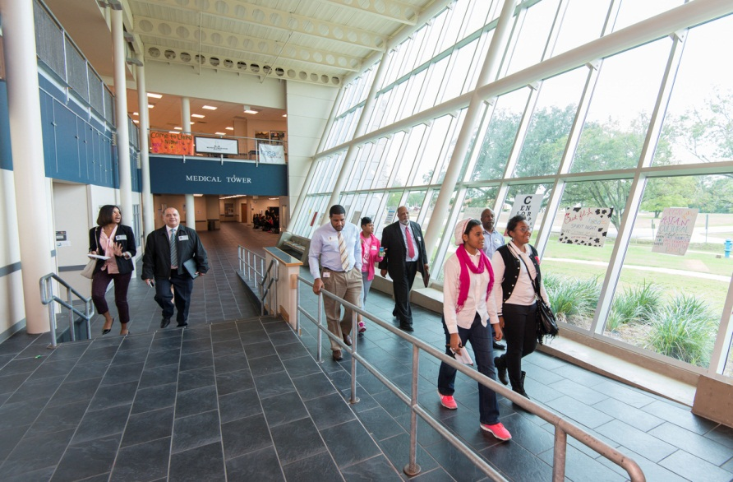
Year in Review: 2012 Program
First tranche of bonds were sold for $340 million in February 2013
CMAR contracts were awarded for 25 schools and district athletic upgrades
Design charrettes were held for 10 schools: Furr, Lee, Sharpstown, Sterling, Mandarin Chinese Language Immersion, Condit, DeBakey, HSPVA, Milby and YMCPA
Project Advisory Teams went on tours of 21st century campuses

Slide 15
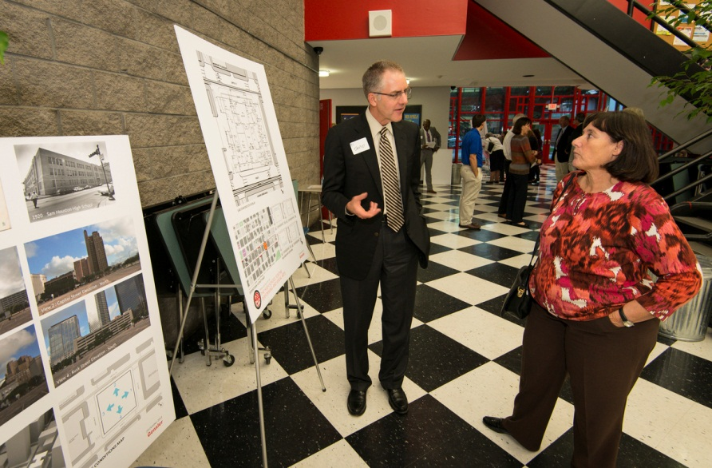
Year in Review: 2012 Program
First round of community meetings were held for Group 1 bond campuses
14 of 31 design contracts are with certified M/WBE firms
Overall, M/WBE commitment rate for professional services is 51 percent

Slide 16
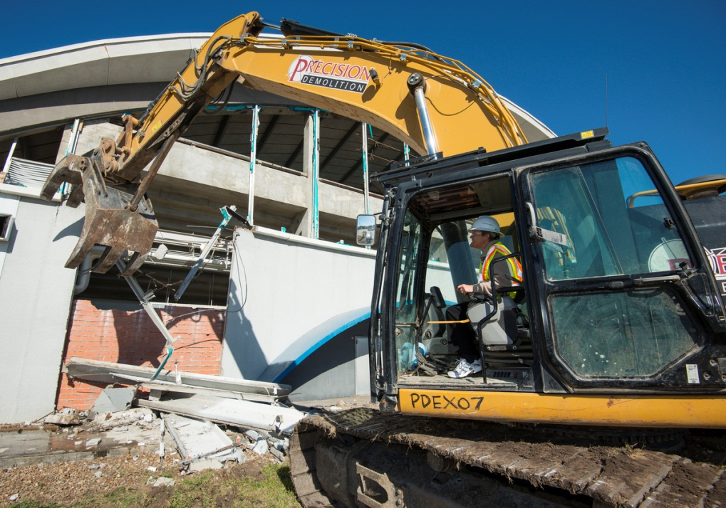
Year in Review: 2012 Program
Site work and construction began at 4 schools
Demolition began on Delmar-Tusa Fieldhouse

Slide 17
Year in Review: Communications
HISD is committed to providing timely and accurate information on the 2007 and 2012 bond programs.
Award-winning newsletter sent out monthly sent to nearly 3,000 subscribers
Bond update sent to 140,000 district households
Regular updates to bond website at houstonisd.org/bond
Dedicated email for questions at bondinfo@houstonisd.org

Slide 18
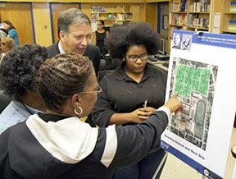
Looking Ahead: 2012 Program
Construction to begin on all remaining schools in Group 1
An estimated 24 community meetings will be held for schools in Groups 1 & 2
Design contracts to be awarded for Group 3 schools
Supplier diversity networking events will be held at bond campuses to encourage community participation

