Slide 1
Bond Oversight Committee Workbook
July 30, 2013
Presented by
Construction and Facility Services

Slide 2
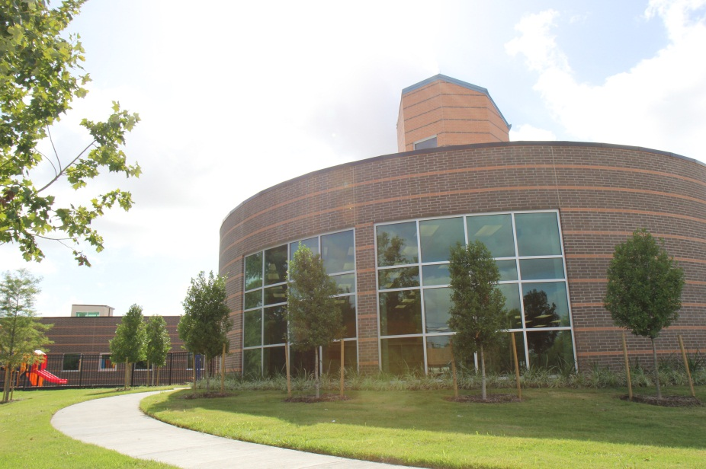
2007 Bond Key Facts
• $805 million in bond funding
• New fencing installed at 131 schools
• More than 8,800 security cameras installed
• 20 new schools open
• 3 new schools scheduled to open: Atherton, Dogan and Sherman
• 2 schools renovated and expanded: Crockett and Valley West

Slide 3
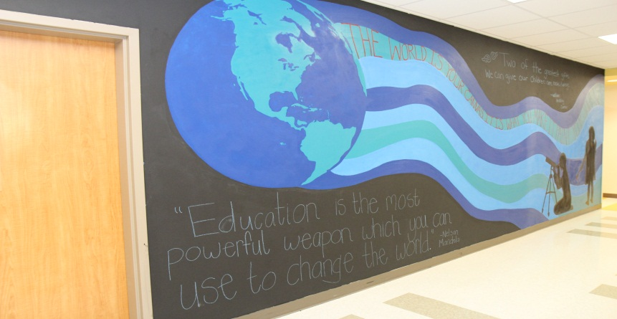
2007 Bond Update
Renovated restrooms at Wainwright ES and a new library addition at Southmayd ES
Improved HVAC systems at T.H. Rogers K-8 and Revere MS
New fire, PA, and security systems at Deady MS
More than 60 construction projects underway this summer
New 750-student campus dedicated at Neff ES

Slide 4
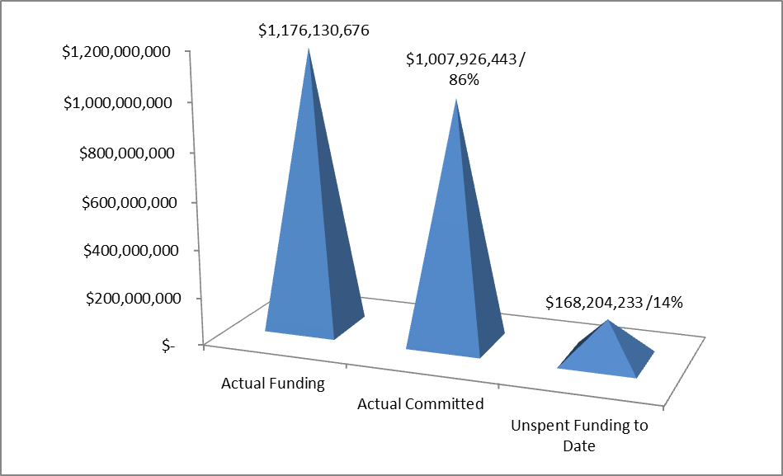
2007 Bond Financial Report
Total funding of $1,176,130,676
Actual committed of $1,007,926,443 (including encumbrances of $109,274,627 and actual expenditures of $898,651,816)
Unspent funding balance of $168,204,233 or 14% of total funding

Slide 5
2007 Bond M/WBE Participation
HISD exceeded minimum M/WBE goal levels of 20% for 2007 bond program
HISD’s M/WBE participation reached nearly 35% in 2007 bond program

Slide 6
2012 Bond Key Facts
HISD is committed to creating 21st century schools.
$1.89 billion in funding
$1.6 billion to build or renovate 40 schools
$117.3 million for safety, security and technology upgrades
$35 million for middle school restroom renovations
$44.7 million to improve district athletic facilities
$55.7 million for land acquisitions

Slide 7
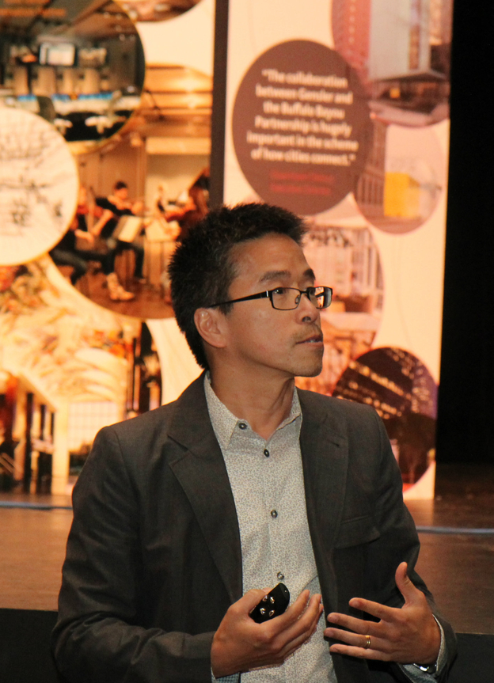
Making Progress
HISD is committed to completing all bond work within budget by the end of 2020.
Architects selected for 24 schools
Design contracts awarded for middle school restroom renovations and district athletic facility upgrades
Program managers hired to help oversee construction
Planning and design meetings underway for at least 20 schools
Real estate acquisitions underway

Slide 8
Meet the Architects
Group 1
Condit ES - VLK
DeBakey HS - WHR/Lake Flato
Delmar Stadium - PBK
Furr HS - ERO
Grady MS - Natex
HSPVA - Gensler
Lee HS - WHR
Mandarin Chinese Language Immersion School - PBK
Milby HS – Kirksey
North Early College - RdlR
Relief ES - English
Sharpstown HS - Munoz
South Early College - Smith Architects
Sterling HS - SHW
Waltrip HS - Gensler
Washington HS - FH-HP
Worthing HS - Molina Walker
Young Men’s College Prep - Harrison Kornberg

Slide 9
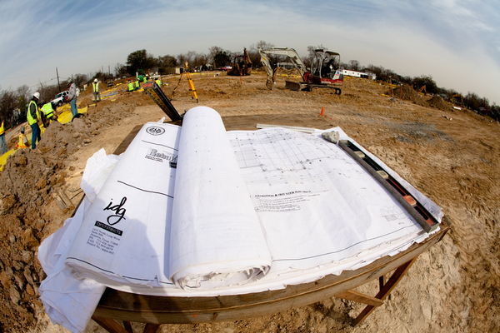
Meet the Architects
Group 2
Bellaire HS - PBK
Davis HS - Bay-IBI
Dowling MS - Harrison Kornberg
Eastwood Academy - Prozign
Lamar HS - Perkins + Will
Parker ES - Brave/Architecture
Yates HS - Moody-Nolan

Slide 10
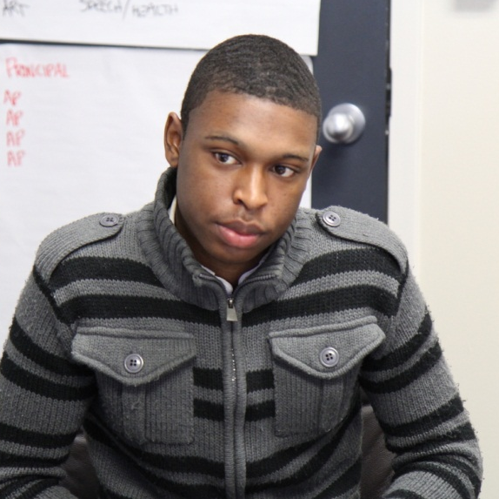
Maintaining Accountability
HISD is committed to a quality bond program
that is transparent, accountable and responsive.
Bond Oversight Committee meets quarterly to monitor progress of district’s bond programs
Project Advisory Teams meet monthly at each bond campus to take part in the school planning and design
21st Century Schools Advisory Committee meets monthly to help guide the district’s approach in designing 21st century learning environments

Slide 11
2012 Bond Financial Report
2012 Capital Program to expend $1.89 billion over the next 8 years
Issuance of bonds has been planned in four different sales (shown below)
Majority of the $340 million will be allocated for design and management fees for Group 1 projects
2013 (Sold Feb) 2014 (Q3) 2015 (Q1) 2016 (Q1)

Slide 12
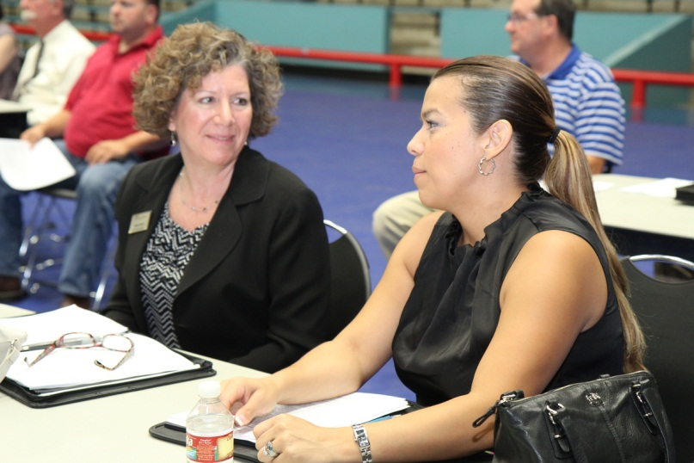
Doing Business
HISD is committed to supplier diversity.
Monthly outreach events are being held for minority and women-owned businesses
Contracts awarded to date represent a 51 percent commitment rate by M/WBE firms
Local job fairs will be held at each bond campus to encourage neighborhood participation

Slide 13
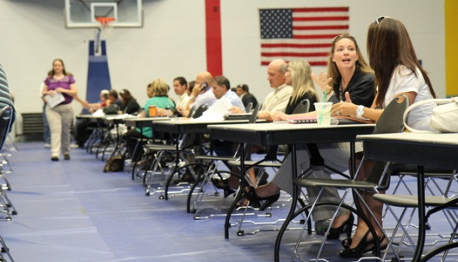
M/WBE Outreach Events
Workshop Wednesday
May: Social Media Marketing-What is it and How Can it Increase Your Bottom Line?
June: Supplier Diversity Strategies and How to Grow Your Business Globally
July: Conversation with Certified M/WBE(s)
HISD Construction Networking Event
Information Technology’s Networking Event
M/WBE Participation Form Workshop
Participated in over 30 outreach events

Slide 14
2012 Bond M/WBE Commitment
Certified Minority/Women Owned Businesses Breakdown by Project Type

Slide 15
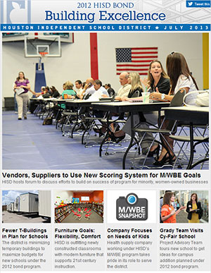
Staying Informed
HISD is committed to engaging the public with timely and accurate information.
Award-winning monthly newsletter sent to nearly 3,000 subscribers
Regular updates to bond website at houstonisd.org/bond
Dedicated email for questions at bondinfo@houstonisd.org

Slide 16
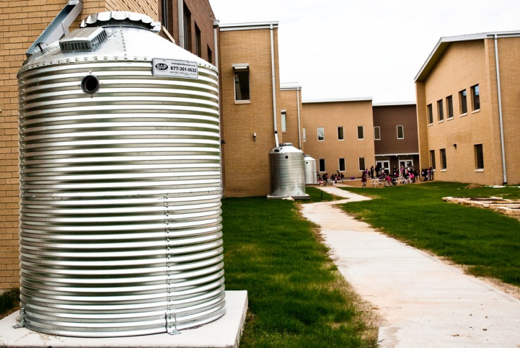
Next Steps
HISD is committed to sustaining momentum.
Bond planners hosting a Green School workshop for architects, engineers and program managers
CMAR recommendations for Worthing, Waltrip and South and North Early College high schools in July; more to come
Information session on architect selection process and tips for improving future proposals

