Slide 1
Bond Oversight Committee Meeting
Second Quarter 2014
July 29, 2014

Slide 2
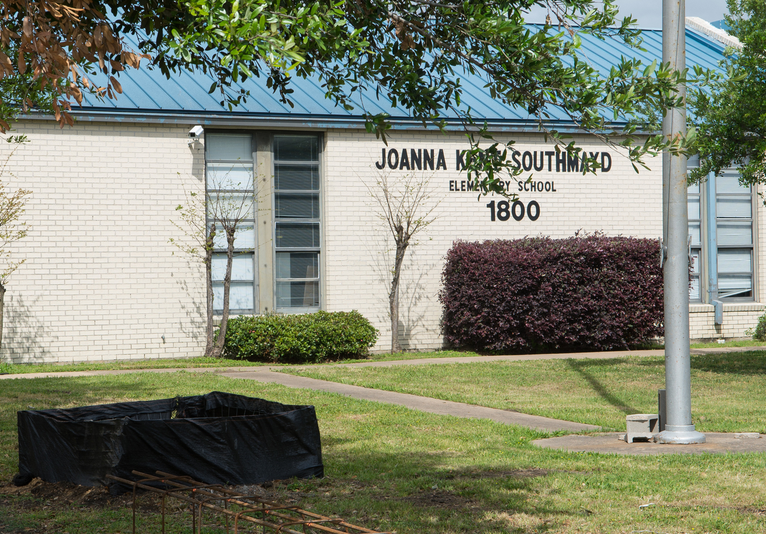
2007 Bond Update
All work in the 2007 program will be in the closeout phase by the end of 2014.
Completion of major renovation, including roof work, will occur at Cullen MS and Southmayd ES over the next few months.
The expansion of Kate Smith ES is moving forward, which is an additional scope of work made possible through program realignments.

Slide 3
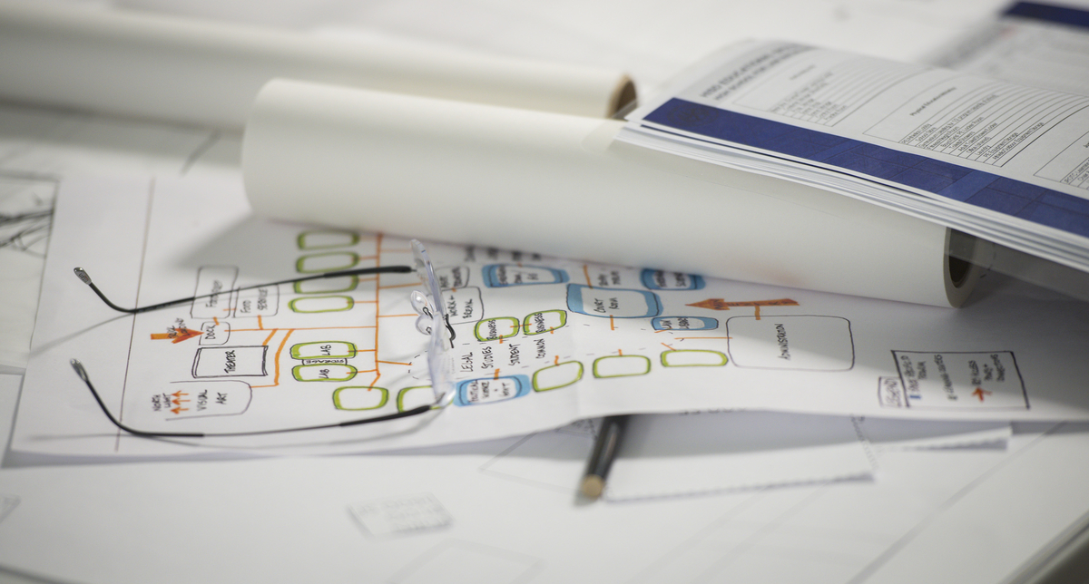
2012 Bond Planning
Planning is almost complete for all schools in Group 2 of the 2012 bond program.
Group 2 projects include some of the district’s largest high schools – Bellaire, Lamar, Davis, and Yates.
Design charrettes have been held.
Several initial community meetings have been held in the 2nd quarter of 2014.
PATs have been actively meeting to further define the needs of their respective campuses.

Slide 4
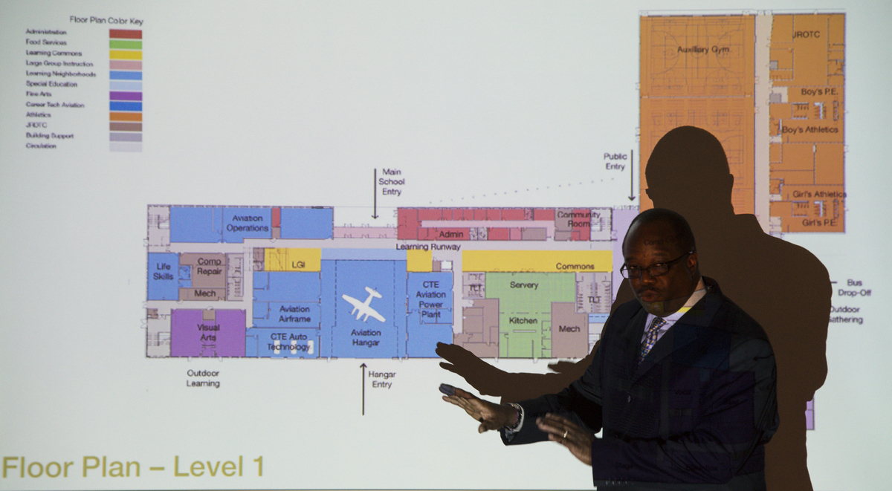
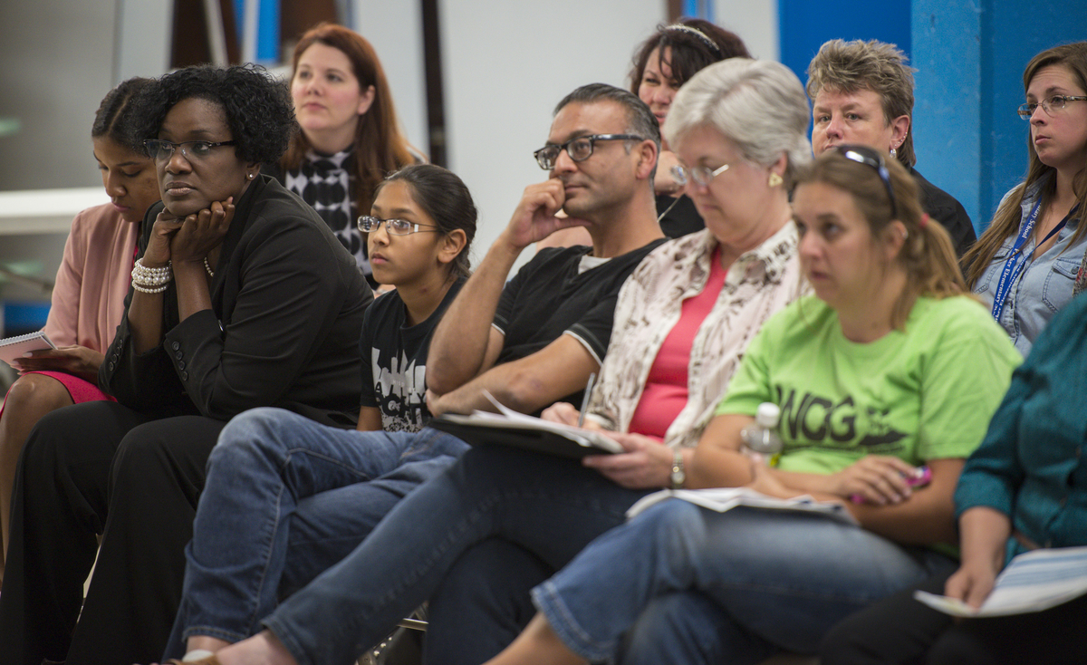
2012 Bond Design
Safety and security symposium held for Group 1 & Group 2 project teams.
Group 1 projects are moving out of Design Development and into Construction Documents stage.
3 Group 1 projects are nearing completion of Construction Documents stage.
Community meetings held for 8 schools during 2nd quarter.

Slide 5
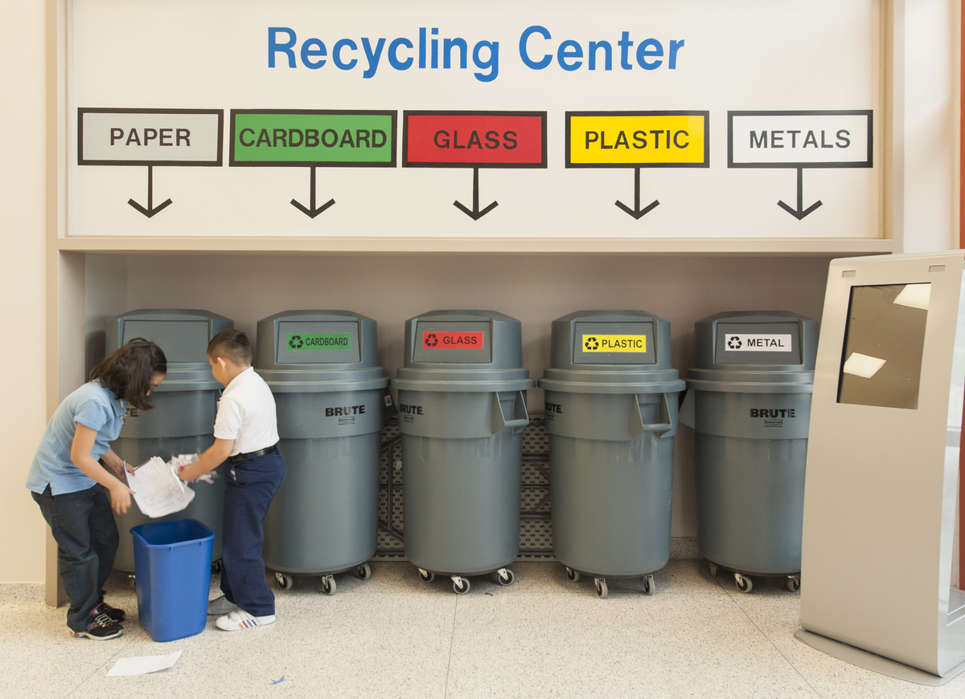
Sustainability
HISD is committed to building sustainable schools with eco-friendly design features that serve as learning tools.
All of the Group 1 and Group 2 schools are being designed for sustainability, with several projects targeting Gold-level LEED certification.
In Group 1, 5 schools are going for Gold certification, 1 school has a goal of Platinum,11 are going for Silver, and the rest are seeking certification.

Slide 6
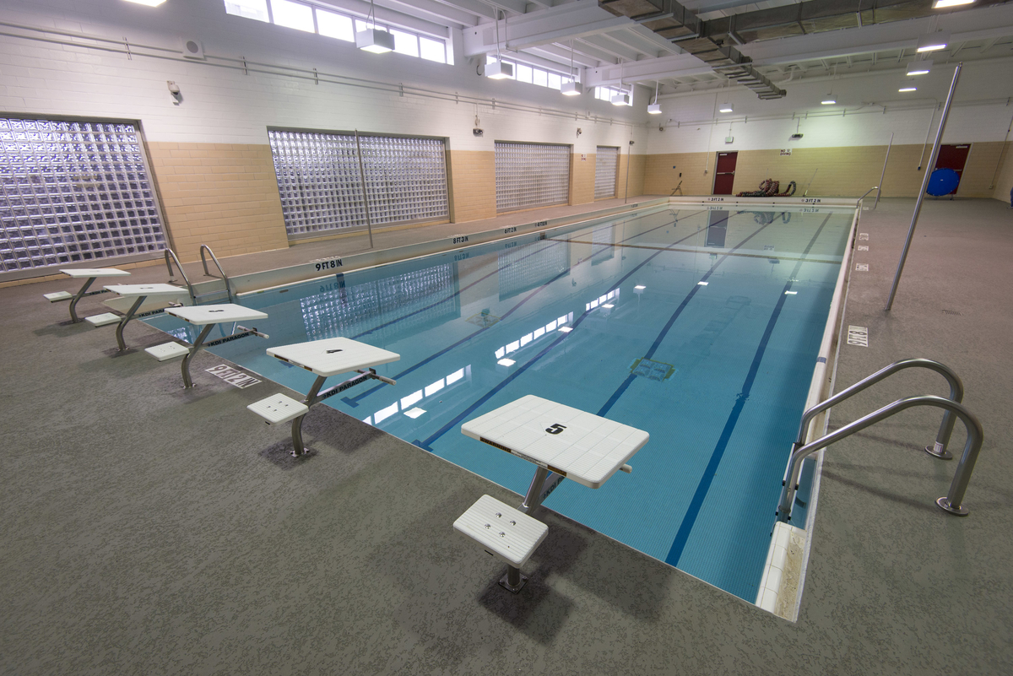
2012 Bond Construction
Waltrip High School
Contractor has completed pool renovation and currently is working on major electrical and HVAC upgrades.
Community meeting is scheduled for 3rd quarter of 2014.
South Early College HS
Installation of meter vault and main water line have been installed. Major construction is set to begin in the 3rd quarter of 2014.

Slide 7
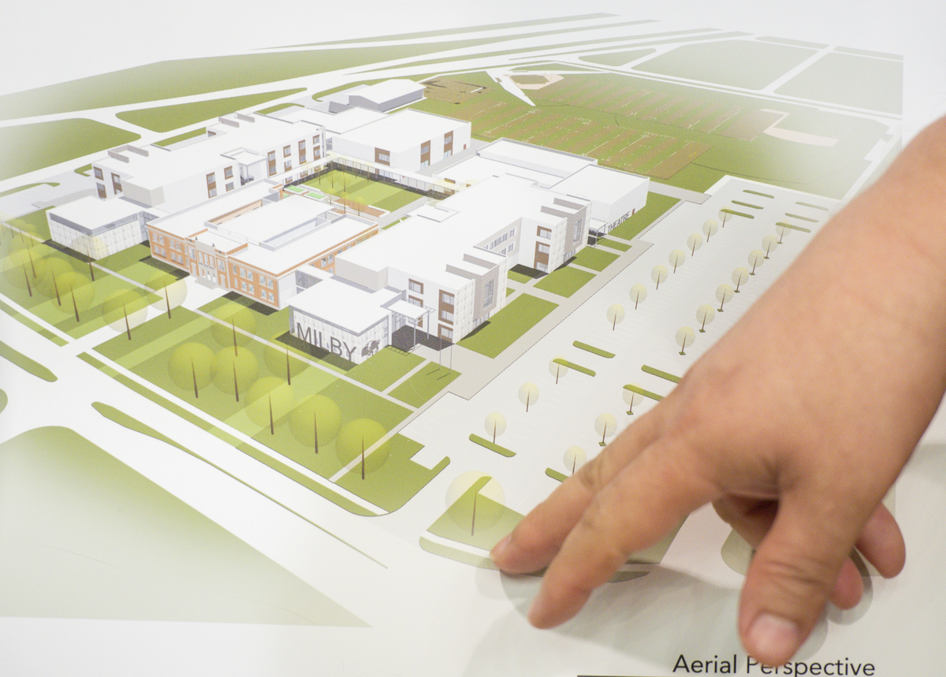
2012 Bond Construction
Milby High School
Asbestos survey has been completed, and asbestos abatement is scheduled to begin in July. Demolition is scheduled to start in 3rd quarter of 2014.
North Houston Early College HS
Sewer and main water lines complete.
Major construction is set to begin in the 3rd quarter of 2014.

Slide 8
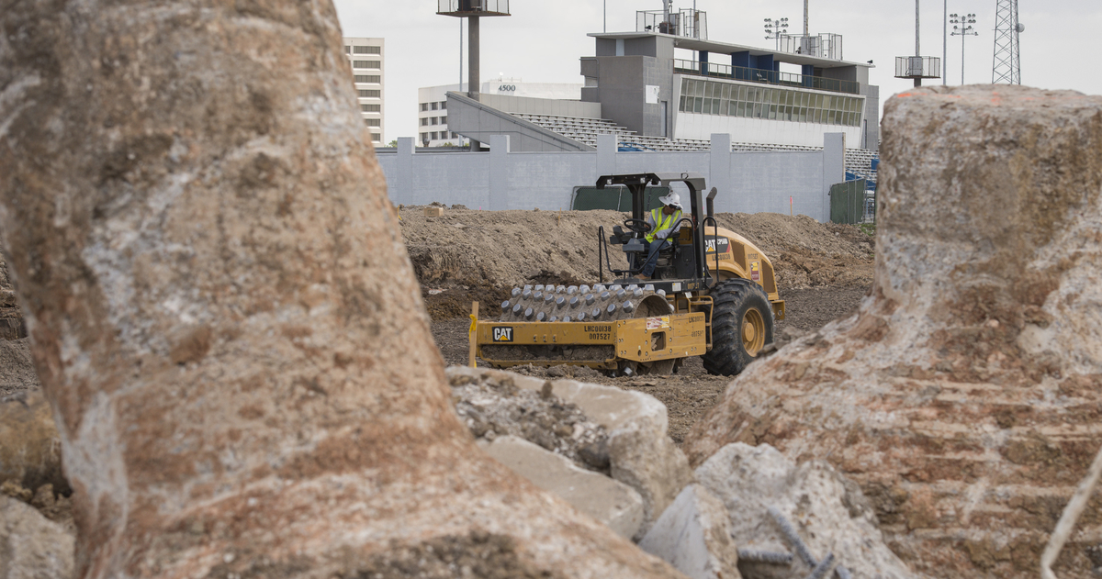
Districtwide Upgrades
Delmar Fieldhouse
Construction Documents phase in progress.
Earthwork and building pad work in progress.
Middle School Restrooms
Design has begun on Phase 1 & 2 projects.
Safety and Security
Safety and security assessment of all district facilities complete.
CFS working with Threat Assessment Team to review and prioritize districtwide safety improvements.
Design and documentation of work required for prioritized items will begin in the 3rd quarter of 2014.

Slide 9
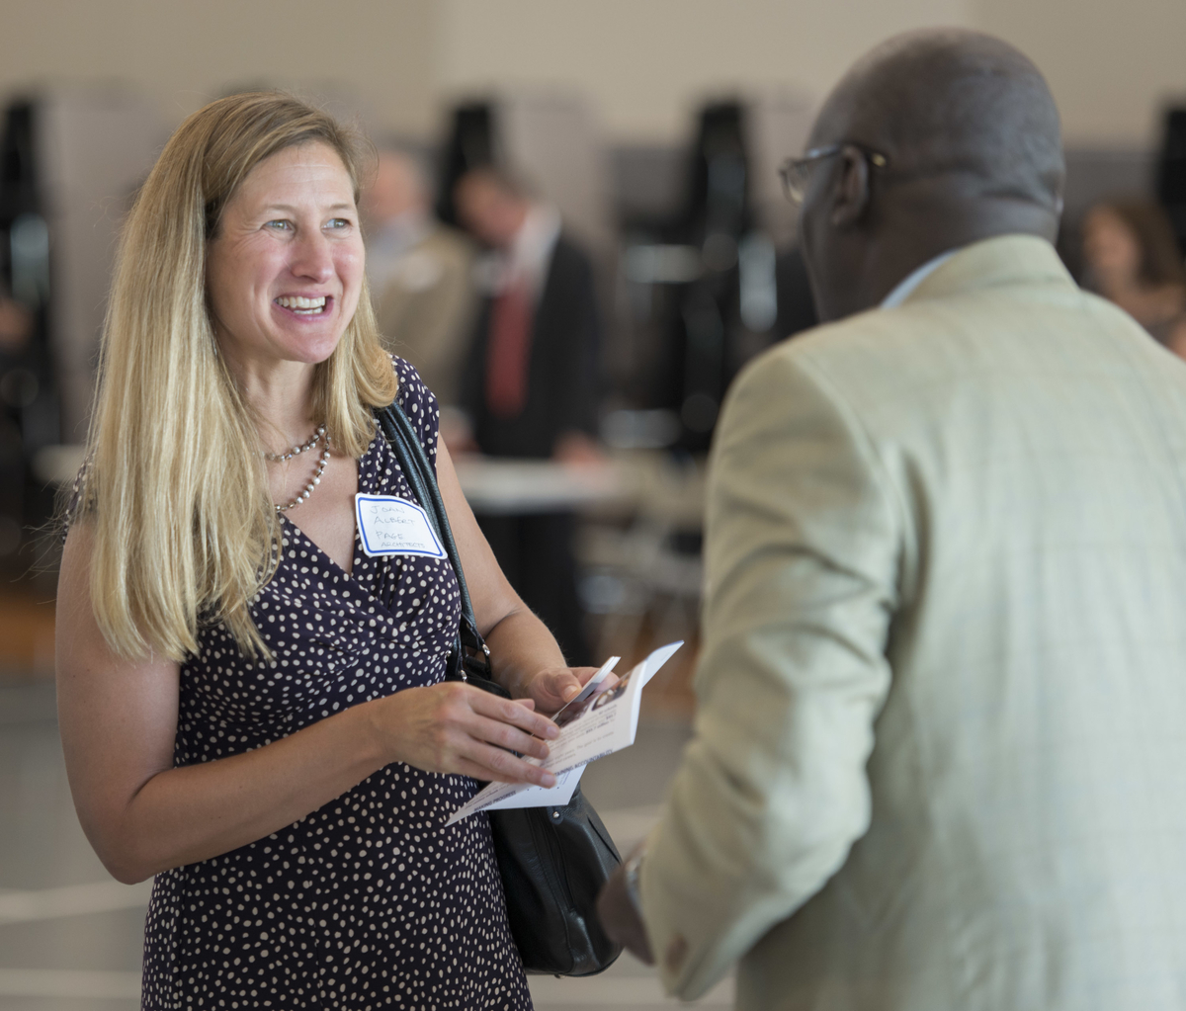
Doing Business
HISD is committed to Supplier Diversity.
Office of Business Assistance held and participated in multiple programs to promote HISD business opportunities.
M/WBE commitments for contracts awarded to date:
Professional Services represent 51%
CMARs represent 20% to 40%
Office of Business Assistance received the 2013 Texas Excellence Award from the U.S. Department of Trade and Commerce.

Slide 10
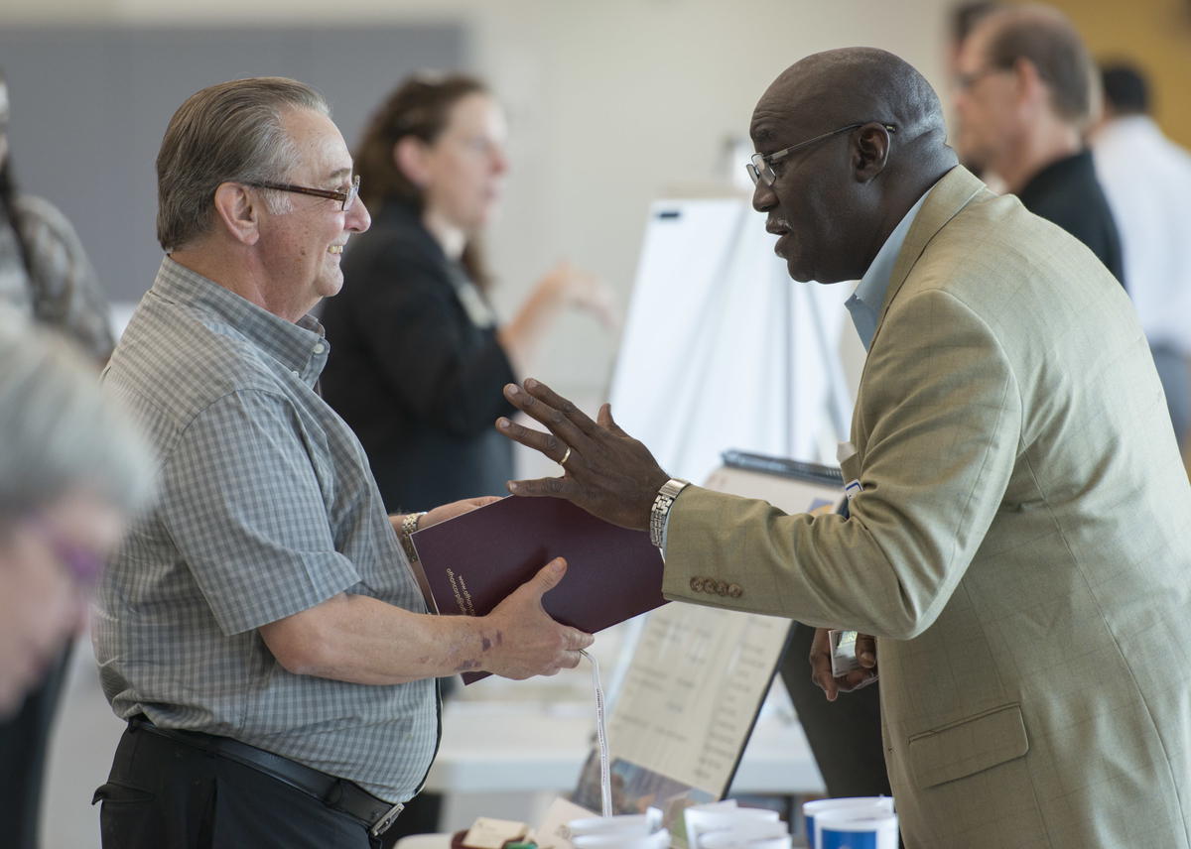
M/WBE Networking Events
Supplier Diversity Advisory Committee (SDAC) Update Meeting
2012 Bond Program Potential A&E Meet & Greet
Carnegie Vanguard High School
Small Business Today Talk Show
(guest appearance)

Slide 11
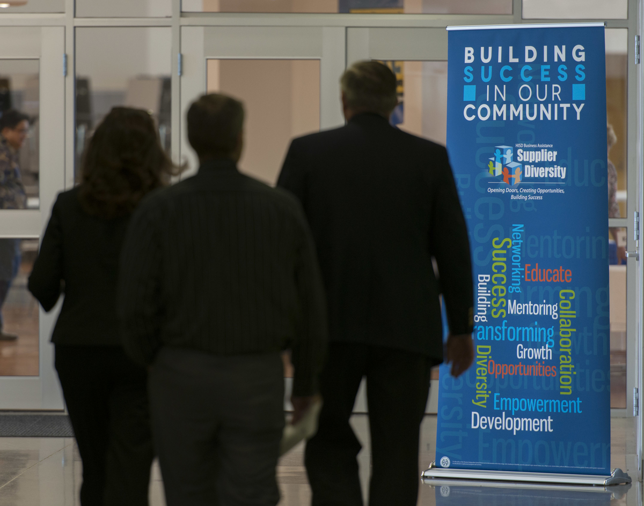
M/WBE Outreach Events
City of Houston
“Morning Money Mindset” Workshop
Turner School of Construction Management Graduation Ceremony
Greater Houston Business Procurement Forum
Greater Houston Business Procurement Forum: “Where Business Takes Place”
Procurement Summit & Business Expo
Government Procurement Connections
GPC Planning Meeting
State of Procurement Event

Slide 12
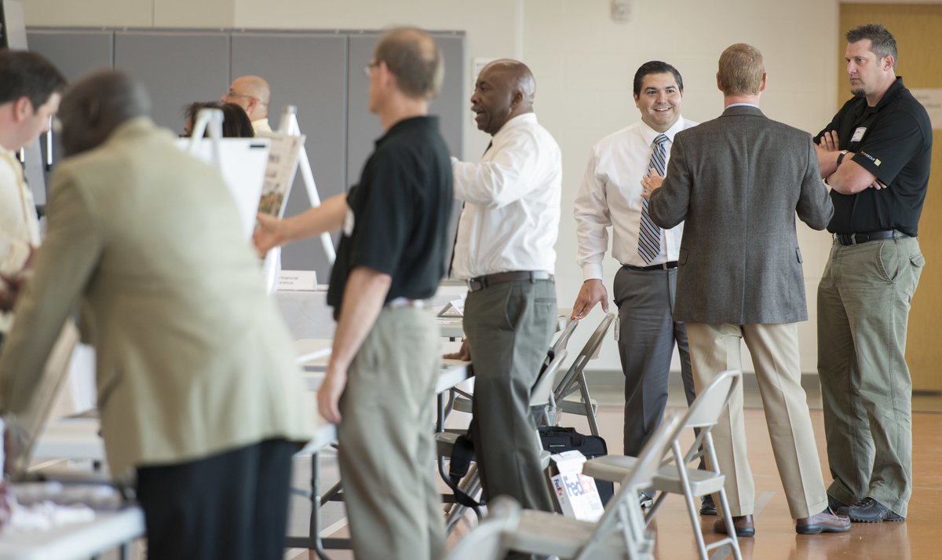
M/WBE Outreach Events
Houston Airports
Houston Airport Fair 2014
Houston Hispanic Chamber of Commerce
Annual Luncheon & Business Expo
Houston Community College
How to Do Business with HISD
Texas House of Representatives Committee on Economic & Small Business Development
Metro Transit of Harris County
Interagency Mentor Protégé Program Planning Sessions
Port of Houston
June Networking Luncheon/Port of Houston Capital Improvement Plan

Slide 13
2007 Bond M/WBE Participation
Exceeded minimum M/WBE goal levels of 20% for 2007 bond program.
M/WBE participation has reached nearly 35% in 2007 bond program.
*As of June 30, 2014

Slide 14
2012 Bond M/WBE Commitment
Certified Minority/Women Owned Businesses Breakdown

Slide 15
2007 Bond Financial Report
Total funding of $1,176,130,676.
Actual committed of $1,060,400,472 (including encumbrances of $52,982,873 and actual expenditures of $1,007,417,599).
Uncommitted funding balance of $115,730,204 or 10% of total funding.

Slide 16
2012 Bond Financial Report
The total for the 2012 Bond Program is $1.89 billion, and the issuance of the bonds has been planned in four sales.
Commitments of $126,492,124 (including encumbrances of $75,194,479 and actual expenditures of $51,297,645) leaving $1,763,507,876 of available funding.

Slide 17
Communications
HISD is committed to providing timely and accurate information on the 2007 and 2012 bond programs.
Produced 5 videos that show PATs and community participation in design process and school site tours.
Creating and distributing fliers and meeting invitations to key stakeholders for 8 school community meetings.
Posted 44 blog posts and photo galleries on school community meetings, green school efforts, and community outreach events.
Highlighted bond activities in about 40 tweets and Facebook posts.

Slide 18
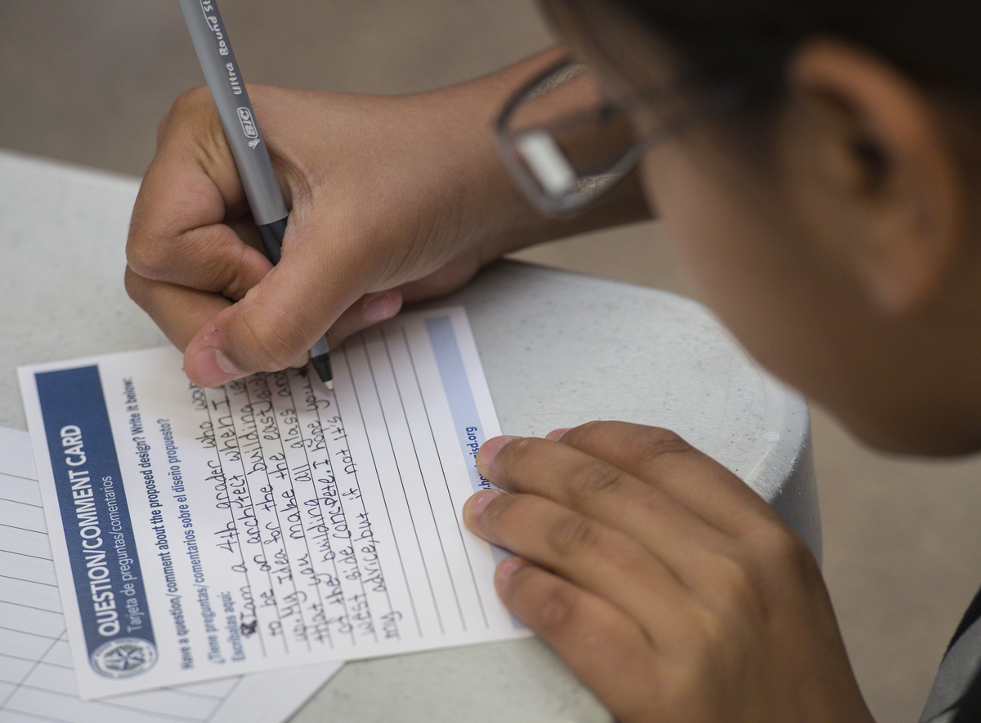
Looking Ahead
By the end of 2014, construction will begin on all remaining schools in Group 1.
In the 3rd and 4th quarters, all Group 1 schools will transition from Design Development to Construction Documents.
Architects will be selected for the remaining schools in Groups 3 and 4 during the 3rd quarter.

Slide 19
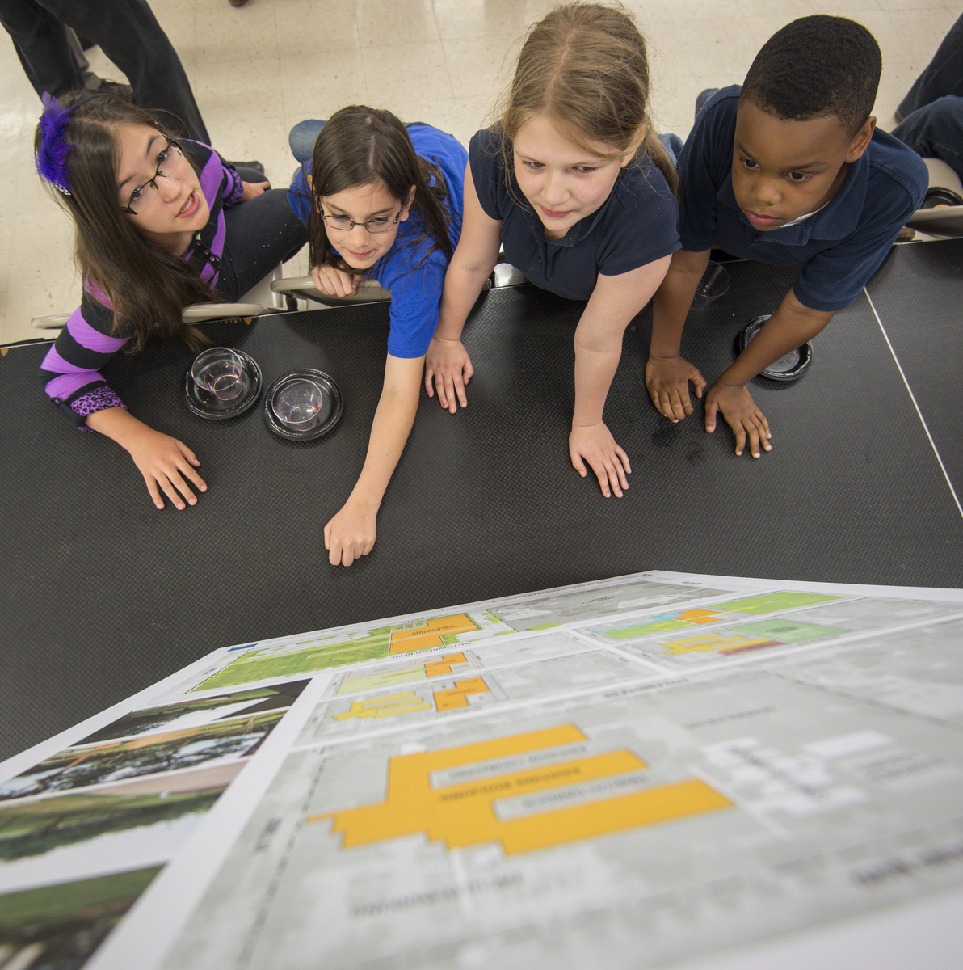
Looking Ahead
The first community meeting will be held for the remaining schools in Group 2 – Bellaire and Yates.
Demolition at the Milby and Young Men’s College Preparatory campuses will begin in the 3rd quarter.
PATs will be organized and will be actively meeting for all schools in Groups 3 & 4.

Slide 20
Thank you

