Slide 1
Bond Oversight Committee Meeting
Second Quarter 2015
July 29, 2015

Slide 2
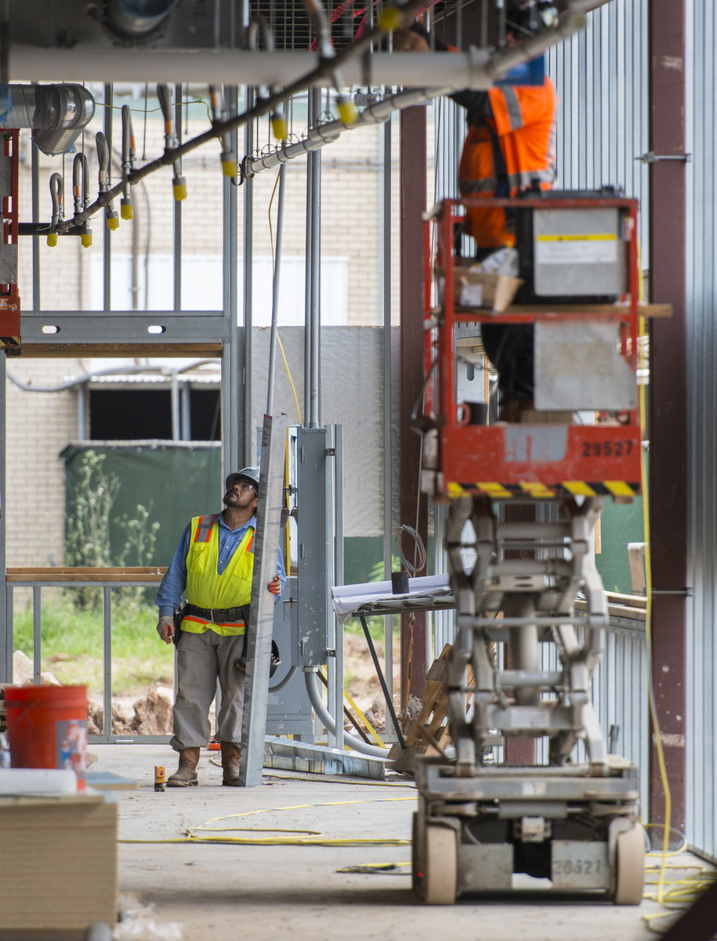
Construction update
Group 1 construction progressing
Group 2 projects moving into construction documents phase
CMAR contracts approved for 7 projects in Groups 3 & 4

Slide 3
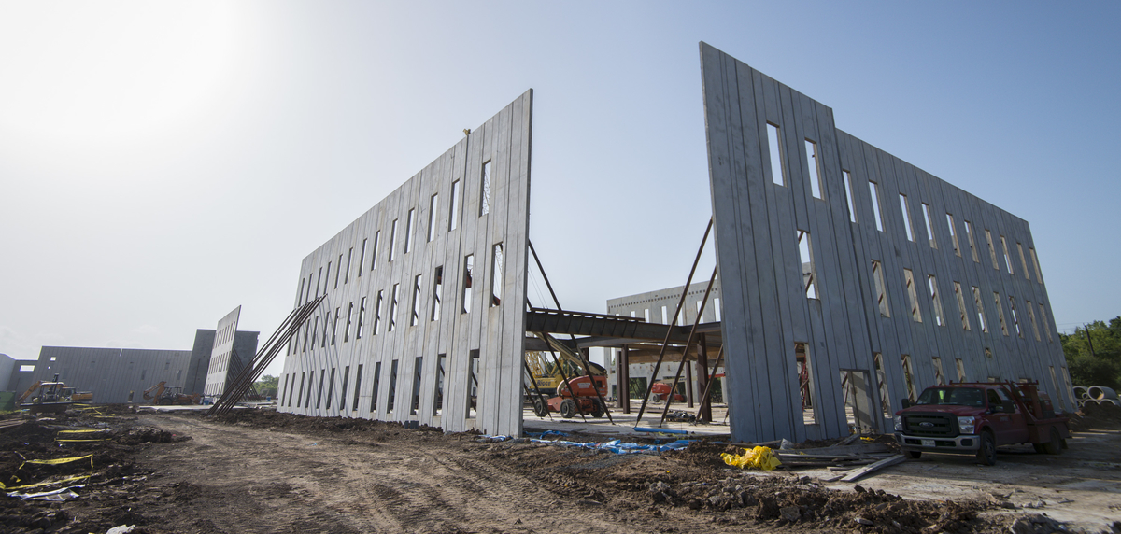
Project highlights
Sterling HS
First concrete tilt wall raised at site

Slide 4
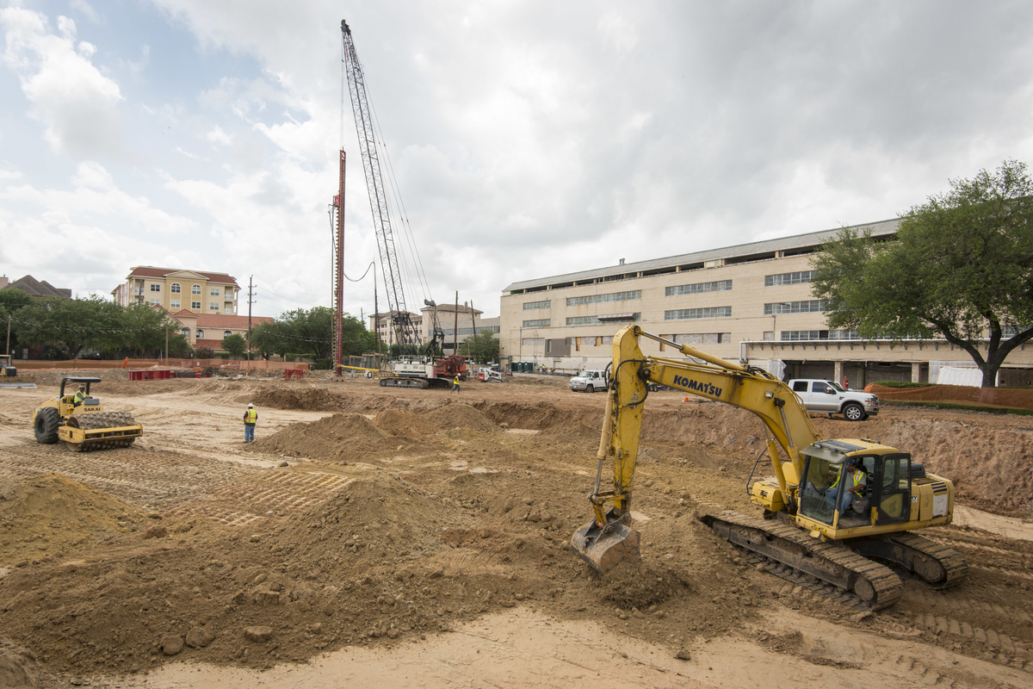
Project highlights
DeBakey HS
Site cleared and drilling of piers is underway

Slide 5
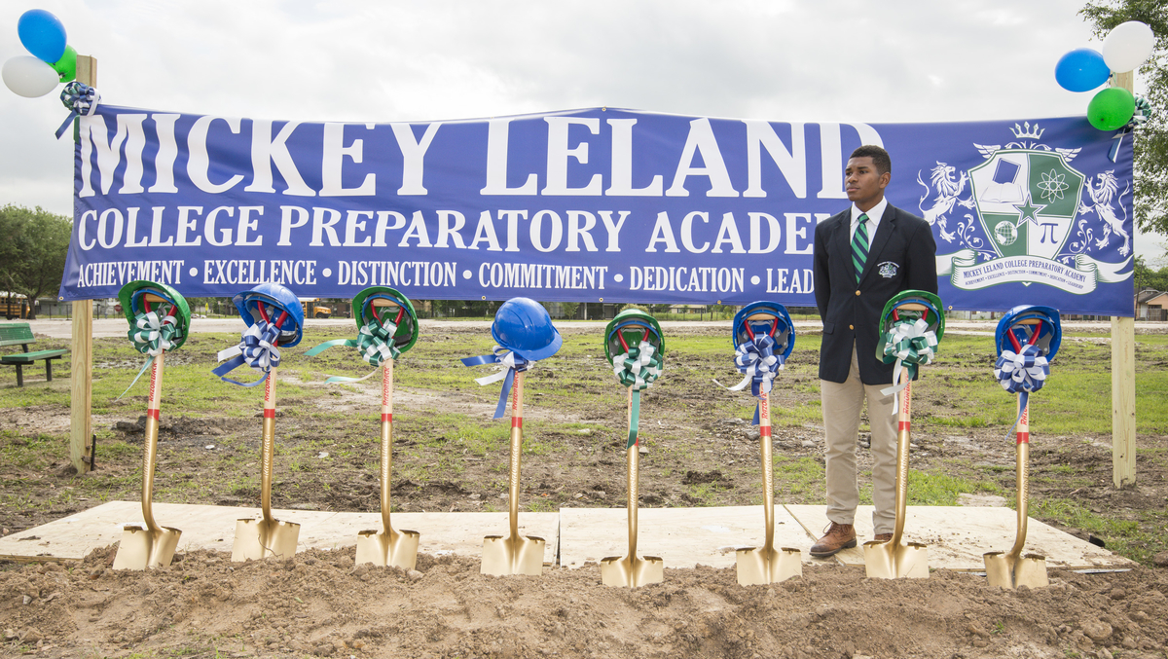
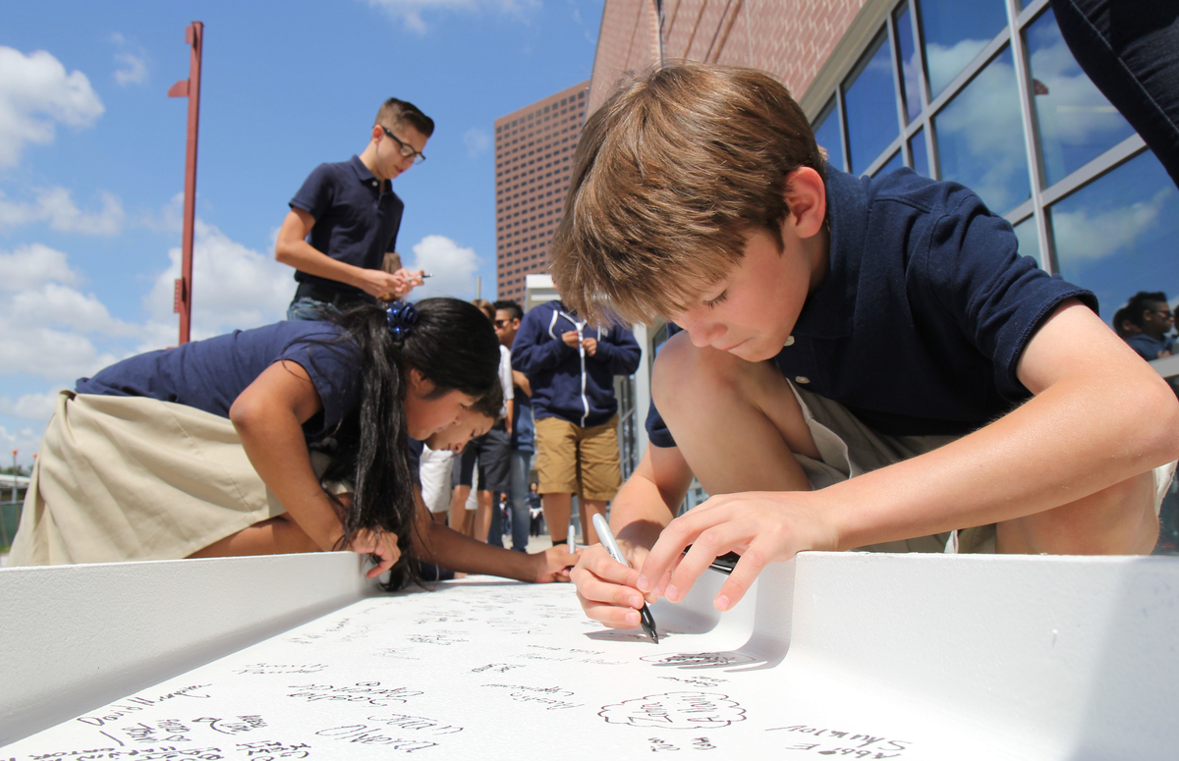
Project highlights
Mickey Leland
Groundbreaking held
for new school
Grady MS
Vertical construction celebrated with
beam-signing
Worthing HS
Brick facade added
to classroom wing

Slide 6
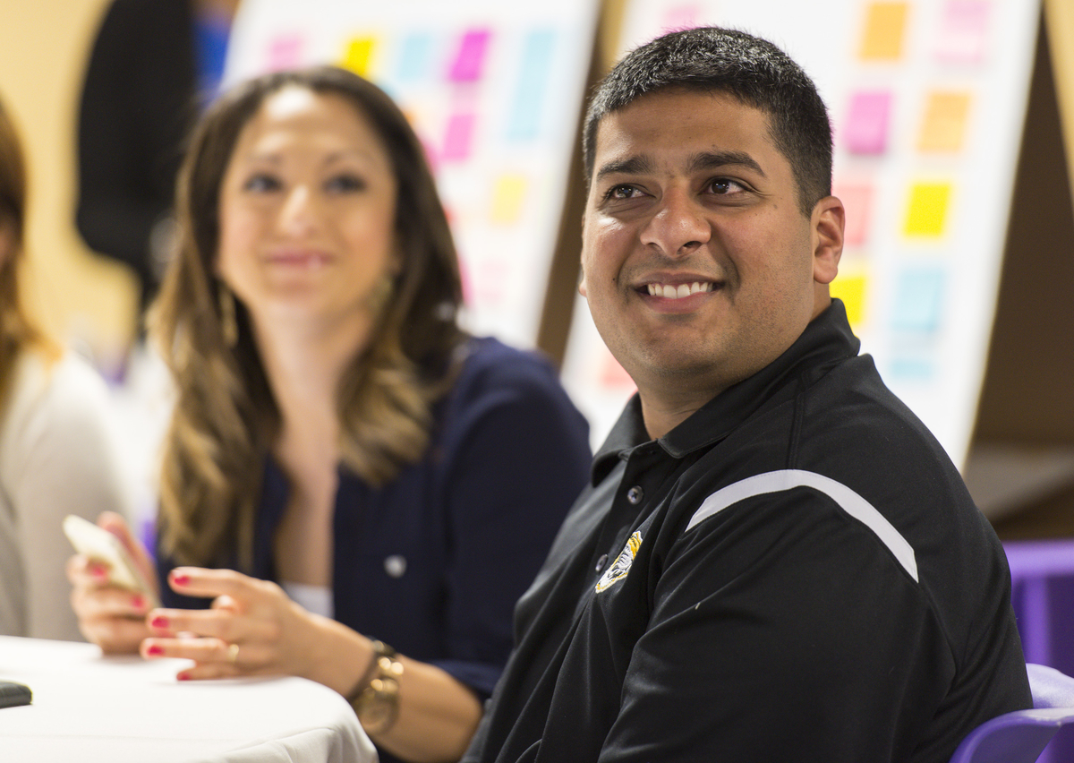
Bond design
All projects are now
out of planning and
into design
Group 2 projects are
finishing DD phase and
moving into CD phase
Design charrettes
were held for 13 schools:
Kashmere, Scarborough, Westbury, Austin, Askew, Wharton, YWCPA, Garden Oaks, Pilgrim, Wilson, Sam Houston, Madison, and Jordan.

Slide 7

Doing Business
Office of Business Assistance
held and participated in multiple
programs to promote
HISD business opportunities
M/WBE commitments for
contracts awarded to date:
  Professional Services represent 51%
  CMARs represent 20% to 40%

Slide 8
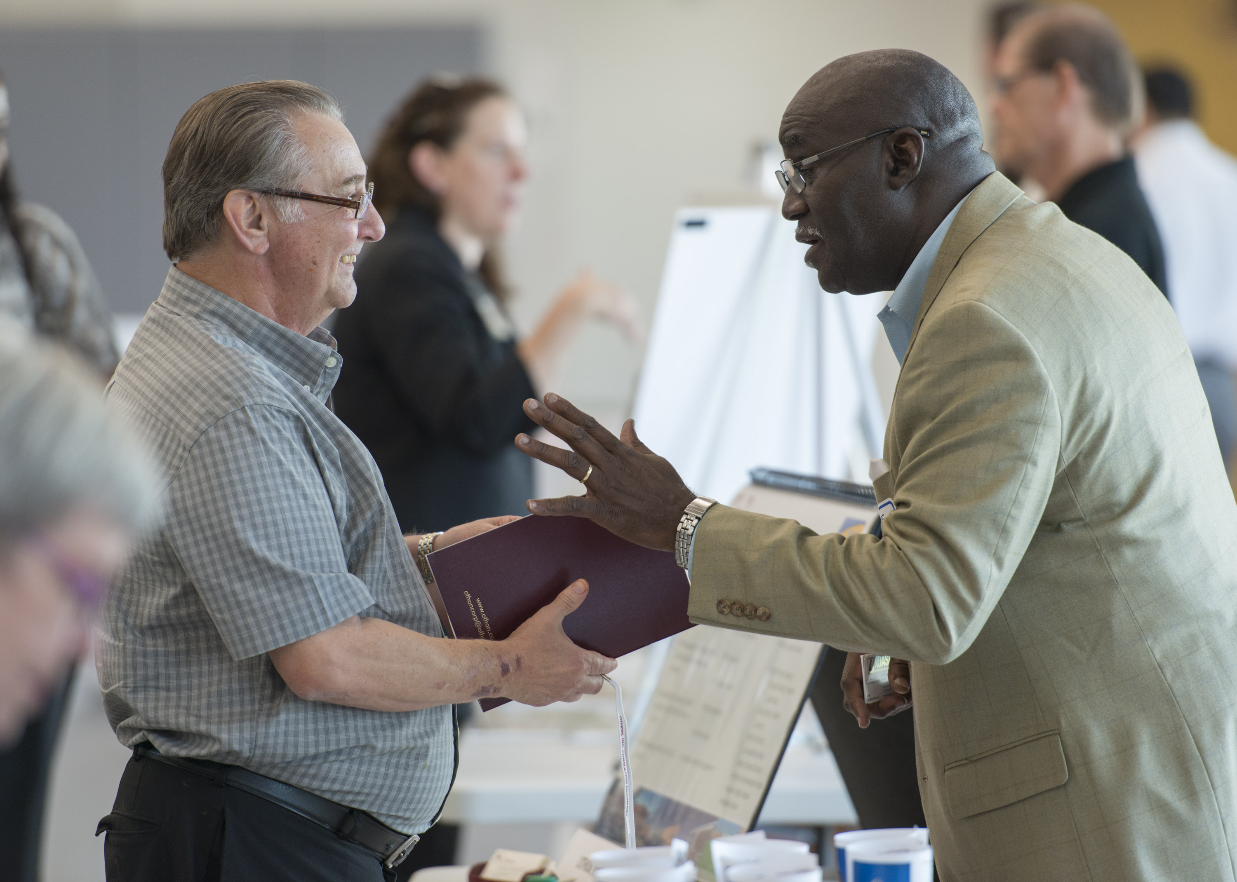
M/WBE networking events
Interagency Mentor
Protégé Program
Workshop Wednesdays:
April – “Meet the Experts,
Ask Procurement”
May – “Let’s Talk Construction: RFP/CSP/RFQ”
June – “M/WBE Documentation Conversation”

Slide 9
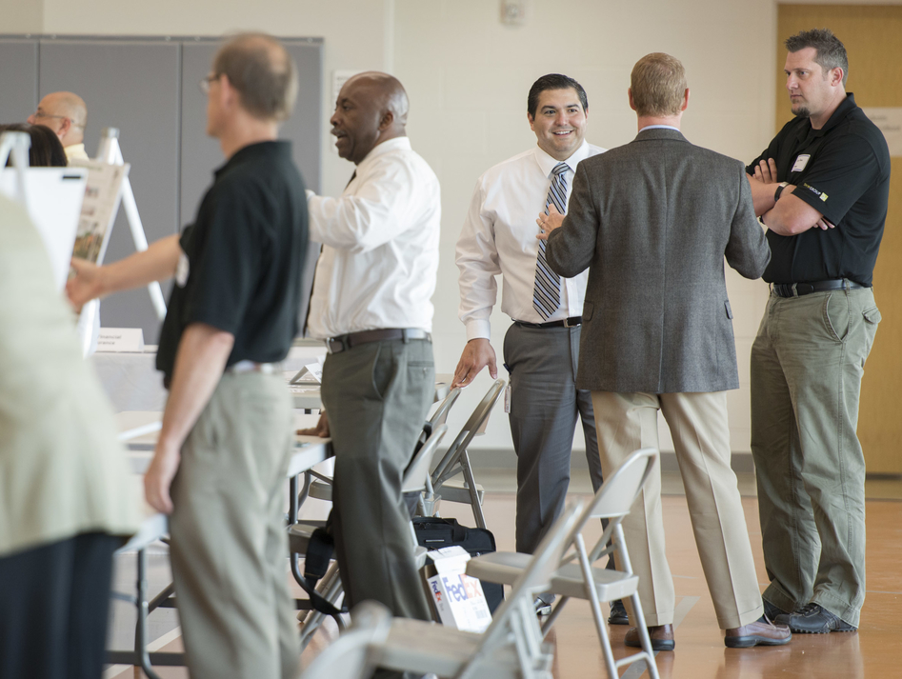
M/WBE outreach events
Greater Houston Business
Procurement Forum
Houston Hispanic Chamber
of Commerce: 22nd Annual
Luncheon & Business Expo
Houston Minority Supplier
Development Council: HMSDC
Ignite Your Success, Procurement Roundtable
Goodwille Pierre, LLC – The Pierre Firm: Success
in Business: HISD Bond Program

Slide 10
M/WBE commitment
Certified Minority/Women Owned Businesses Breakdown
2012 Professional Service Projects*
* Design and Program Management Firms, as of
June 30, 2015

Slide 11
Bond financial report
The total for the 2012 Bond Program is $1.89 billion, and the issuance of the bonds has been planned in four sales.
Commitments of $459,626,853 (including encumbrances of $296,647,422 and actual expenditures of $162,979,431) leaving $1,430,373,147 of available funding.
Total Budget, Commitments & Available Funding to Date
Total Budget: $1.89 billion
(issuance sales in millions)

Slide 12
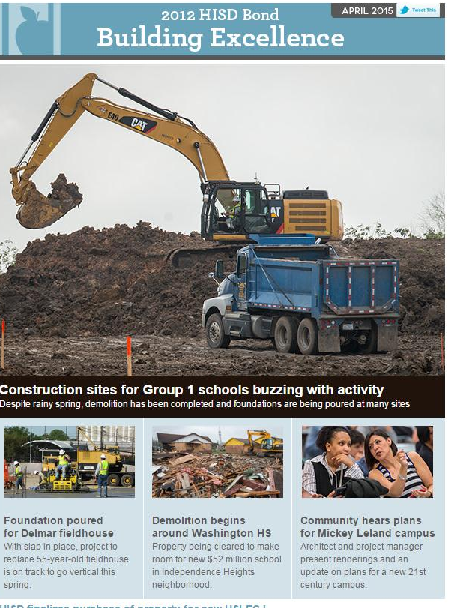
Communications
Created handbook for project
managers on community relations
Held brown bag lunch for bond
staff on effective social media
Working with PATs to proactively
address communications needs
Provided communications support
for Mickey Leland groundbreaking
Coordinated 4 community meetings
Regular social media, blog, and Facebook updates

Slide 13
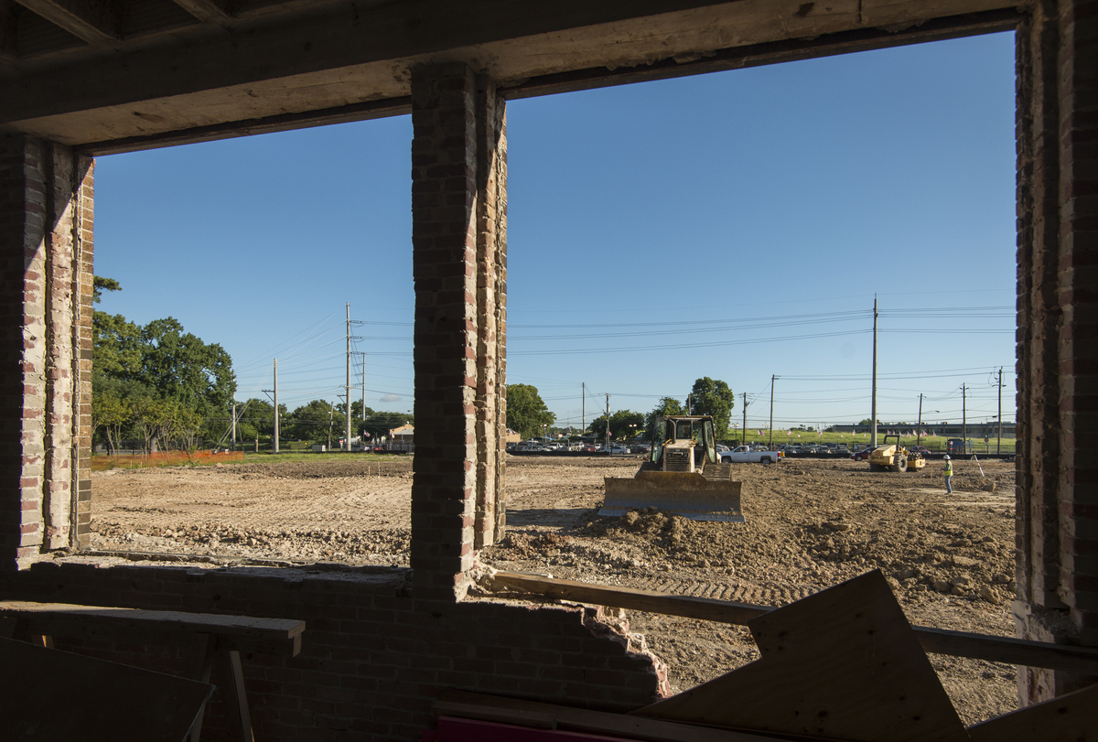
Looking ahead
Community
meetings for
Groups 2, 3 & 4 schools
Groundbreaking ceremonies for
Furr HS and
HSLECJ
Additional contracts to be awarded/approved

Slide 14
Thank you

