Slide 1
Bond Oversight Committee Meeting
Second Quarter 2016
July 26, 2016
Notes:
Welcome – Derrick Sanders

Slide 2
Second Quarter Progress
Construction underway at 22 campuses – more than any other time in HISD history
Construction contracts executed: 7, including 1 districtwide project
6 schools to open in August; move-in preparation/furniture delivery underway
Groundbreaking at Yates HS; Topping Out at Wisdom HS
All projects, except Bellaire, to be bid by end of the year
Six new schools to open for 2016-2017
Condit Elementary
Mark White Elementary
North Houston Early College High School
South Early College High School
Mandarin Immersion Magnet School
North Forest Early Childhood Center
Notes:
Second Quarter Progress – Derrick Sanders

Slide 3
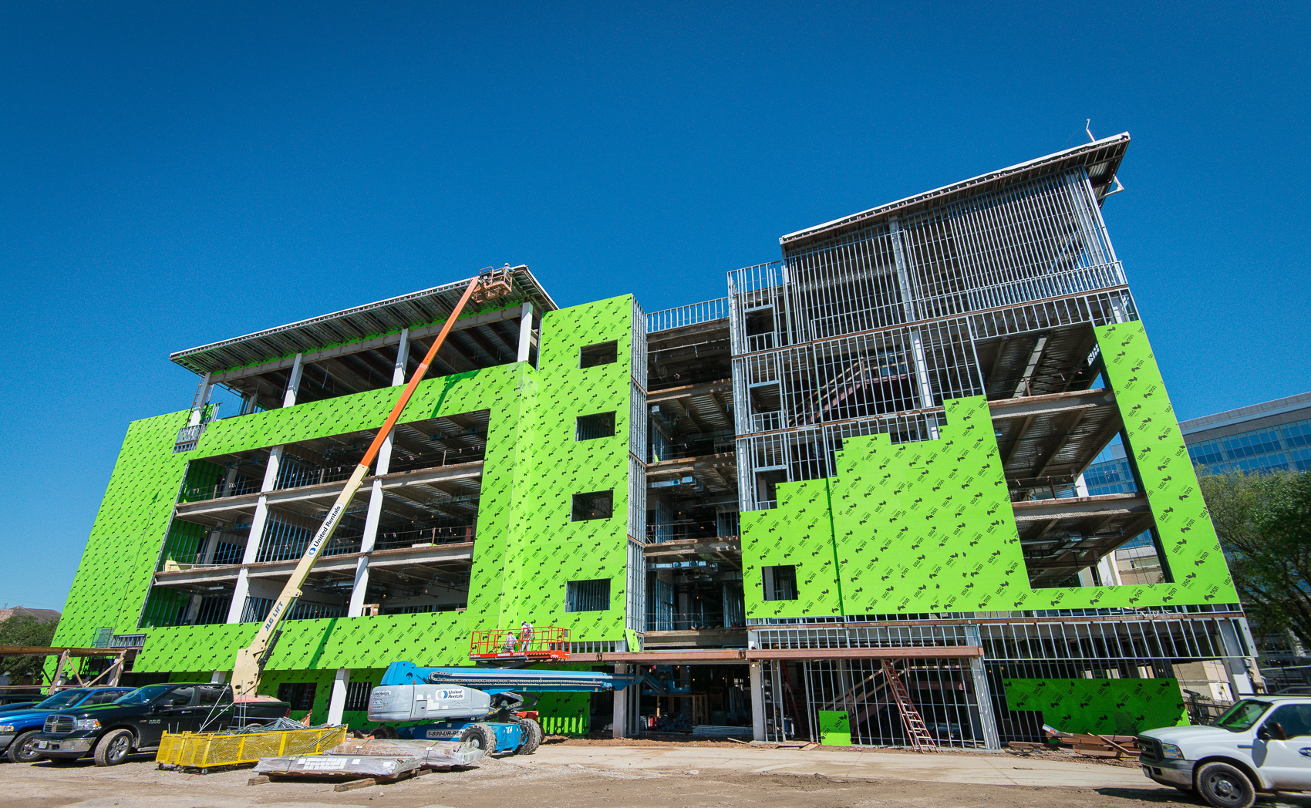
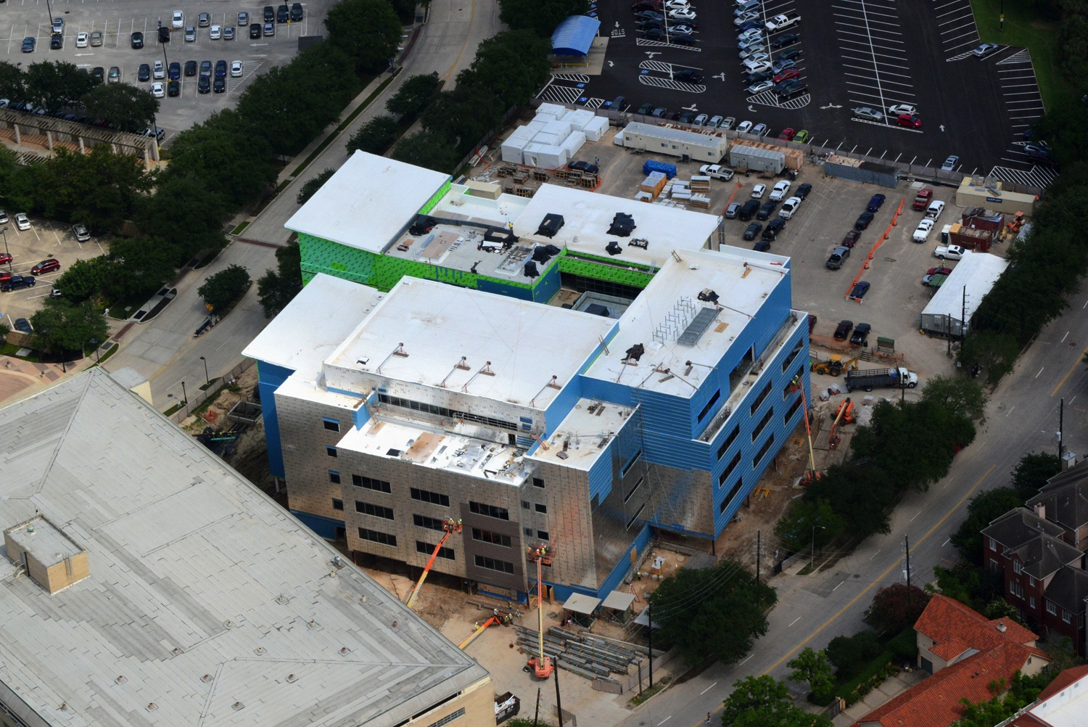
Construction Highlights
DeBakey High School for Health Professions
New school for 900 – 1,000 students
Located in Texas Medical Center
Notes:
Construction Highlights – Derrick Sanders

Slide 4
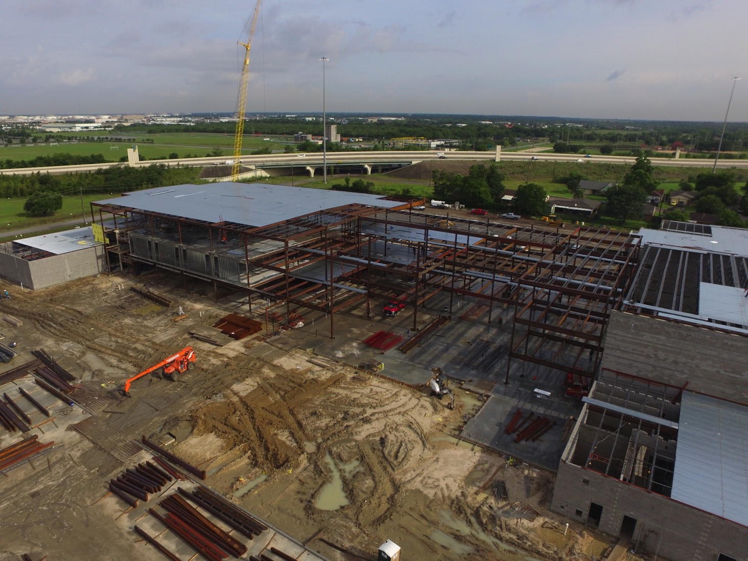
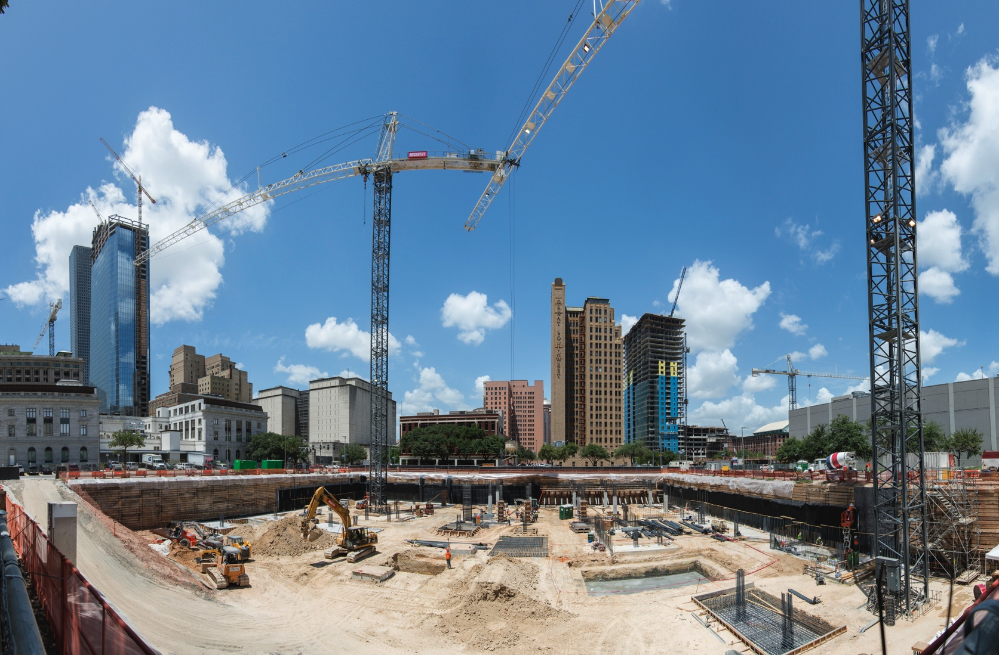
Construction Highlights
Furr High School
HSPVA
New school for 1,000 – 1,300 students
New performing & visual arts school for 750 students
Notes:
Construction Highlights – Derrick Sanders

Slide 5
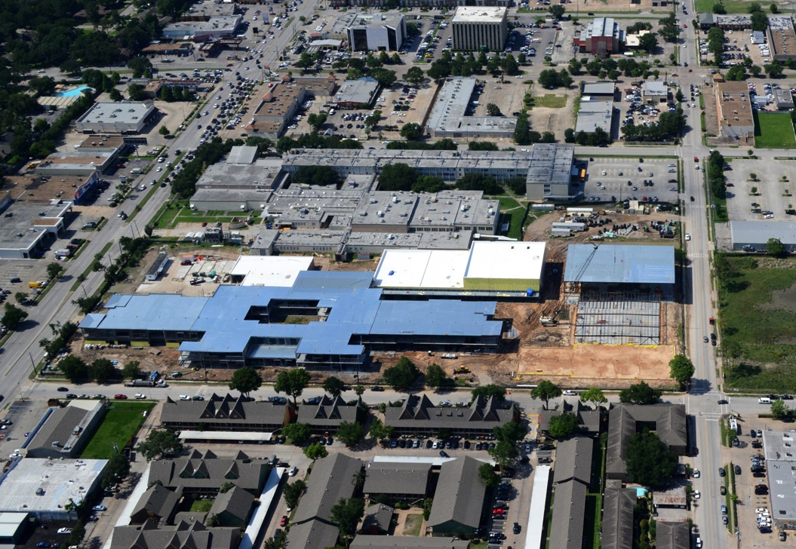
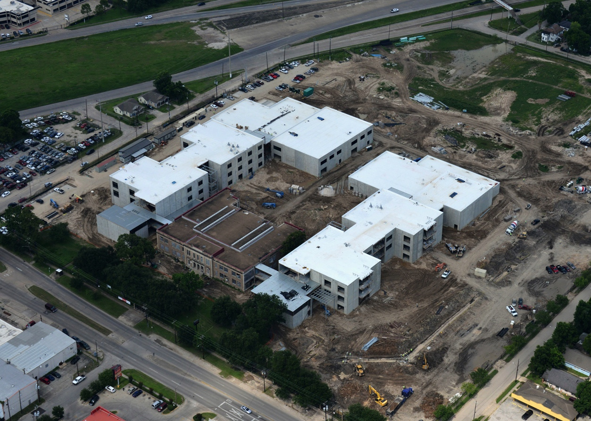
Construction Highlights
Wisdom High School
Milby High School
New school for 1,700 – 1,900 students
New school preserving significant architecture for 1,800 – 2,000 students
Notes:
Construction Highlights – Derrick Sanders

Slide 6
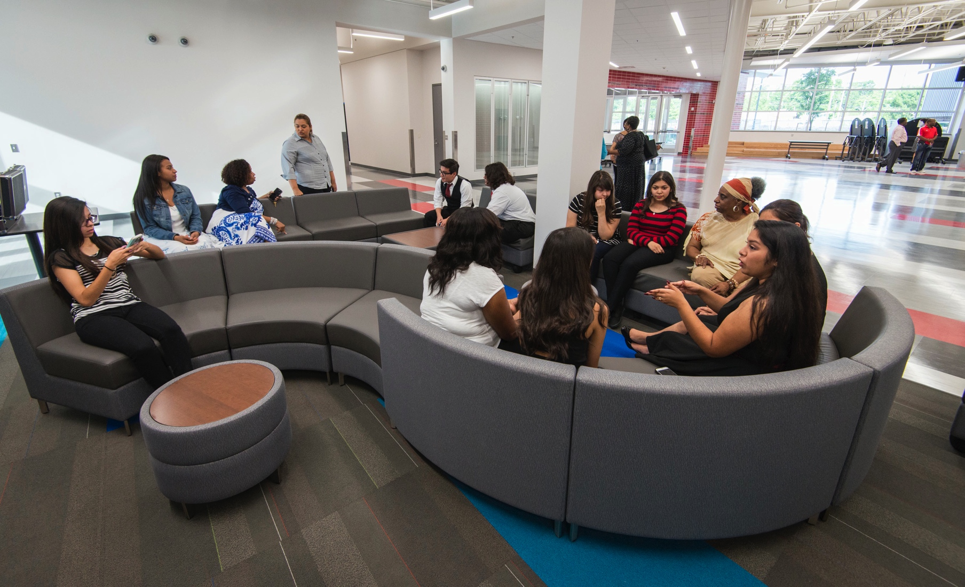
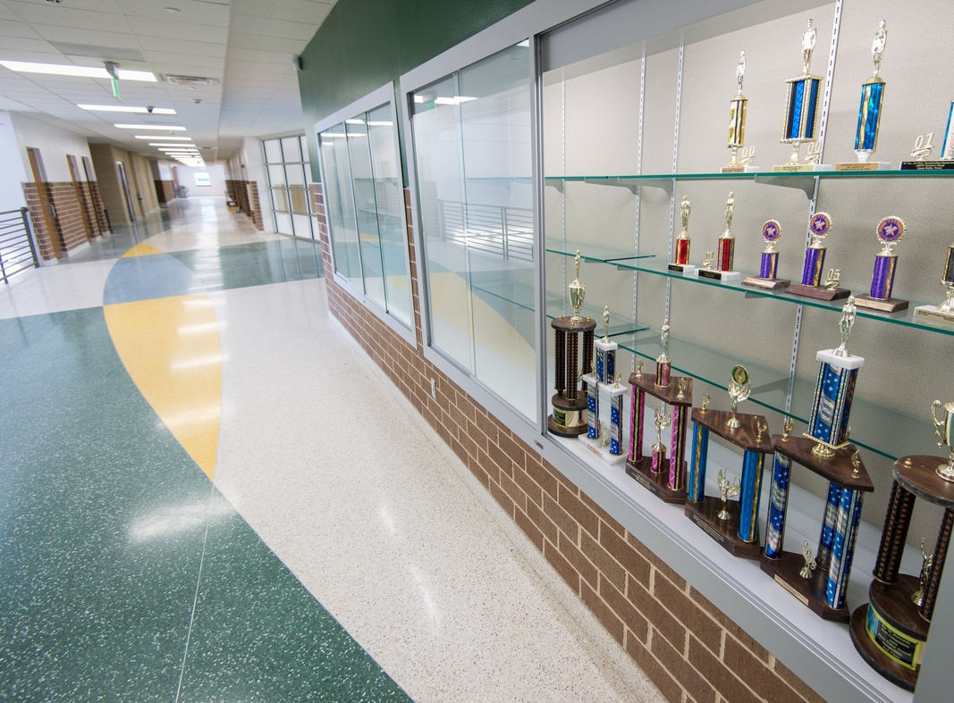
Construction Highlights
North Houston ECHS
Worthing High School
New school for 400 students
Phase 1 complete
Phases 2 ongoing
Notes:
Construction Highlights – Derrick Sanders

Slide 7
Construction Highlights
Mark White Elementary
Mandarin Immersion
New school for 750 students
New school for 750 – 900 students
Notes:
Construction Highlights – Derrick Sanders

Slide 8
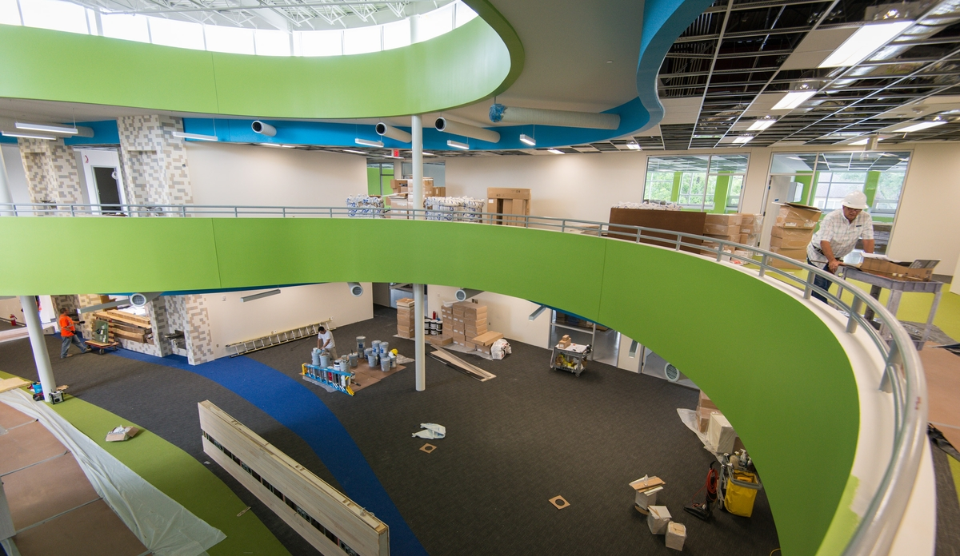
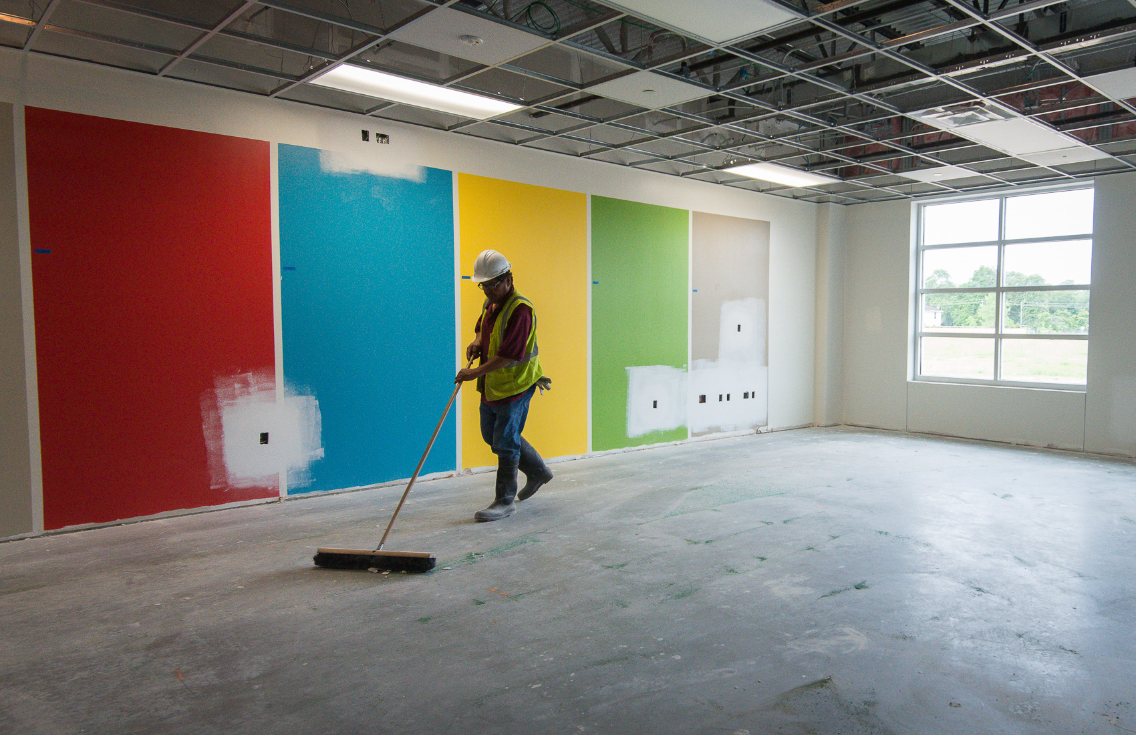
Construction Highlights
Condit Elementary
North Forest ECC
New school for 750 students
New center for 500 – 600 students
Non bond school
Notes:
Construction Highlights – Derrick Sanders

Slide 9
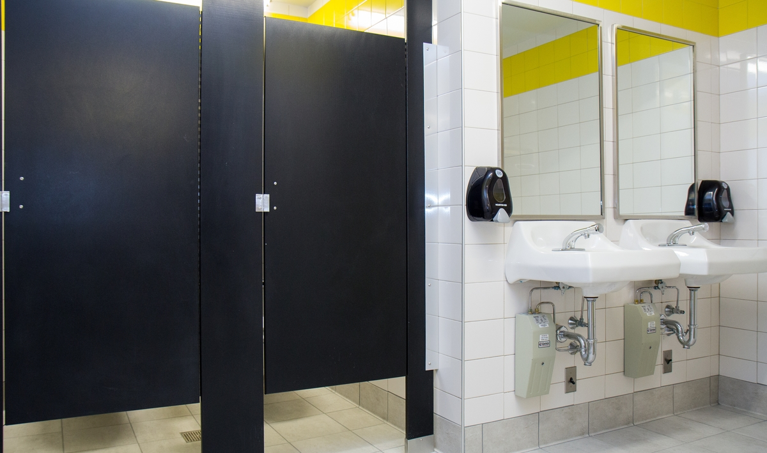
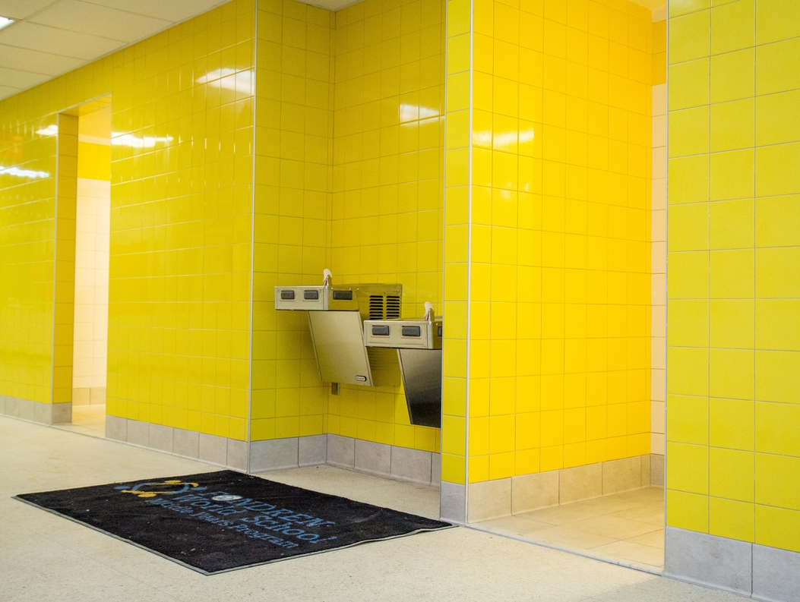
Construction Highlights
Middle School Restroom Renovations
All but 1 package currently under contract
All packages to be under construction by end of 2016
Notes:
Construction Highlights – Middle School Restrooms – Andreas Peeples

Slide 10
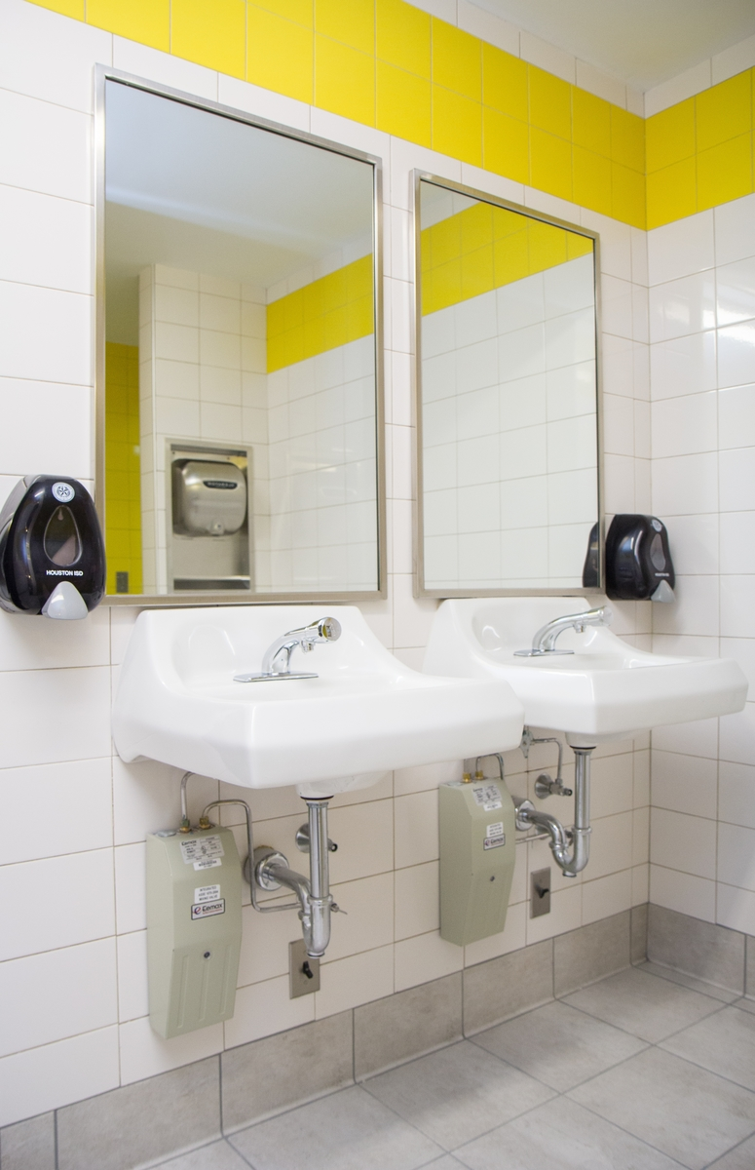
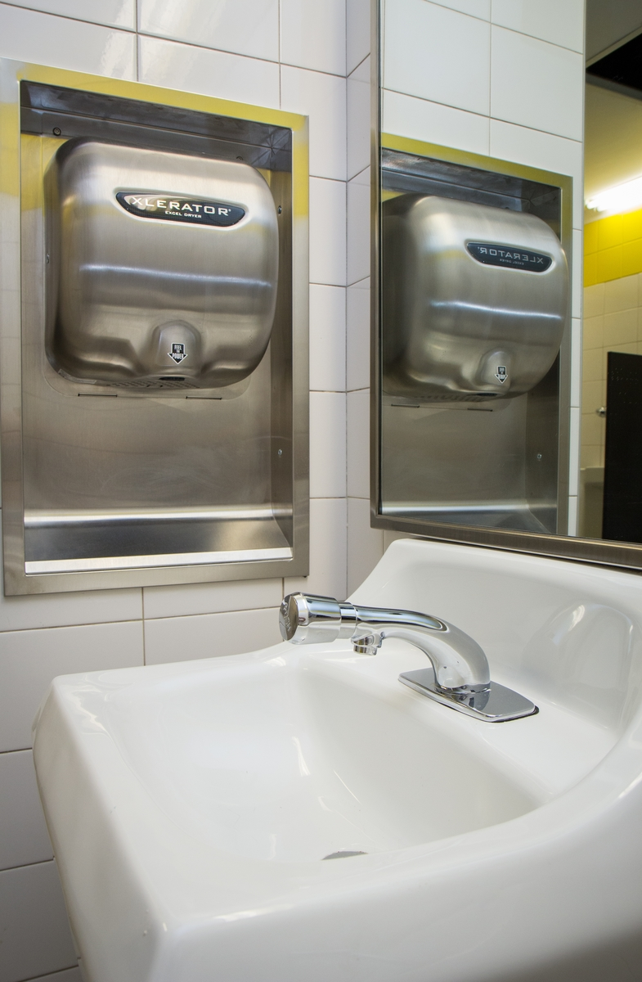
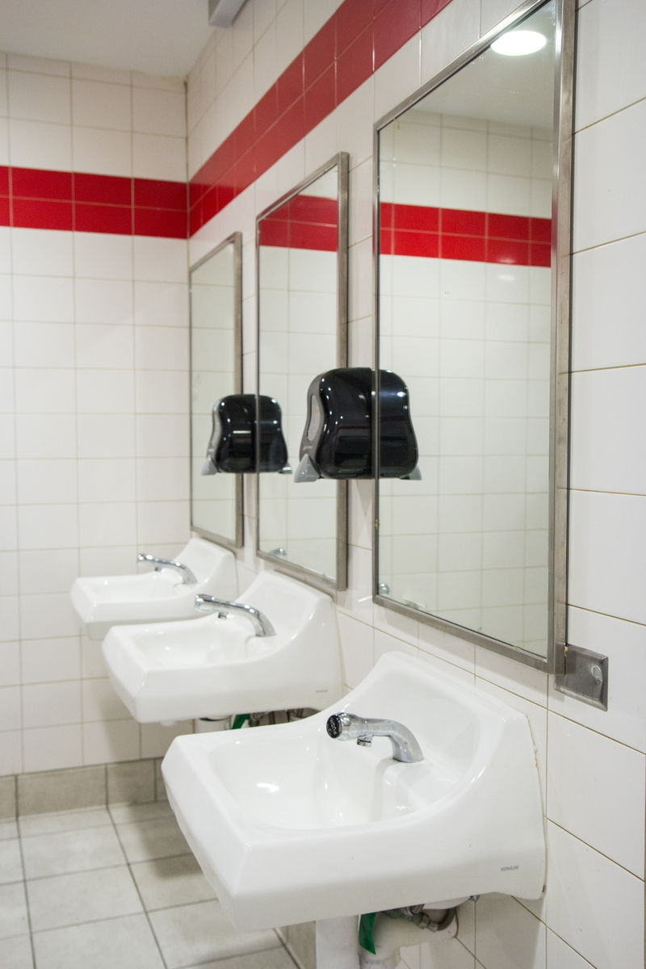
Construction Highlights
Middle School Restroom Renovations
Notes:
Construction Highlights – Middle School Restrooms – Andreas Peeples

Slide 11
Doing Business
Office of Business Assistance held and participated in multiple programs to promote HISD business opportunities
M/WBE commitments for contracts awarded to date:
Architect projects represent 54%
Construction firm projects represent 23%
Program management firm projects represent 48%
Other projects represent 39%
Notes:
M/WBE – Alexis Licata

Slide 12
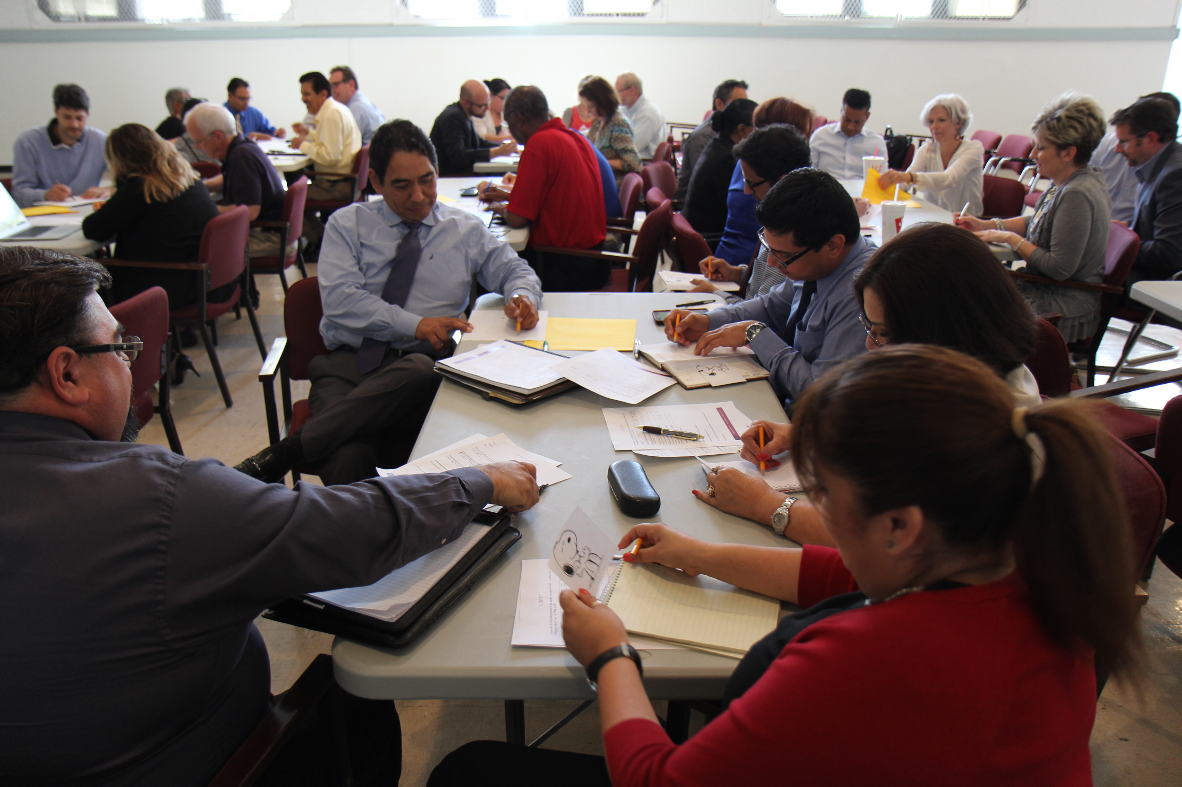
M/WBE networking events
Workshop Wednesdays
April Delivering Excellent Customer Service
May Achieving Your Desired Results
June: Building Cyber Resilience – Being Proactive in a Reactive Cyber World
Notes:
M/WBE – Alexis Licata

Slide 13
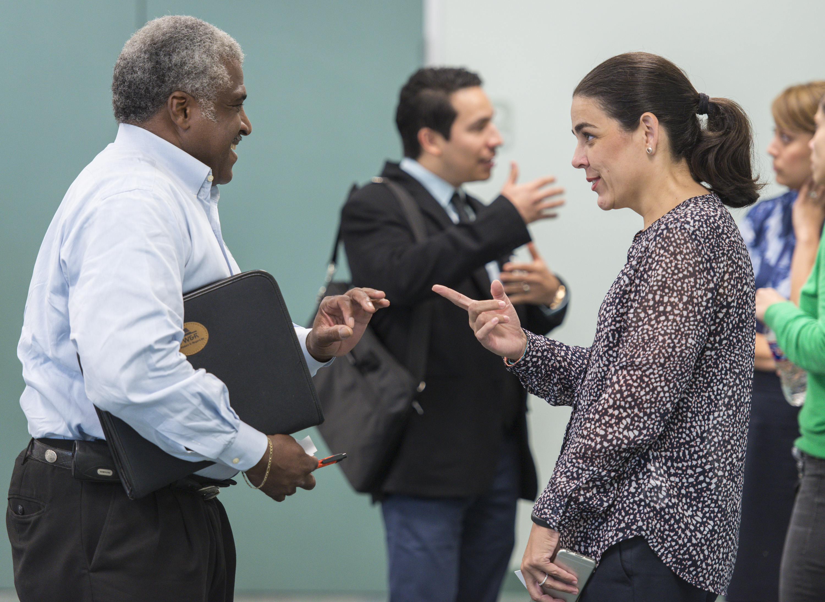
M/WBE outreach events
Greater Houston Black Chamber
U of Houston/TxDOT Forum
Southeast Texas Association of Public Purchasing: Expo/Forum
Women’s Business Enterprise Alliance: Expo/Luncheon
Houston Minority & Supplier Diversity Council
Greater Houston Business Procurement Forum
Women’s Contractor Association: Luncheon/Expo
East End Chamber of Commerce: Expo/Luncheon; Small Business Development
Notes:
M/WBE – Alexis Licata

Slide 14
M/WBE commitment
Certified Minority/Women Owned Businesses Breakdown
2012 Total Combined Projects
Committed WBE
$28,055,886 3.15%
Notes:
M/WBE – Alexis Licata

Slide 15
Bond financial report
The 2012 Bond Program is $1.89 billion, and the issuance of bonds is planned in four sales. Additionally, the Board of Education in 2015 approved an additional $212.4 million. Total budget is $2.1 billion.
Commitments of $889,857,978 (including encumbrances of $435,479,381 and actual expenditures of $454,378,597) leaving $1,212,591,985 of available funding.
Total Budget, Commitments & Available Funding to Date Total Budget: $2.1 billion
(issuance sales in millions)
2013
(Sold Feb)
2014
(Sold Sept)
2015
2016
(Sold April)
Notes:
Finances – Sherrie Robinson and Tonya Savoie

Slide 16
Communications
Finalizing surveys to assess community engagement efforts
Developing communications plan for transitioning schools
Created guide for bond principals planning celebrations for project milestones
Notes:
Communications – Sylvia Wood

Slide 17
Communications
Coordinated 8 community meetings, 3 groundbreakings
Provided frequent construction updates to highlight progress
Posted regular updates to social media, blog, Facebook
Strategically pitched stories to media outlets
Notes:
Communications – Sylvia Wood

Slide 18
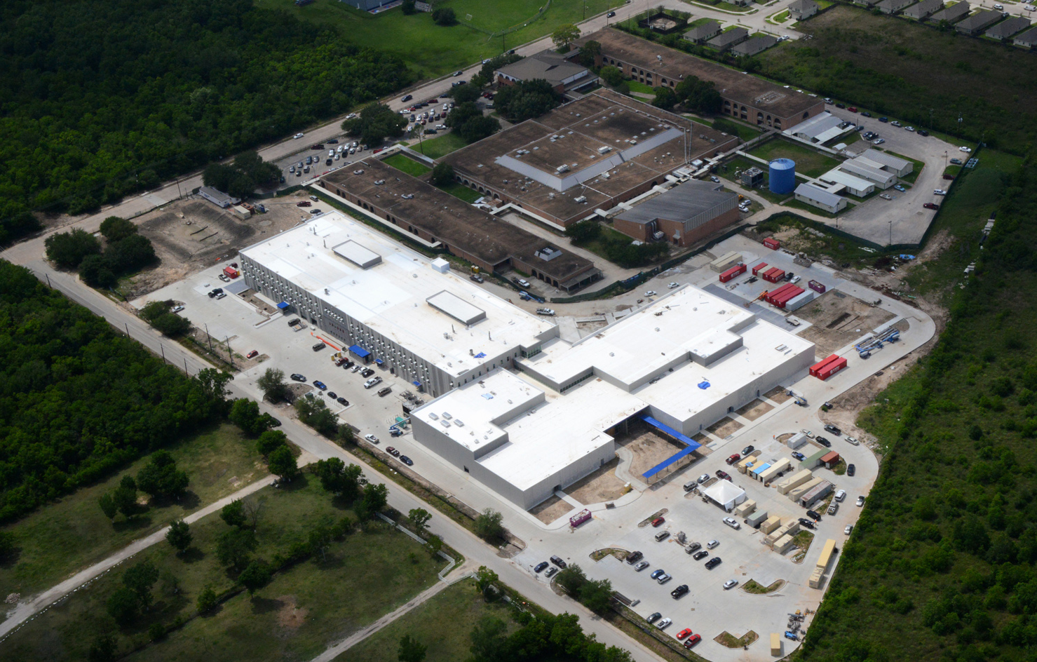
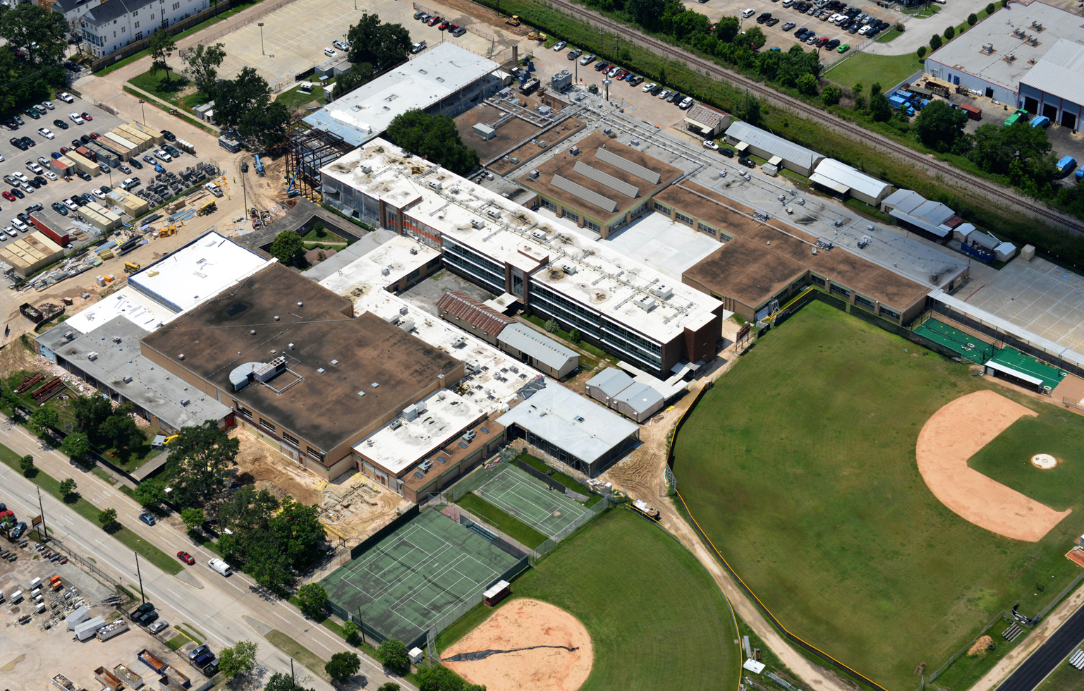
Looking ahead
By end of September:
6 new schools open
10 more contracts executed
7 more projects under construction
Projects nearing completion:
Sterling Aviation HS
Delmar Fieldhouse
Waltrip HS Renovations
Sterling HS
Waltrip HS
Notes:
Looking Ahead – Derrick Sanders

Slide 19
Thank you

