Slide 1
Bond Oversight Committee Meeting Third Quarter
October 29, 2013

Slide 2
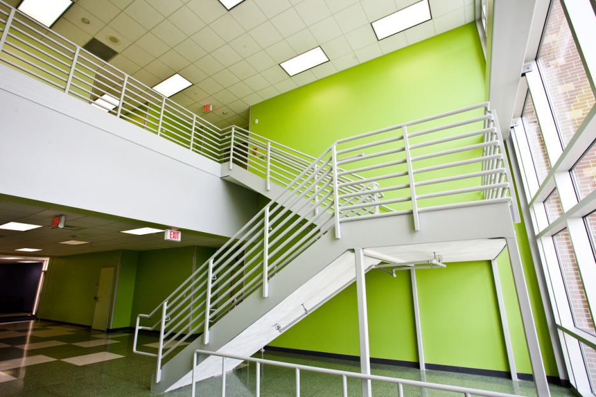
2007 Bond Accomplishments
Promise Made: Build 23 new schools
Promise Kept: 22 new schools open, including Atherton and Dogan; Sherman opening this fall
Promise Made: Expand 2 schools
Promise Kept: 2 schools renovated and expanded: Crockett and Valley West
Promise Made: Renovate and repair schools
Promise Kept and Exceeded: More than 180 projects underway or completed; all bond work to be done by the end of 2014

Slide 3
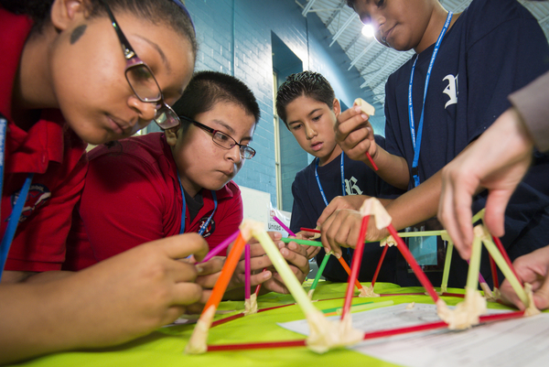
2007 Bond Accomplishments
Promise Made: Improve campus safety and security
Promise Kept: More than 8,800 security cameras installed; new fencing installed at 92 schools
Promise Made: Update and improve middle and high school science labs
Promise Kept: New science lab equipment and materials have been delivered to all middle and high schools; science lab renovations are ongoing at middle and high school campuses across the district

Slide 4
2007 Bond Financial Report
Total funding of $1,176,130,676
Actual committed of $1,043,994,979 (including encumbrances of $101,516,502 and actual expenditures of $942,478,477)
Uncommitted funding balance of $132,135,697 or 11% of total funding
As of September 30, 2013

Slide 5
2012 Bond Financial Report
$340,000,000 of the total $1.89 billion approved by voters in November 2012 has been issued.
Actual committed of $41,061,736 (including encumbrances of $40,120,070 and actual expenditures of $941,666) and $298,938,264 uncommitted.
As of September 30, 2013

Slide 6
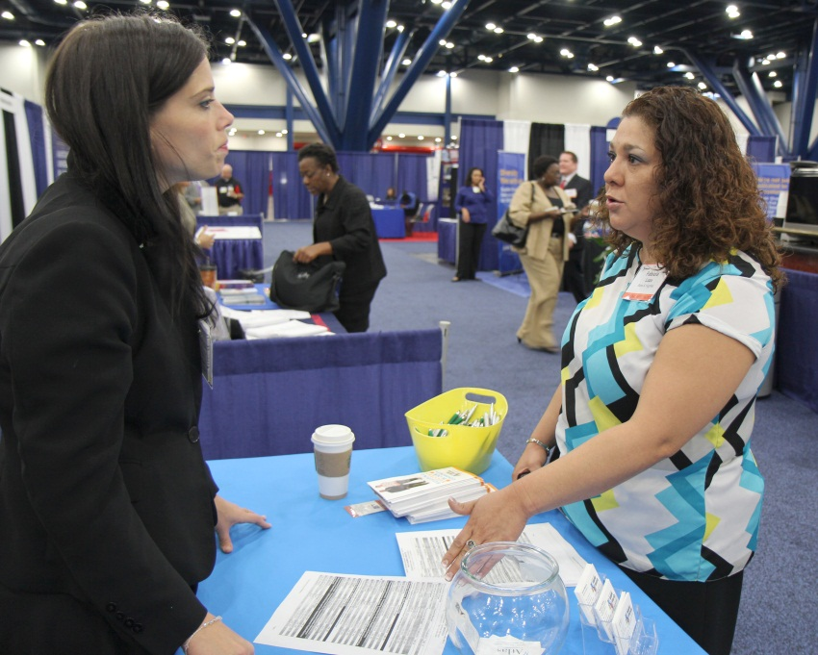
M/WBE Outreach Events
Workshop Wednesday
August: Bonding Workshop
September: Effectively Acquire & Manage Capital Resources for Your Small Business
Interagency Mentor Protégé Program
Participated in nearly a dozen M/WBE business outreach events

Slide 7
2007 Bond M/WBE Participation
Exceeded minimum M/WBE goal levels of 20% for 2007 bond program
M/WBE participation has reached nearly 35% in 2007 bond program

Slide 8
2012 Bond
M/WBE Commitment
Certified Minority/Women Owned Businesses Breakdown

Slide 9
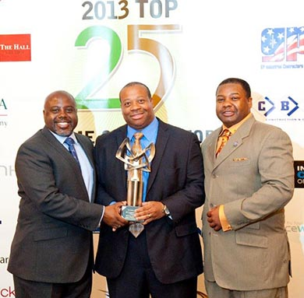
Doing Business
HISD is committed to supplier diversity.
Monthly outreach events are being held for minority and women-owned businesses
Contracts awarded to date represent a 51 percent commitment rate by M/WBE firms
Local job fairs will be held at each bond campus to encourage neighborhood participation

Slide 10
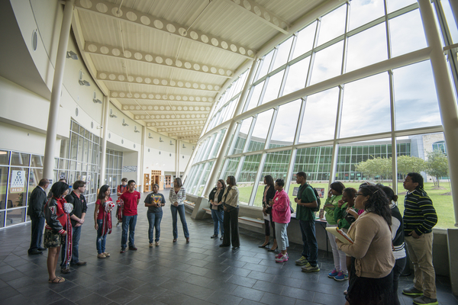
21st Century Learning Spaces
HISD is building modern facilities to support students in becoming college and career ready in the 21st century.
Flexible learning spaces
Ergonomic furniture
Visual connections
Linked learning
Natural light
Sustainable design
Technology to support a variety of teaching and learning styles
More info at houstonisd.org/21stCentury

Slide 11
2012 Bond Schedule
Group 1 Status:
All schools currently in Planning and Design phase
All construction to begin in Mid/Late 2014
Group 2 Status:
All ahead of schedule in Planning and Design
Construction to begin in Mid/Late 2015
Group 3 Status:
District-Wide Educational Specifications complete
Planning and Design to begin Early/Mid 2015
Anticipated Construction to begin Mid/Late 2016
Group 4 Status:
District-Wide Educational Specifications complete
Planning and Design to begin Late 2015/Early 2016
Anticipated Construction to Begin in Mid 2017

Slide 12
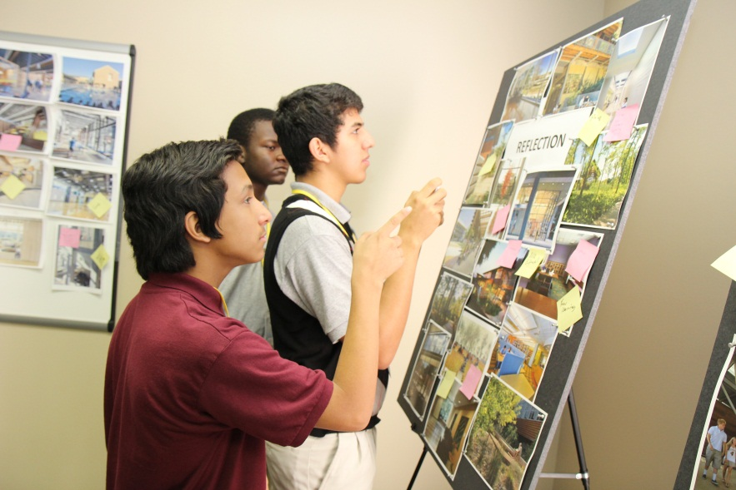
Making Progress
HISD is committed to completing all bond work within budget by the end of 2020.
First schools in 2012 program break ground
Delmar-Tusa Fieldhouse demolition approved
Design charrettes held for four campuses

Slide 13
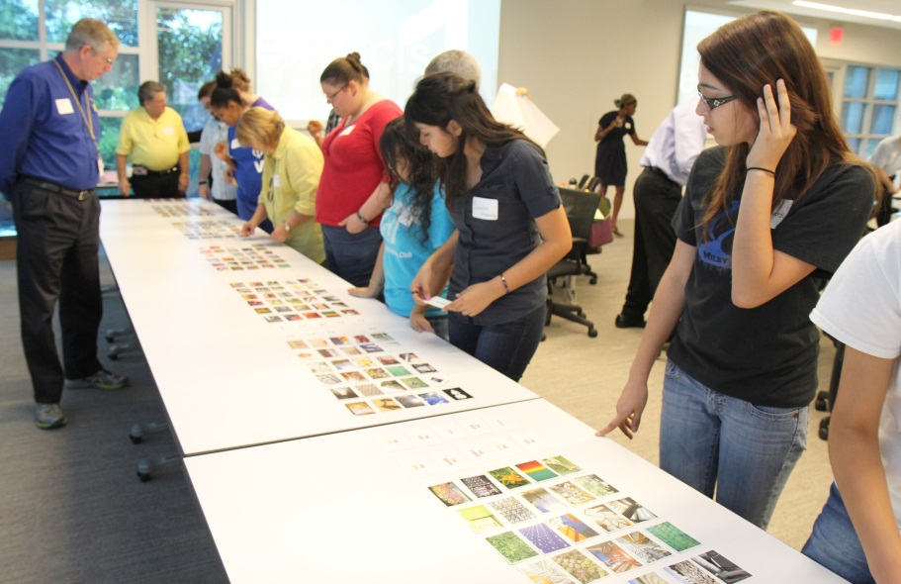
Making Progress
HISD is committed to completing all bond work within budget by the end of 2020.
Construction Manager at Risk (CMAR) selections underway
Planning, design and community meetings ongoing
Real estate acquisitions underway
District-Wide Design Guidelines complete

Slide 14
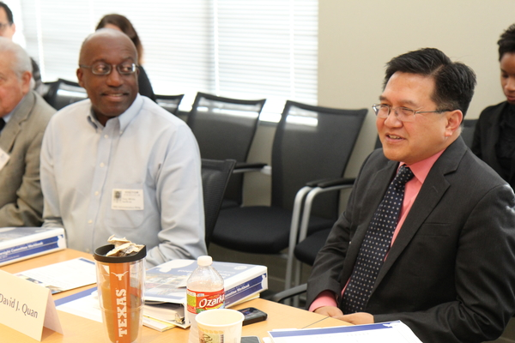
Maintaining Accountability
HISD is committed to a quality bond program
that is transparent, accountable and responsive.
Bond Oversight Committee meets quarterly to monitor progress of district’s bond programs
Project Advisory Teams meet monthly at each bond campus to take part in the school planning and design
21st Century Schools Advisory Committee meets monthly to help guide the district’s approach in designing 21st century learning environments

Slide 15
Next Steps
HISD is committed to sustaining momentum. Here are next steps through the end of the year:
More CMAR recommendations will be brought to the Board
Design workshops and community meetings are being held
Furniture fair will be held on November 5
Job fairs being planned for Waltrip, Worthing, and North and South Early colleges
Educational facility tours for PATs are ongoing

Slide 16
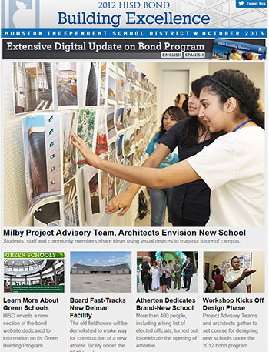
Staying Informed
HISD is committed to engaging the public with timely and accurate information.
Award-winning monthly newsletter sent to nearly 3,000 subscribers
Bond update sent to 140,000 district households
Regular updates to bond website at houstonisd.org/bond
Dedicated email for questions at bondinfo@houstonisd.org

