Slide 1
Bond Oversight Committee Meeting
Third Quarter 2016
Oct. 25, 2016
Notes:
Welcome – Derrick Sanders

Slide 2
Third Quarter Progress
Six new schools and one classroom addition opened in time for start of 2016-2017 school year
Crews continuing to complete punch lists for new schools
Three construction contracts executed:
  Lawson MS
  YWCPA
  Final Restroom Renovation Package
2016-2017 Openings
Condit Elementary
Mark White Elementary
North Houston Early College HS
South Early College HS
Mandarin Immersion Magnet School
Fonwood ECC (non bond)
Worthing HS (Phase 1) Classroom Addition
Notes:
Third Quarter Progress – Derrick Sanders

Slide 3
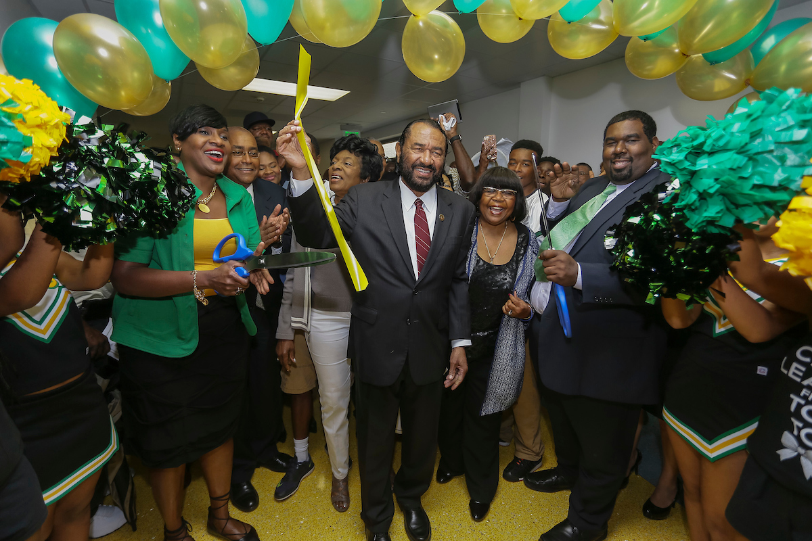
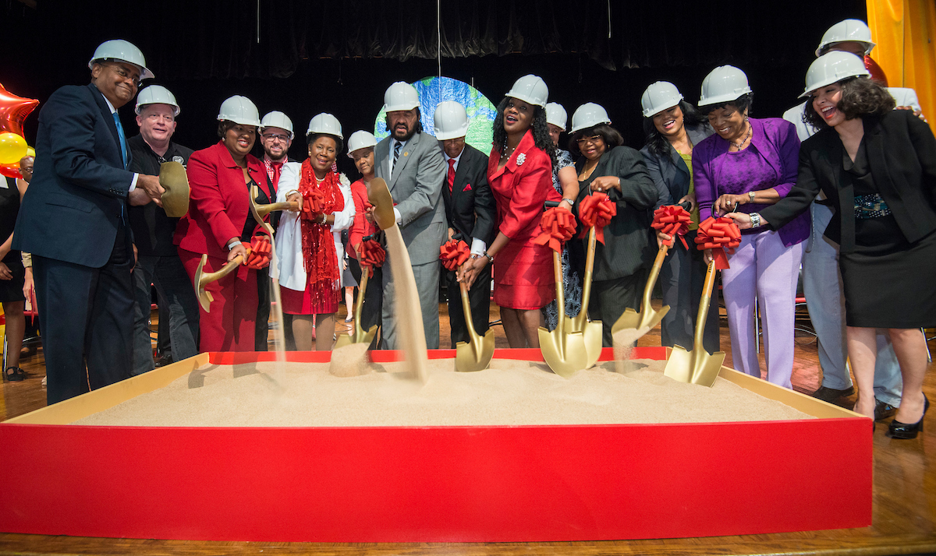
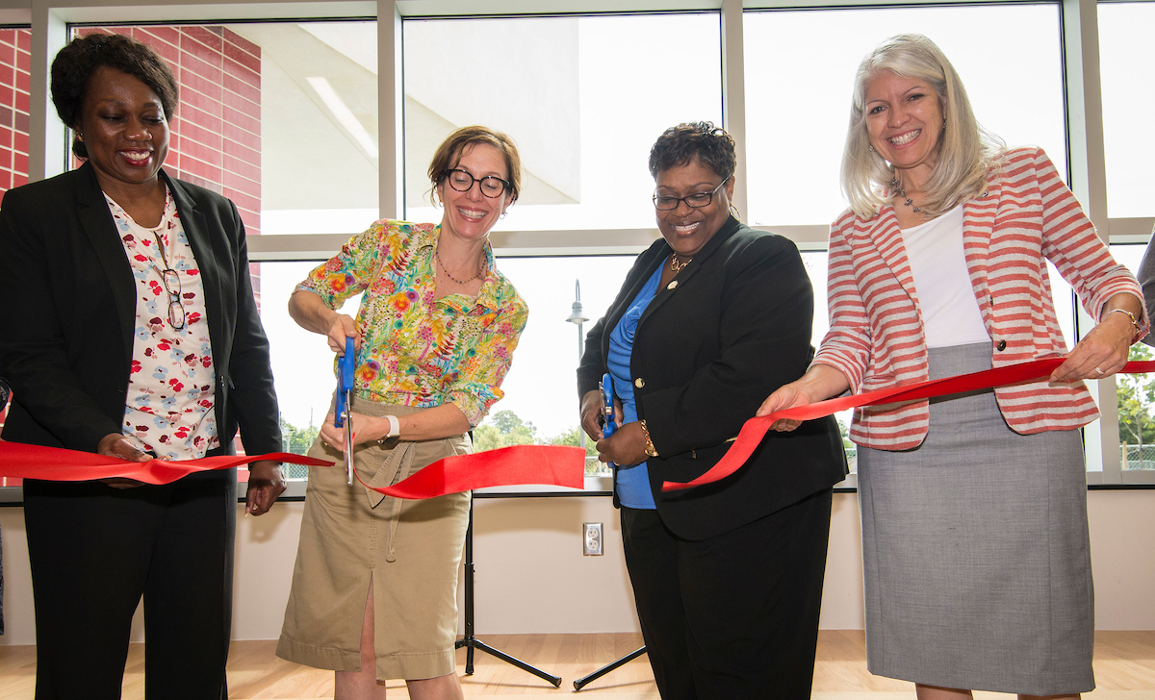
Third Quarter Progress
Grand Openings held for North Houston Early College High School and Worthing HS (Phase 1) Classroom Addition
Groundbreaking held for Lawson MS
Almost a dozen more project milestone celebrations scheduled throughout Q4
Worthing HS
Lawson MS
North Houston ECHS
Notes:
Third Quarter Progress – Derrick Sanders

Slide 4
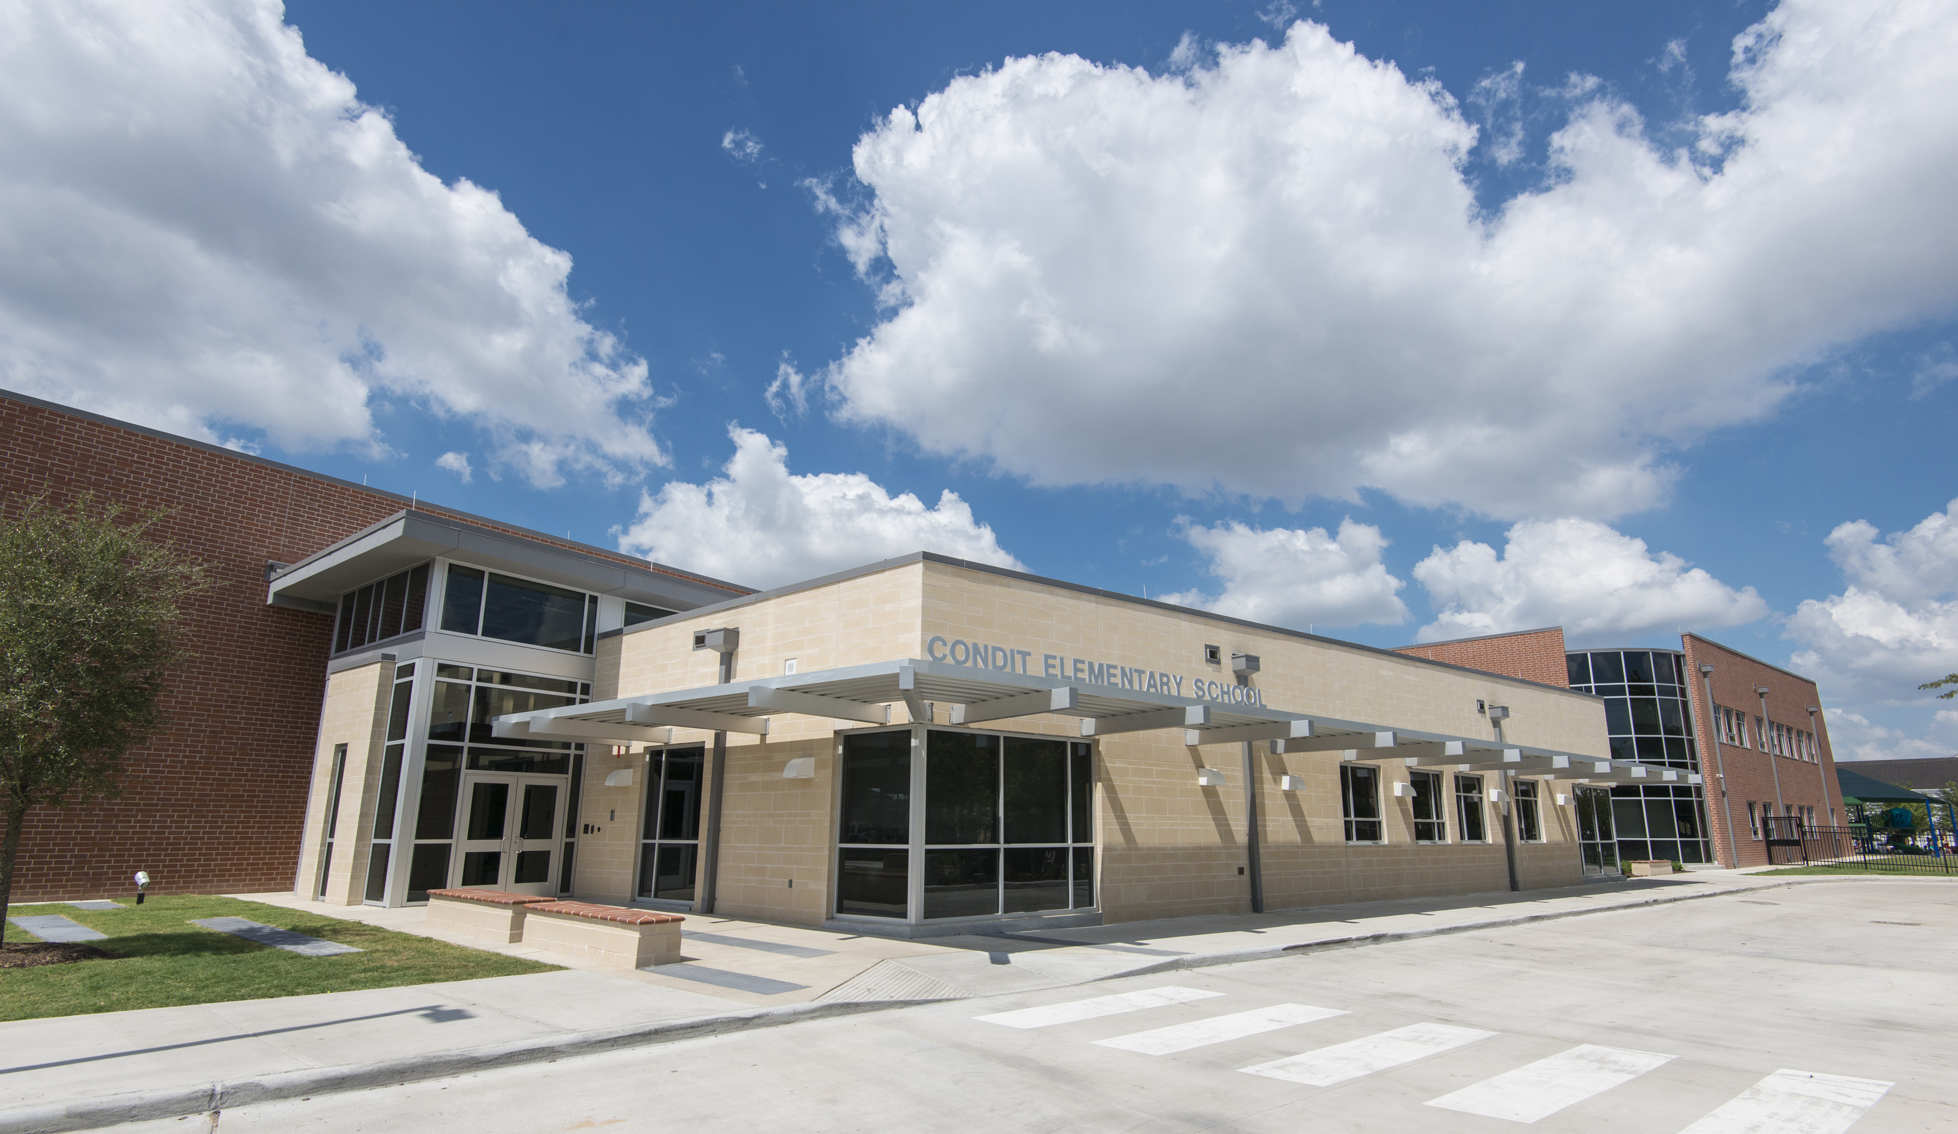
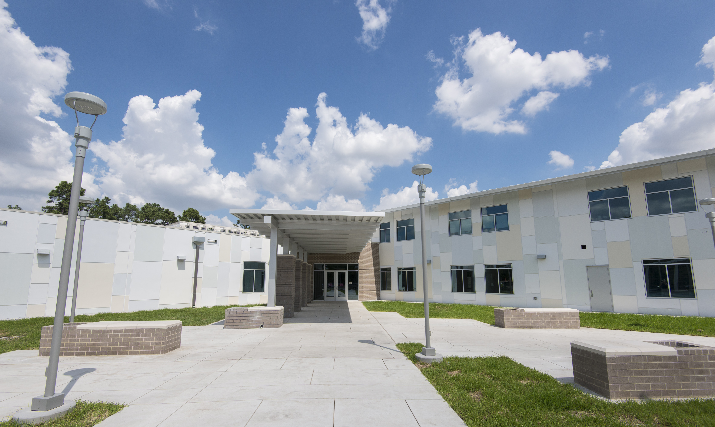
Project Highlights
Condit Elementary
Mark White Elementary
New school for 750 students
New school for 750 students
Notes:
New School Project Highlights – Derrick Sanders

Slide 5
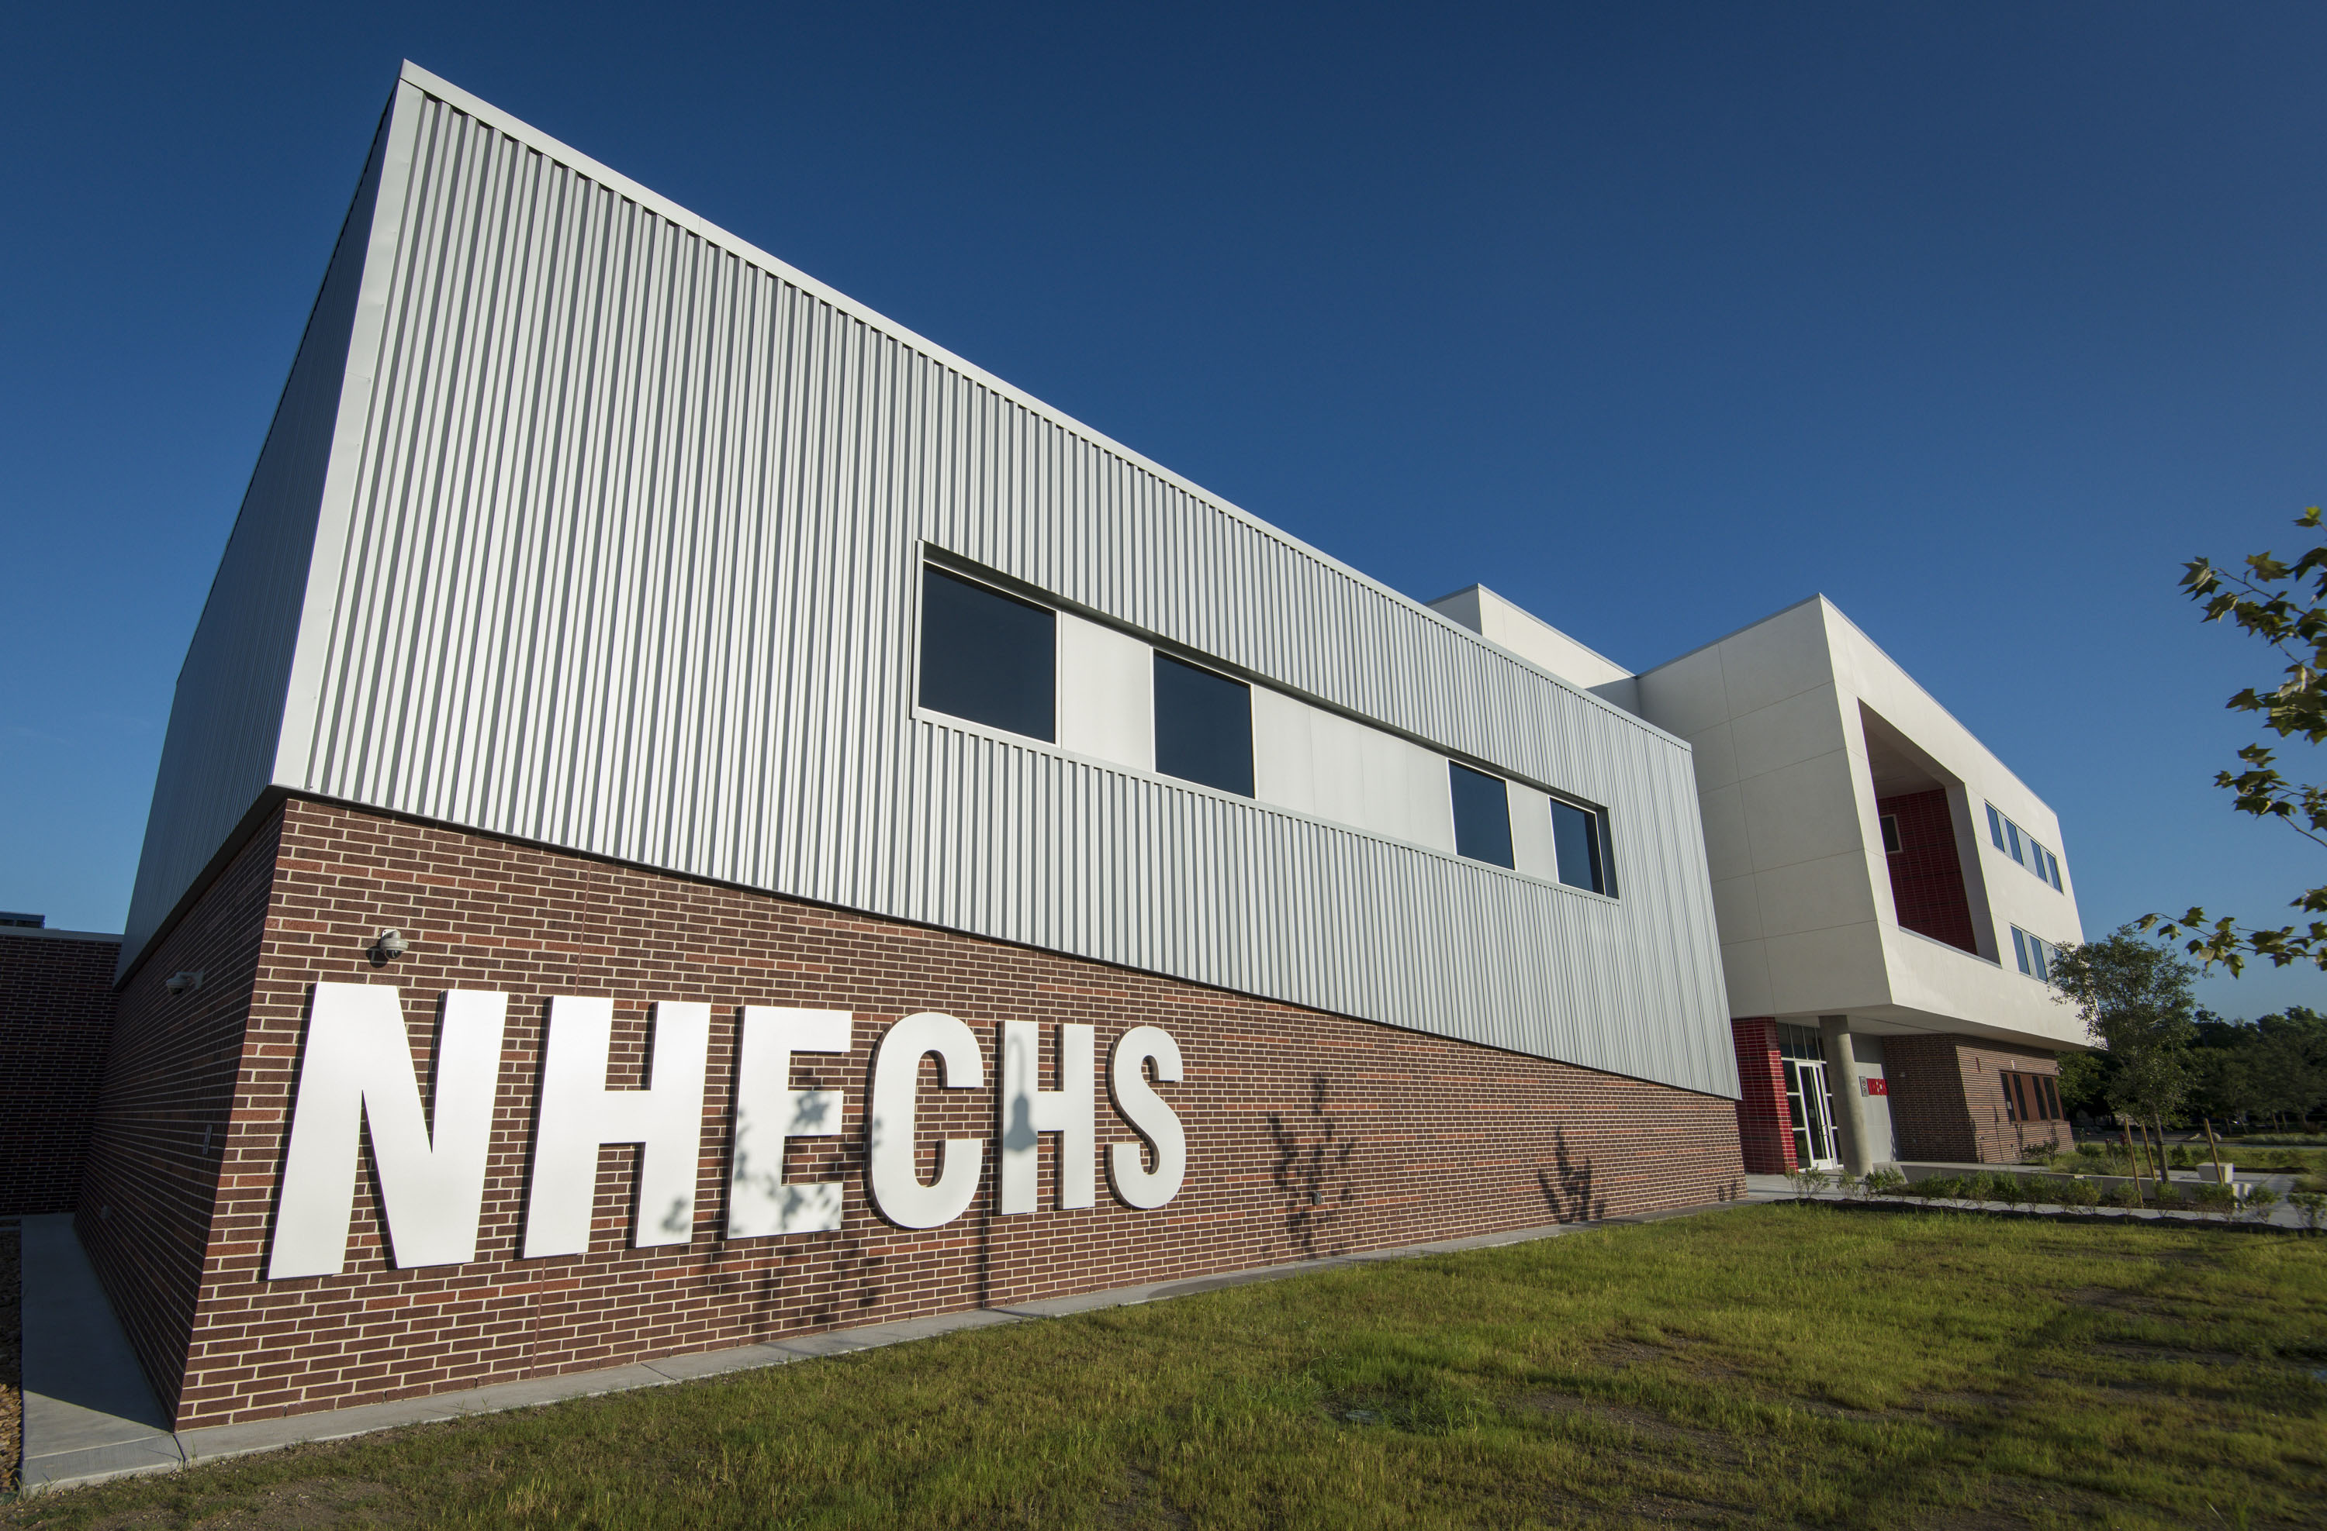
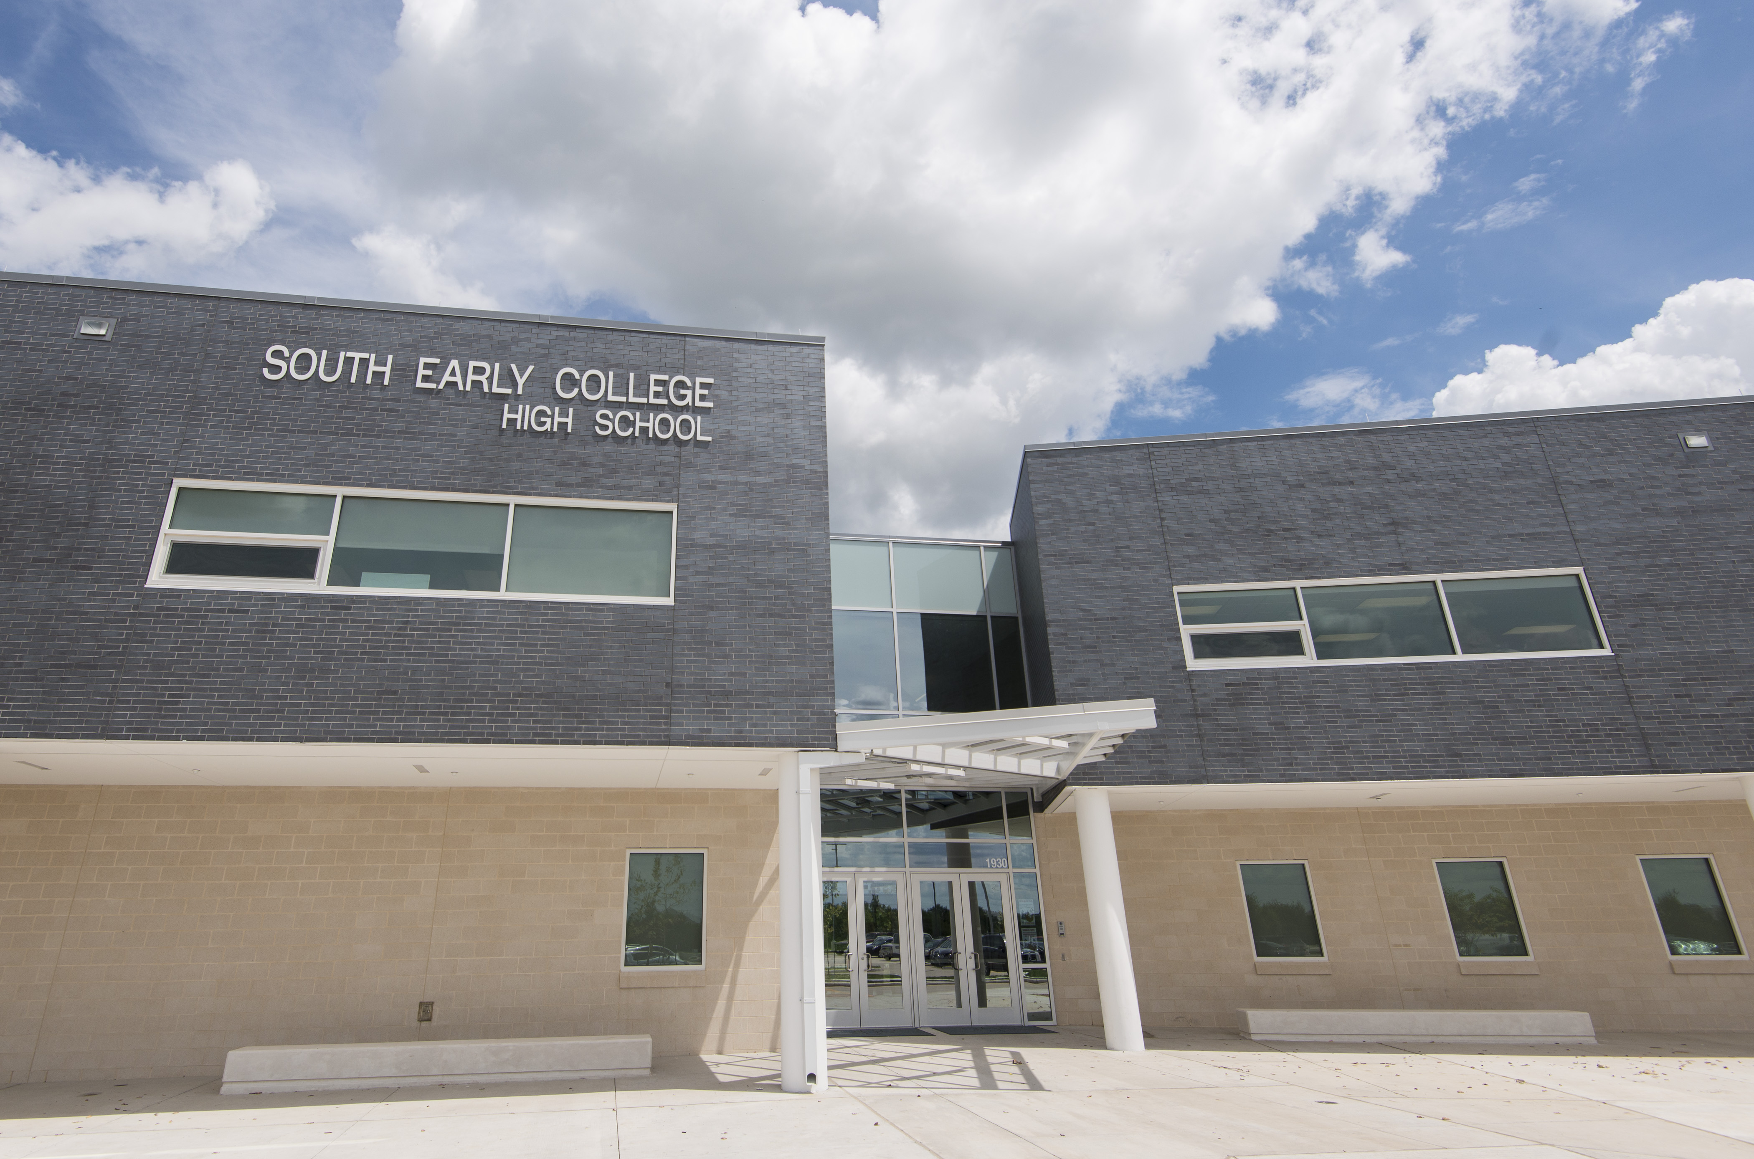
Project Highlights
North Houston ECHS
South ECHS
New school for 400 students at HCC-Northline
New school for 400 students at HCC-South
Notes:
New School ProjectHighlights – Derrick Sanders

Slide 6
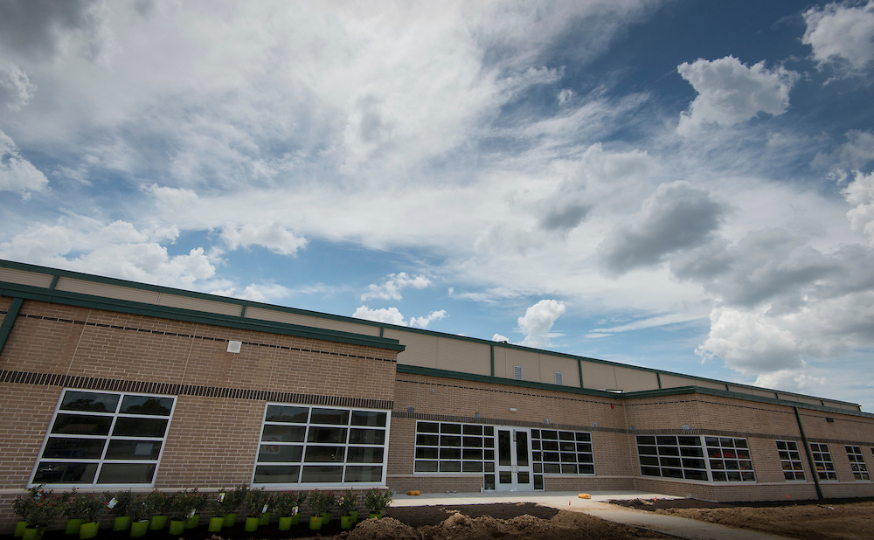
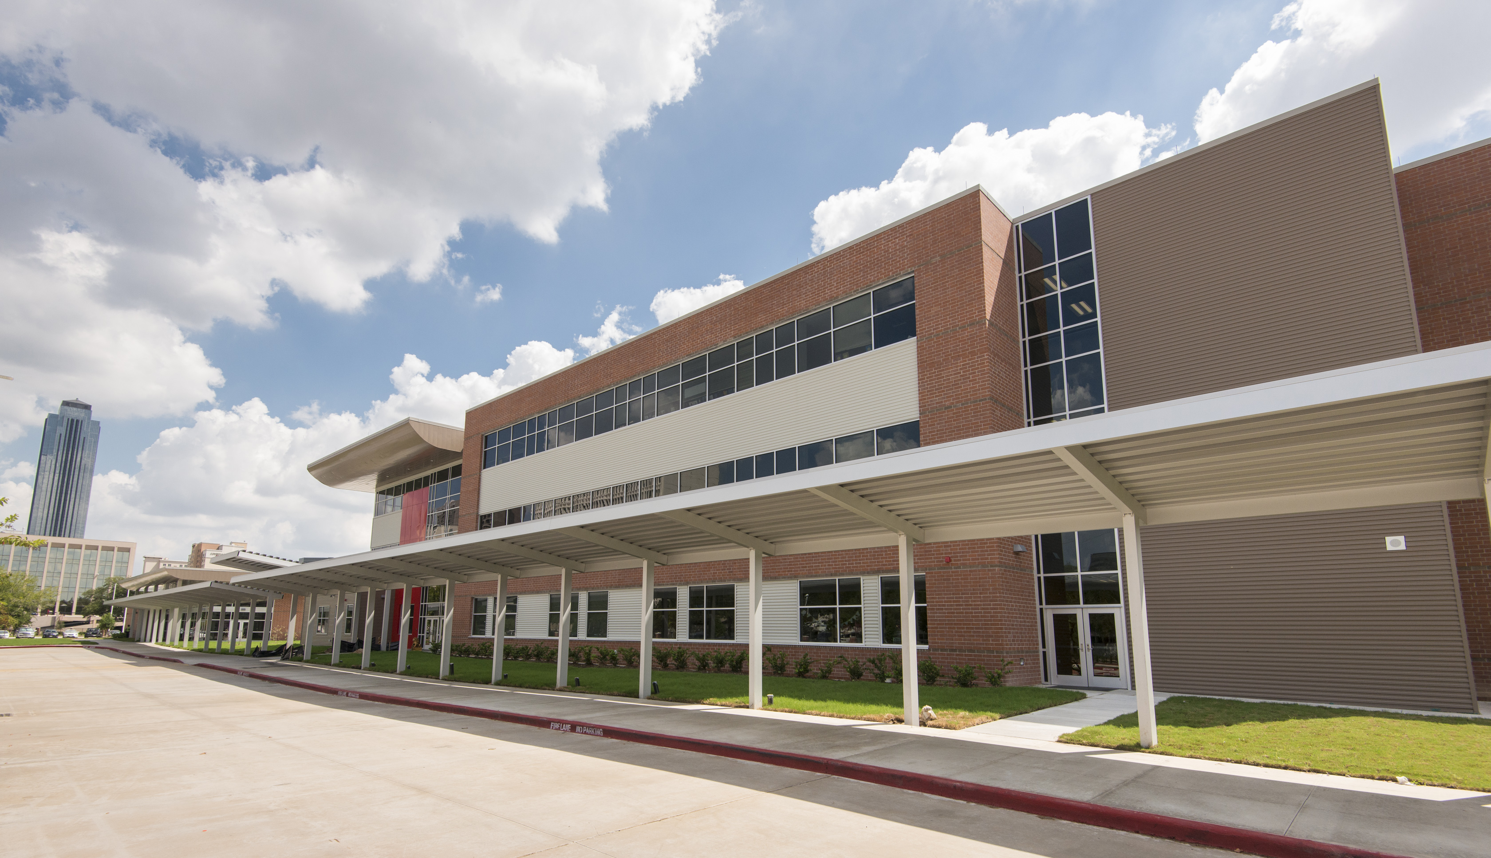
Project Highlights
Fonwood ECC (non-bond)
Mandarin IMS
New early childhood center for 500 - 600 students
New school for 750 -900 students
Notes:
New School ProjectHighlights – Derrick Sanders

Slide 7

Project Highlights
First Day of School: 21st Century Learning in Action
Notes:
New School Project Highlights: Cue to play first day of school compilation video showcasing new buildings and 21st century learning -- Derrick Sanders

Slide 8
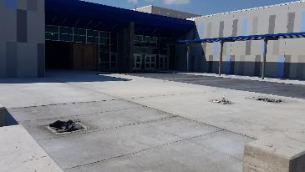
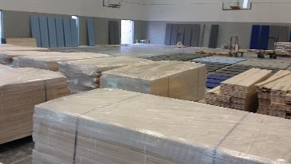
Construction Highlights
Sterling Aviation High School
Revised east patio at bus drop off
Gym wood floor ready for installation
New school for 1,600 – 1,800 students
Target Completion Date: Q1 2017
Notes:
Construction Highlights – Derrick Sanders

Slide 9
Construction Highlights
DeBakey High School for Health Professions
Exterior
Atrium
New school for 900 – 1,000 students
Target Completion Date: Q1 2017
Notes:
Construction Highlights – Derrick Sanders

Slide 10
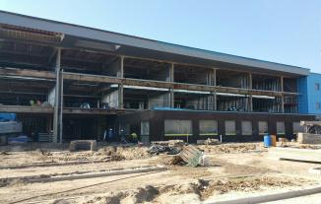
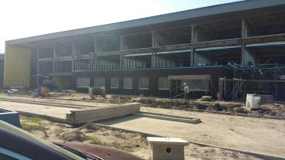
Construction Highlights
Furr High School
Roof flooring
Outside corner of face brick installed in place
Face brick installed in place on first floor
New school for 1,000 – 1,300 students
Target Completion Date: Q2 2017
Notes:
Construction Highlights – Derrick Sanders

Slide 11
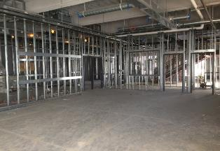
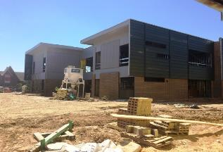
Construction Highlights
Wisdom High School
YMCA daycare is framed
Metal siding proceeding on East Neighborhood
New school for 1,700 – 1,900 students
Target Completion Date: Q2 2017
Notes:
Construction Highlights – Derrick Sanders

Slide 12
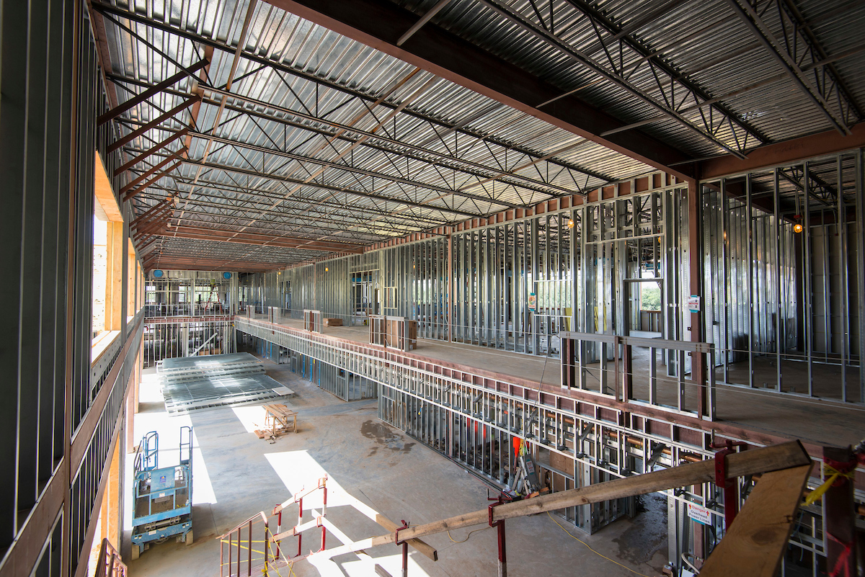
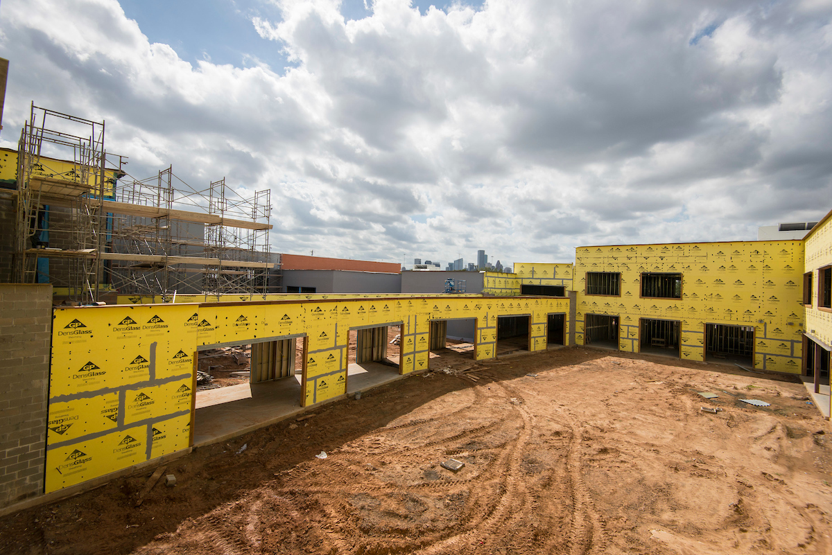
Construction Highlights
Mickey Leland College Prep Academy for Young Men
Main school artery
Rear view of courtyard
New school for 900 – 1,000 students
Target Completion Date: Q2 2017
Notes:
Construction Highlights – Derrick Sanders

Slide 13
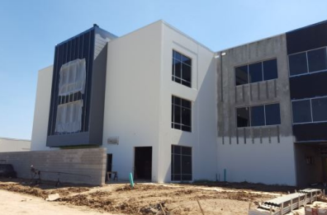
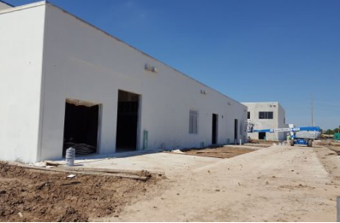
Construction Highlights
Milby High School
Area E & F: Metal R panels being installed
Area A: LMI is texturing tilt wall.
New school for 1,800 – 2,000 students
Target Completion Date: Q3 2017, but expected
to be ready for summer school
Notes:
Construction Highlights – Derrick Sanders

Slide 14

Doing Business
Office of Business Assistance
held and participated in multiple
programs to promote
HISD business opportunities
M/WBE commitments for
contracts awarded to date:
  Architect projects represent 53.38%
  Construction firm projects represent 22.67%
  Program management firm projects represent 46.91%
  Other projects represent 39.5%
Notes:
M/WBE – Alexis Licata

Slide 15
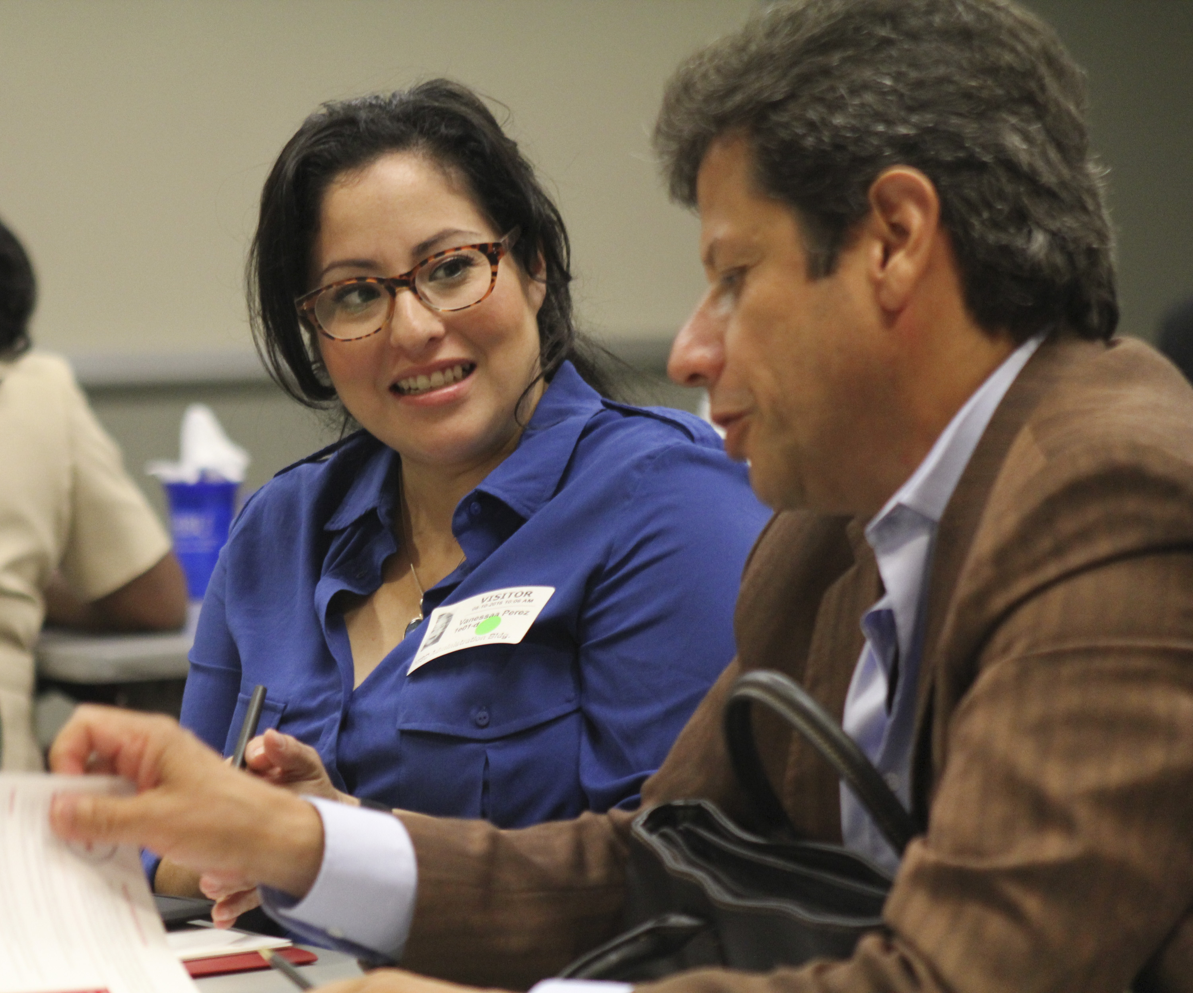
M/WBE networking events
Workshop Wednesdays
July
Achieving your Desired
Results
August
Overcoming Small
Business Obstacles
September
Business Strategies & Tax Updates for Small Businesses
Notes:
M/WBE – Alexis Licata

Slide 16
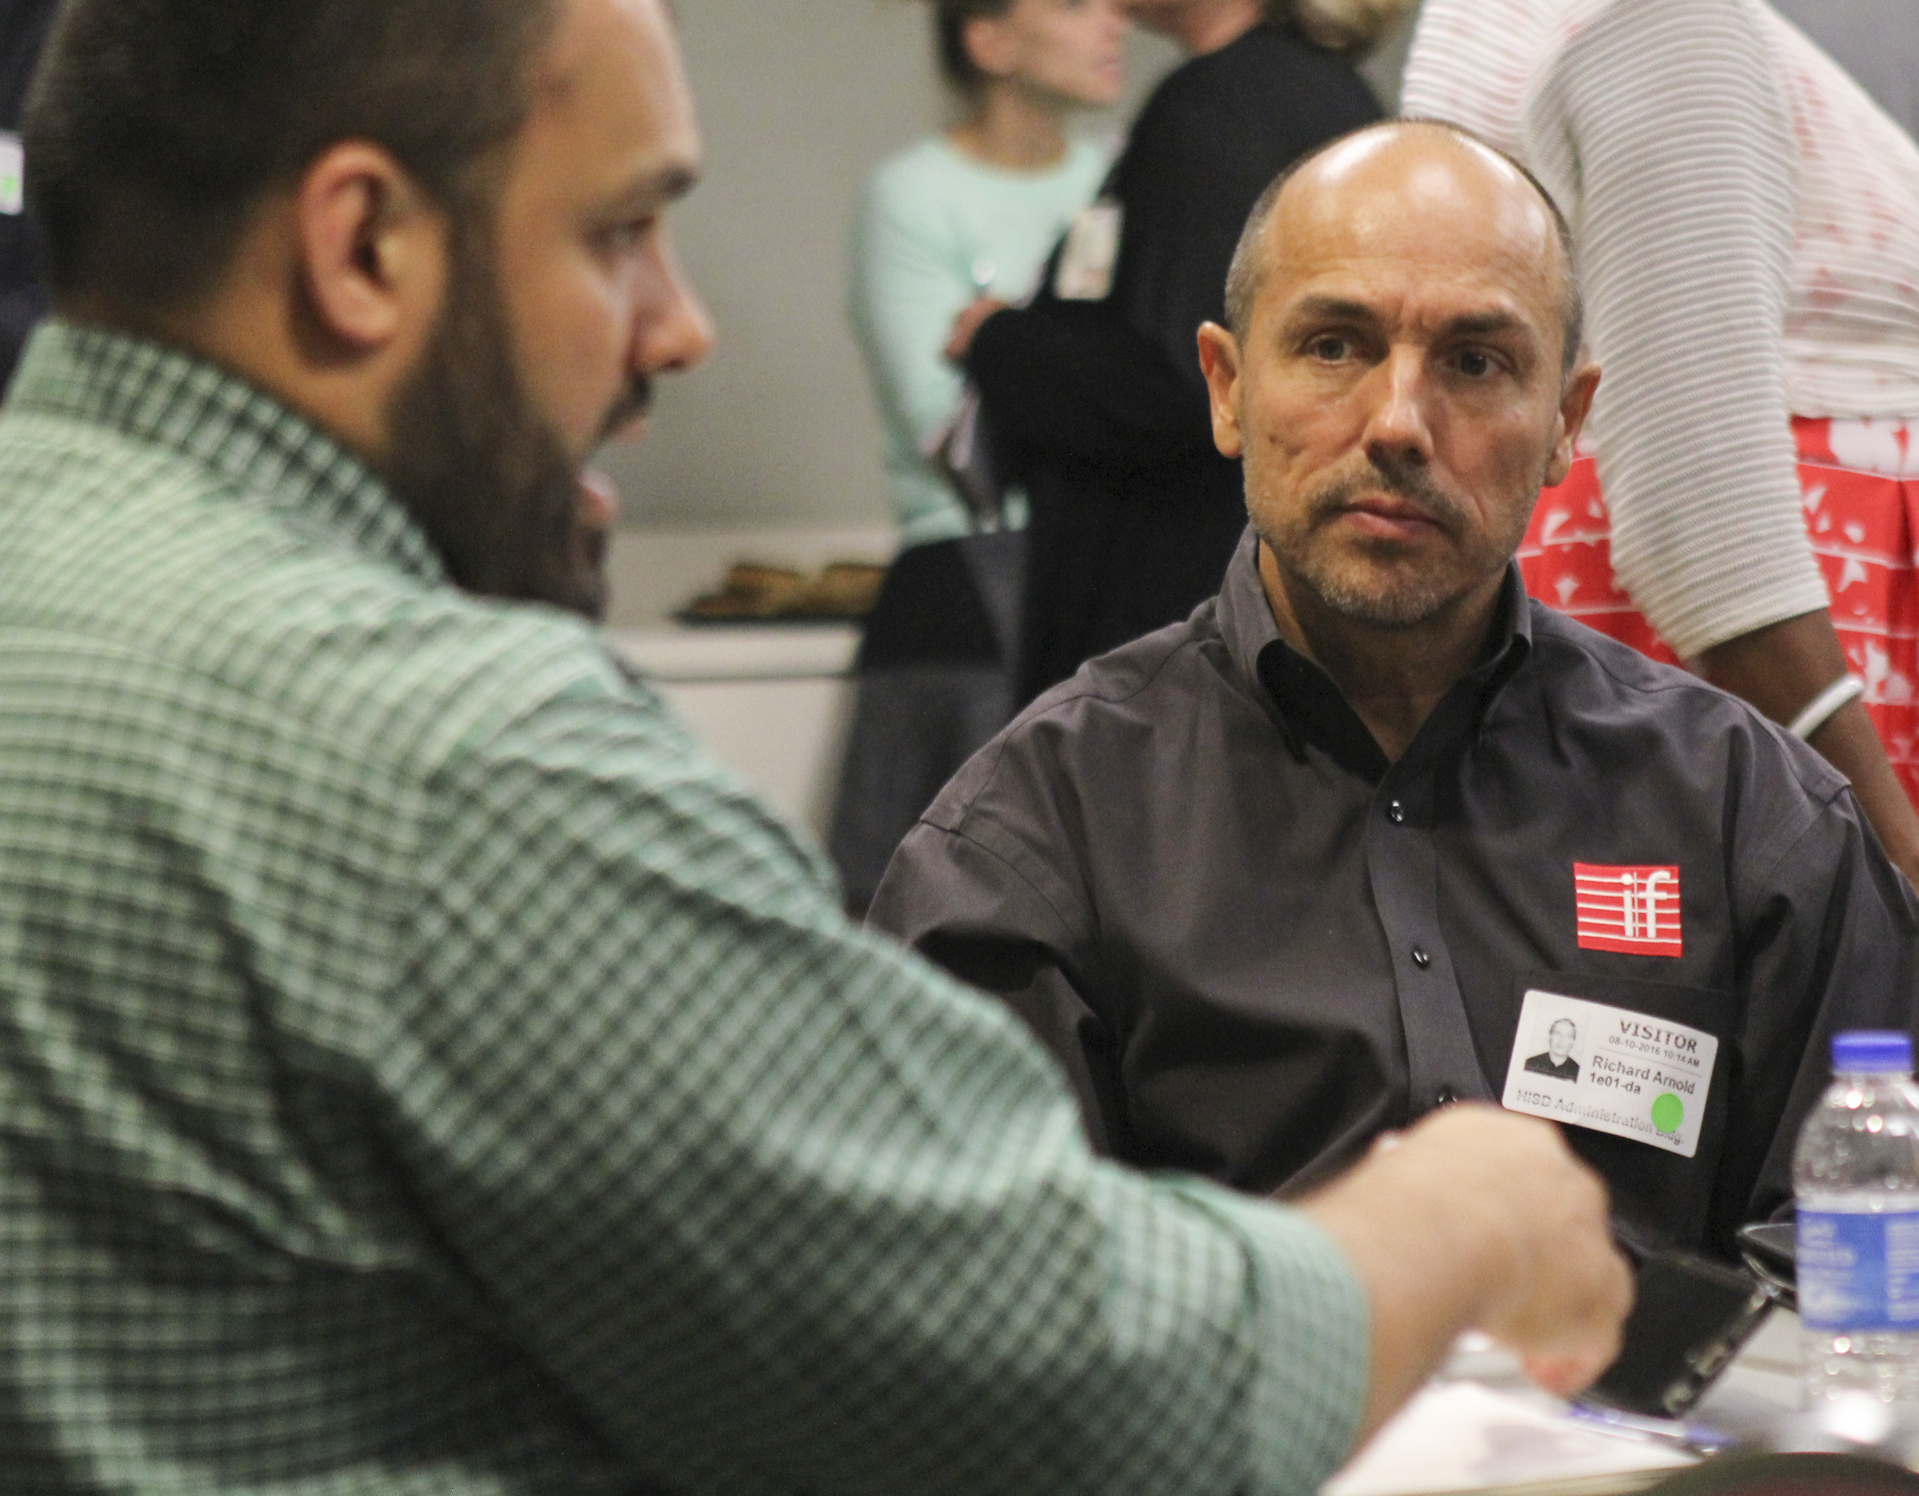
M/WBE outreach events
Greater Houston Black Chamber
East End Chambers of Commerce
Port of Houston: Appreciation Day
Business Expo & Lunch
Construction Contractor’s College:
How to Do Business with HISD
Houston Minority Supplier Diversity
Council: Certification Compliance
Greater Houston Business Procurement Forum & Breakfast
City of Houston Office of Business Opportunity: “I’m Certified, What’s Next?”
Women’s Business Enterprise Alliance
Notes:
M/WBE – Alexis Licata

Slide 17
M/WBE commitment
Certified Minority/Women Owned Businesses Breakdown
2012 Total Combined Projects
Committed WBE
$38,050,899
3.67%
Notes:
M/WBE – Alexis Licata

Slide 18
Bond financial report
Original 2012 Bond Program is $1.89 billion, with issuance of bonds planned in four sales. In 2015, Board of Education approved an additional $212.4 million. The total budget now is $2.1 billion.
Commitments of $1,035,747,838 (including encumbrances of $477,650,454 and actual expenditures of $558,097,384) leaving $1,066,702,125 of available funding.
Total Budget, Commitments & Available Funding to Date
Total Budget: $2.1 billion
(issuance sales in millions)
2013
(Sold Feb)
2014
(Sold Sept)
2015
2016
(Sold April)
Notes:
Finance – Sherrie Robinson and Tonya Savoie

Slide 19
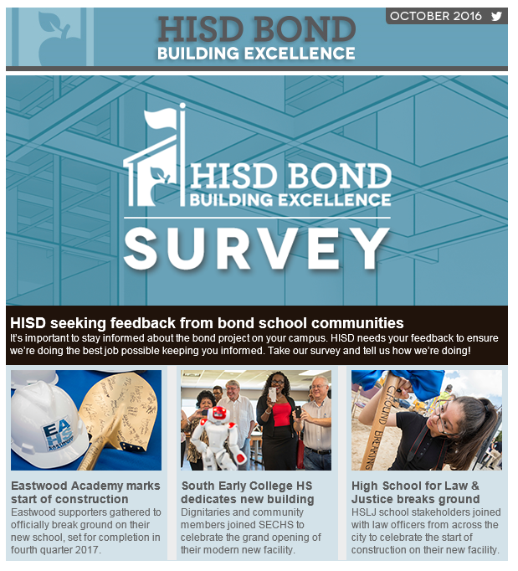
Communications
Developed communication
plans for schools transitioning
into new buildings
Coordinated 3 grand openings,
3 groundbreaking in Q3 and
first week of Q4
Coordinating 8 more milestone
celebrations to be held this fall
Posted regular updates to
social media, blog
Strategically pitched stories to media outlets
Notes:
Communications – Sylvia Wood

Slide 20
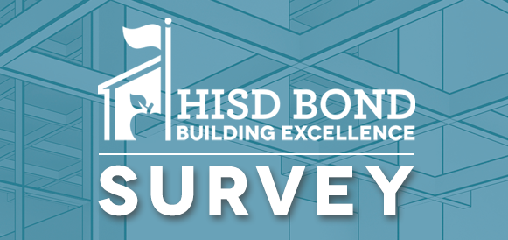
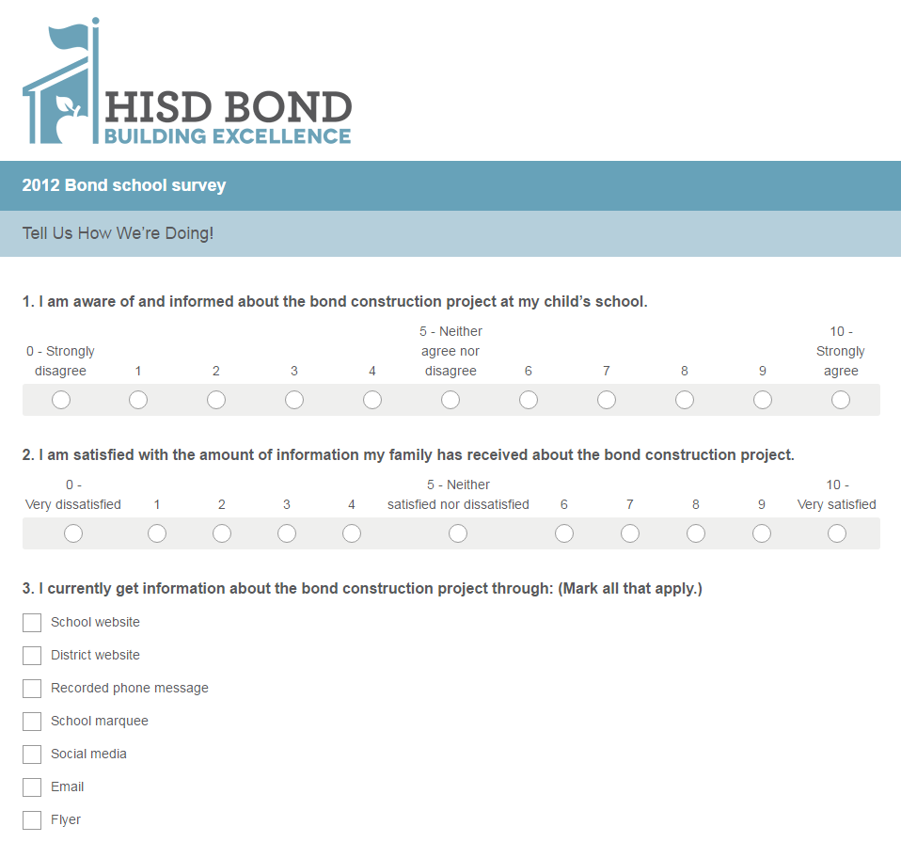
Communications
Conducting survey to assess community engagement
Distributed by principals, as
well as the bond website, bond newsletter, and social media
Open through October
Results to be analyzed in Q4
Roughly 650 replies by mid October
Notes:
Communications – Sylvia Wood

Slide 21
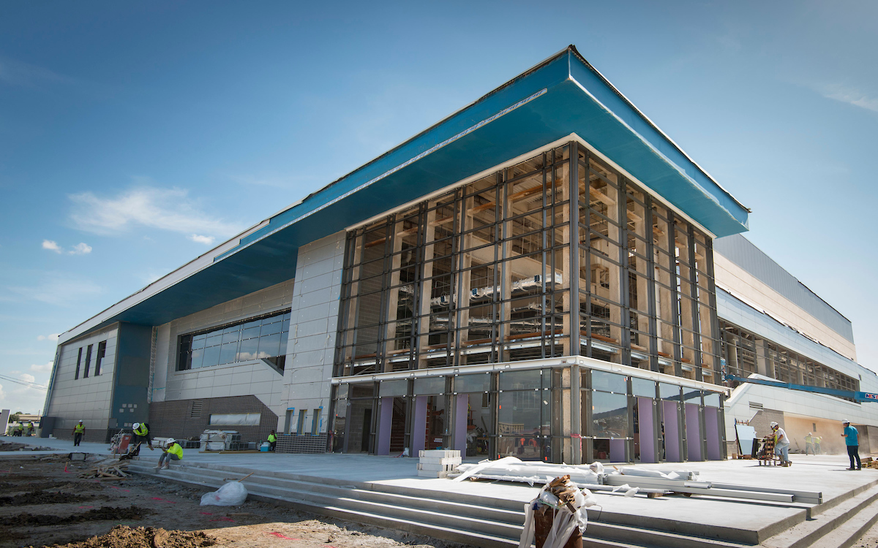
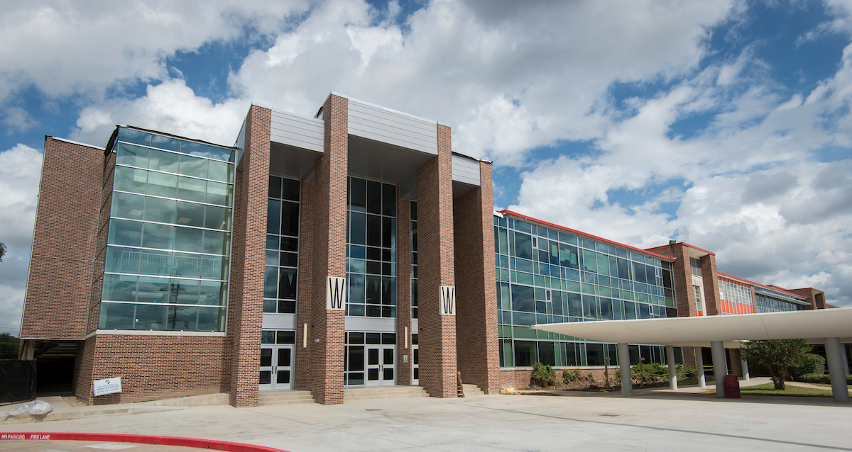
Looking ahead
By end of December:
  11 more contracts executed
  35 projects under construction
  Delmar Stadium, Waltrip HS, Jones Futures Academy to be completed
Completion in 2017 Q1:
  Sterling HS
  DeBakey HS for Health Professions
Delmar Stadium
Waltrip HS
Notes:
Looking Ahead – Derrick Sanders

Slide 22
Thank you

