Slide 1
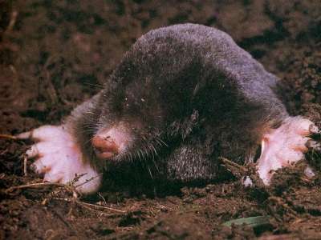
The Mole Concept
Avogadro’s Number = 6.022 x 10²³
Notes:
Objectives:
To state the value of Avogadro’s number: 6.02 x10²³.
To state the mass of Avogadro’s number of atoms for any element by referring to the periodic table.
To relate the moles of a substance to the number of particles.
http://www.birdxcanada.com/sonic/mole_400.jpg

Slide 2
How do you measure how much?
You can measure mass,
or volume,
or you can count pieces.
We measure mass in grams.
We measure volume in liters.
We count pieces in MOLES.

Slide 3
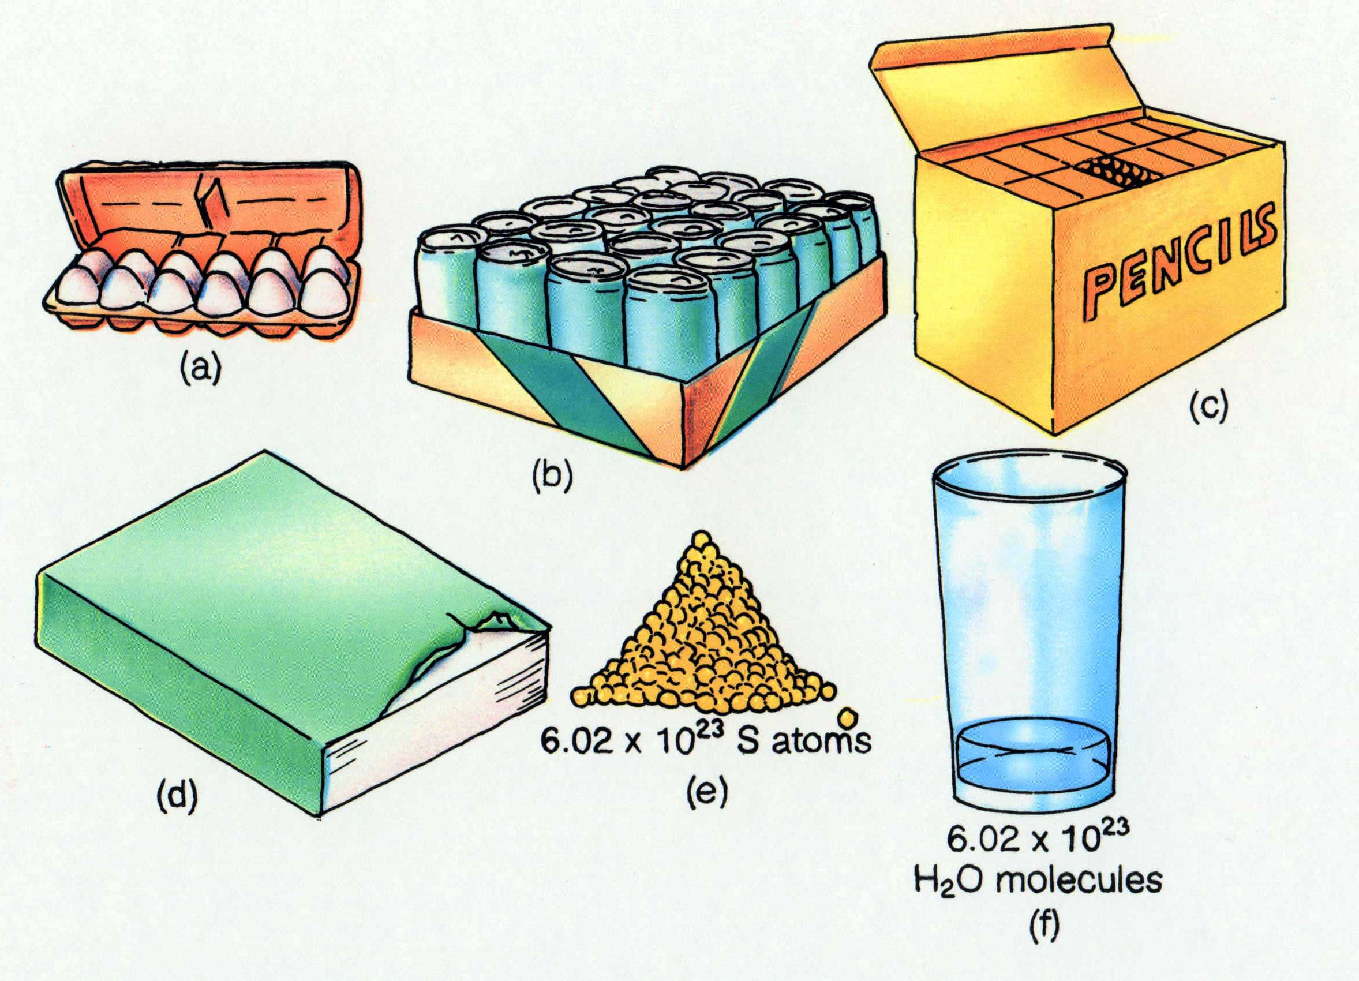

Counting
Counting words are used to simplify a description of a number of items.
1 dozen = 12 eggs
1 case = 24 cans
1 gross = 144 pencils
1 pair = 2 shoes
(b)
(d)

Slide 4

Counting
As you know, atoms and molecules are extremely small. There are so many of them in even the smallest sample that it’s impossible to actually count them.
That’s why chemists created their own counting unit called the mole.
We count pieces in MOLES.

Slide 5
????? = 6.0 x 10²³ atoms
This quantity is called a MOLE.

Slide 6



A MOLE (mol) is just a word representing a quantity.
What does dozen mean?
Yep, it means 12.
But 12 what?
12 steers
12 dinosaurs
12 flags

Slide 7
Just like the word dozen can stand for 12 things, the mole stands for 6.02 x 10²³ things.
Things, however, are limited to
Representative Particles
Atoms
Molecules
Ions
Formula units

Slide 8
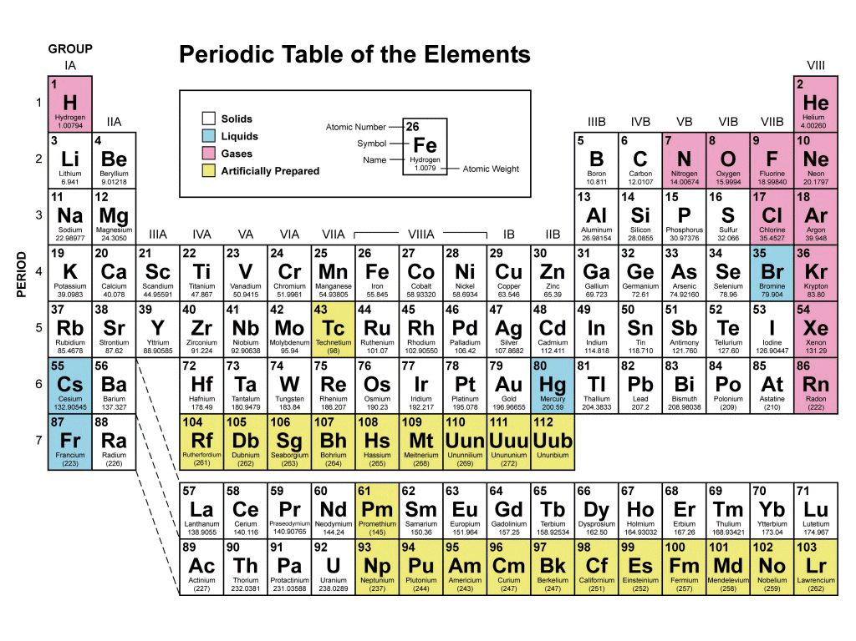
Representative particles
The smallest pieces of a substance.
For an element it is an atom.
    Fe
  Unless it is diatomic
    H₂, N₂, O_{2,} F₂, Cl₂, Br_{2,} I₂
For a molecular compound it is a molecule.
  H₂O
For an ionic compound it is a formula unit.
  NaCl

Slide 9

Calculations with Moles
Use Mickey Mouse Mole Graphing Chart to help you calculate

Slide 10
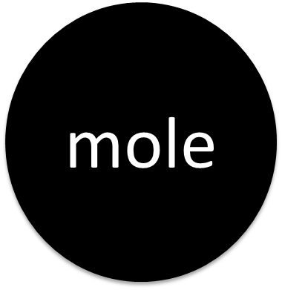
6.02 x10²³
particles

Slide 11
Converting factors
Conversion factor : 6.02 x 10²³ representative particles 1 mole
Conversion factor : 1 mole 6.02 x 10²³ representative particles

Slide 12
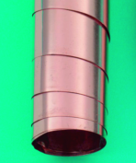
Converting Moles to Particles
Avogadro’s number is used to convert
moles of a substance to particles.
How many Cu atoms are in 0.50 mole of
Cu?
Particle Example 1:
0.50 mole Cu x
6.02 x 10²³ Cu atoms
1 mole Cu
= 3.0 x 10²³ Cu atoms

Slide 13
Particle Example 2:
Determine the number of formula units in 3.25 mol of AgNO_{3.}
3.25 mol of AgNO₃
x
6.02 x 10 ²³ formula units
1 mole of AgNO₃

Slide 14
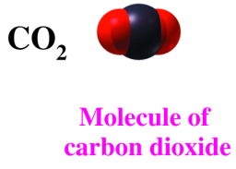
Converting Particles to Moles
Avogadro’s number is used to convert
particles of a substance to moles.
Example 3
How many moles of CO₂ are in 2.50 x 10²⁴ molecules of CO₂?
2.50 x 10²⁴ molecules CO₂ x
1 mole CO₂
6.02 x 10²³ molecules CO₂

Slide 15
Converting Particles to Moles
Example 4 Determine how many moles are in 1.204 X 10²⁵ atoms of Phosphorus
1.204 X 10²⁵ atoms of P
x
I mole of P
6.02 x 10 ²³ atoms of P

Slide 16
Learning Check
1. The number of atoms in 2.0 moles of Al is
A. 2.0 Al atoms
B. 3.0 x 10²³ Al atoms
C. 1.2 x 10²⁴ Al atoms
2. The number of moles of S in 1.8 x 10²⁴ atoms of S is
A. 1.0 mole of S atoms
B. 3.0 moles of S atoms
C. 1.1 x 10⁴⁸ moles of S atoms

Slide 17
Solution
1. The number of atoms in 2.0 moles of Al is
C. 1.2 x 10²⁴ Al atoms
2.0 moles Al x 6.02 x 10²³ Al atoms
1 mole Al
2. The number of moles of S in 1.8 x 10²⁴ atoms of S is
B. 3.0 moles of S atoms
1.8 x 10²⁴ S atoms x 1 mole S
6.02 x 10²³ S atoms

Slide 18
Mass and the Mole
The mass in grams of one mole of any pure substance is called its molar mass.
The molar mass of any element is numerically equal to its atomic mass and has the units g/mol.

Slide 19
Molar Mass (MM)
molar mass = mass of 1 mole of substance
Molar mass can be determined by adding up the atomic masses from the periodic table (atomic mass goes to 1 decimal place).

Slide 20
MM Example 1:
Find the MM of CH_{4.}
  = 1C + 4H
  = 12.0 + 4(1.0)
  = 16.0 g/mol

Slide 21
MM Example 2:
Find the MM of Mg(OH)_{2.}
  =Mg + 2O + 2H
  =24.3 + 2(16.00) + 2(1.0)
  =58.3 g/mol

Slide 22
MM Example 3:
Find the MM of MgSO₄•7H₂O.
  =Mg + S + 4O + 7(H₂O)
  =24.3 + 32.1 + 4(16.00) + 7(1.0+1.0+16.00)
  =246.4 g/mol

Slide 23
Atomic Mass Units (amu) versus
Molar Mass
The mass in grams of 1 mol of an element is numerically equal to the element’s atomic mass from the periodic table in atomic mass units.
In other words, 1 g/mol = 1 amu
They are interchangeable

Slide 24
Molar Mass
6.02 x10²³
particles

Slide 25
Converting Factors
Conversion factor : 1 mole molar mass
Conversion factor : molar mass 1 mole

Slide 26
Converting Moles to grams (mass)
How many grams are in 7.20 moles of dinitrogen trioxide?
MM of N₂O₃ = 2N + 3O = 2(14.01) + 3(16.00) = 76.02
1 mole = 76.02 g N₂O₃
Dinitrogen trioxide = N₂O₃
7.20 mol of N₂O₃
76.02 g N₂O₃
1 mol of N₂O₃
= 547 g N₂O₃
x

Slide 27
Converting grams (mass) to Moles
Find the number of moles in 92.2 g of iron(III) oxide.
Iron (III) oxide = Fe₂O₃
MM of Fe₂O₃ = 2Fe + 3O = 2(55.85) + 3(16.00) = 159.70
1 mole = 159.70 g Fe₂O₃
92.2 g of Fe₂O₃
1 mol Fe₂O₃
159.70 g Fe₂O₃
= 0.577 g Fe₂O₃
x

Slide 28
Learning Check
Calculate the mass of 6.89 mol antimony.
839g Sb
A chemist needs 0.0700 mol selenium for a reaction. What mass of selenium should the chemist use??
5.53g Se

Slide 29
22.4 Liters*
Molar Mass
At STP
Standard
Temperature: 0 °C
Pressure: I atmosphere
6.02 x10²³
particles

Slide 30
Converting Factors
Conversion factor : 1 mole of gas 22.4 L
Conversion factor : 22.4 L
1 mole of gas
At STP
Standard
Temperature: 0 °C
Pressure: I atmosphere

Slide 31
Converting Moles to liters (volume)
Volume Example 1: Determine the volume, in liters, of 0.600 mol of SO₂ gas at STP.
0.600 mol of SO₂
22.4 L of SO₂
I mol SO₂
= 13.4 L SO₂
x

Slide 32
Converting liters (volume) to
Moles
Volume Example 2: Determine the number of moles in 33.6 L of He gas at STP.
33.6g L of He
1 mol He
22.4 L He
= 1.50 mol He
x

Slide 33
Putting it ALL together
You can move from mass to moles to particles and vice-versa!
Review: What are the conversion factors?
1 mole = 6.02 x 10²³
1 mole = molar mass
Therefore 6.02 x 10²³ = molar mass
  And if it is a gas at STP, 1 mole = 22.4 L
  1 mole = 6.02 x 10²³ = molar mass= 22.4 L

Slide 34
22.4 Liters
Molar Mass
6.02 x10²³
particles

Slide 35
Putting it ALL together
How many atoms are in a pure gold nugget having a mass of 25.0 grams?
mass mole atoms
1 mol Au
197.00 g Au
x
6.02 x 10 ²³ atoms Au
1 mol Au
25.0 g
x
= 7.64 x 10²² atoms Au

Slide 36
Learning Check
Calculate the number of atoms in 4.77 g lead.
mass mole atoms
4.77 g Pb
1 mole Pb
6.02x10²³ atoms Pb
X
X
207.2 g Pb
1 mol Pb
=
1.39x10²² atom Pb

Slide 37
Good Practice!!
Elem | Mass | Moles | # of particles
Au | 2.5g
Zn |  | 4.95 mol
C |  |  | 3.95 x10²³
Cu |  | 12.5 mol
Sc |  |  | 8.75 x10²¹
Ba |  |  | 4.93 x10²⁵

Slide 38
Good Practice!!
Elem | Mass | Moles | # of particles
Au | 2.5g | 0.0127 | 7.64 x10²¹
Zn | 324g | 4.95 mol | 2.98 x10²⁴
C | 7.88g | 0.656 | 3.95 x10²³
Cu | 794g | 12.5 mol | 7.53 x10²⁴
Sc | 0.654g | 0.0145 | 8.75 x10²¹
Ba | 11200g | 81.9 mol | 4.93 x10²⁵

Slide 39
Subscripts and Moles
The subscripts in a formula give
the relationship of atoms in the formula
the moles of each element in 1 mole of a compound
Glucose
C₆H₁₂O₆
In 1 molecule: 6 atoms of C 12 atoms of H 6 atoms of O
In 1 mole: 6 moles of C 12 moles of H 6 moles of O

Slide 40
Subscripts State Atoms and Moles
1 mole of C₉H₈O₄ = 9 moles of C 8 moles of H 4 moles of O

Slide 41
Factors from Subscripts
Subscripts used for conversion factors
relate moles of each element in 1 mole compound
for aspirin, C₉H₈O₄ , can be written as:
9 moles C 8 moles H 4 moles O
1 mole C₉H₈O₄ 1 mole C₉H₈O₄ 1 mole C₉H₈O₄
and
1 mole C₉H₈O₄ 1 mole C₉H₈O₄ 1 mole C₉H₈O₄
9 moles C 8 moles H 4 moles O

