Slide 1


Slide 2
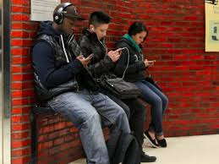
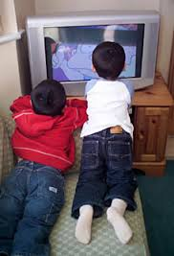
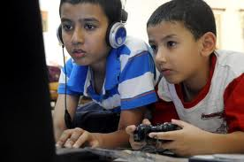
How many hours per day does the average child between the ages of 8 and 18 spend with media and technology?
(this includes TV, computers, tablets, video games, and cell phones)
A) 2 hours
4 hours
6 hours
7 hours
Text your answer to:
Notes:
Action: As people are walking in, thank them for coming and start off with a quick quiz on the screen via poll everywhere.
Ask people to think about their answers as they sit down and if they have a cell phone, text their answer.
OR
Just use the PowerPoint slides and do not make it interactive
As we begin our presentation tonight I want to start off with a quick quiz. Don’t worry, you aren’t going to be graded, and the quiz is only one question.
How many hours does the average child between the ages of 8 and 18 spend with media and technology? That includes TV, computers, tablets, video games, and cell phone.

Slide 3
The answer is: D
Children spend
7 hours and 38 minutes a day
• Watching TV
• Playing games
• Using apps
• Watching videos/movies
• Reading books
• Social media
Source: Common Sense Media
Notes:
Action: Show the poll everywhere results on the screen as people are coming in and then reveal slide to give the answer
The answer is D, 7 hours. Actually it’s more like 7 hours and 38 minutes.
So what are our kids doing during those 7 hours and 38 minutes?
They are watching TV, playing games, using apps, watching videos and movies, reading books and sharing comments and photos via social media.
Bottom line. Our kids are spending more time doing these activities than they are spending in school, with you their parents, and in many cases even sleeping.
Technology is not going away but rather it is increasing and will continue to increase.

Slide 4



How do we make sure our children are:
1. Safe and protected
2. Good digital citizens
3. Have the skills they
need for college and a
career
Notes:
So if technology isn’t going anywhere, how do we make sure our children are:
Safe and protected.
Good digital citizens (just like you want your child to be a good citizen and respect their neighbors and community members, you want them to do the same online and in the digital world)
Have the skills they need for college and career
In the next half-hour, we are going to cover all three topics and give you some tools and resources you can use at home with your children so you can make sure they are safe and protected, that they are good digital citizens and that they are developing the skills they need to be successful in college and a career.
We are going to start first with #3

Slide 5

What skills do you think students need to succeed in college and a career?
Text your answer to:
Notes:
Action:
--Ask guests to take out their cell phones again and text a skill or skills that they think students must have to land a job after high school or college.
--As answers come in, mention them aloud to the group
OR
Just have parents think of their answer and ask them share it with the person next to them or raise their hand and share their answer. After about 30 seconds or so advance to the next slide.

Slide 6
The 10 skills employers want in college graduates:
1. Ability to work in a team
2. Ability to make decisions and solve problems
3. Ability to plan, organize and prioritize work
4. Ability to communicate verbally with people
5. Ability to obtain and process information
6. Ability to analyze quantitative data
7. Technical knowledge related to a job
8. Proficiency with computer software programs
9. Ability to create and/or edit written reports
10. Ability to sell and influence others
***according to survey by National Association of Colleges and Employers
Notes:
While those are all great skills that can give our students a leg up in the work force, a recent survey by the National Association of Colleges and Employers came up with their top ten list of skills that employers want most in college graduates.
You can read over all ten, but I want to point out several skills that are on the list.
They include #5 the ability to obtain and process information, #6 the ability to analyze quantitative data and #8 proficiency with computer software programs.
Those three skills are very closely tied to computers, technology and to the devices your kids are already using on a daily basis.
Here at HISD we want to make sure that your student graduates with all ten of these skills.
That’s why we are changing the way we are delivering instruction in the classroom.

Slide 7
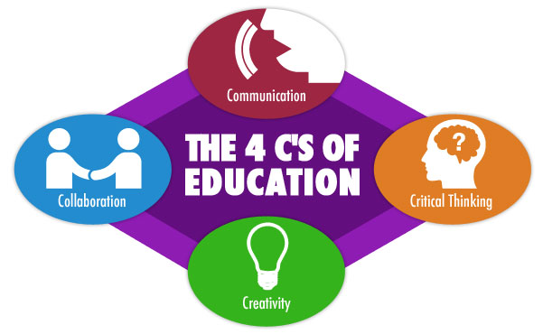
Going beyond the 3 R’s
Notes:
I am sure we all remember the three R’s—reading, writing and arithmetic. Those are still skills all students must have.
But now in education we are adding the 4C’s — which are skills all students will need to compete in today’s 21st century workforce.
They are communication, critical thinking, creativity, and collaboration.

Slide 8
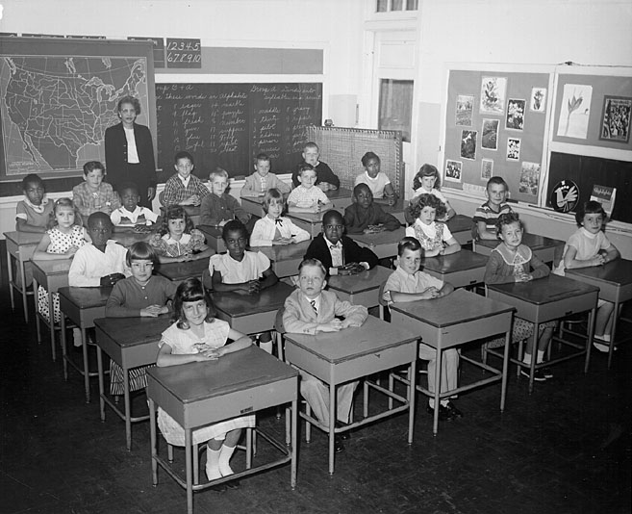
The Classroom of the Past:
Notes:
How many of you are familiar with this image?
It probably looks very similar to your elementary, middle and even high school experience.
Desks all lined up in a row, the teacher at the front of the room writing on the chalkboard.

Slide 9
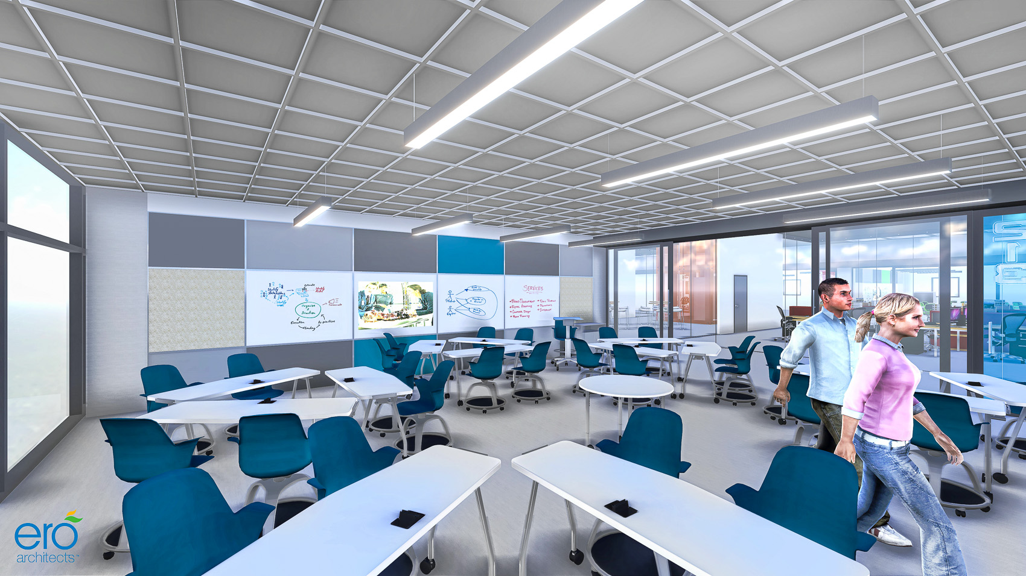
The Classroom of the Future:
Notes:
Now take a look at the classroom of the future. Things look a lot differently, don’t they.
This is an actual rendering from an architect that is designing one of our new high schools.
Under the 2012 bond program, 42 schools across the district are being rebuilt, redesigned and remodeled to foster 21st century learning.
This drawing will be a reality at our schools in just only a few short years.

Slide 10




Transforming Teaching and Learning
Classrooms and learning spaces designed to support:
--Communication
--Critical thinking
--Creativity
--Collaboration
Laptops and web tools for students 24 hours a day
Training and Guidance for teachers on how to incorporate technology and digital tools to engage students
Notes:
As HISD transforms our school buildings to foster the 4Cs, we are also transforming the way teaching and learning is happening in the classrooms.
That includes using technology and using the tools that students are already using outside the classroom.
And most importantly, training teachers how to use laptops and web 2.0 tools to engage students.
We have a name for the digital transformation that is happening in teaching and learning across HISD and it is called PowerUp.

Slide 11
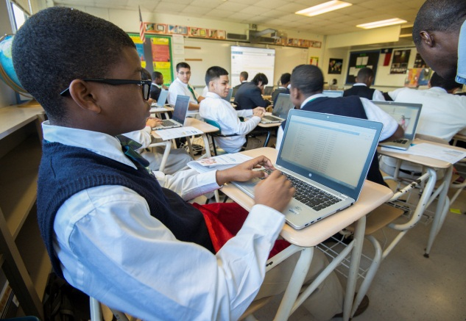
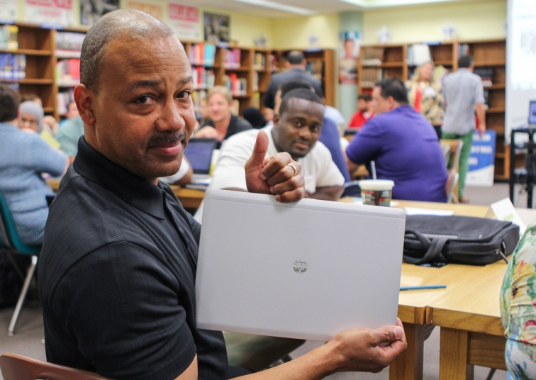
“It is more that just giving our students laptops”
By 2016 every student at all 42 high schools will have a laptop to use at school and at home
Intense teacher training and professional development
Expanded curriculum to support technology
Notes:
Under PowerUp every high school student will receive a laptop to use at school and at home. We call it a one-to-one program because there is one laptop for every one student.
HISD is distributing the laptops in phases and:
Our School is in phase one, which means our students will be getting a laptop the first day of school.
--OR--
Our school is in phase two, which means our students will be getting a laptop in January.
But PowerUp is about more that just giving our students computers. It is about transforming teaching and learning.
As part of the initiative, our teachers are undergoing training and professional development on how to use the laptops as well as different resources and web tools inside the classrooms.
The HISD curriculum department has also created an expanded and enhanced set of planning documents to assist teachers in their daily instruction and lesson planning.
As a result, classrooms throughout the district are beginning to look very different. And so are the projects and the homework kids are taking part in outside of the school day.

Slide 12
https://vimeo.com/104565066
Notes:
I want to show you short video now that will go over the PowerUp initiative, the distribution of laptops to students, and some important information that both parents and students need to know.
Action: either click on link and play live or download video to laptop beforehand (Highly suggest this option)

Slide 13
How do we make sure our children are:
1. Safe and protected
2. Good digital citizens
3. Have the skills they
need for college and a
career
Notes:
Earlier tonight I told you that I was going to talk about three key things when it relates to technology and our kids.
We talked about #3 and now I hope you now all have a better understanding of how we are using technology at HISD to make sure our students have the skills they need for college and career.
But now I want to address how we can work together to keep our kids safe and protected and make sure they become good digital citizens. The video talked about some of this, but we are going to address it further.

Slide 14

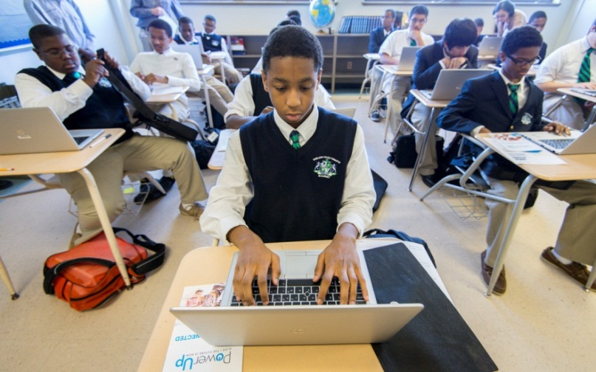
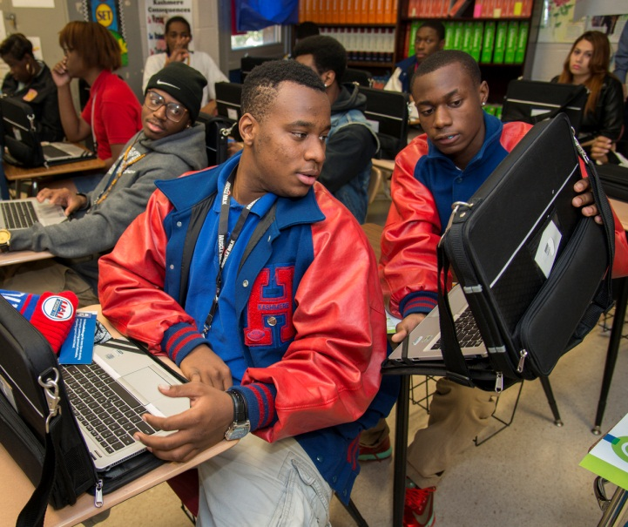
Lowjack
*report immediately if lost or stolen*
Filtering software active 24 hours a day
Administrators can remotely view student computers
Student and parent acceptable use form
Notes:
Here at HISD safety is a top priority, and we have taken steps to ensure that the laptops we are distributing are safe for your student to use at school and at home.
As you saw in the video, the device comes with Lowjack so if they are lost or stolen, the district can immediately deactivate and track down the laptop’s location.
Important: Students must report that their device is lost/stolen within 3 days. With the Lowjack, we can find the device and recapture. Also, the insurance will not cover the cost of the device if the student does not report in 10 days. We are going to ask teachers to check that students have their devices every day. If a device is not in school, teachers will ask their students, Where is your device? And will request that the device be brought the very next day
They also come with filtering software that blocks certain social media sites such as Youtube and Facebook.
It also blocks inappropriate content based on key word filtering. This filtering is active 24 hours a day whether the student is using the internet at school, home, Starbucks or any place with a wireless connection.
Administrators also have capability to remotely view student computers
Your and your student (also signed) or (will sign)a form stating that you both understand that HISD does not permit the unethical use of the laptop, the Internet, email or any other media.
However, with that being said—we want to have an honest conversation about technology, the Internet and some of the consequences that can result when we put these tools in the hands of our kids.

Slide 15





9 out of 10 teens use or have social media
75% of teens have cell phone
Most Popular Social Media Sites
61% 55% 22% 21% 13%
Tumblr Facebook Twitter Instagram Snapchat
Source: Common Sense Media
Notes:
There are real dangers that exist in the 24/7 world we now live.
Particularly when it comes to the way our kids are socializing and interacting with one another.
And like it or not, the majority of today’s teenagers are using social media to communicate with each other.
Recent data suggests that nine out of ten teenagers are using social media
The most popular social media sites for teens are
Tumblr
Facebook
Twitter
Instagram
Snapchat
If you are not familiar with these social media sites, you need to get familiar with them.
While most of them are blocked by the laptops we are giving out to our students at HISD, they are not blocked on the cell phones that you have provided and purchased for your children.
And the reality is, most kids have already been accessing and will continue to access these sites using their phones.
In fact, 75% of teens have their own cell phones or have access to a cell phone at home. And they are using their phones to access these social media sites.

Slide 16

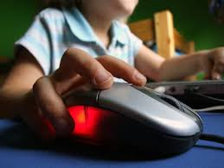

What Teens are Posting
91% 71% 71% 53% 20%
Photos School City or Email Cell
of name town address phone #
Themselves they live
Source: Common Sense Media
Notes:
So when teenagers go to these sites, what are they posting?
91% Photos of themselves
71% School name
71% city or town they live in
53% email address
20% cell phone
As you can see from these stats, teenagers are very often sharing private information.
Teens are extremely comfortable with documenting their lives online.
But this “always on” culture also creates an environment where teens can make some impulsive decisions that can come back to haunt them.

Slide 17


Clicks can have Consequences
Scams
Cyberbullying
Sexting
Digital harassment
Damaged reputations
Risky online relationships
Notes:
The clicks your teens are making can have some real consequences. You only have to listen to the news to hear about a teenager falling victim to one or more of the scenarios listed here. They are real, they happen often and not just to teens, but adults as well. They include
Scams
Cyberbullying
Sexting
Digital Harassment
Damaged Reputation
Risky online relationships

Slide 18

Digital Footprint
The data trail left by the interactions in a digital environment including the use of TV, mobile phone, the Internet, and other connected devices and sensors.
Notes:
They also can lead to your teen having a bad digital footprint.
A digital footprint is the digital trail left by interactions in a digital environment including TV, mobile phones, the Internet and other connected devices and sensors.
In other words, it is your online reputation.
Everything you or anyone else posts about you online becomes part of a public online presence known as a digital footprint.
Basically Google yourself and see what comes up. That’s your digital footprint.

Slide 19
The importance of a good digital footprint
29% of College Admissions officers have Googled an applicant
31% have visited social media sites to learn more about an applicant
70% of job recruiters say they have rejected an applicant based on their social media postings
Some financial lending companies are using social media to determine a person’s credit worthiness.
Social media has been used as evidence in court cases
Notes:
Having a good digital footprint is extremely important. What a student or even we as adults post online can help or hurt our image and future opportunities,
For example.
--29% of College Admissions officers have Googled an applicant
--31% have visited social media sites to learn more about an applicant
--70% of job recruiters say they have rejected an applicant based on their social media postings
--Some financial lending companies are using social media to determine a person’s credit worthiness.
--In some cases, social media has even been used in court cases.,
That’s why it is so important that we help our children understand that they have the ability to shape their online profile so that it presents an image they can be proud of.
Something that happens spur of the moment –like a picture or angry post can resurface years later. Your teen may think they are sending something to a friend, but that friend can send it to someone else, and they can send it to someone else, and so on.

Slide 20

Helping your teen create a Positive Digital Footprint
Help them think long term
Have an agreement on what’s ok to post
Teach them to keep personal information private
Make sure they use privacy settings on their social network pages
Remind them to protect their friends’ privacy
The golden rule applies online
Notes:
So what can you as a parent do to help your teen create a positive digital footprint.
Help them think long term. Explain to your teen that everything leaves a digital footprint with information that can be searched and passed along to thousands of people. Others can pass on that information too, so if they don’t want to see something tomorrow, they better not post today.
Have an agreement on what’s ok to post. Make sure your teens know your rules about suggestive material and other content that will reflect poorly on them.
No embarrassing or cruel posts, not hate speech, no compromising pictures.
Teach teens to keep personal information private. Help teens define which information is important for them to keep private when they’re online. To start, we recommend that teens not share their addresses, phone numbers, or birth dates.
Make sure your teens use privacy settings on their social network pages. Encourage teens to think carefully about the nature of their relationships (close friends, family, acquaintances, strangers) and adjust their privacy settings accordingly.
Remind teens to protect their friends’ privacy. Passing along a rumor or identifying someone in a picture (called “tagging”) affects other people’s privacy. If your teen is uncomfortable being tagged in friends’ photos, they can ask to have the photos or the tags removed. But beyond that, there’s not too much they can do. So teach your teen that it’s better to check with friends first before posting something about them.
Remind teens that the Golden Rule applies online. While teens don’t always have control over what other people post of them, they can be proactive and help guide which snapshots of their lives are taken in the first place. What goes around comes around. If teens spread a rumor or talks badly about a teacher, they can’t assume that what they post will stay private. Whatever negative things they say can and probably will come back to haunt them, in more ways than they can imagine.

Slide 21
What HISD is doing
Setting clear, realistic, and enforced policies
Teaching digital citizenship in our classrooms
Encouraging students to stand up, not stand by
Website for students, staff, and parents with tools, tip sheets, and resources
www.houstonisd.org/cybersafety
Notes:
So what can you as a parent do to help your teen create a positive digital footprint.
Help them think long term. Explain to your teen that everything leaves a digital footprint with information that can be searched and passed along to thousands of people. Others can pass on that information too, so if they don’t want to see something tomorrow, they better not post today.
Have an agreement on what’s ok to post. Make sure your teens know your rules about suggestive material and other content that will reflect poorly on them.
No embarrassing or cruel posts, not hate speech, no compromising pictures.
Teach teens to keep personal information private. Help teens define which information is important for them to keep private when they’re online. To start, we recommend that teens not share their addresses, phone numbers, or birth dates.
Make sure your teens use privacy settings on their social network pages. Encourage teens to think carefully about the nature of their relationships (close friends, family, acquaintances, strangers) and adjust their privacy settings accordingly.
Remind teens to protect their friends’ privacy. Passing along a rumor or identifying someone in a picture (called “tagging”) affects other people’s privacy. If your teen is uncomfortable being tagged in friends’ photos, they can ask to have the photos or the tags removed. But beyond that, there’s not too much they can do. So teach your teen that it’s better to check with friends first before posting something about them.
Remind teens that the Golden Rule applies online. While teens don’t always have control over what other people post of them, they can be proactive and help guide which snapshots of their lives are taken in the first place. What goes around comes around. If teens spread a rumor or talks badly about a teacher, they can’t assume that what they post will stay private. Whatever negative things they say can and probably will come back to haunt them, in more ways than they can imagine.
Model good behavior and review your own habits. Parents are the ultimate role model. Keep channels of communication open and practice what your preach.

Slide 22

Notes:
The new site offers updated and user-friendly information about safe and sensible use of the Internet and social media.
The site features resource links, tip sheets, videos, learning resources, parent information, and a model media agreement for families to use to set down guidelines for use of cell phones, tablets, laptops, and gaming devices.
We want this site to become a resource for you parents to use with not only your children in high school but with younger siblings as well. And I highly encourage you to check it out.
Once again the address is www.houstonisd.org.cybersafety.
There is also a direct link on our school website.

Slide 23
Notes:
At this time I would like to open up the floor to questions.

