Slide 1
Open House
Dana Darden, Principal
September 23-24, 2020

Slide 3
Introduction
Principal Dana Darden
15 years at Benbrook ES
31 years with HISD
ddarden@houstonisd.org

Slide 4
Dr. Lathan’s Video
https://youtu.be/-O2PMINo6wo
Reopening Plan – Link here: https://www.houstonisd.org
Communicable Disease Plan - Link here: http://houstonisd.org
Instructional Continuity Plan - Link Here: http://houstonisd.org

Slide 5
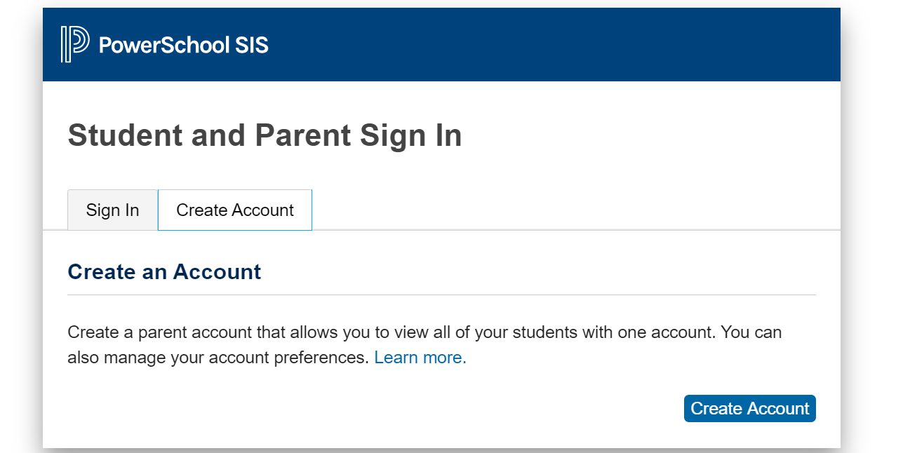
Selection period for in-person or virtual instruction begins Sept. 21 -25

Slide 6
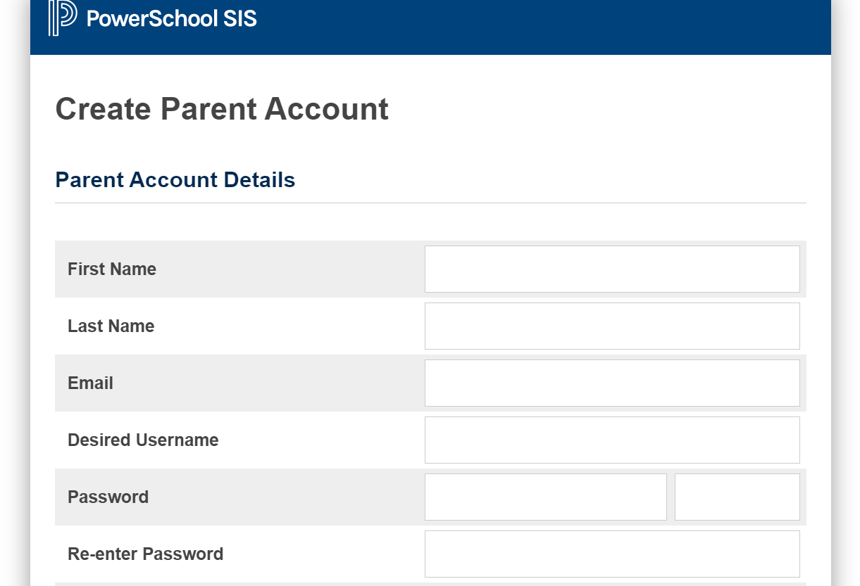
Selection period for in-person or virtual instruction begins Sept. 21 -25

Slide 7
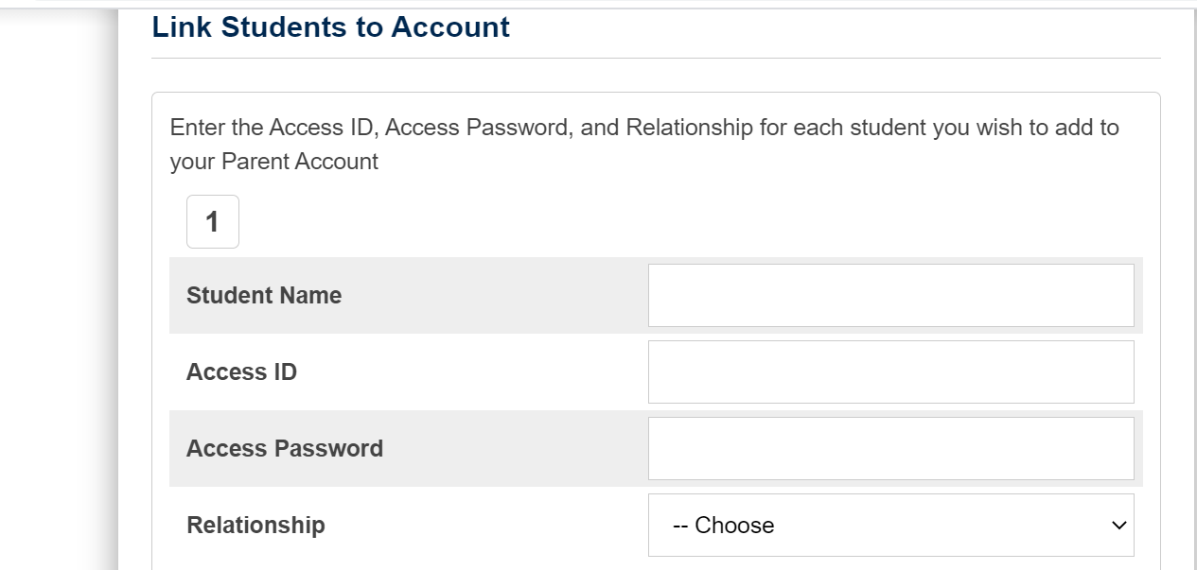
Selection period for in-person or virtual instruction begins Sept. 21 -25

Slide 8
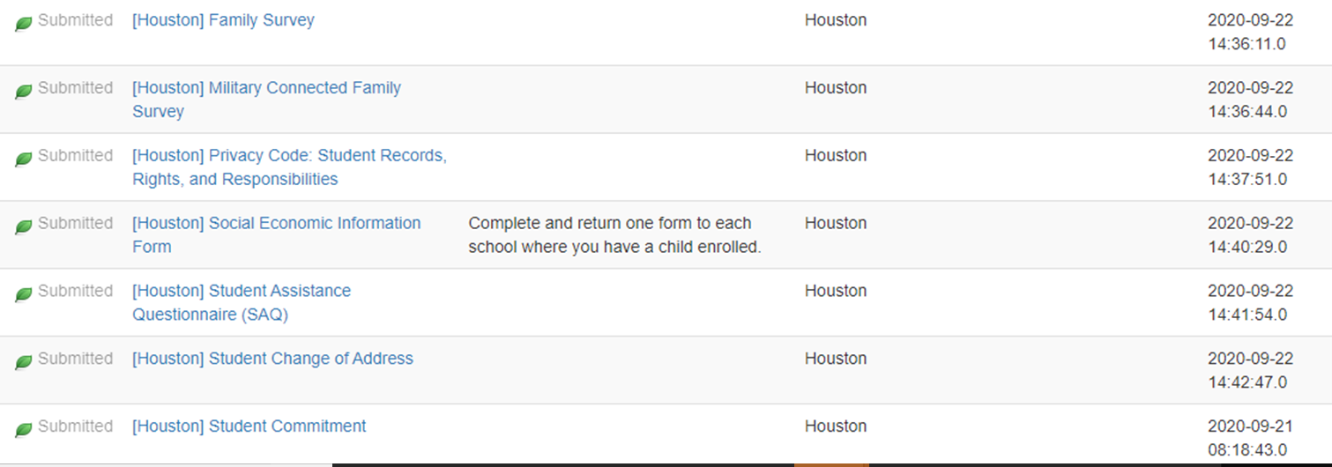

Slide 9
Parent Video
English: https://youtu.be/BtL7zzIlB6M
Spanish: https://youtu.be/O8YaQHWdEiw

Slide 10
Learning Space
Learning at home can be a balancing act.
Routine to follow and a space in which to work and learn
Provide an appropriate learning space for the students when possible
Help your child keep track of deadlines and what time any online video sessions are held for your child’s class.
Plan a daily schedule for your child to follow.
Communicate any instructional needs to the campus such as a lack of device or internet connection as defined in the campus communication plan
Learning Space
Maintain communication with teachers as needed
Connect with your student every day at a time that works well for your household. This might be a quick check-in a few times a day or a longer check-in in the morning or evening.
Some questions that might help spark a conversation include:▪
Were you able to complete all the assigned activities?
What did you learn/practice/read today?
What was easy or challenging for you?
Do you have any questions for your teacher?

Slide 11
face-to-face instruction 1. Certified teachers will provide instruction in the classroom. 2. Physical distancing will be enforced with reduced class sizes. 3. Physical distancing signage will be placed around the campus. 4. Facilities, Maintenance, and Operations will distribute personal protective equipment (PPE) to each campus on a weekly and monthly basis. 5. PPE will include thermometers based on the number of students. 6. Each week, schools will receive disposable masks (one per staff member and one per student), and wipes will be provided for classrooms and campuses. 7. Each month, gloves will be provided for classrooms and campuses.

Slide 12
Who will teacher Virtual:
Certified in-district teachers will teach students whose parents have chosen to continue online instruction.
If a parent has selected virtual learning but the student reports to school on October 19, the student should be assigned to a classroom, and the campus should confirm the choice with the parent.
If a parent has selected face-to-face instruction but the student does not report to school on October 19, the campus should check whether the student is logged in virtually.
If the student is not logged in, the campus should follow up with the parent and ask them to select their preferred option.

Slide 13
Student Attendance
Students required to log in and participate daily.
To be marked “present” students must….
1. Participate in the HUB and complete independent reading or work assignments
2. Interact with teacher virtually via TEAMS as part of live or small group instruction
3. Complete & submit assignments via the HUB by 2:30pm (when unable to submit via HUB, students can submit via email, photos, phone conference, or forms of documentation) OR the student will be marked ABSENT.
*Absences can be resolved if the student completes one of the three requirements by 11:59pm on that same day.
*State law and HISD policy still require students to attend 90% of their classes to receive credit and be promoted.
*Parents and students will receive absence notifications via School Messenger after 6pm each day and will be reminded of the opportunity to resolve that day’s absence.
*Note: If a student is engaged in remote learning and completes the entire week’s work of learning activities on Monday and does not log into the HUB Tues – Friday, the student will be marked absent Tues – Friday.
BENBROOK ELEMENTARY
PREPARE LEADERS TO AIM HIGH, HOLD THE VISION, AND ACHIEVE GREATNESS

Slide 14
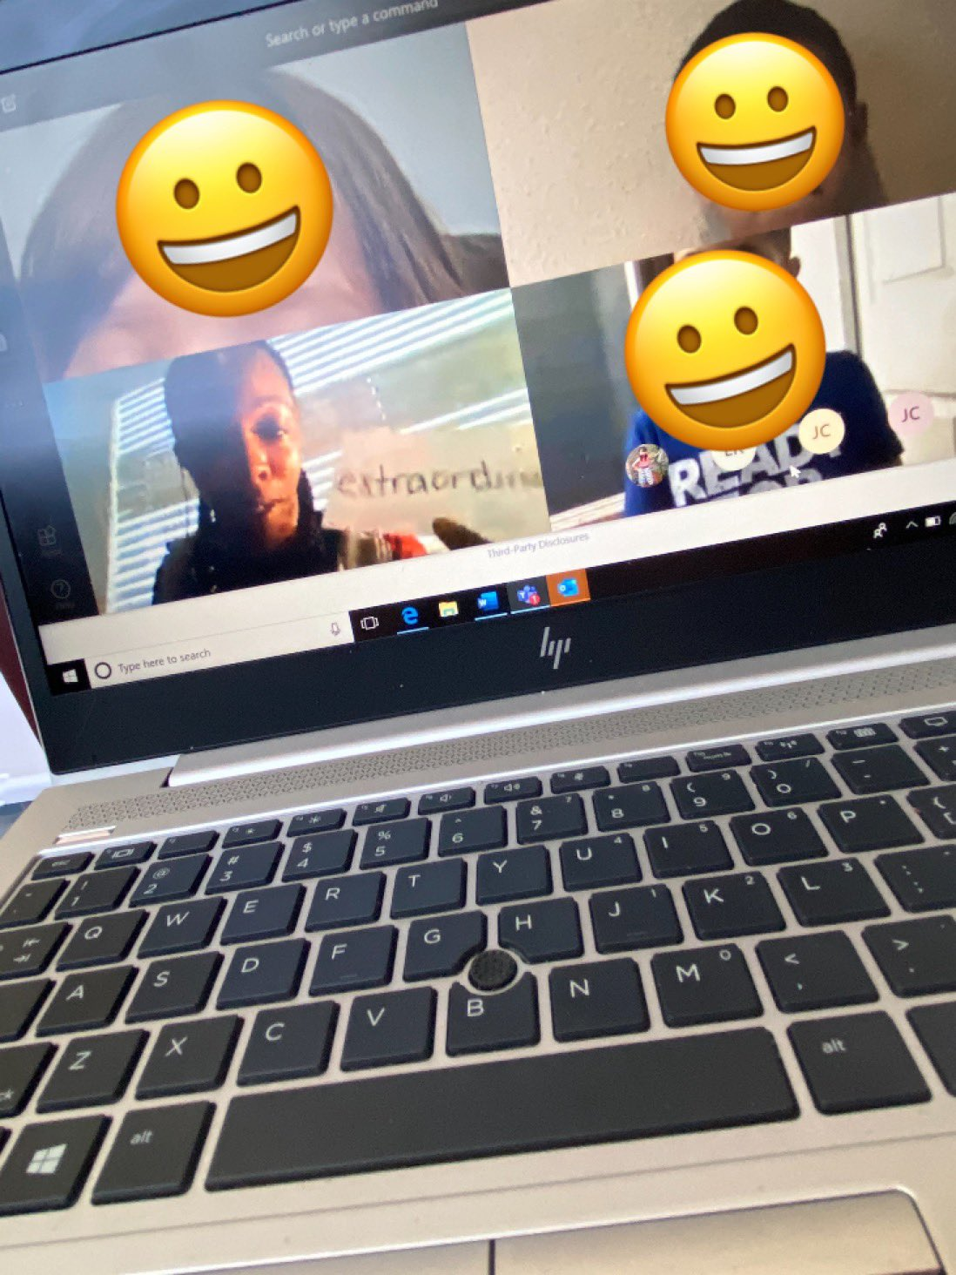
Grades
Students required to log in and participate daily.
Students are expected to complete daily assignments on time in the HUB.
Grades will be taken during each grading cycle (2 grades minimum per week/content area)
All cycle grades will be used to calculate final averages for each class.
Teachers will enter grades every week to monitor student progress.
Assessments will be given online to track students progress
Key: Communication!

Slide 15
Spanish HUB Webinars
The Academic Instructional Technology team has organized parent workshops to help parents understand how to access the HUB and support their student. The workshop will take place in a virtual live session with opportunities for question and answers. The “Getting to Know the HUB for Parents” training can be access through HISD@Home. Below you will find the links to the trainings in English and Spanish
Spanish Webinars
Parent HUB Training Dates | Time | Links Webinar
Martes, Septiembre 22, 2020 | 5 PM | Familiarización con el HUB para padres
Jueves, Septiembre 24, 2020 | 5 PM | Familiarización con el HUB para padres
Martes, Septiembre 29, 2020 | 5 PM | Familiarización con el HUB para padres
Jueves, Octubre 1, 2020 | 5 PM | Familiarización con el HUB para padres
Martes, Octubre 6, 2020 | 5 PM | Familiarización con el HUB para padres
Jueves, Octubre 8, 2020 | 5 PM | Familiarización con el HUB para padres
The Academic Instructional Technology team has organized parent workshops to help parents understand how to access the HUB and support their student. The workshop will take place in a virtual live session with opportunities for question and answers. The “Getting to Know the HUB for Parents” training can be access through HISD@Home.

Slide 16
English HUB Webinars
Parent HUB Training Dates | Time | Links to Webinar
Tuesday, September 22, 2020 | 5 PM | Getting to Know the HUB for Parents
Thursday, September 24, 2020 | 5 PM | Getting to Know the HUB for Parents
Tuesday, September 29, 2020 | 5 PM | Getting to Know the HUB for Parents
Thursday, October 1, 2020 | 5 PM | Getting to Know the HUB for Parents
Tuesday, October 6, 2020 | 5 PM | Getting to Know the HUB for Parents
Thursday, October 8, 2020 | 5 PM | Getting to Know the HUB for Parents
The Academic Instructional Technology team has organized parent workshops to help parents understand how to access the HUB and support their student. The workshop will take place in a virtual live session with opportunities for question and answers. The “Getting to Know the HUB for Parents” training can be access through HISD@Home.

