Slide 1
Houston Academy of Computer Science (hacs)
“A World-Class Public school With a Computational Edge”

Slide 2
The Gap in K-12 Computer Science Education
2 in 5 US schools offer classes that teach students to code.
In elementary school boys and girls show equal enthusiasm for computer science, but only 22% of AP Computer Science test-takers are girls, and only 13% are underrepresented minorities.
Women and minorities are nearly ten times more likely to major in computer science once they’ve had exposure in K-12.
In 2020, there will be over 1 million unfilled Computer Science related jobs¹.

Slide 3
The Need for Computer Scientists in Houston
Houston is the 12th largest metro area in the United States for IT related employment.
62% of tech professionals in Houston work in non-tech industries, this makes Houston #1 in the United States in tech occupational diversity².
A recent report shows that in 2019, 89 percent of Houston IT managers have problems finding skilled tech workers, the hardest to fill positions being³:
Cybersecurity
Software and Applications Development
Networking and Database Management

Slide 4
Why HISD Needs a 6-12 Computer Science Academy
Schools with AP Computer Science Principles Passing Rates over 50% on 2019 Exam (at least 10 exams)
School | # of exams | Passing Rate
*Bellaire | 91 | 100%
*Lamar | 41 | 27%
*Carnegie Vanguard | 36 | 75%
*North Houston | 35 | 24%
Milby | 19 | 26%
Chavez | 18 | 67%
Yates | 13 | 15%
Energy | 12 | 50%
Westside | 11 | 99%
Sharpstown | 10 | 100%
Wisdom | 8 | 38%
YMCPA | 7 | 0%
Westbury | 7 | 29%
Austin | 4 | 0%
Texas Connections | 1 | 0%
Earlier preparation in Computer Science would motivate students to choose and earn credit for AP Computer Science
AP Computer Science only offered at 15 High Schools in HISD
*4 schools enroll 55% of total students (203/366)
Underrepresentation of students of color

Slide 5
ADVANCED PLACEMENT COMPUTER SCIENCE Principles course in HISD Total exams in 2019= 366
Why take this course? Because the data shows that these students want to continue learning CS!
According to the College Board, “students who take the AP CSP Exam are nearly 6 times more likely to go on to take CSA compared to other AP STEM examinees, and about 15 times more likely than non-AP STEM examinees.”
https://advocacy.code.org/2019_state_of_cs

Slide 6
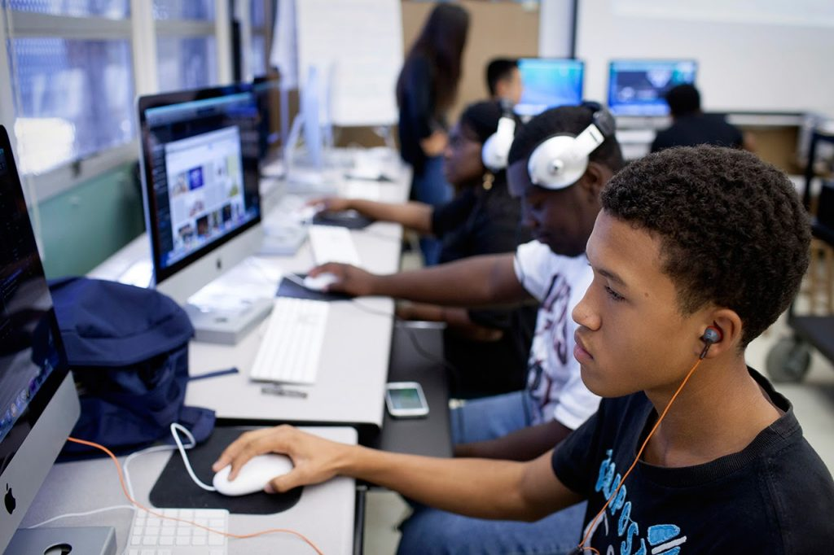
Summary of Problem
There is no K-12 school in Houston solely focused on Computer Science.

Slide 7
Houston Academy of Computer Science
The first school in the Houston region focused on preparing students for a career in Computer Science
Opens in Fall of 2021 with 6th and 9th grade classes only (~100 students), a grade level added each year
Fall of 2025 –First cohort of seniors graduates

Slide 8
Vision for HACS : All HACS students wilL
Take a Computer Science elective in each grade with an emphasis on jobs/skills in Computer Science
Be college ready based on their SAT, ACT or TSI scores
Take Advanced Placement Computer Science A or earn industry certification in a Computer Science related program of study
Pass the AP Computer Science Principles Exam by the end of 11th grade
Graduate with a working knowledge of at least two coding languages
(Java, JavaScript or Python)

Slide 9
Hacs – CURRICULUM *COMPUTER SCIENCE ELECTIVE Course SEQUENCE**
6th Grade
Touch System Data Entry
7th Grade
Fundamentals of Comp Sci-CTE(HS Credit)
8th Grade
Comp Sci 1-CTE (HS Credit)
Middle School
9th Grade
Comp Sci 2-CTE
10th Grade
Comp Sci 3-CTE
11th Grade
Advanced Placement Comp Sci Principles-CTE
12th Grade
AP CS A - CTE, OnRamps - CS,
Practicum of IT-CTE
High
School
All coursework offered in middle and high school will be rigorous Pre AP, AP, Dual Credit or Dual Enrollment
* TxEdAgency, Aug 22, 2019
**Courses can be modified, additional sequences added as per needs

Slide 10
Hacs - student recruitment
Marketing
Targeted outreach to boundary option schools
Press release, newsletter & social media content
HISD web homepage, Video
Brochure mail outs
Call outs & community meeting at HMW Oct & May
Scratch Day, Coding Fair for parents
School Choice Fairs
Visit ALL boundary option schools in Fall & Spring
Introduce coding clubs in elementary schools
Hooks at HACS
Anime, Board Games, Robotics Clubs, Gaming Clubs
Hackathon
Camps in 6th & 9th
At least one in state and out of state college tour in middle and high school
Build your own app
High paying jobs after high school
UIL Academics (Debate, CS)
Recruitment
Identify boundary option elementary* & middle schools**
Priority to students from boundary option schools
Student population in 6th & 9th grade (~100 each grade)
Open enrollment in 6th grade
Selection matrix for 9th grade (70 points)
If space available - open to all students in HISD
Student demographic is reflective of HISD
Add to school choice application option for Phase 1

Slide 11
Hacs - staffing
Hiring Staff
Robotics, STEM Manager Oct 2020– Outreach, Partnerships, student recruitment, plan summer camps for 6th & 9th grade
Principal and secretary/Magnet clerk in Fall 2020
Principal will recruit students aggressively and hire new staff
Consult with Chief South area when hiring school leader
Hiring Staff
13 teachers hired by March/April : Teachers will commit for 6th & 9th grade camps in June & attending Professional Development in July
Strategic hiring – Coding in Music and Art
STEM Magnet coordinator
Assistant Principal (Dean/Counselor)

Slide 12
Hacs - transportation
All students who live at a distance of more than 2 miles from the school will be eligible to receive magnet transportation.
All parents will be informed about the same.

Slide 13
make CS Essential & Fundamental IN HISD
Establish Houston Academy of Computer Science in 2020 : Implementation Plan (Handout)
Define CS & establish rigorous K-12 standards
Partner with PVAMU, Rice for curriculum & PD support
Require all HS to offer CS P with implementation timelines
PD & Training for current teachers to teach CS
Explore CS, AP CS-P, AP CS-A : Offer all 3 courses at all HS
Spread CS in HISD
Coding and computing clubs in all ES, CS elective in MS
Seek funding & donors, grow CS in HISD

Slide 14
SB 1882 Innovation Partnership Opportunity
Given the innovative nature of this program, the SB 1882 partnership could be used to provide unique support and additional resources to campus staff and students.
The partner entity would be responsible for managing personnel, supporting curriculum, calendar and assessment and possibly providing additional supports to HISD.
Manage Personnel
Supporting employee professional development and appraisal
Attracting, training and retaining high quality teachers and administrators
Manage student recruitment for the campus
Support Curriculum, Calendar and Assessments
Would provide TEKS-aligned curriculum that supports the long-term vision of the program
Raise funds to support the 1:1 program and extracurricular opportunities for students
Manage and cultivate partnerships with businesses, community partners, and key stakeholders to provide additional resources
Additional Supports
Provide curricular support to expand computer science programs across HISD.
Train teachers to help develop a pipeline of certified candidates for HISD.

Slide 15
Contacts Made:
Richard Tapia & Paul Hand (hand@rice.edu) –RICE STEM camp
Jennifer Saenz (jennifer.saenz@austin.utexas.edu) Director, UT OnRamps
Republic Schools Network – Michael Burgevin (mburgevin@republiccharterschools.org); Allison Arth (aarth@republiccharterschools.org). Charter network that built its own custom Comp. Sci. Curriculum for teachers with zero experience
Angie Bealko (angie.Bealko@kle.foundation) – Very knowledgeable about Comp. Sci education in the state of Texas, great resource; very well connected nationally as well
Ivan Rudnicki (irudnicki@ebrooke.org) – Brooke Charter Schools Network – Brooke Charter Schools integrate Comp. Sci into their core curricular courses. Ivan is the Dean of Comp. Sci for the network
Paula Harris (pharris@slb.com) Schlumberger
Shawn Raeke (sraeke@afsenyc.org) Academy For Software Engineering at NYPC
Uteach (Sarah Jenevein jenevein@uteach.utexas.edu), Weteach_CS (carol.fletcher@utmail.utexas.edu)
Lisa McMillan(Lisa.McMillan@fortbendisd.com) FBISD coding clubs
HISD Staff – Rick Cruz, Michael Love, Juliet Amara, Jharrett Bryantt, Nicole Moore, Adrian Acosta, Rene Flores, Scott Godley, Kaire Hopson, Sarah Butler

