Slide 1
Lovett
Fifth Grade
Open House
2019-2020

Slide 2
5th Grade
Mr. Locander
elocand1@houstonisd.org

Slide 3
What We Will Learn this Year!
Financial Literacy
Adding and Subtracting Fractions
Multiplying Fractions
Dividing Fractions
Multiplying Decimals
Dividing Decimals
Multi-step problems
+, -, x, /

Slide 4
Homework and Grading
Students will receive a weekly homework assignment on Friday’s
It needs to be turned in the following Friday
IXL and/or Imagine Math

Slide 5
Ms. Cyr
kcyr@houstonisd.org
Mrs. Williams
ewilli21@houstonisd.org
Our Conference Time:
8:40 - 9:10 Please email for an appointment

Slide 6
Vocabulary:
Focus on Prefixes and Suffixes
Supported through Workstations
Spelling:
Spelling tests will be given
bi-monthly

Slide 7
Class Novels/Book Clubs:
We will read fiction and nonfiction texts
Teacher will model expectations whole group, students will practice on their own and in groups

Slide 8
Language Arts:
- Complete Sentences
- Parts of Speech
Punctuation
Spelling:
- Bi-monthly Lists & Tests

Slide 9
Writing:
- The Writing Process
- Integrated in Reading and Social Studies
- Supported through Workstations

Slide 10
U.S. History:
- Studies Weekly
- Projects explored throughout the year

Slide 11
Curriculum Focus
Building Strong Scientific Vocabulary
The Scientific Method
Conducting Labs and Investigations
Building Scientific Inquiry
Earth, Life and Physical Science

Slide 12
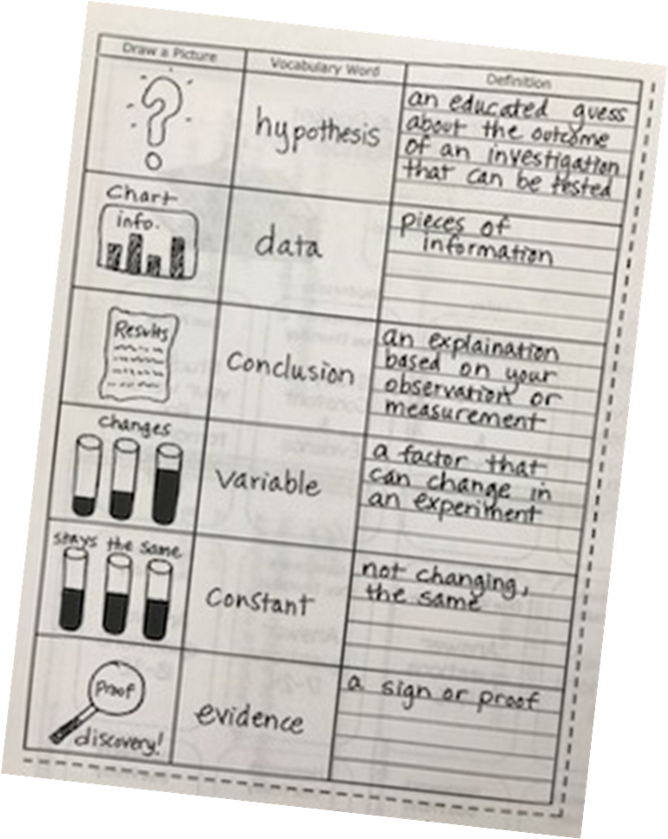
Vocabulary
Students will be learning new vocabulary each week to coincide with the unit of study we are working on.

Slide 13
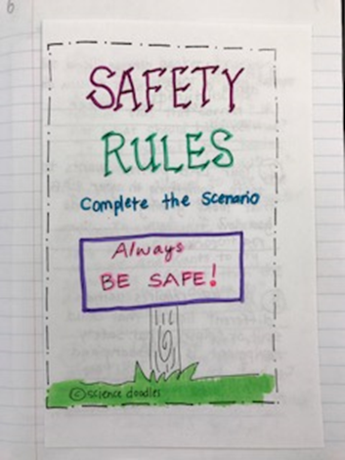
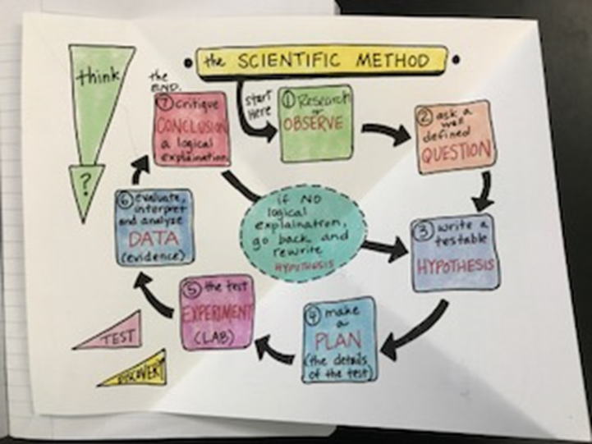
Interactive Notebook

Slide 14
Students are expected
follow the 3Rs:
Be Ready
Be Responsible
Be Respectful

Slide 15
In order to be eligible to volunteer, you must be VIPS approved. This includes chaperoning fieldtrips.
Please expect about 3 weeks to complete the process.
You can visit the HISD homepage, click Get Involved and register here

Slide 16
Please only send healthy snacks. Please send dry food or fruit. We do have students with food allergies so be mindful of this.
Water is welcome throughout the day in all classrooms, coffee and colored drinks are not permitted.

Slide 17
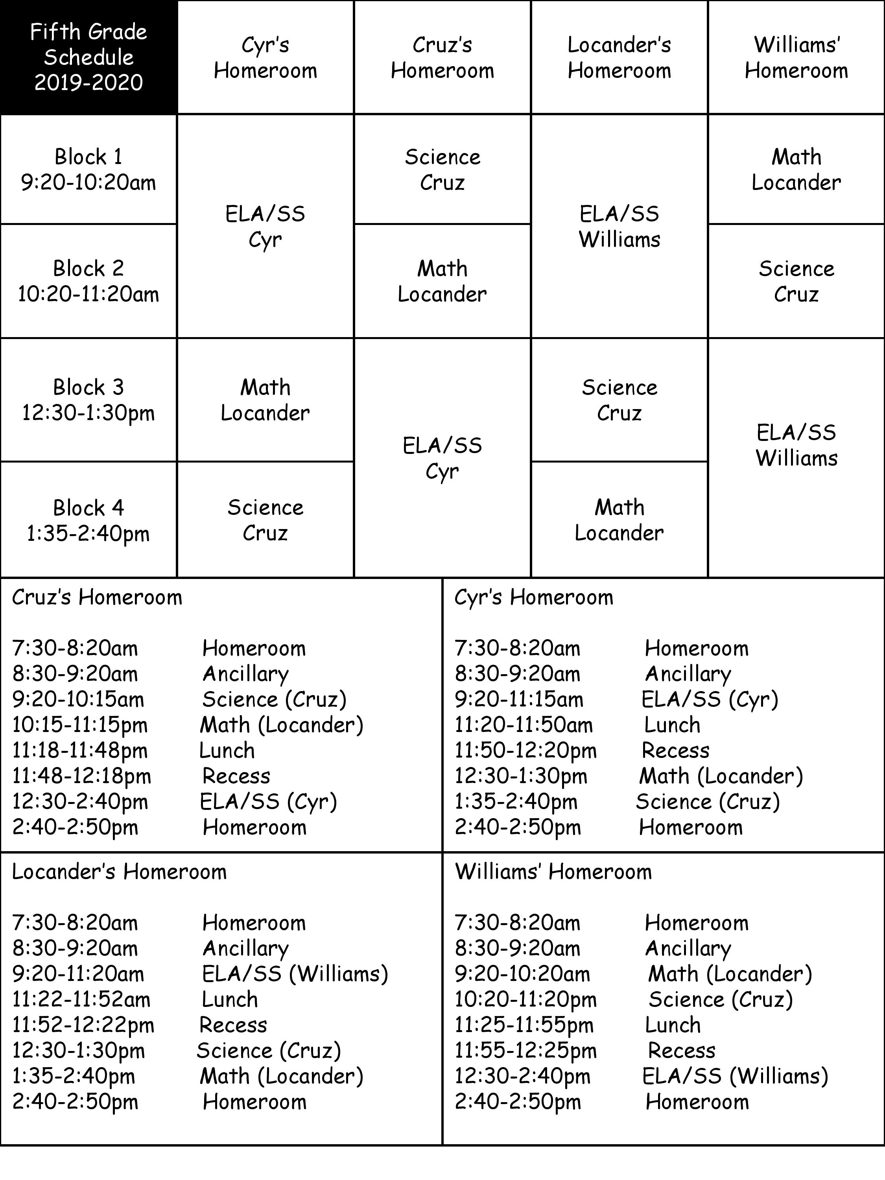

Slide 18
Begins at 2:50pm.
Car riders exit to the back on Birdwood.
Walkers exit through the front on Jason St.
Extended day and after school programs are dismissed to their assigned rooms.

Slide 19
Tardies begin at 7:40am
7 or more tardies will cause your child’s conduct to drop by one letter grade.
Attendance is taken daily at 9:40am
Absence notes should be sent to school (or emailed to ssims1@houstonisd.org) within 3 days of a child’s absence in order for an absence to be considered excused
Excessive absences and/or tardies may lead to your child being placed on a growth plan

Slide 20
The Lovett dress code can be found in the student handbook printed at the beginning of your child’s agenda in the Lovett Elementary Student Handbook section.

Slide 21
Science Fair
Biz Town
Promotion

Slide 22
All chaperones must be VIPs certified in order to attend.
Field trip scheduled in May to BizTown, no chaperones needed.

Slide 23
Celebrated at the beginning of recess
Any birthday treats sent to school must be store bought
Please include enough for every child in the class and no additional treats may be shared with students in other classes
Parents and visitors are welcome to have lunch with their child

Slide 24
Math STAAR - April 7
Reading STAAR - April 8
Science STAAR - May 13

Slide 25
Donations will occasionally be requested. Please do not feel obligated to participate. We appreciate everything you do to support your child’s learning.

Slide 26
Friday Folder- Please check
every Friday for conduct and graded work.
Homework Folder/Agenda-Please
check/sign daily.
Newsletter-Comes out every
Monday.
Please join Remind for your child’s.
classes.

Slide 27
Ericka Williams - ewilli21@houstonisd.org
Kim Cyr - kcyr@houstonisd.org
Annemarie Cruz – acruz8@houstonisd.org
Jamie Locander – elocand1@houstonisd.org

