Slide 1
Sinclair ES Campus Expansion Town Hall
Tuesday, January 19, 2021

Slide 2
Norms
We are respectful of each other's’ perspectives and beliefs
We are considerate of our airtime, allowing others time to share
We remain committed to our membership in the Sinclair community
We exercise patience, understanding we have various experiences
Chat

Slide 3
Meeting Agenda
Sinclair Mission & Vision
Sinclair Enrollment History & Capacity
Response to Enrollment Increase
Scope of Work
Discussion
Reflection & Closing

Slide 4
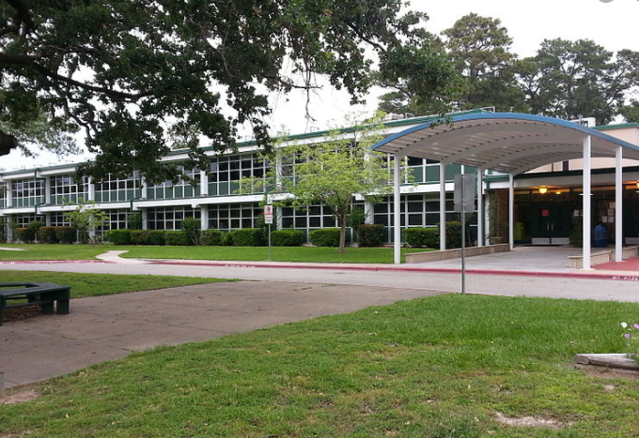
Sinclair Mission, Vision & Values
Mission Statement: We exist to ensure learning for all
Vision Statement: Every student will be proficient at or above grade level in all content areas by the end of each grade level.
Core Values:
We will put safety first
We are patient, welcoming and open in our communication
We are focused on solutions
We are prepared and engaged.

Slide 5
Sinclair Enrollment History & Capacity
2017 - 2018 Zoned families lined up at 3:00 am to ensure they would have a place at Sinclair. Small number of students were transferred to another campus due to space constraints.
2018 - 2019 Parents spent the night starting at 10:00 pm the night before to ensure they had a place at Sinclair. Growing number of students were transferred to another campus due to space constraints.
2019 - 2020 Number of zoned students needing to transfer due to space constraints was equal to one classroom, requiring the campus to open an additional kindergarten classroom. No zoned students were transferred to HUB campus.
2020 - 2021 We opened a new 1st grade class, carried a waiver for overage in 2nd and only turned away 2nd grade families after the start of the year.
2018- Present 70% reduction in the number of kinder seats being offered to magnet (out of zone) students with there currently being only 10 seats available in kinder. This number will be 5 beginning in 2022.

Slide 6
Sinclair Enrollment History & Capacity
School Year | (Anticipated) Enrollment | Annual Growth from Previous Year
2017-2018 | 561 | 3%
2018-2019 | 577 | 3%
2019-2020 | 586 | 2%
2020-2021 | 589 | COVID- 19
2021-2022 | 611 | 4%
2022-2023 | 633 | 4%
2023-2024 | 655 | 3%
2024-2025 | 677 | 3%
2025-2026 | 700 | 3%

Slide 7
Sinclair Enrollment History & Capacity
Main building (18 classrooms x 22 students = 396 students )
26 rooms total
18 rooms are general education classrooms
3 rooms are Special Education classrooms
4 rooms are magnet classrooms
1 room is a computer lab
Outside buildings ( 10 classrooms x 22 students = 220 students)
15 outside rooms total
10 are general education classrooms
1 is a Special Education classroom (shared with Speech Services)
2 are PE classrooms
1 is teacher resources
1 is an administration (meeting,office and guided reading library) space
396 + 220 = 616 students

Slide 8
Building Capacity without new classrooms*
2021- 2022
Cohort of 5 homerooms matriculate* to grade 2, requiring consolidation of current Speech, Dyslexia, and Special Education pull out spaces.
Campus will need a fifth magnet classroom, requiring use of traveling magnet classrooms.
2022 - 2023
Cohort of 5 homerooms will matriculate* to grade 3, requiring use of another (magnet) classroom. 2 magnet classrooms will be traveling.
2023 -2024
Cohort of 5 homerooms will matriculate* to grade 4, requiring use of another (magnet) classroom.
Campus-wide, at least 3 magnet classrooms would be traveling.
2025 - 2026
Cohort of 5 homerooms will matriculate*to grade 5, requiring 4 magnet classrooms to travel.
*This scenario assumes the campus decides to admit 5 cohorts in incoming kinder.
An existing alternative is to exercise the the transfer of zoned overflow students to neighboring campus.

Slide 9
Response to Enrollment Increase
April 2019 Community Meeting held with district leadership to discuss concerns surrounding enrollment and capacity constraints
November 2019 Community members and principal speak out at HISD School Board Meeting expressing concerns surrounding enrollment, capacity constraints, and quality of existing building.
November 2019 Superintendent visits the campus to discuss capacity concerns and facility needs. Plans are submitted to the school board for approval.
December 2019 Plans to address capacity constraints at Sinclair (installation of 2 outside buildings and 1 outside restroom) are submitted and approved by school board. Facilities begins preliminary work investigating the site, drainage, plumbing, electrical, and environmental impact.
March 2020 Due to COVID, a gap in communication occurs. Principal does meet with district facility leadership to continue discussion for site plans.
Summer- Fall 2020 Pre-construction meetings are held. Due to COVID, continued delay in project.
November 2020 Due to COVID project finally receives notice to proceed

Slide 10
Scope of Work
2 outside buildings that will each contain 8 classrooms, 1 adult restroom. Also, an additional building with student restrooms (4 girl and 4 boy) will be installed.
Classrooms will be equipped with new smart technology and new furniture
Available for the start of the 2021 -2022 school year
Will move all of 3rd, all of 2nd, Special Education, speech, into new buildings and have space for teacher planning and parent/student conferences
Enhanced teacher planning and conference spaces
Enhanced after-school care facilities. After- school care will no longer have to share classrooms with homeroom teachers
Opportunity to consider Pre-Kindergarten (Pending enrollment trends)
Site plans considered alternate placements along Ella
11 mature trees would have to be removed
Safety
Soccer field and baseball field would be compromised
Play structures would be compromised

Slide 11
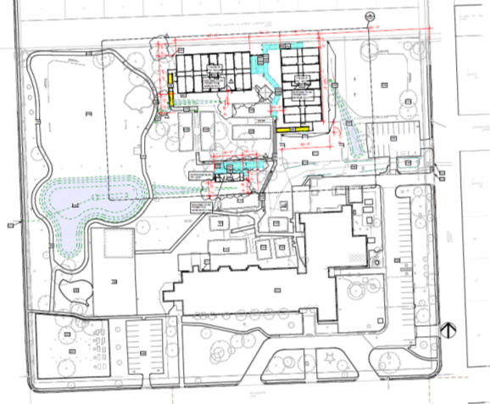
Scope of Work
•Buildings strategically placed to minimize disruption of existing campus fabric
•20 to 22 trees will be cleared (remaining 244 on site)
•Greater convenience and safety for students in existing outdoor buildings
•Improved site drainage and reduced flooding of walkways leading to/from outdoor buildings

Slide 12
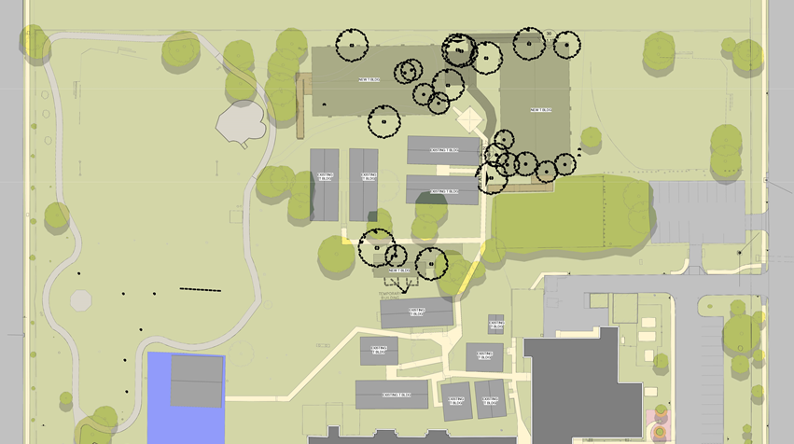
Scope of Work, Con’t

Slide 13
Scope of Work, Con’t
Goal: Open for Start of School August 2021
Confirm tree markings in field
Layout and stake building corners to determine if additional trees may remain
Install protection fencing to ensure all non-marked trees remain
Conduct a celebration of trees to include a show of respect for existing trees to be removed, plans to incorporate some of the wood in school projects and a planting day to replace (exponentially) the trees removed. Teachers will be asked to include a lesson within their lesson plans with a read aloud and writing.

Slide 14
Commitments & Next Steps
Communication
Monthly Project Updates

Slide 15
Discussion
At this time, the project has been submitted, approved, and set to begin very soon. While we may discuss methods to better communicate projects in the future and suggestions for how best to move forward with this project, the decision to pause or delay this project would have very real negative impacts on our ability to provide a meaningful educational and Magnet experience this Fall.
How could the communication of this project (and for future projects) have been improved?
For future project affecting our campus, how would you like to have your opinion shared?
How can we honor the trees that have been marked for cutting due to this project?
Other comments or concerns to share?

Slide 16
Reflection & Closing

