Slide 1
POW and HOW week 34
Ziyad Mohiuddin 4th period

Slide 2
Sine
Sine= opposite to the angle.
Sine is pronounced as sin.
sine rule is an equation that relate the lengths of the sides of any triangle to the sines of its angles.
The law of sines can be used to find the remaining sides of a triangle when you know two angles and a side are known.

Slide 3
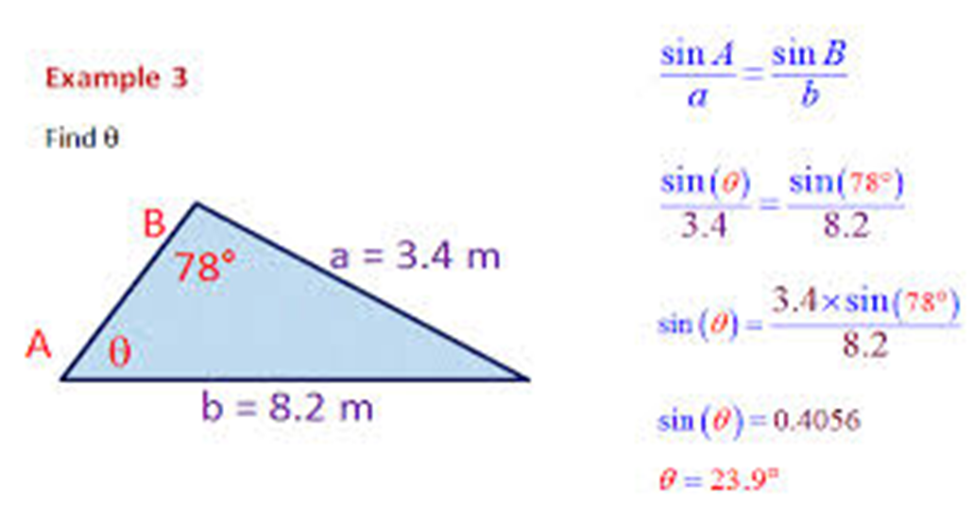
Sine Example
Here is an example of a Sine problem.

Slide 4
Cosine
The Cosine Rule can be used in a triangle where you are trying to relate all three sides to a one angle.
If you need to find the length of a side, you need to know the other two sides and the opposite angle.
Formula= a² = b² + c² – 2bc cos(A).

Slide 5
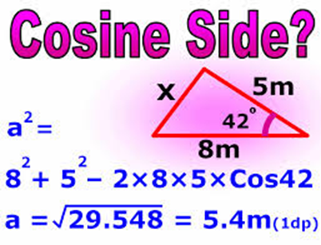
Cosine example
An example of the cosine rule.
Formula= a2 = b2 + c2 – 2bc cos(A). All of the 2 are squares.
You plug in the numbers for the formula and keep solving.

Slide 6
Both Rules Picture

