Slide 1
Records Management
Registrar Meeting
Date: 12/12/2022
Presenter: Ann Ebrahimi, Records Manager

Slide 2
Agenda
Introduction and Services Provided
RIM Web Resources
Retention Schedule
Boxing, Labeling, Forms
Questions

Slide 3
Organizational Structure Services
IT
Records Destruction
Records Storage
Retention Schedules
Document Imaging
Consulting
Administrative
Services
Print Shop
Graphics
Post Office
Fleet Copiers
Records and Information Management (RIM)

Slide 4
RIM Web Resources

Slide 5
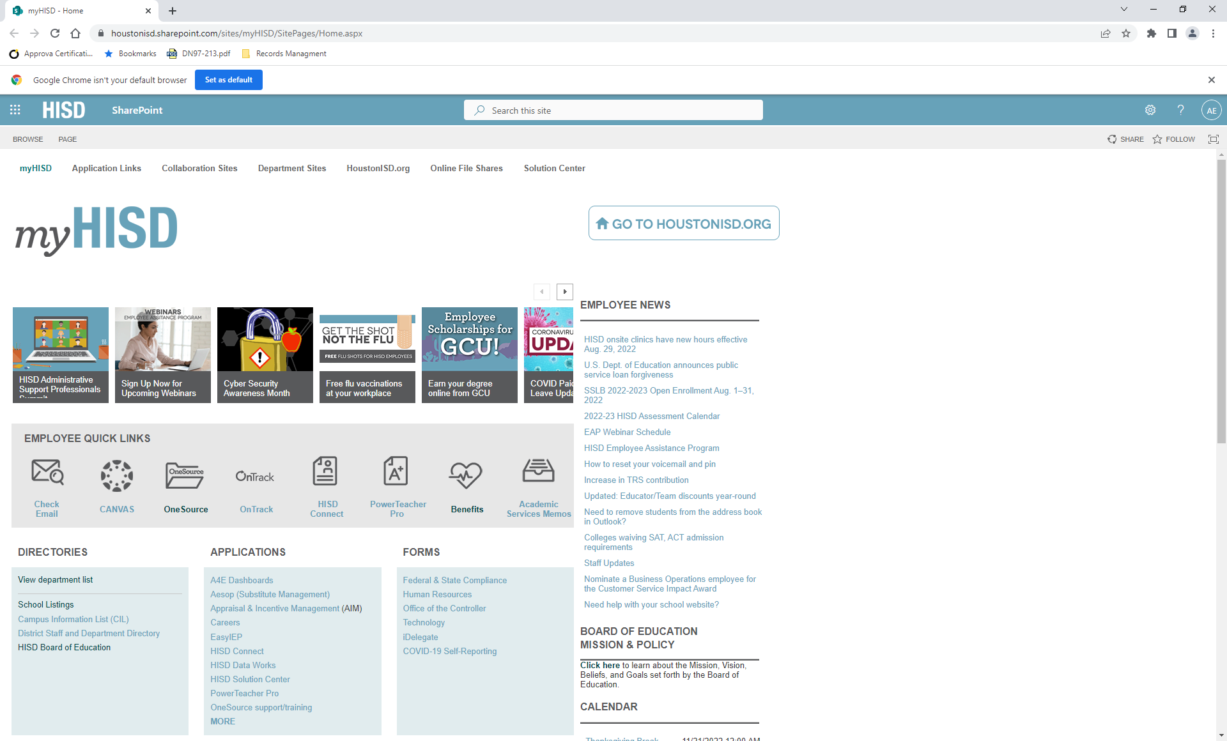
On the intranet, click on View department list

Slide 6
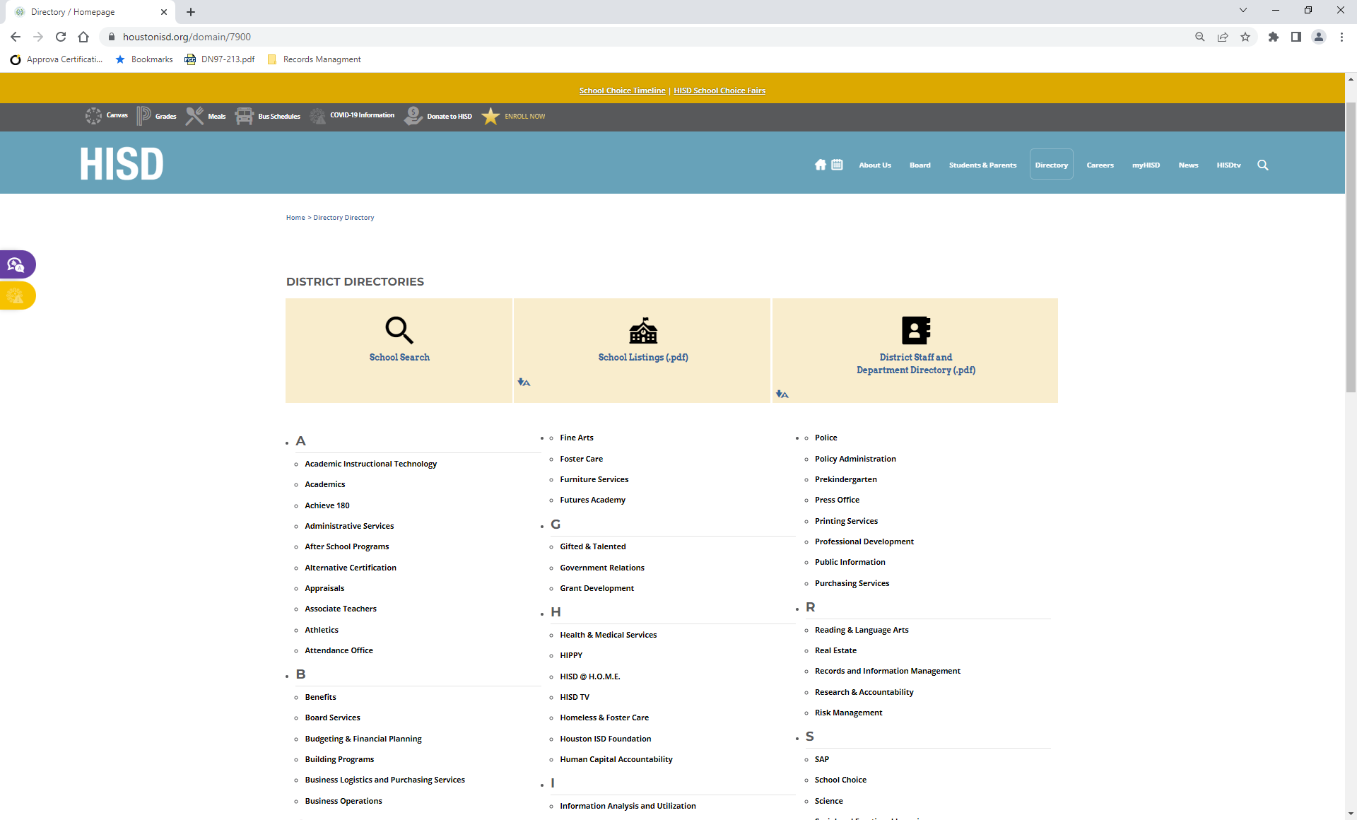
Click on department name – Records and Information Management

Slide 7
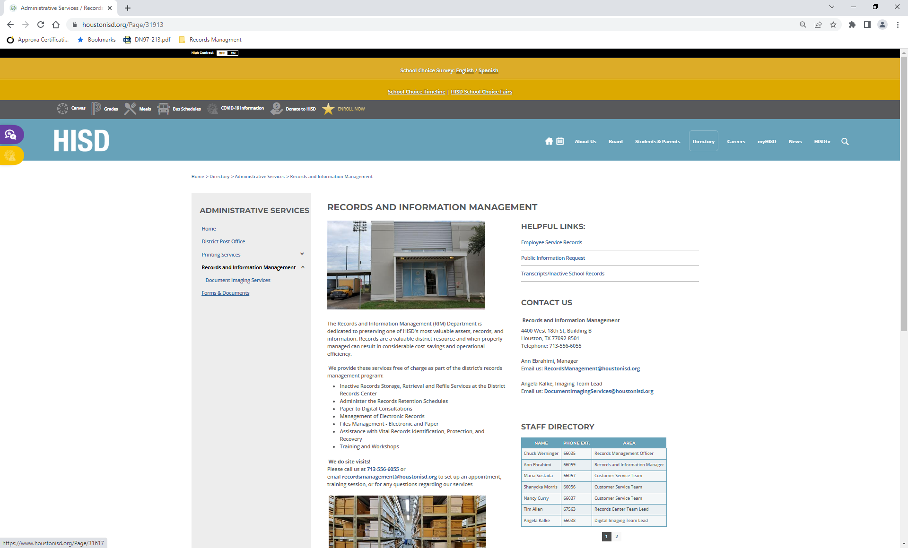
Click on Forms and Documents

Slide 8
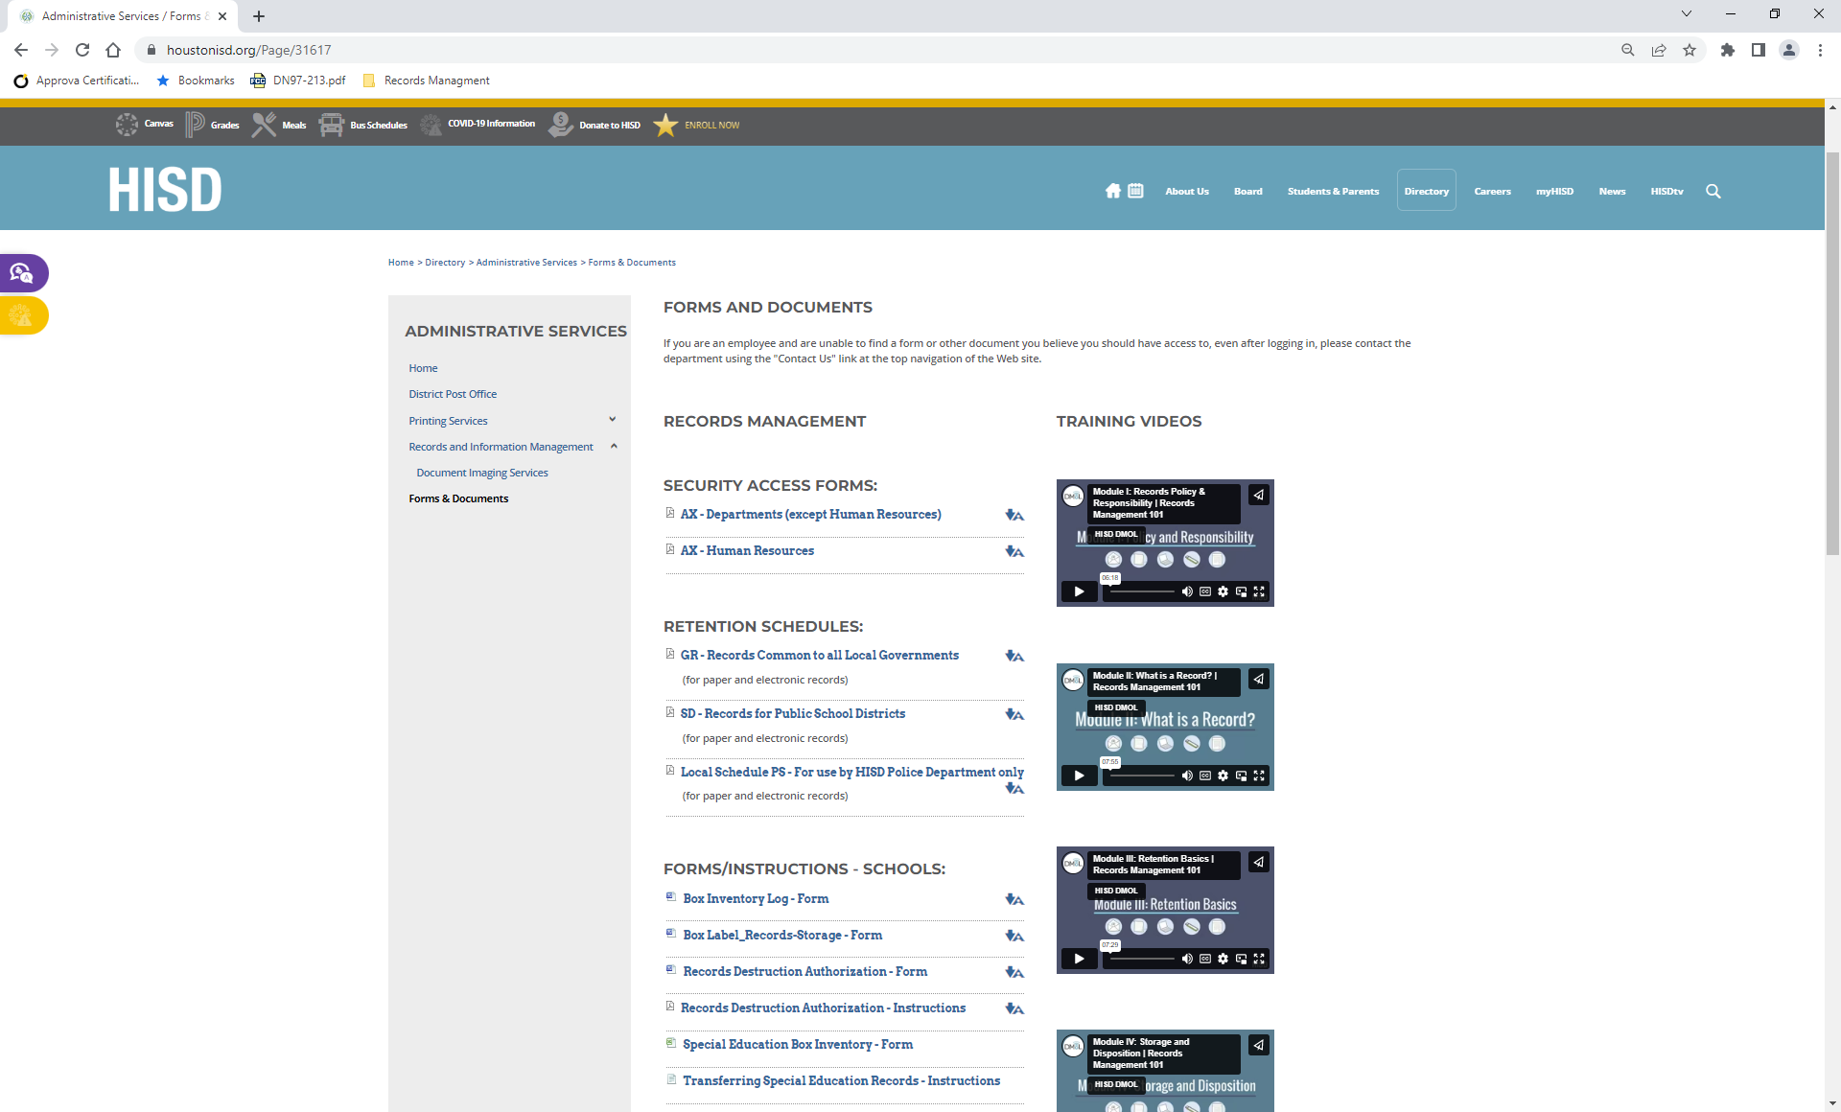
Retention Schedules and forms for Schools

Slide 9
Retention Schedule

Slide 10
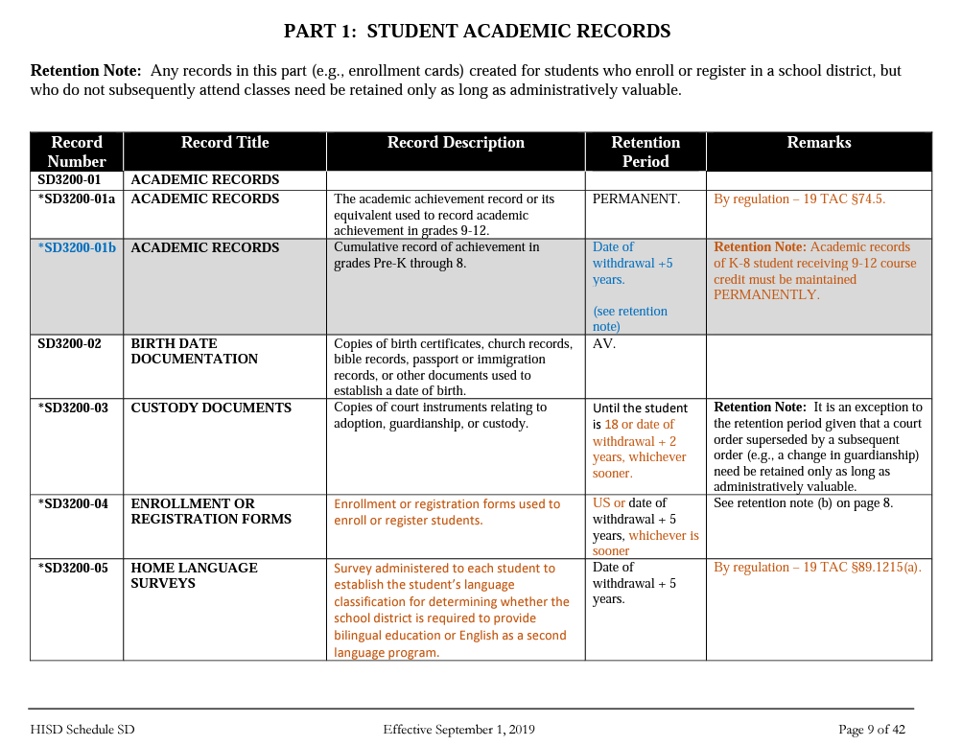

Slide 11
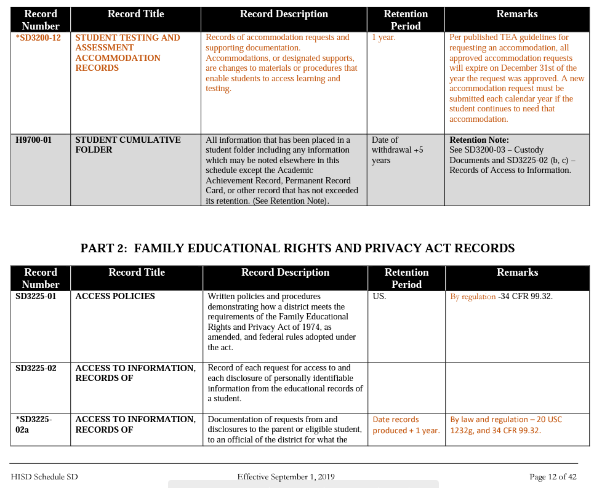

Slide 12
Boxing, Labeling, Forms

Slide 13
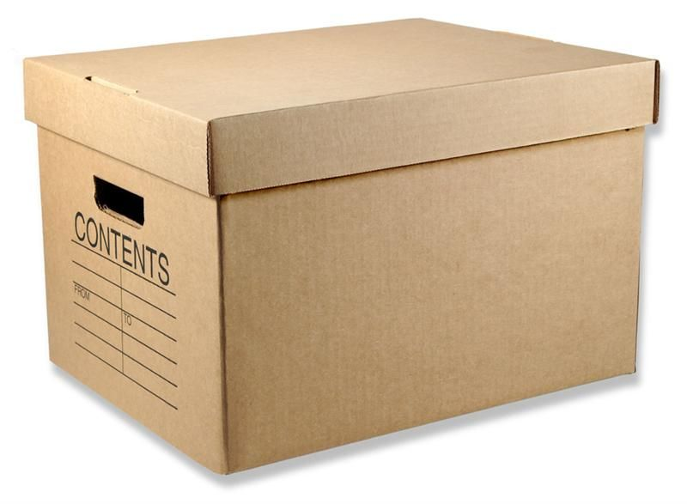
Inadequate Box Label
What are “dead files”?
10th What?
What is the date range of contents?
When can box be destroyed?
Dead Files
6th
Dead Files
10th
Notes:
Does anyone know what dead files are?

Slide 14
Box Label Sample
SCHOOL NAME ABC High School |  | SCHOOLYEAR 2016-2017
OFFICE Registrar’s Office |  | RETENTION SCHEDULE NUMBER H9700-01
RECORD TITLE/BOX CONTENT: Student Cumulative Folders Graduates (A – L) (or Withdrawals) |  | DATE RANGE: Sept. 1, 2016 – May 31, 2017
 |  | BOX NO: 1 of 2
 |  | DATE TO BE DESTROYED: June 1, 2022
RECORDS STORAGE USE ONLY
DATE RECEIVED FOR STORAGE: | TO BE MICROFILMED: (Yes / No) | STORAGE ROOM: 201

Slide 15
Labeling Boxes for Digitizing or Verification
SCHOOL NAME ABC High School |  | SCHOOLYEAR 2016-2017
OFFICE Registrar’s Office |  | RETENTION SCHEDULE NUMBER SD3200-01a, b
RECORD TITLE/BOX CONTENT: Student Transcripts – Grads or Student Transcripts - Withdrawals (Hold to be digitized) |  | DATE RANGE: Sept. 1, 2016 – May 31, 2017
 |  | BOX NO: 1 of 2
 |  | DATE TO BE DESTROYED: Permanet
RECORDS STORAGE USE ONLY
DATE RECEIVED FOR STORAGE: | TO BE MICROFILMED: (Yes / No) | STORAGE ROOM: 201

Slide 16
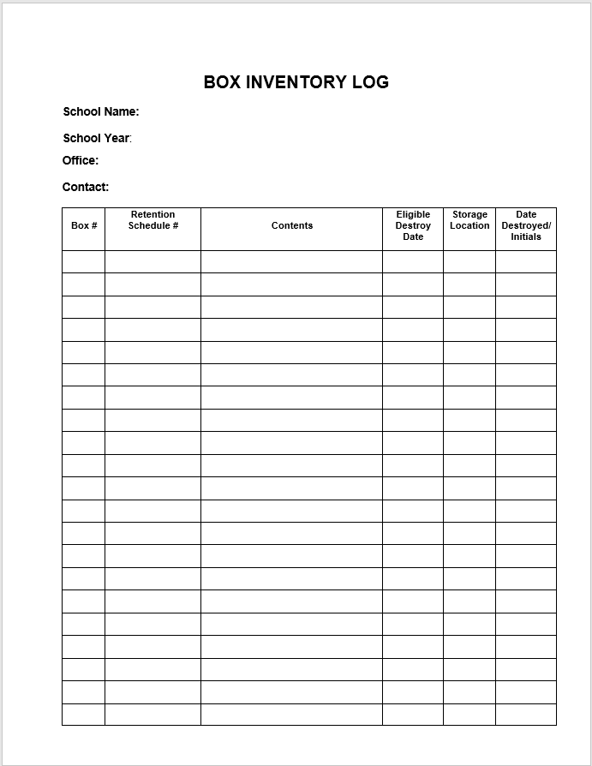

Slide 17
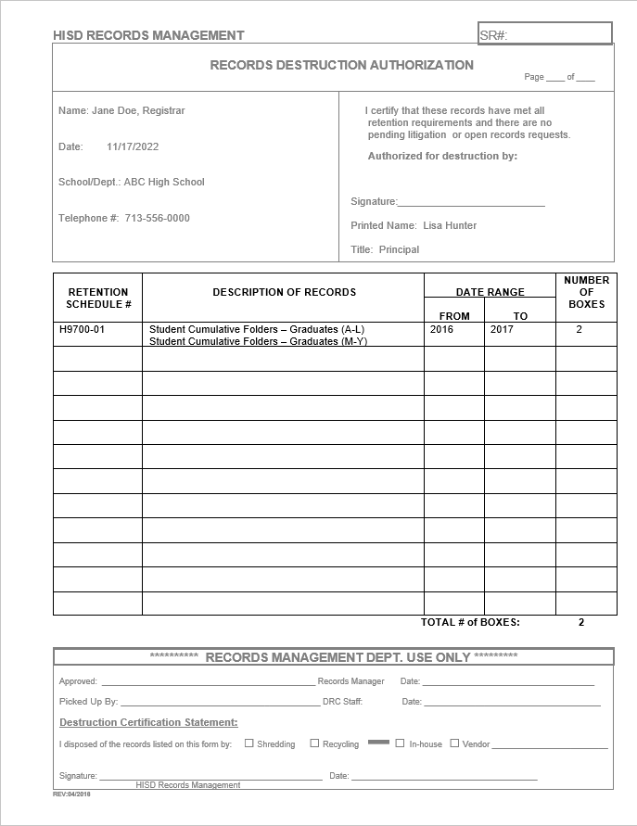
Documenting Records Destruction
Contact information
B. Retention schedule
number
Description of records
Date range
Number of boxes for that row
Total number of boxes to be destroyed
G. Approval signature
Forward the completed form to
recordsmanagement@houstonisd.org
for review and scheduling the
pick up.
A
G
B
C
D
E
F
Notes:
Do not have to list each box individually if the same record group as long as there is not a break in the date range.

Slide 18
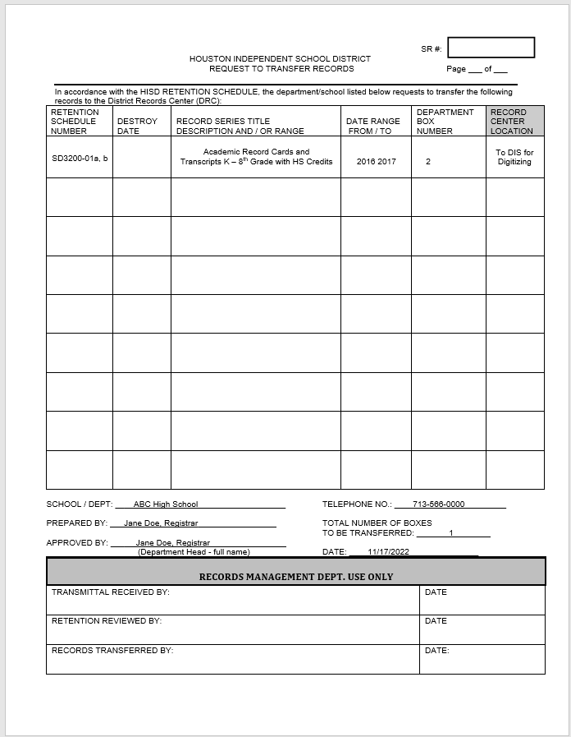
Records to be digitized or verified: create a transfer form and request a pickup for digitizing.

Slide 19
Contact Info / References
RecordsManagement@houstonisd.org
Customer Service 713-556-6055
Fax 713-556-7010
http://www.houstonisd.org/Page/31913
Retention Schedules and Forms
Training Videos and other Resources

Slide 20
Questions

Slide 21
Thank you
Date: 12/12/2022
Presenter: Ann Ebrahimi, Records Manager

