Slide 1
Welcome to Pre-K
Ms. Simpson & Ms. Liu

Slide 2
PK NEWS
Both teachers need to be included in all emails. HISD emails.
Simpson-rsimpso5@houstonisd.org
Liu-hliu@housonisd.org
Learning Objectives will be made weekly.
Daily Folders-Parents should initial daily.
Tuesday Folders- Go home every Tuesday
Office information
Red Folders should be returned empty
Returning papers should be returned in daily folders
VIPS-register online/link is on the MIMS website-you HAVE to be VIPS in order to interact with the classroom.
Cafeteria-pay Ms. Judy w/cash only or pay online/link is on the MIMS website

Slide 3
Lunch is at 11:30. Parents are always welcomed to join their child on Friday and on their birthday. Please pack accordingly.
Nurse-All medicine needs to be taken to the nurse.
Rest time-All students need a hand towel.
Hand towel will be kept in cubby and sent home on Fridays
Snack time-Snacks are for your child only.
Your child needs a LEAK-PROOF labeled water bottle.
Ancillary is at 8:45am-four rotations-PE, Art, and Music
You are tardy by 8:35 and will need a tardy slip.
Please LABEL all your clothes. (JACKETS)
Please keep an extra set in cubby.
Before you leave here, please check your child’s cubby to make sure they have their towel and extra clothes.
Please make sure you have turned in your school supplies.

Slide 4
Dress Code is strictly ENFORCED
https://www.houstonisd.org/mandarinimmersion\
TOPS • Polo style shirt either short or long sleeves.
• Any MIMS t-shirt such as grade level shirts, various club
shirts or school celebration shirts.
Solid Colors: red, white, navy
blue or black with or without
the MIMS logo
PANTS AND SHORTS • All clothing must fit appropriately. A belt is preferred to
hold up pants.
• Any oversized, undersized, torn, cut at the seam or
frayed pants or shorts are not permitted.
• Shorts must be worn at the knee, or no more than 3
inches above the knee.
Solid Colors: khaki, navy blue,
black or blue denim

Slide 5
SKIRTS, DRESSES AND
JUMPERS
• Must be worn at the knee, or no more than 3 inches
above the knee.
• Elementary students only are required to wear shorts or
leggings under skirts, dresses and jumpers.
Solid Colors: khaki, navy blue,
black or blue denim
TIGHTS AND LEGGINGS • Tights and/or leggings are to be worn only under skirts,
dresses or jumpers.
• May not be worn alone.
Solid colors: navy blue, black,
red, or white
SHOES AND SOCKS • Closed-toe shoes are worn at all times. These shoes may
be leather of sneaker styles.
• Socks are recommended with all shoes.
• For safety reasons, platform shoes, wedge shoes, spiked
heels, steel-toed boots, or any backless shoes including,
but not limited to, clogs, crocs, shoes with wheels or
lights, house shoes, sandals, or flip-flops, are not
permitted.

Slide 6
Please email absent notes to teachers.
Early pick up is by 3:15pm
Last chance to change dismissal is 3:15pm
Dismissal email is: mimsdismissal@houstonisd.org
This is very important when changing from ASP to PPU
Email the teachers to let us know if someone different is picking up
Front Office closes at 3:30pm
Homework packets stay home-three different varieties
Practice with the resources in the daily folder

Slide 7
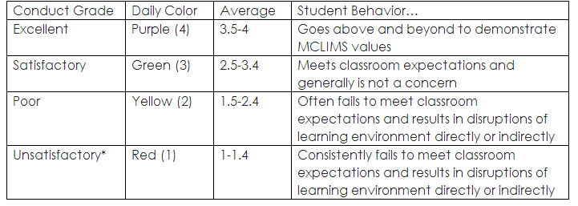
Conduct

Slide 8
Report Card
Four report card-every 9 weeks
Math and Science are graded in Mandarin
Circle (Eng/Math) 3 assessments: Beginning, Middle and End of the Year
Chinese High Frequency Words Evaluation (HFWE) four assessments:
Words will be sent home to review

Slide 9
ELA Curriculum
Recognize all letters
All letter sounds
Vocabulary
Listening
Rhyming
Alliteration
Syllabication
Words in a sentence
Onset/Rime (Blending)

Slide 10
Math Curriculum
Shape Naming
Rote Counting pass 30
Numeral Recognition up to 30
Cardinal Value-Counting and telling numbers
Positional Words
Number Discrimination
Patterns
Ordinal Words
Shape Discrimination
Operations-(problem solving)

Slide 11
Chinese Curriculum
Recognize 52 Chinese Characters, Practice writing 52 Chinese Characters
Numbers From 1 to 30
Better Chinese
Peng Peng Hu youtube vocabulary videos

Slide 12
To Help at Home
Quizlet
Apps
Youtube Videos
Raz-Kidz

Slide 13
Faciliators
For each of the activities we are looking for a parent to volunteer and lead the activity.
Class T-Shirt
Christmas Party
Chinese New Year Party
End of the Year Party

Slide 14
Thank you!

