Slide 1
Pow & How #34
Halima Abdulahi
Period 1

Slide 2
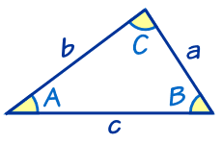
The rule of cosine
The rule of Cosines is very useful for solving triangles
Let a, b, and c be the lengths of the legs of a triangle opposite angles A, B, and C.
It works for any triangle
a, b and c are sides. C is the angle opposite side c

Slide 3
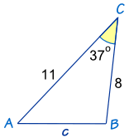
We know angle C = 37º, a = 8 and b = 11
The Law of Cosines says: c2 = a2 + b2 − 2ab cos(C)
Put in the values we know: c2 = 82 + 112 − 2 × 8 × 11 × cos(37º)
Do some calculations: c2 = 64 + 121 − 176 × 0.798…
More calculations: c2 = 44.44...
Take the square root: c = √44.44 = 6.67 to 2 decimal places
Answer: c = 6.67
Example: How long is side "c" ... ?

Slide 4
The Rule of Sine
The Law of Sines (or Sine Rule) is very useful for solving triangles
a, b and c are sides.
A, B and C are angles.
(Side a faces angle A,
side b faces angle B and
side c faces angle C).
It works for any triangle
So when we divide side a by the sine of angle A it is equal to side b divided by the sine of angle B, and also equal to side c divided by the sine of angle C

Slide 5
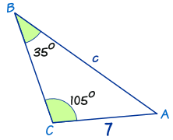
Law of Sines: a/sin A = b/sin B = c/sin C
Put in the values we know: a/sin A = 7/sin(35°) = c/sin(105°)
Ignore a/sin A (not useful to us): 7/sin(35°) = c/sin(105°)
Now we use our algebra skills to rearrange and solve:
Swap sides: c/sin(105°) = 7/sin(35°)
Multiply both sides by sin(105°): c = ( 7 / sin(35°) ) × sin(105°)
Calculate: c = ( 7 / 0.574... ) × 0.966...
Calculate: c = 11.8 (to 1 decimal place)
Example: Calculate side "c"

