Slide 1
Records Management
Managing Nutrition Services Records
Date: July 2021
Presenter: Ann Ebrahimi, Records Manager

Slide 2
Training Objective
Provide best practice guidance for records retention, storage, and disposition.

Slide 3
Agenda
Records Management Program
General RM Information
Retention Schedules
Getting Control of Your Records
Recap
Q & A

Slide 4
Records Management Program

Slide 5
Organizational Structure
IT
Administrative
Services
Print Shop
Graphics
Post Office
Fleet Copiers
PS Customer Service
Records and Information Management
Notes:
The district’s records management program is operated by the Records and Information Management office. We report to Administrative Services along with the Print Shop, Graphics, Post Office, Fleet Copier and Printing Services Customer Support teams. We all ultimately report to IT.

Slide 6
HISD’s Records Management Program
Records Management Officer (RMO)
Records Center
Records Storage
Records Retrieval and Return
Records Destruction
Customer Service
Retention Schedules
Best Practices
Destruction and Transfer Requests
Records Center Tracking System
Coordinates Service Requests
Document Imaging Services
Records Conversion
Archival Records Preservation
Document Management Repository
Records Manager
Records Center
Customer Service
Document Imaging Services
Campus Records Coordinator
Department Records Coordinator

Slide 7
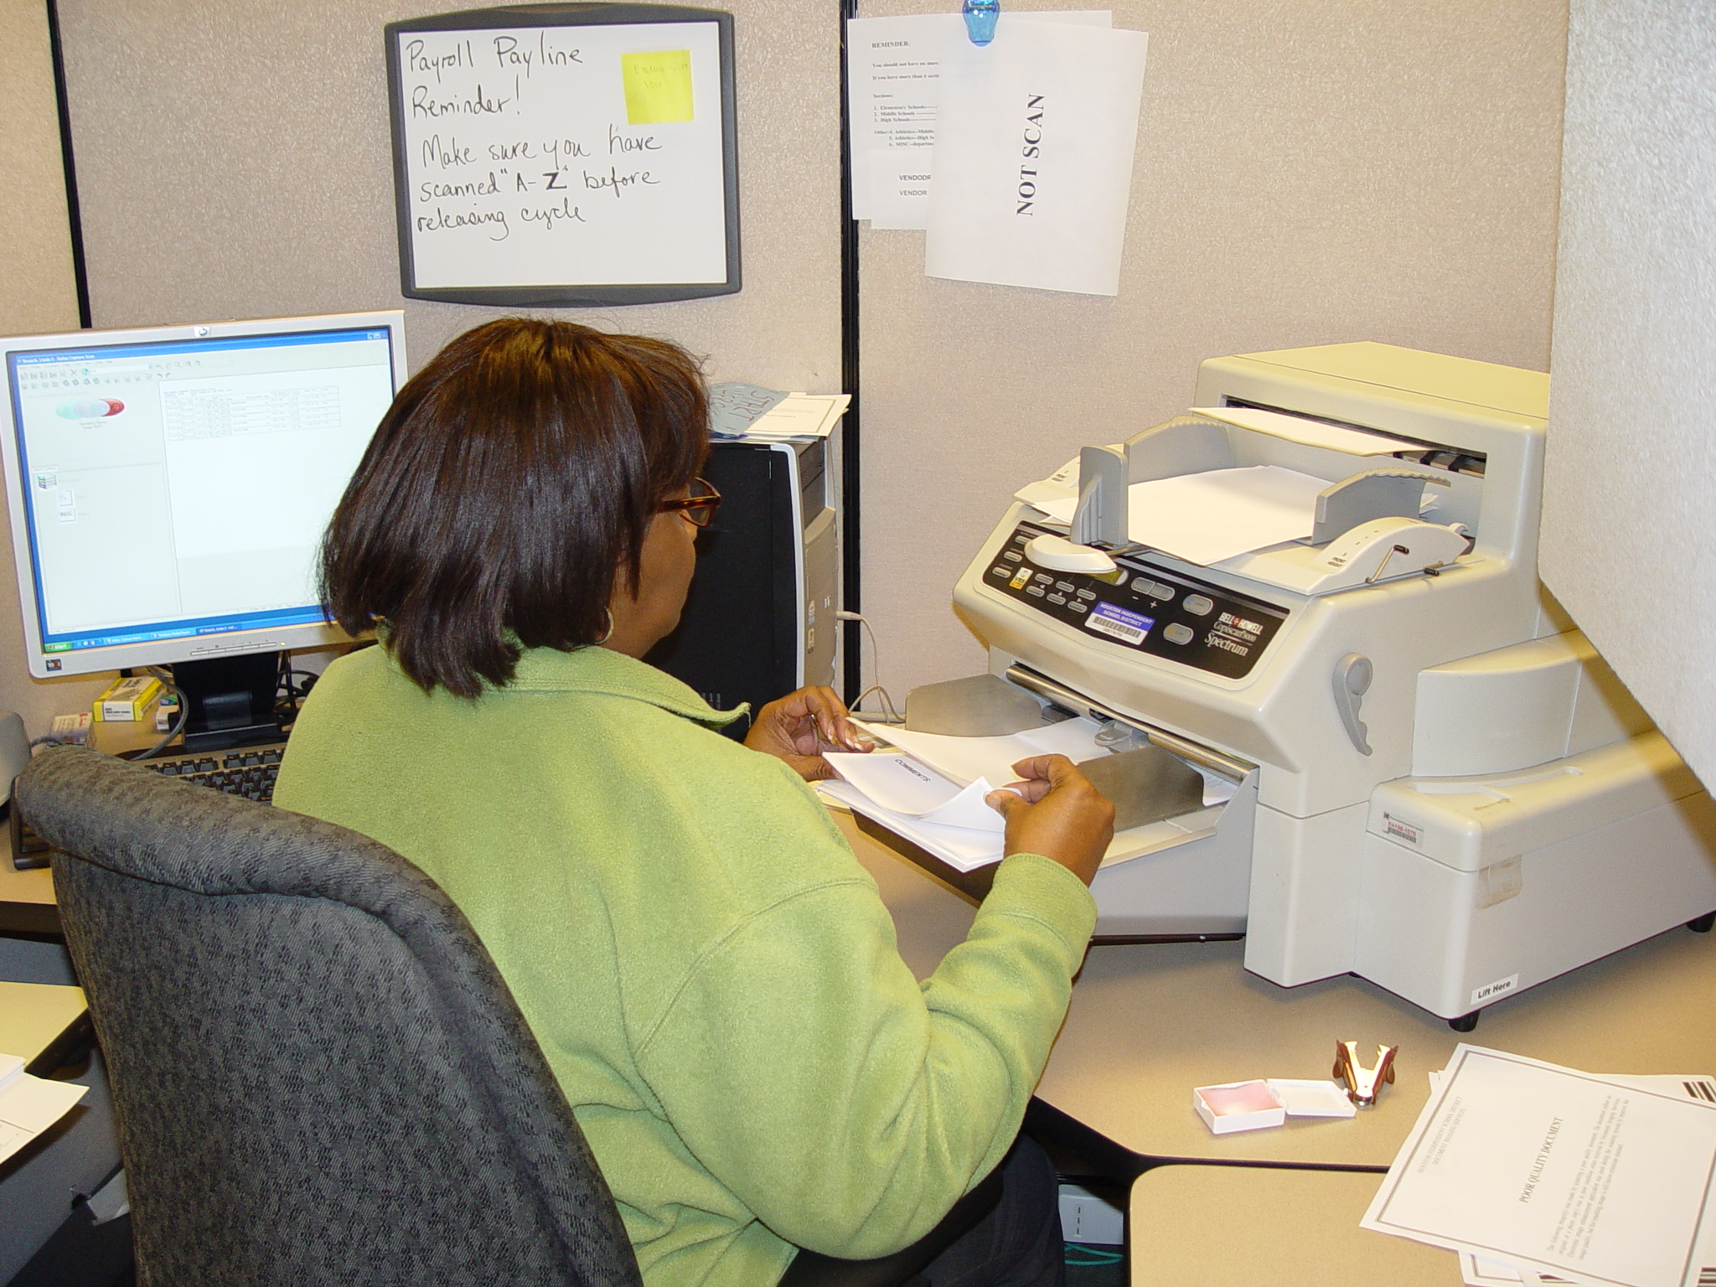
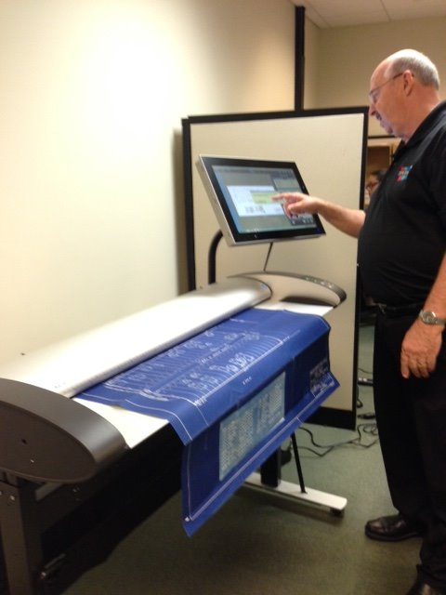
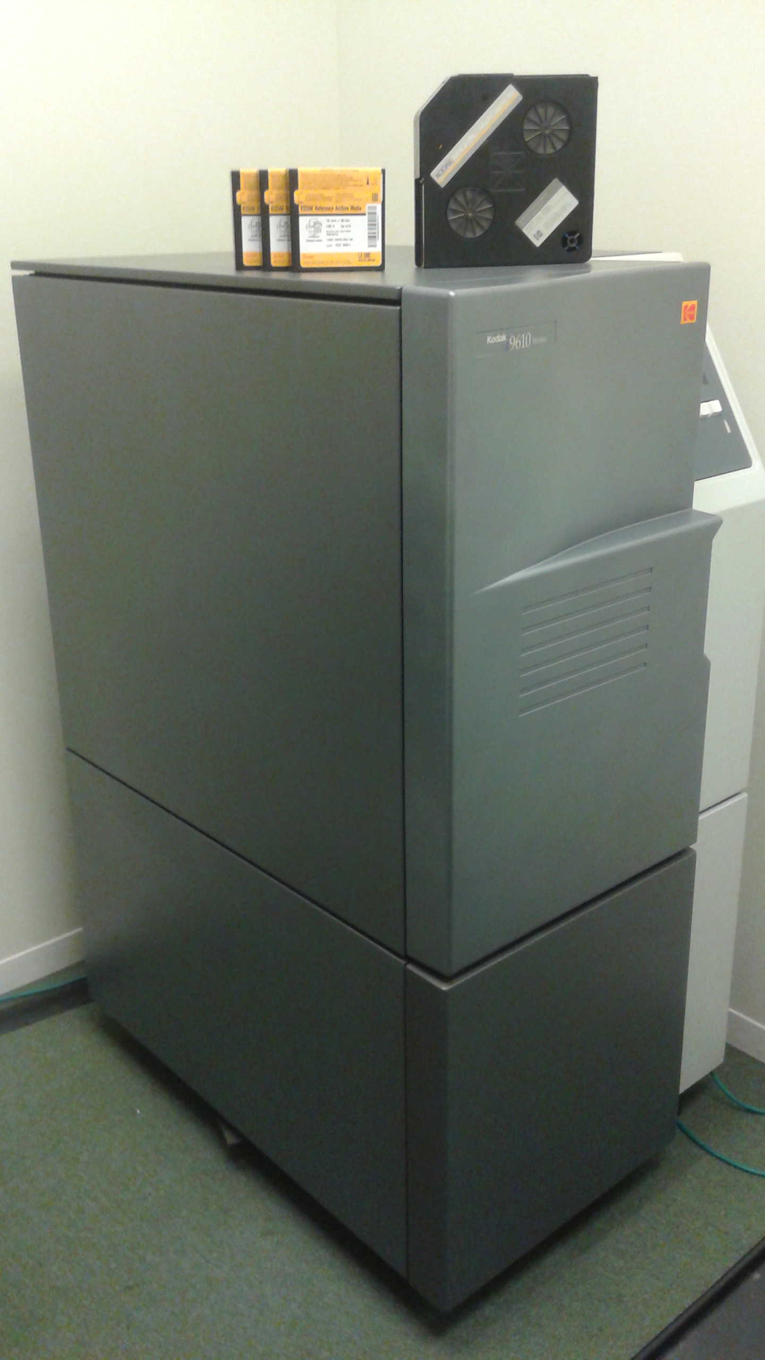
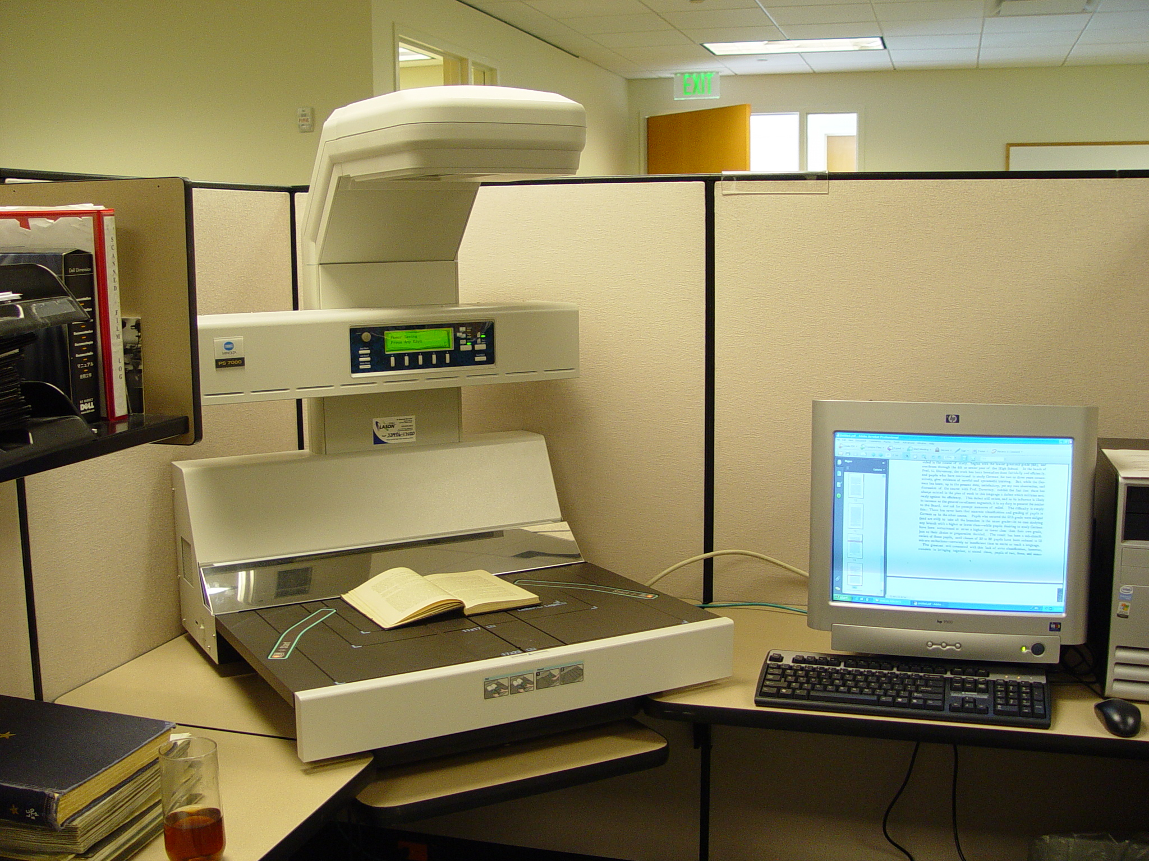
Production Scanner
Microfilm/Fiche
5,100 rolls
95,000 fiche
Large Format
Scanner
Book Scanner
Notes:
High volume color production scanners that can scan 135 ppm single-sided or 270 ipm duplex (two-sided).
Book scanner – enables us to scan books and manuscripts without need to cut the binding. Scanned a special project for Library Services of the Houston Public Schools annual reports dating back to the early 1900’s.
Large format scanner can scan records up to 42” wide such as maps and architectural drawings.
Microfilm - used to archive Board Services records and Student Transcripts that have a permanent retention and personnel records that have a 75-year retention. The digital images are now uploaded to the State Archives Drop box and it’s a turn-key solution where they create, process and store the microfilm.

Slide 8
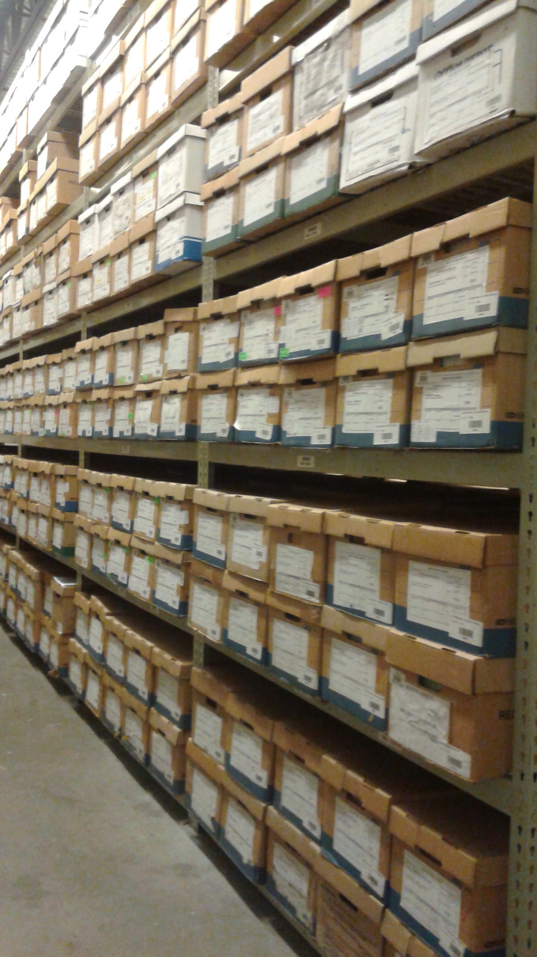
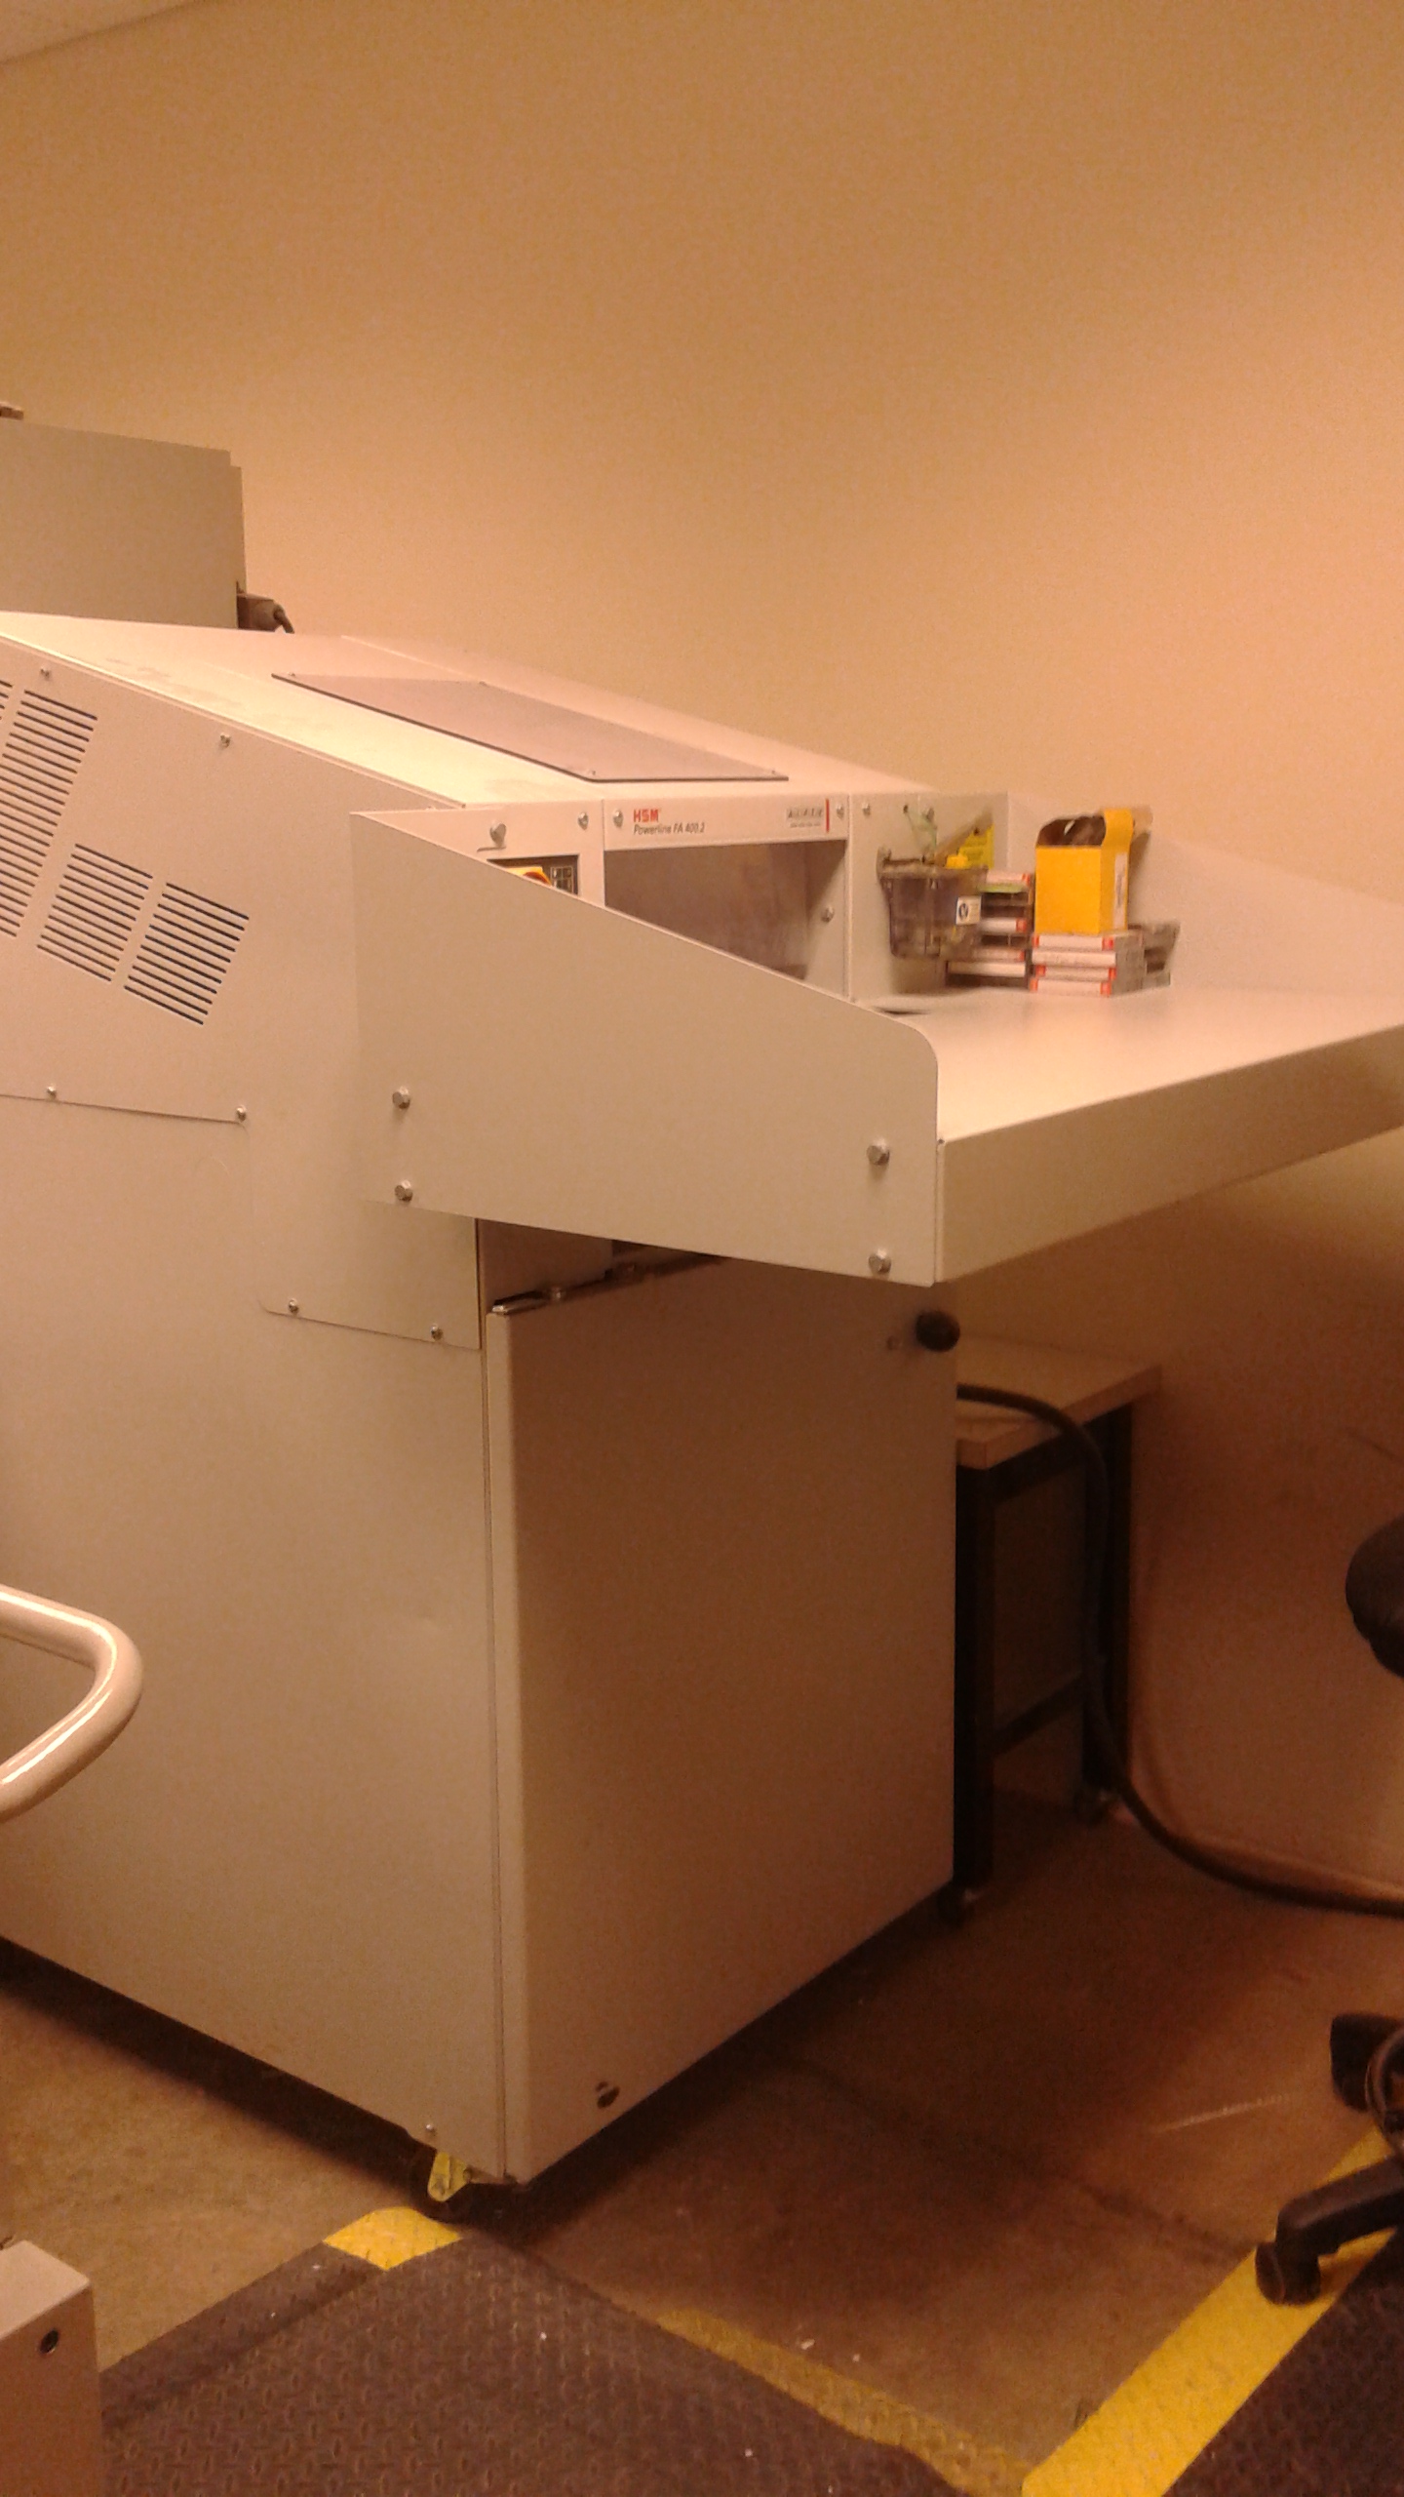
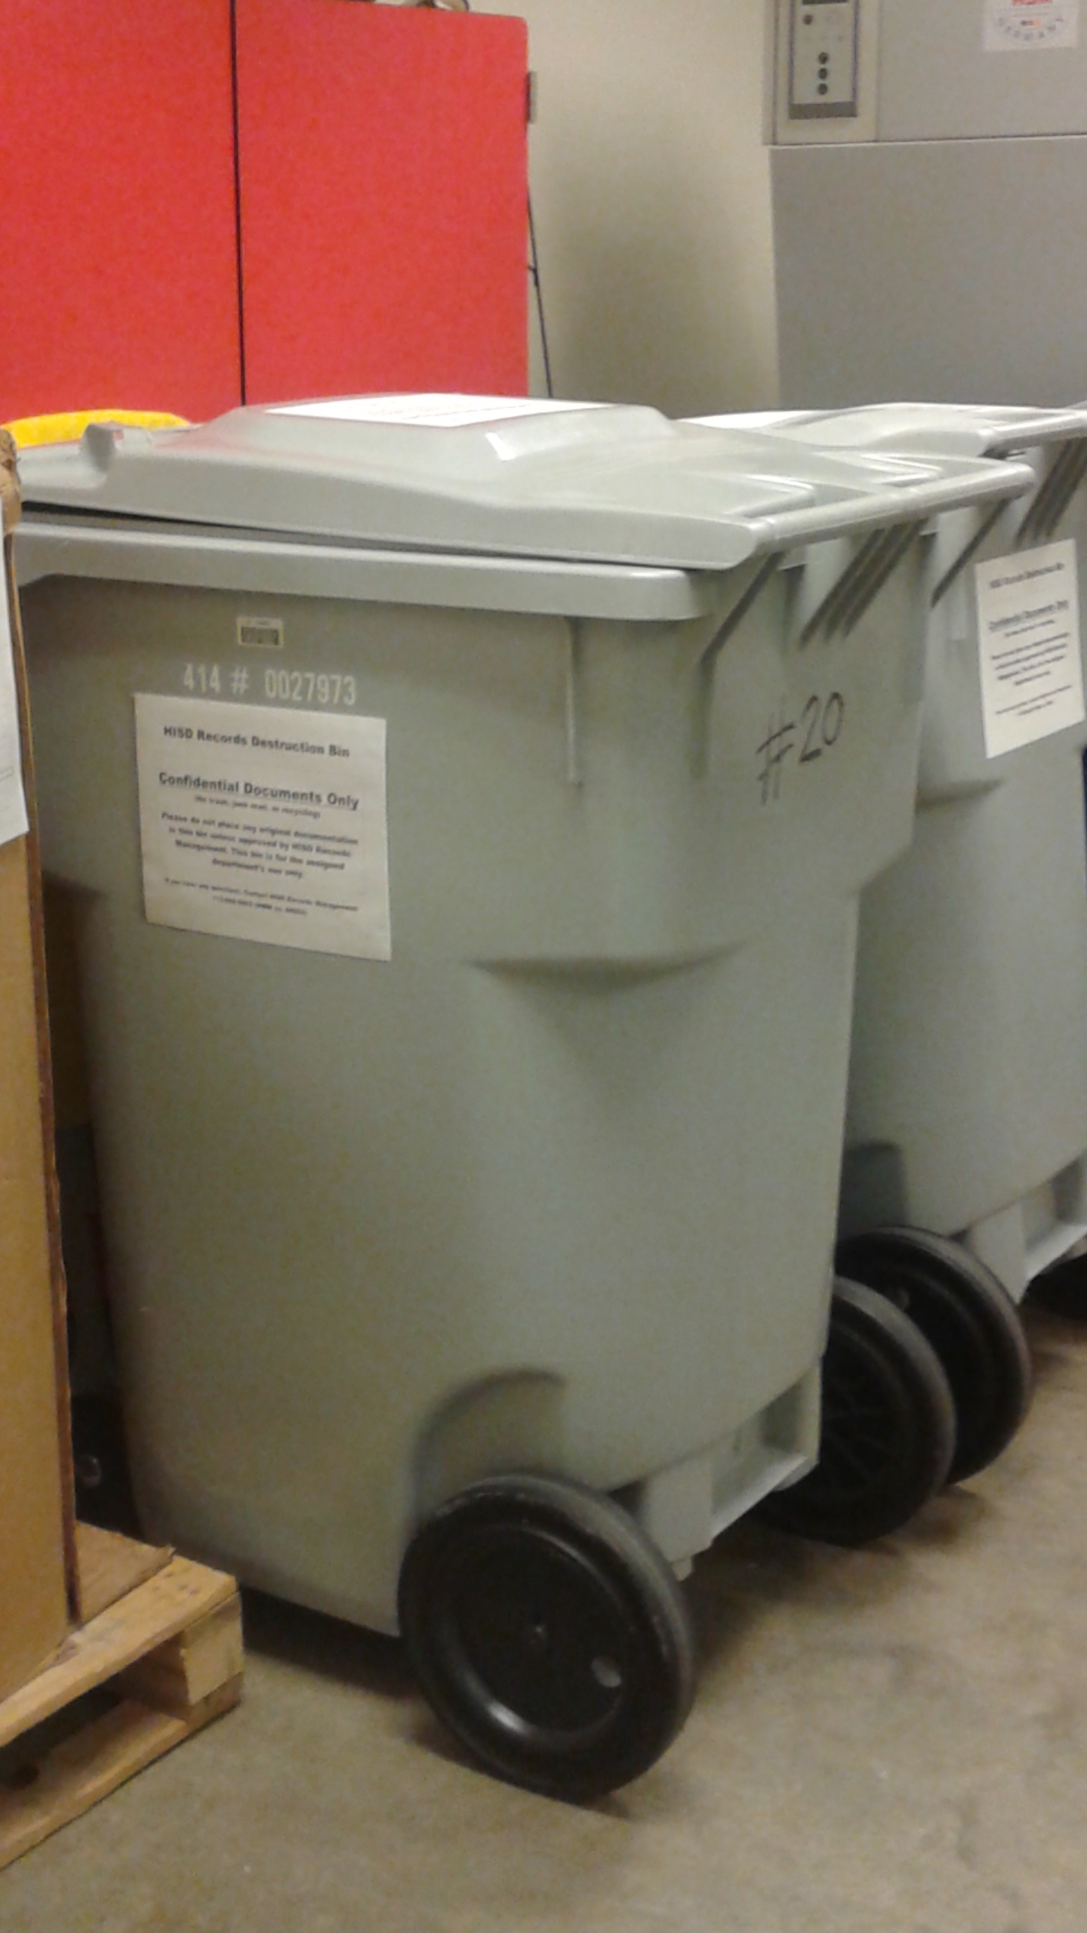
Stack Area
37,440 box capacity
Destruction Room
- processed over 3,800
boxes for destruction in
SY 2021

Slide 9
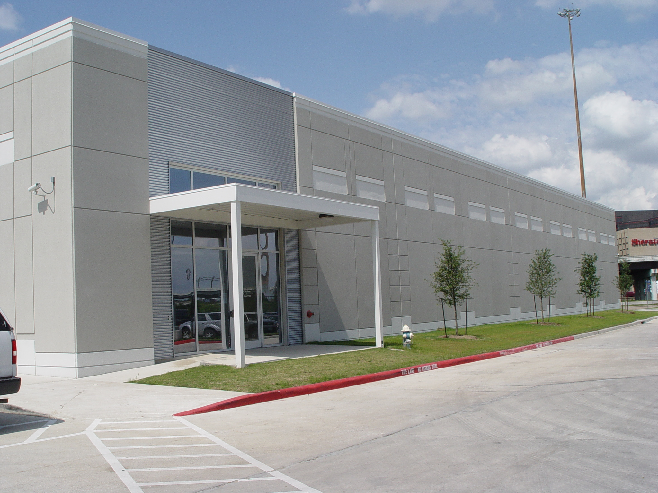
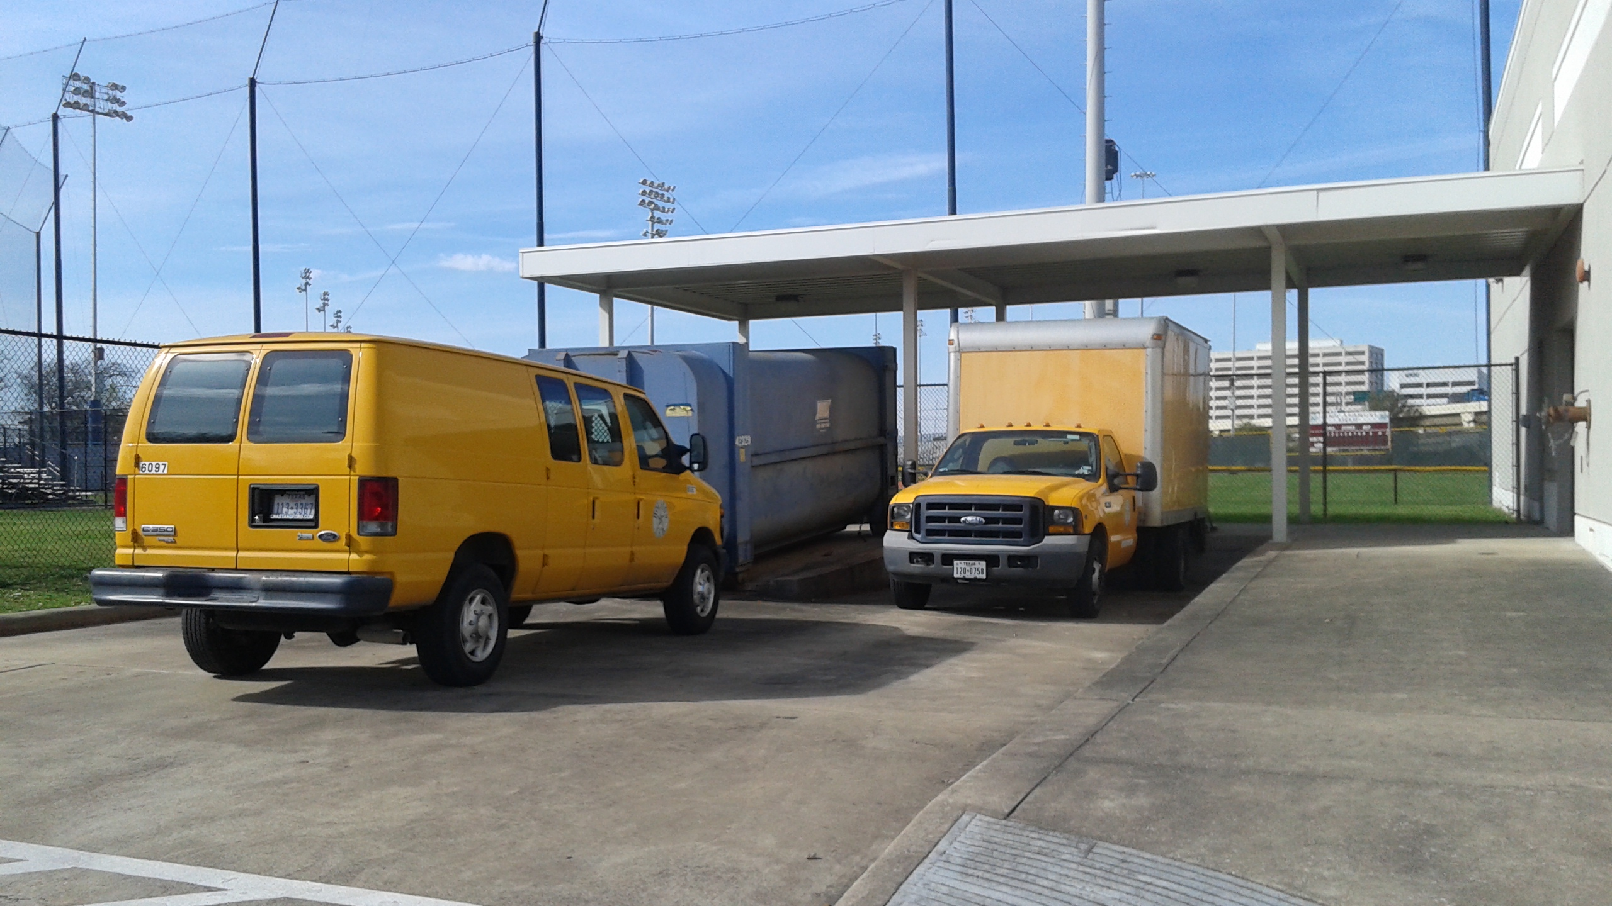
DRC Facility
4400 West 18th Street
Building B
(behind the main HMW
Building)
Vehicles
Truck – 160 box capacity
Van – 30 box capacity

Slide 10
General RM Information

Slide 11
What is records management?
“the efficient and systematic control of the creation, receipt, distribution, use, maintenance, storage, and disposal of records”
ISO15489: 20 01 (International Standard for Records Management)
It is about knowing…….
What we have (and what we don’t have)
Where it is
Who has it and who has access to it
What format we have it in
How long we need to keep it for

Slide 12
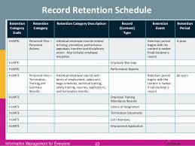
Terms and Definitions
Retention Schedule
Records Series
Retention Period
Unscheduled Record
Convenience / Working Copy
Legal Hold
Notes:
Retention Schedule
document that lists the records maintained by the district, their retention periods, and other disposition information that may be required.
Records Series
A group of identical or related records that are normally used and/or filed together, and that permit evaluation as a group for retention scheduling purposes.
Retention Period
the minimum time that must pass after the creation, recording, or receipt of a record, or the fulfillment of certain actions associated with a record, before it is eligible for destruction.
Unscheduled Record
official record that is not listed on the approved retention schedule.
Convenience / Working Copy
all copies of a document that are not the “official” copy are considered convenience copies.
Legal Hold
classification given to records that have been placed on hold until the completion of an audit, claim, investigation, litigation, public info request or other event. Note: Records that have passed the required retention period cannot be destroyed until the legal hold is lifted.

Slide 13
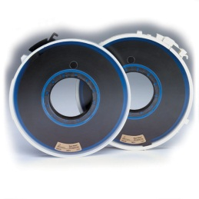
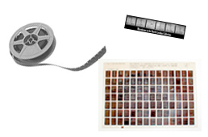
What are Records?
Recorded information made or received by the District
Regardless of the form, the recorded information is the record and the medium only contains the information.
Notes:
Records are recorded information made or received by the District in the transaction of public business.
It’s that contract or bid proposal in our file folder in the cabinet or that invoice that was sent as a PDF to us by email.
It’s important to understand that regardless of the form, the recorded information is the record and the medium only contains the information.

Slide 14
What are not records?
Extra copies of publications and brochures
Reference materials
Junk mail
Preliminary drafts, worksheets, and transmittal memos or fax cover sheets
Extra copies of official records
Blank forms and office supplies
Notes:
Reference material:
vendor catalogs
books
periodicals, and other technical reference materials.

Slide 15
Retention Schedules

Slide 16
The Texas State Library and Archives Commission (TSLAC)
Provides rules, regulations and guidance to state and local governments for the management of records in all media
Issues and updates retention schedules establishing mandatory retention periods for local government records
Notes:
As mentioned previously, retention schedules lists records maintained by state and local governments and their minimum required retention period.

Slide 17
Retention Schedules
Schedule SD
Records for Public School Districts
Schedule GR
Records Common to all Local Governments
Notes:
The RIM office manages several retention schedules some specific to certain departments like HISD Police. The two main retention schedules you should become familiar with are Schedule SD – Records for Public School Districts and Schedule GR- Records Common to all Local Governments.

Slide 18
Retention Schedules - cont’d.
Online Review:
Where to access retention schedules
Structure of the retention schedule
Notes:
The retention schedules can be found on the RIM web page. Go to the district’s intranet, click on view Department List, and click on Records and Information Management. Then click on Forms and Documents. Under the section that says Retention Schedules, you’ll find the SD and GR schedules listed.
If you use Explorer, you can do a “find” for key words in the retention schedule. However, if you use Chrome, you will need to download the document first.

Slide 19
Getting Control of Your Records

Slide 20
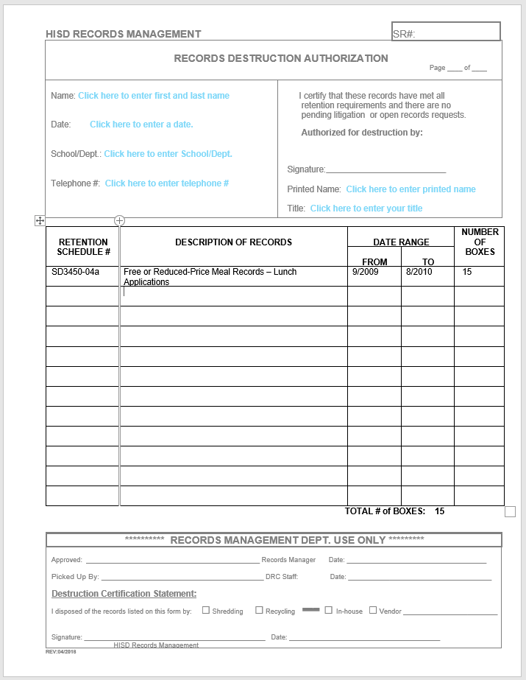
Steps to Clean Out and Destroy Eligible Records
Utilize two resources – the records retention schedules and destruction authorization form.

Slide 21
Review your records to determine which
records are eligible for destruction.
What records series are you working with?
What is the date range of the records?
Box records by record series – one type per box is preferred.
Label the box.
Notes:
What records series are you working with? Lunch applications? Menu records? Health Inspection records?
What is the date range of the records? Are the records kept by calendar year (Jan-Dec), fiscal year (July-Jun), academic year (Sept – Aug)?
It’s preferred that you box only one record records series in each box. However, you can put more that one records series in the same box as long as you list on the destruction form all the records series in the box along with their retention schedule numbers.

Slide 22
Destroy all eligible records based on
the retention schedule.
Complete the destruction authorization
form.
Submit to Records Management for
review and approval.
Records Center staff schedules the
pick up of the boxes.

Slide 23
Documenting Records Destruction
Contact information
B. Retention schedule
number
Description of records
Date range (mm/yyyy)
Number of boxes for that row
Total number of boxes to be destroyed
G. Approval signature
Forward the completed form to
the Records Management office
for review and scheduling for
pick up.
A
G
B
C
D
E
F
Notes:
Do not have to list each box individually if the same record group as long as there is not a break in the date range.

Slide 24
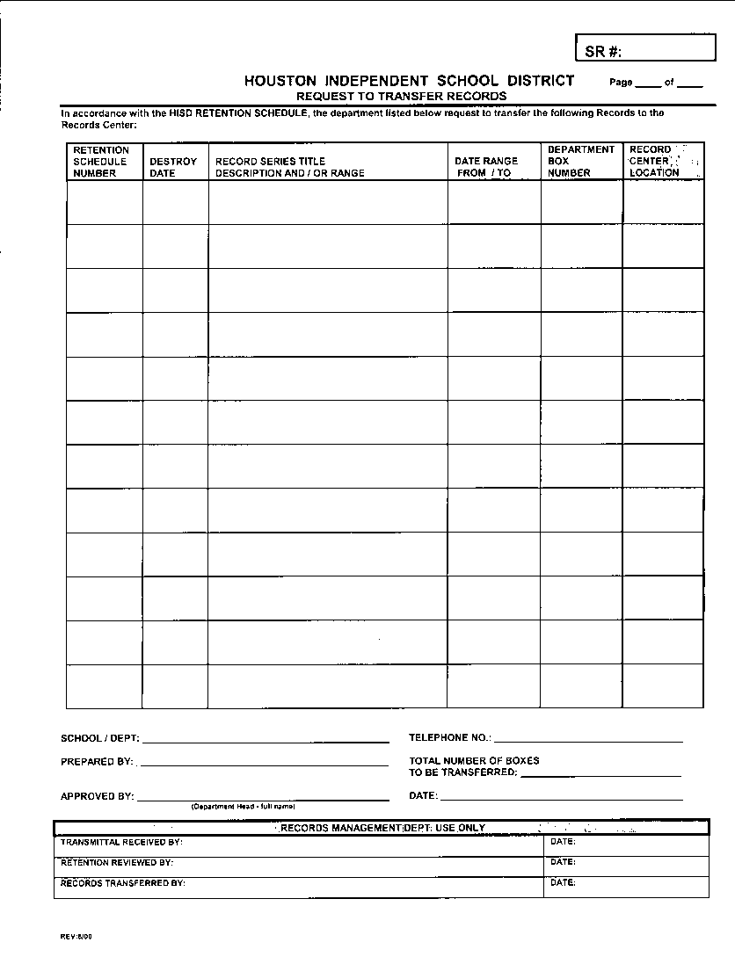
Steps to Transfer Eligible Records to the DRC
Utilize two resources – the records retention schedules and request to transfer records form.

Slide 25
2. Review your records to determine what
needs to be maintained until the required
retention period has been met.
What records series are you working with?
What is the date range of the records?
Box records by records series – one type per box preferred.
Label the box.
Notes:
What records series are you working with? Lunch applications? Menu records? Health Inspection records?
What is date the range of the records? Are the records kept by calendar year (Jan-Dec), fiscal year (July-Jun), academic year (Sept – Aug)?
It is preferred that you box only one record records series in each box. However, you can store more that one records series in the same box provided that they have the same retention period and you must list all the records series in the box along with their retention schedule numbers.
Note: if more that one record type is stored in the box, the
box will be kept for the longest retention period.

Slide 26
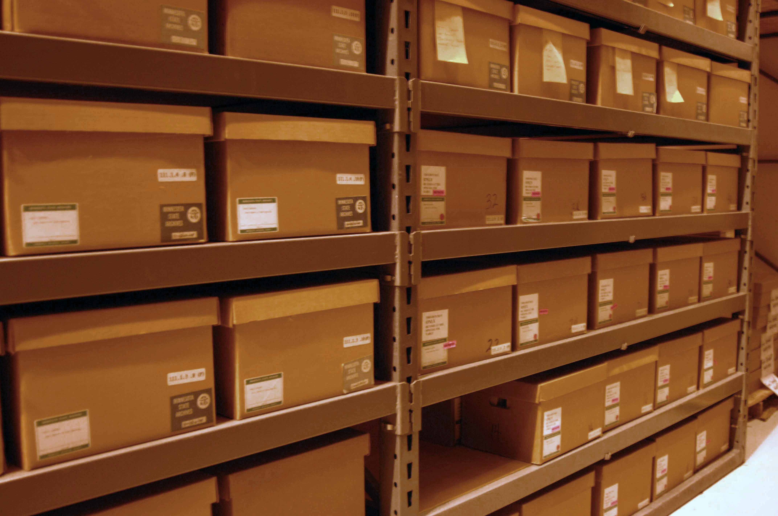
3. Box records for transfer to the DRC that
must be kept for retention.
Use letter/legal size boxes also referred to as banker boxes
Dimensions are 10x12x15
Double-walled preferred
HISD Warehouse SAP #2692 or purchase from supply vendor

Slide 27
Records Transfer Request Form
A. Retention schedule
number
B. Destroy date
C. Description
D. Date range (mm/yyyy)
E. Department box
number
F. Record Center location (RIM)
G. Department information
A
B
C
D
E
F
G
Notes:
Records sent to the records center are monitored for when they are eligible for destruction.
No records are destroyed without authorization from the department head.
Departments maintain custody of the records and can retrieve them at any time.

Slide 28
Boxing Records for Destruction or Storage
No
hanging
files
No 3-ring binders
Do not over
pack boxes.
Do not tape
or bind boxes
shut.
No unauthorized storage boxes
Notes:
When packing a records storage box:
No hanging files
No 3-ring binders
No unauthorized storage boxes
Do not overstuff the box, bind or tape shut
If other media than paper store in the box, state on the paperwork.
And, do not include anything that is not an official district record.

Slide 29
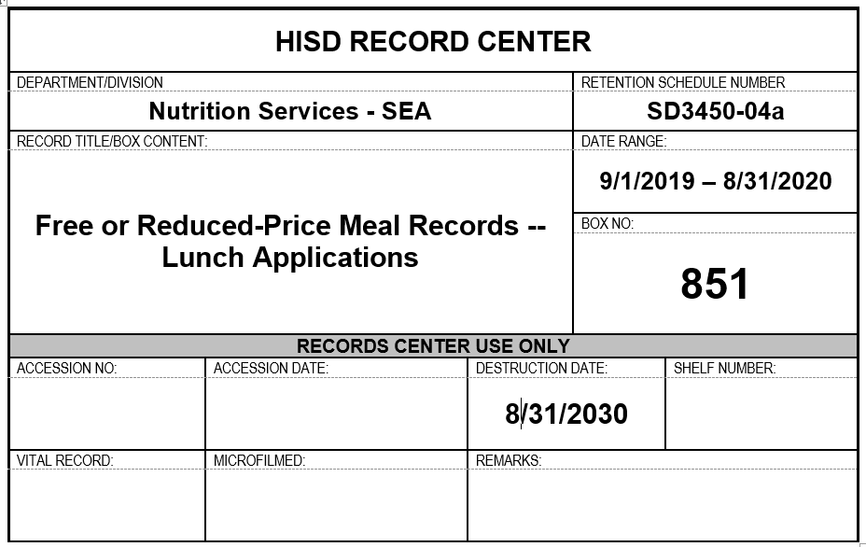
Box Label Sample
Notes:
When labeling the boxes use the box template created in WORD.
Type the information and print on label paper, affix to the short end of the box, or
Type the information and print on plain paper and completely tape down all sides of the form, or
Print out the box form, write the information in black marker, and completely tape down all sides of the form. Information must be readable.
You can also write the information directly on the box provided that it is readable.
Never label the box lid. Lids can fall off or moved from one box to the other.
* Filling out the box label will make it easy to complete
the transfer form.

Slide 30
Recap

Slide 31
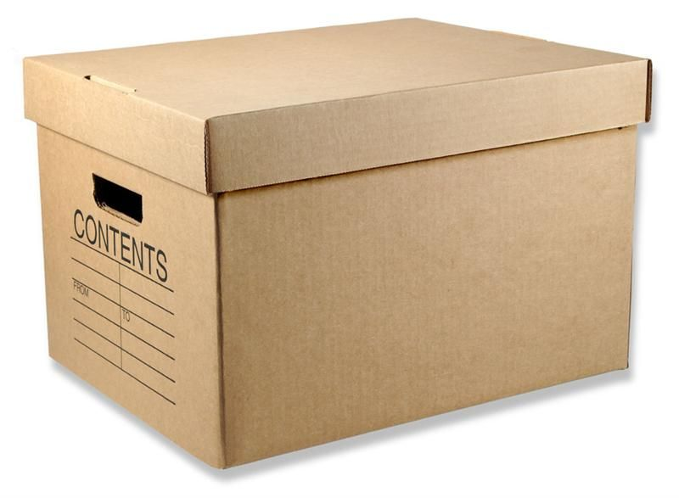
On an annual, routine basis:
Purge Box Submit
Files Records Destruction
Request

Slide 32
On an annual, routine basis:
Purge Box Submit
Files Records Transfer
Request

Slide 33
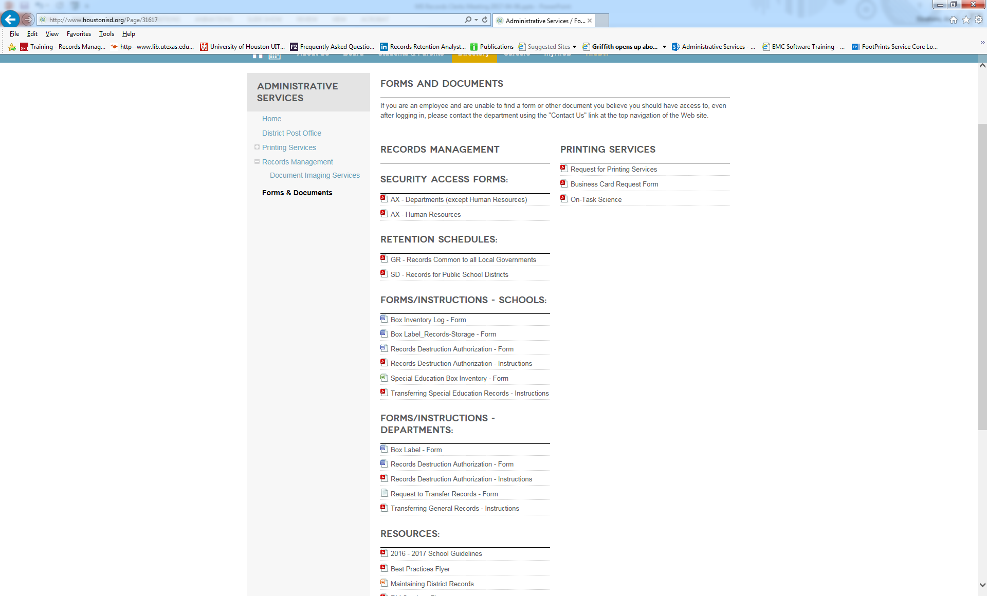

Slide 34
Contact Us
RecordsManagement@houstonisd.org
713-556-6055

Slide 35
Questions
How can we help?

Slide 36
Thank you
Date: July 2021
Presenter: Ann Ebrahimi, Records Manager

