Slide 1
Inactive Special Education Records Transfer to the District Records Center
Date: 02/08/2024
Presenters: Shanycka Morris, Customer Service
Maria Sustaita, Customer Service
Notes:
This PowerPoint will cover the procedures for submitting inactive Special Education records to the District Records Center for storage or destruction.

Slide 2
Important Information
Retention Number
SD3250-02
Records Description
Special Education Student Records
Retention Period
Cessation of services + 5
Last date of service
Last IEP Entry
Date no longer qualify for service
Date of withdrawal
Notes:
Here is some important records retention information you should remember about inactive Special Education records.
Special Education records are only maintained by HISD for the cessation of service plus five years then destroyed.

Slide 3
Identify Folders
Eligible years based on last date of service
Last date of Service:
Admission Review & Dismissal
Individual Evaluation Program
Withdrawal or Graduation
Separate and Group folders by academic year
September 1– August 31
Notes:
Inactive Special education records can be submitted to the District Records Center for transfer or destruction. Inactive folders that have two to three years until destruction can be submitted to the DRC for storage. Folders ready for destruction can be submitted to be shredded immediately. Maintain the current school year plus the past two years of inactive records on campus.
As of today
Keep on Campus: 9/1/2021 – 8/31/2022, 9/1/2022– 8/31/2023, 9/1/2023– 8/31/2024
Transfer: 9/1/2018– 8/31/2019, 9/1/2019– 8/31/2020, 9/1/2020– 8/31/2021
Destruction: prior to August 31, 2018 or older

Slide 4
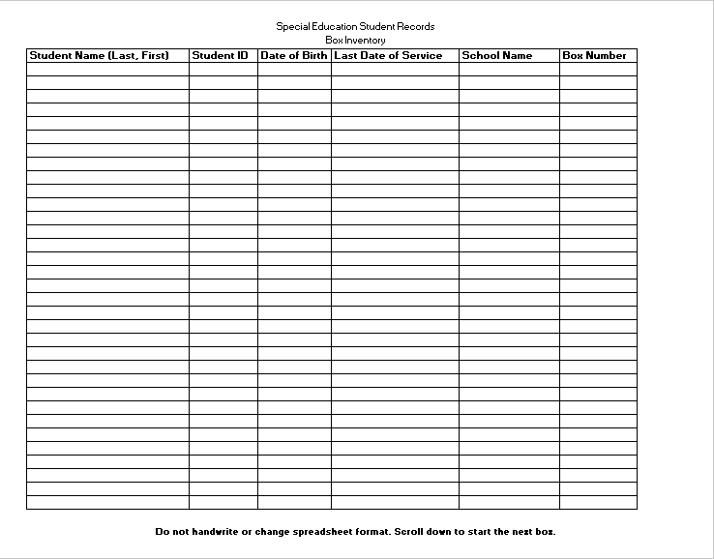
Inventory Folders
Complete the Excel box inventory spreadsheet for transfer and destruction folders.
Notes:
Each campus must submit a typed Excel box inventory spreadsheet with each student's information.
The spreadsheet data is imported in the RIM database to assist with SPED records retrieval/requests.
Be sure to save a copy of the spreadsheet on your computer for your records and to make revisions (if needed).

Slide 5
Box Folders
Use records storage boxes
(10”x12”x15” with detachable lid)
HISD Warehouse (SAP order # 2692) or an HISD office supply vendor
Box by academic year then
Alpha order
Do not overstuff the boxes.
Notes:
The box pictured is the type required for storage of inactive SPED folders. This box can be purchased by your campus from the HISD warehouse or an office supply vendor.
Do not overstuff the boxes
Remove all non-paper items. Binders, binder clips, hanging files, sheet protectors, etc.

Slide 6
Label Boxes
Use black marker only or complete the Word box label template.
Include the school's name, box number (1 of 4, 2 of 4, 3 of 4, etc.), date range (academic year) and a description of the contents.
Place the label on the short side of the box. If plain paper is used, be sure to tape down all four sides.
Notes:
All boxes must be labeled with campus name, alpha range, date range and box number. The label should be placed on the short side of the box. (Not lid or side)

Slide 7
Submit Request
Email the Excel box inventory spreadsheet to RecordsManagement@houstonisd.org for review and processing.
Notes:
Email the excel spreadsheet to the department email. The spreadsheet will be reviewed for accuracy. Your transfer or destruction request will be completed after review.

Slide 8
Signatures Required
Transfer Form
Destruction Form
Notes:
A transfer request will be created for boxes being submitted for storage. The person processing the request and the SPED chairperson must sign.
The destruction requests received must have the information for the person submitting the request. The campus principal must sign in the authorized for destruction section.

Slide 9
Ready for Pickup
The Records Center Team Lead will contact you to schedule pickup.
Pickup is scheduled within 10 business days.
Notes:
The Records Center staff will contact you within 10 business days after all information is correct & complete to schedule pickup. Pickup delays depend on weather and priority projects.

Slide 10
Contact Info / References
RIM Customer Service
713-556-6055
http://www.houstonisd.org/Page/31913
Retention Schedules
Forms and Procedures

Slide 11
Thank you
Notes:
Thanks for your time!

